Slide 1
Discrete Hartley transform

Slide 2
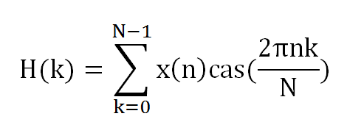
Basics
Gives Amplitude & Phase information
Produces real output for a real input
Equation
Where cas(x) = cos(x) + sin(x)

Slide 3
properties
Split into even & odd part
H(k) = [ H(k) + H(-k) ]/2 ; for even
H(k) = [ H(k) - H(-k) ]/2 ; for odd

Slide 4
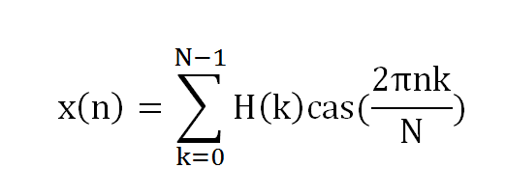
properties
Easier form of Inverse DHT (Unlike DFT, it doesn’t have separate inverse DHT)

Slide 5
properties
Linearity
Transformation of x1(n) + x2(n) = DHT(x1) + DHT(x2)

Slide 6

properties
Convolution
DHT transforms a convolution into a simple combination of pairs of real frequency components

Slide 7
Advantages
Forward & Inverse DHTs are identical. So less memory required
Simpler as absence of complex arithmatic
As fast as DFT

Slide 8
Thank you

