Slide 1
A Zero-Watermarking Scheme Based on Discrete Hartley Transform for Audio Signal
Supervised by
Dr. Pranab Kumar Dhar Asst. Professor, CSE, CUET
Presented by
Emtiaj Hasan
ID: 1004050

Slide 2
Contents
Introduction
Motivation
Previous Works and Limitations
Proposed Technique
Objectives
Proposed Methodology
Conclusion
References

Slide 3
Introduction
Protection of information
Digital watermarking
Process of embedding information
For any contents like image, audio, video, text
Visible or invisible watermarking
Blind or non-blind watermarking
Imperceptibility
Robustness

Slide 4
Motivation
Recent proliferation of the Internet
Copyright protection and authentication of audio has become a significant issue
Less literature on audio watermarking
More sensitive HAS than HVS

Slide 5
Previous Works and Limitations
Time domain technique
Changes the signal values
Transform domain technique
Changes the coefficients
Degradation of audio quality

Slide 6
Proposed Technique
Zero watermarking
No need to embed information
Remove conflict between imperceptibility and robustness

Slide 7
Discrete Hartley Transform
Transforms a real-valued sequence into a real-valued sequence
Symmetric
Efficient than Discrete Fourier Transform

Slide 8
Objectives
To propose an audio watermarking scheme
To propose an imperceptible and robust watermarking scheme

Slide 9
Proposed Methodology
Divides into two parts:
Embedding watermark
Generating a key
Extracting watermark

Slide 10
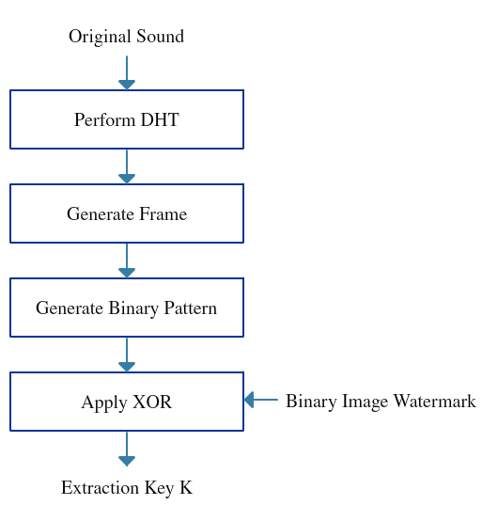
Methodology (Embedding Watermark)

Slide 11
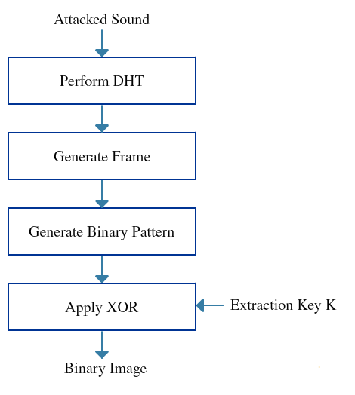
Methodology (Extracting watermark)

Slide 12
Conclusion
Blind Audio Watermarking
Imperceptible
Robust

Slide 13
References
[1] Y. Yang, M. Lei, H. Liu, Y. Zhou, and Q. Luo, “A novel robust zero-watermarking scheme based on discrete wavelet transform,” Journal of Multimedia, vol. 7, no. 4, 2012.
[2] X. Li and G. He, “Efficient audio zero watermarking algorithm for copyright protection based on BIC and DWCM matrix,” International Journal of Advancements in Computing Technology(IJACT), vol. 4, no. 6, 2012.
[3] S. M. Tsai, “A robust zero-watermarking scheme for digital audio,” International Journal of Information and Electronics Engineering, vol. 5, no. 2, 2015.
[4] N. Chen and J. Zhu, “A robust zero-watermarking algorithm for audio,” EURASIP Journal on Advances in Signal Processing, 2008.

Slide 14
References
[5] L. Gao, W. Zhao, X. Wen and L. Wang, “An audio zero- watermarking algorithm based on FFT,” in Procedding of the Interntional Conference on Networking and Digital Society, 2010.
[6] H. liang Dai and D. He, “An efficient and robust zero-watermarking scheme for audio based on DWT and DCT,” in Proceedings of the Asia Pacific Conference on IEEE Microelectronics & Electronics, 2009, pp. 233-236.
[7] R. N. Bracewell, “The discrete hartley transform,” Journal of Optical Society of America, vol. 73, pp. 1832-1835.
[8] V. K. Singh, S. Gupta and U. D. Dalal, “Performance comparison of discrete hartley transform (DHT) and fast fourier transform (FFT),” International Journal of Computer Applications,vol. 70, no. 9, 2013.

Slide 15
THANK YOU

