Slide 1
A Zero-Watermarking Scheme Based on Discrete Hartley Transform for Audio Signal
Supervised by
Dr. Pranab Kumar Dhar
Assistant Professor,
Department of CSE, CUET
Presented by
Emtiaj Hasan
ID: 1004050

Slide 2
Contents
Introduction
Motivation
Objectives
Previous Work and Limitations
Proposed Technique
Proposed Methodology
Conclusion
References

Slide 3

Introduction
Protection of information
Digital watermarking
  Process of embedding information
  For any media contents like image, audio, video, text
  Visible or invisible watermarking
  Blind or non-blind watermarking
  Imperceptibility
  Robustness

Slide 4
Motivation
The recent proliferation of the internet
Copyright protection and authentication of audio has become a significant issue
More sensitive HAS than HVS
Less literature on audio watermarking

Slide 5
Objectives
To propose an audio watermarking algorithm
To propose a imperceptible and robust watermarking scheme

Slide 6
Previous Work and Limitations
Time domain technique
  Changes the signal values
Transform domain technique
  Changes the coefficients
Degradation of audio quality

Slide 7
Proposed Technique
Zero watermarking
  No need to embed information
  Remove conflict between imperceptibility and robustness
Discrete Hartley Transform
  Transforms a real-valued sequence into a real-valued sequence
  Time efficiency of FHT over FFT
  Memory efficiency of FHT over FFT

Slide 8
Proposed Methodology
Divides into two parts:
Embedding watermark
  Generating a key
Extracting watermark

Slide 9
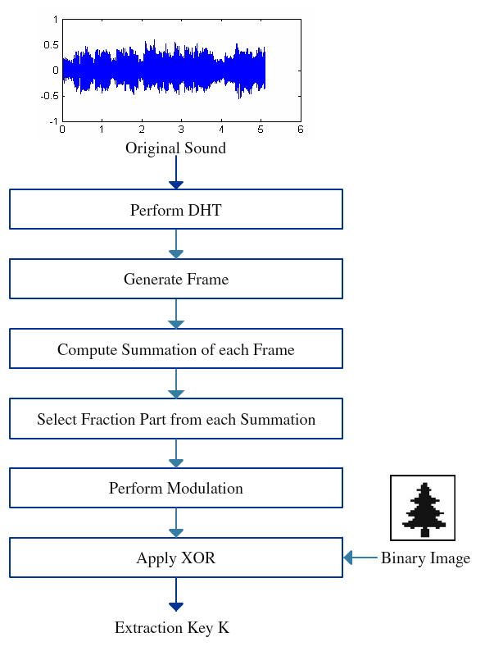
Methodology (Embedding Watermark)

Slide 10
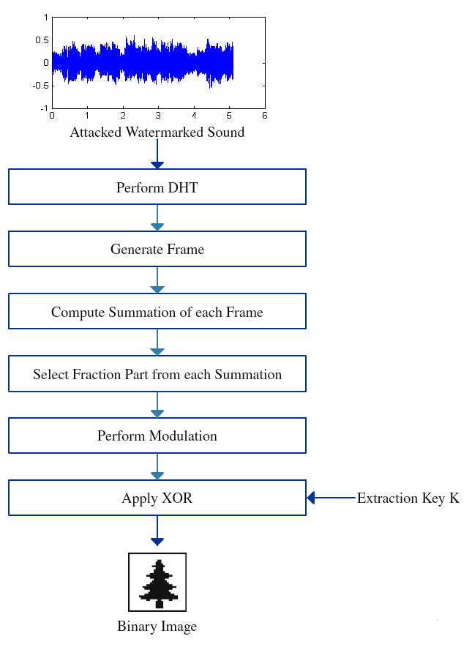
Methodology (Extracting watermark)

Slide 11
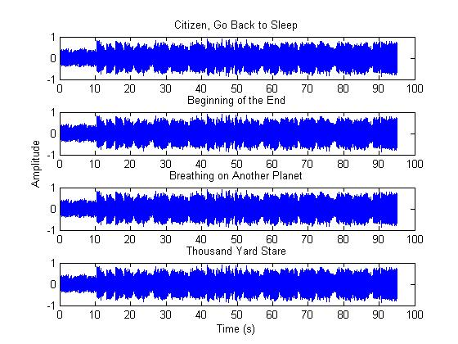
Implementation
Audio Files Used for Simulation
  4194304 sample
  95 seconds long
  44.1 kHz sample rate
  16 bit per sample

Slide 12
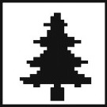
Implementation
Image Used for Simulation
  Binary image
  Size 32 X 32

Slide 13
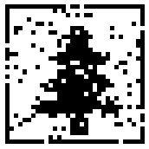
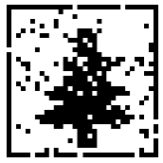
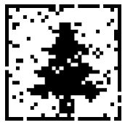
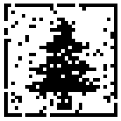
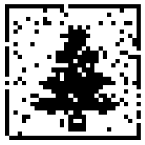
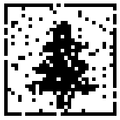
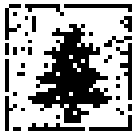
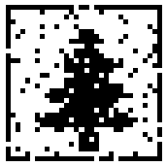
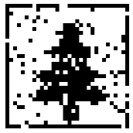
Experimental Result
Extracted Watermark

Slide 14
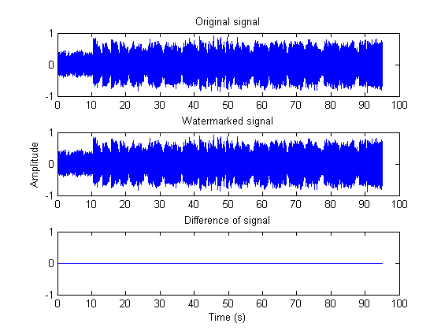
Experimental Result
Imperceptibility Analysis
  Watermark embed into key
  Identical to original audio

Slide 15
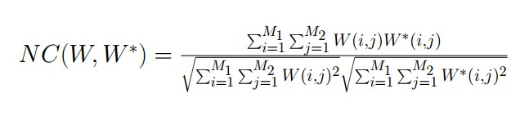
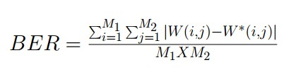
Experimental Result
Robustness
  Normalized Coefficient
  Bit Error Rate

Slide 16
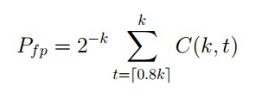
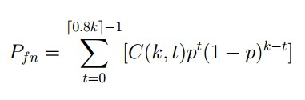
Experimental Result
  False Positive Error
  False Negative Error

Slide 17
Experimental Result
Comparison of NC
Attack | NC[Proposed] | NC[1] | NC[2] | NC[3]
Noise addition | 0.9206 | 0.9901 | 0.5870 | 0.6619
Re-sampling | 0.9158 | 0.9950 | 0.9924 | 0.7847
Filtering | 0.9145 | 0.9942 | 0.6272 | 0.5541
Re-quantization | 0.9172 | 1.0000 | 0.9634 | 0.5454
Echo | 0.9268 | 0.7559 | 0.5820 | 0.7867
Reverse | 0.9199 | 0.4904 | 0.5737 | 0.6150
Compression 32kbps | 0.9225 | 0.9591 | 0.5774 | 0.4034
Compression 64kbps | 0.9279 | 0.9650 | 0.5673 | 0.4806
Compression 128kbps | 0.9271 | 0.9650 | 0.5524 | 0.7270

Slide 18
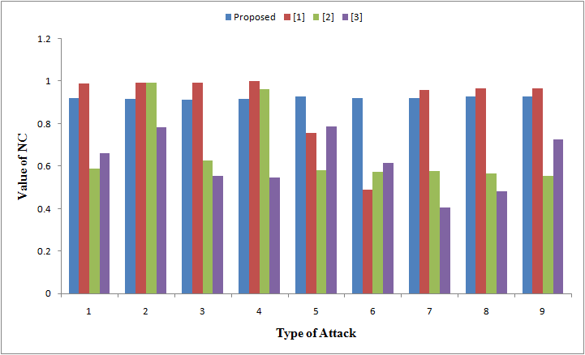
Experimental Result
Comparison of NC

Slide 19
Experimental Result
Comparison of BER
Attack | BER[Proposed] | BER[1] | BER[2] | BER[3]
Noise addition | 10.06 | 1.17 | 47.85 | 37.50
Re-sampling | 10.64 | 0.59 | 0.98 | 25.00
Filtering | 10.84 | 0.68 | 43.65 | 50.00
Re-quantization | 10.45 | 0.00 | 4.69 | 49.00
Echo | 9.28 | 27.83 | 49.02 | 25.00
Reverse | 10.16 | 56.64 | 48.63 | 43.75
Compression 32kbps | 9.77 | 4.79 | 49.51 | 62.50
Compression 64kbps | 9.18 | 4.10 | 49.71 | 56.25
Compression 128kbps | 9.28 | 4.10 | 52.25 | 31.25

Slide 20
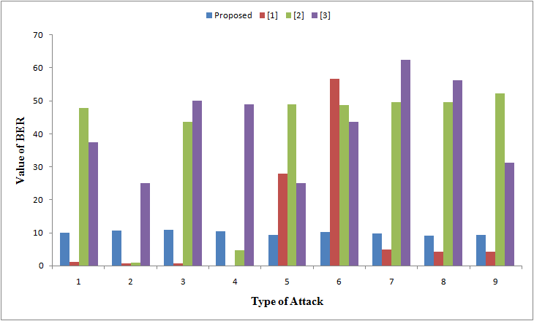
Experimental Result
Comparison of BER

Slide 21
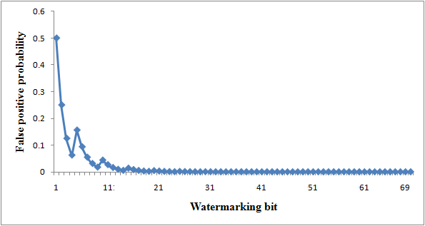
Experimental Result
False Positive Error

Slide 22
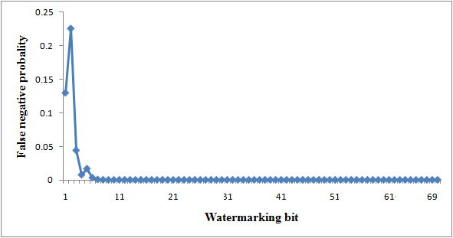
Experimental Result
False Negative Error

Slide 23
Summary
Blind audio watermarking
Imperceptible
Robust

Slide 24
Future Recommendation
Other properties of DHT can be considered for getting more robustness
Some modern attacks such as pitch-scale, channel fading, packet drop should be considered

Slide 25
References
[1] S. M. Tsai, “A robust zero-watermarking scheme for digital audio,” International Journal of Information and Electronics Engineering, vol. 5, no. 2, pp. 117–121, 2015.
[2] Y. Yang, M. Lei, H. Liu, Y. Zhou, and Q. Luo, “A novel robust zero-watermarking scheme based on discrete wavelet transform,” Journal of Multimedia, vol. 7, no. 4, pp. 303–308, 2012.
[3] H. L. Dai and D. He, “An efficient and robust zero-watermarking scheme for audio based on DWT and DCT,” in Proceedings of the Asia Pacific Conference on Microelectronics & Electronics, 2009, pp. 233–236.
[4] N. Chen and J. Zhu, “A robust zero-watermarking algorithm for audio,” EURASIP Journal on Advances in Signal Processing, vol. 2008, no. 103, pp. 1–7, 2008.

Slide 26
References
[5] M. L. Wang, H. X. Lin, and M. T. Lee, “Robust audio watermarking based on MDCT coefficients,” in Proceedings of the International Conference on Genetic and Evolutionary Computing, 2012, pp. 372–375.
[6] R. N. Bracewell, “The discrete hartley transform,” Journal of Optical Society of America, vol. 73, no. 12, pp. 1832–1835, 1983.
[7] [Online]. Available: http://www.jamendo.com/en/album/7365
[8] V. Bhat, I. Sengupta, and A. Das, “An audio watermarking scheme using singular value decomposition and dither-modulation quantizaion,” Multimedia Tools and Applications, vol. 52, no. 2, pp. 369–383, 2011.

Slide 27
THANK YOU

