Slide 1

SmartSpend
Spending Efficiency Analysis in the Turkish Super Lig
Seasons 2023-24 | 2024-25 | 2025-26
Saltuk Bugrahan Tasdemir · Kerem Berkalp Cerekci
EMU430 — Data Analytics | Hacettepe University | May 2026

Slide 2
Methodology
To ensure a robust and comprehensive analysis of spending efficiency in the Turkish Super Lig, we employed a meticulous approach encompassing data collection, metric definition, and advanced analytical techniques.
01
02
Data Collection & Scope
Key Metrics Defined
Extensive data for three consecutive seasons (2023-24, 2024-25, 2025-26) was gathered from reputable football analytics platforms. This included player market values, club league points, transfer spending, and goals scored/conceded.
We focused on quantifiable metrics such as Squad Market Value (SMV), total league points, net transfer expenditures, and goal differentials to assess both financial input and on-field output.
03
04
Efficiency Score Calculation
Statistical Analysis
A novel Efficiency Score was developed using the Ordinary Least Squares (OLS) Residual Method. This allowed us to measure each team's performance relative to their spending, identifying under- and over-performers.
Correlation analysis was employed to identify relationships between financial investment and sporting success. Additionally, descriptive statistics and comparative analyses were used to highlight overall trends and outliers within the league.

Slide 3
EXECUTIVE SUMMARY
Key Findings
Strong Correlation
Galatasaray #1
Small Clubs Win
Pearson r = 0.855 avg. across seasons — money strongly predicts points.
Most efficient large-budget club across all 3 seasons (avg. efficiency +6.9).
Samsunspor & Sivasspor consistently over-perform their budgets by large margins.
Striker Paradox
Best XI Insight
Forward wage spending has a negative correlation with goals (r = -0.12).
G+A per EUR million Best XI is composed almost entirely of mid-table club players.

Slide 4

DATA & METHODOLOGY
Data Sources & Dataset
Dataset Dimensions
Transfermarkt
FBref (StatsBomb)
Player market values (EUR), squad names, positions — 3 seasons, ~20 clubs/season
Points, W/D/L, Goals, Assists, Minutes, Save% — club & player level
Dataset
Rows
Coverage
team_season
57
20+19+18 clubs across 3 seasons
player_full
1,840
Position, goals, assists, minutes
Capology.com
Annual total wage bill (EUR) — club-level, 3 seasons
squad_values
57
Avg. player value per club-season
Key pre-processing: team name standardisation, January transfer wage halving, player deduplication, and FBref standings cleaning.

Slide 5
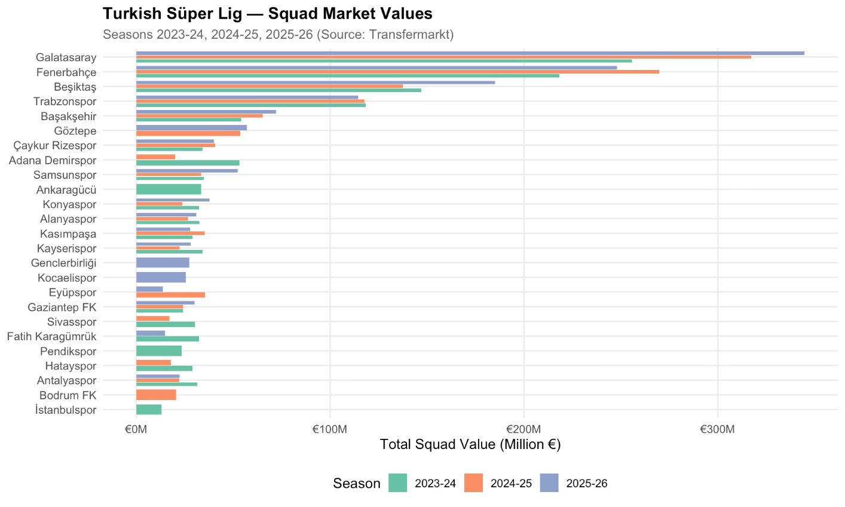
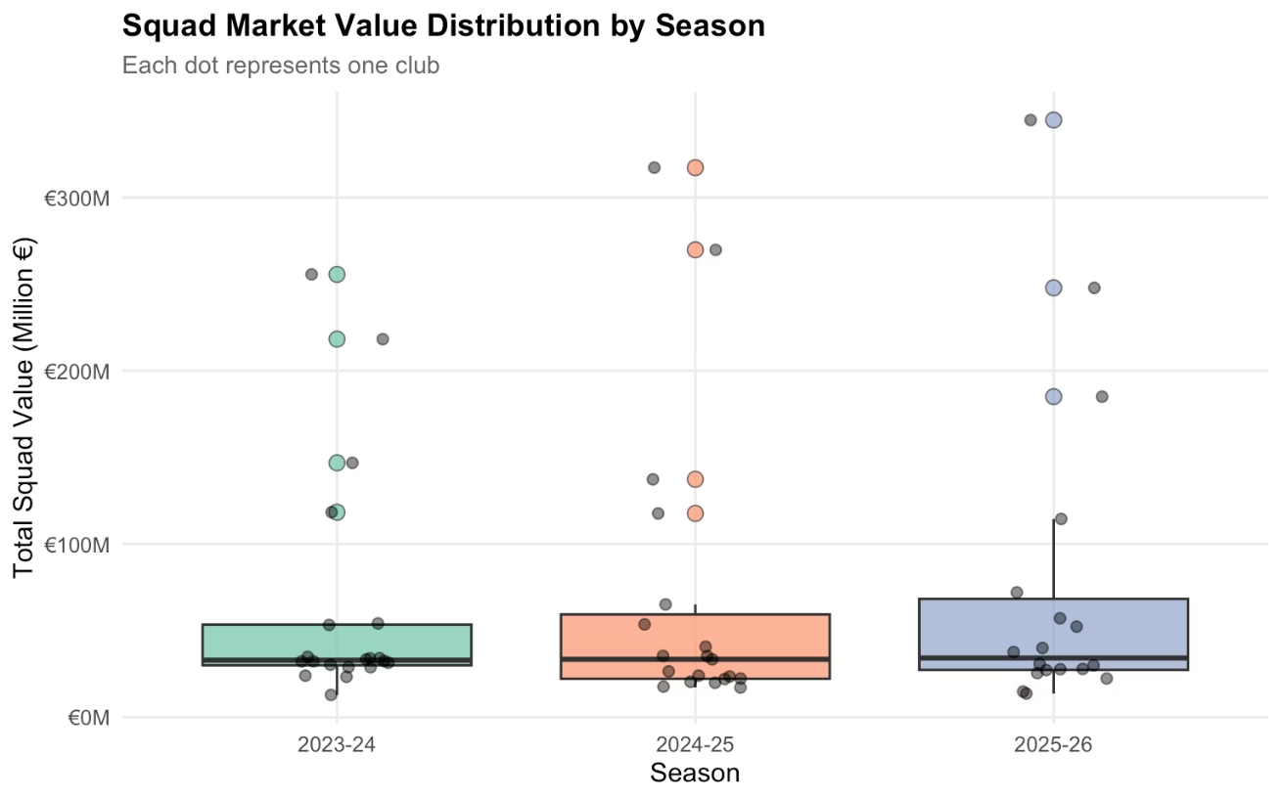
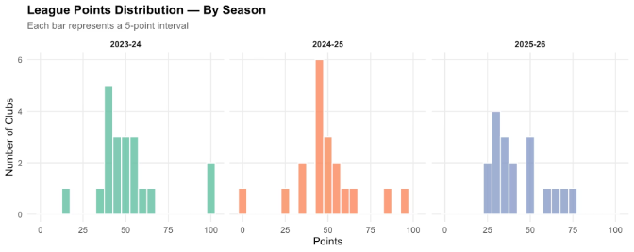
EDA
Squad Market Value Distribution by Club
Galatasaray and Fenerbahçe stand out clearly from the rest of the league across all three seasons.
Fig. 3 — League Points Distribution by Season (Histogram)
Fig. 2 — Squad Value Distribution by Season (Box Plot)

Slide 6
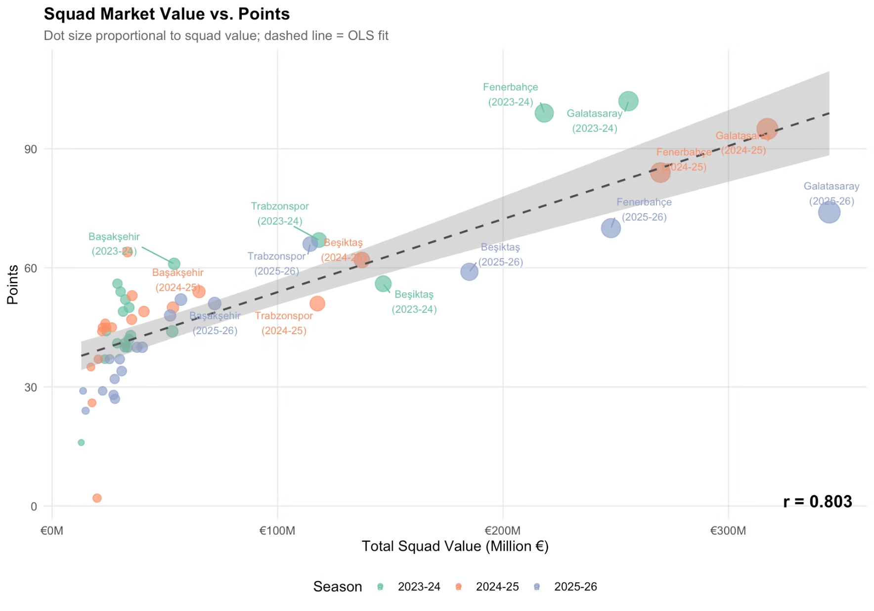

EDA
Squad Value vs. Points: Correlation
Season
Clubs
Pearson r
p-value
Average r = 0.855 confirms a very strong budget-performance link. R² ≈ 0.72 means ~28% of points variance is explained by other factors — coaching, luck, fixture difficulty — creating the efficiency opportunity.
2023-24
20
0.891
< 0.001
2024-25
19
0.803
< 0.001
2025-26
18
0.872
< 0.001
All Seasons
57
~0.855
< 0.001

Slide 7
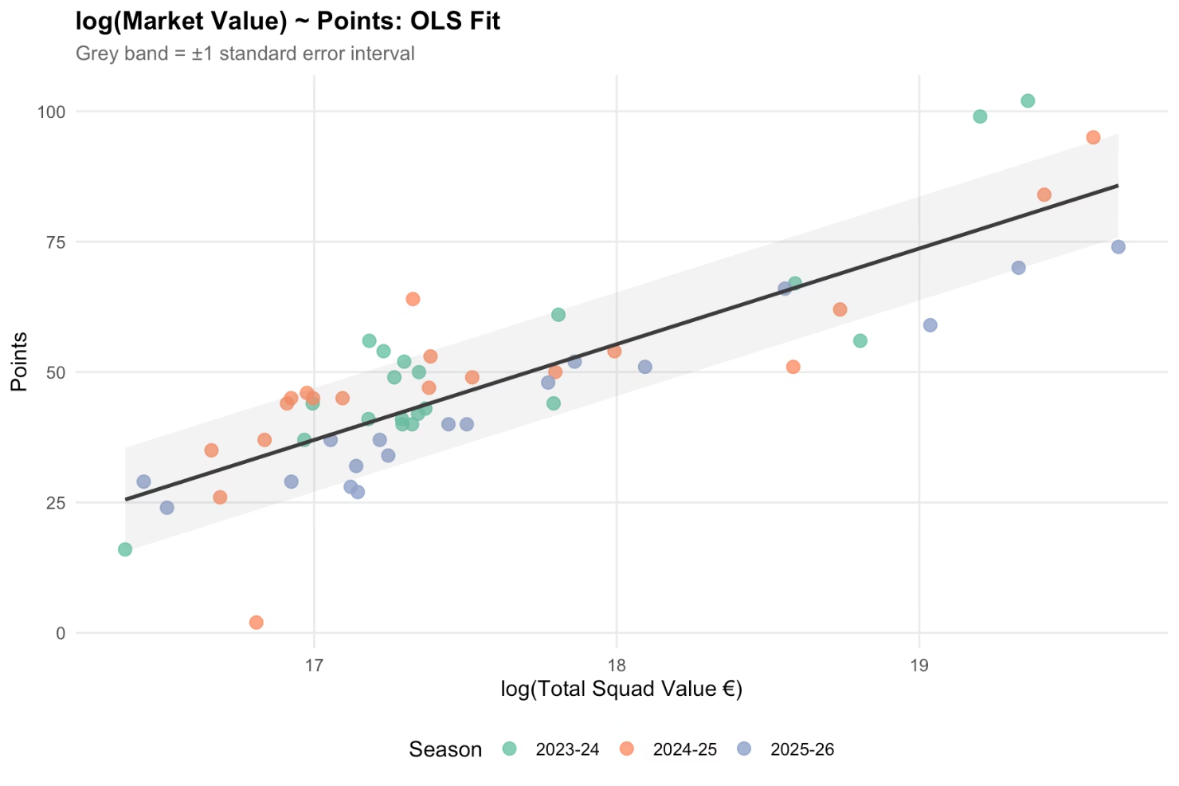

REGRESSION ANALYSIS
Efficiency Score: OLS Residual Method
Model Parameters
Parameter
Estimate
Intercept
-274.85
log(squad_value)
18.34
R-squared
0.7175
Adj. R²
0.7124
Residual SE
9.9451
Observations
57
Efficiency Score = Actual Points − Model-Predicted Points
Positive: over-performs budget. Negative: under-performs budget.
Fig. 5 — log(Squad Value) vs Points: OLS Fit ±1 SE Band
Most & Least Efficient Club-Seasons
Group
Club
Season
Actual Pts
Predicted
Score
✅ Best
Galatasaray
2023-24
102
80.3
+21.7
✅ Best
Fenerbahçe
2023-24
99
77.4
+21.6
✅ Best
Samsunspor
2024-25
64
43
+21.0
❌ Worst
Adana Demirspor
2024-25
2
33.5
-31.5
❌ Worst
Beşiktaş
2025-26
59
74.4
-15.4
❌ Worst
Trabzonspor
2024-25
51
66.1
-15.1

Slide 8
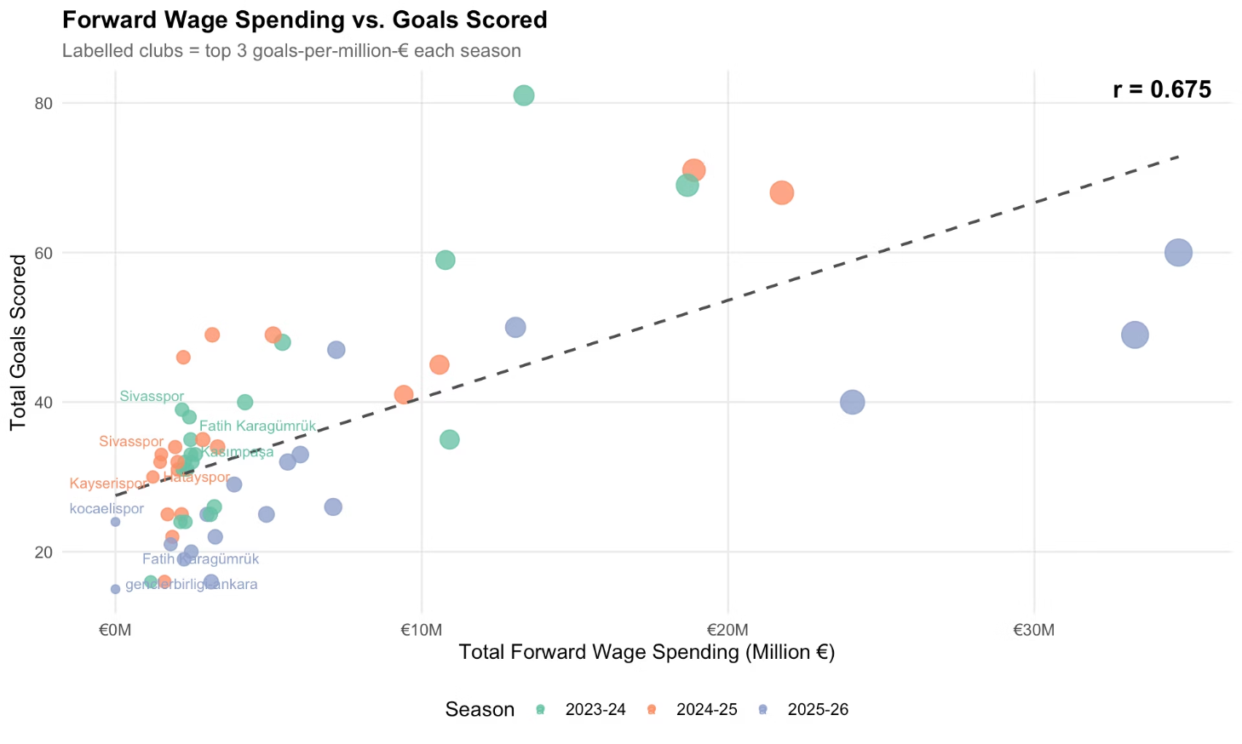
PLAYER ANALYSIS A
Forward Spending vs. Goals
Critical Finding: Correlation between forward wage spending and goals scored: r = −0.12 (NEGATIVE). Expensive attacking squads do NOT guarantee high goal tallies.
Top 10 Clubs by Goals per Million EUR (Forward Wages)
Club
Season
Fwd. Wage
Goals
Goals/M EUR
Sivasspor
2023-24
€2.17M
39
17.96
Fatih Karagümrük
2023-24
€2.41M
38
15.74
Kasımpaşa
2023-24
€2.45M
35
14.27
Antalyaspor
2023-24
€2.26M
32
14.16
Kayserispor
2023-24
€2.20M
31
14.09
İstanbulspor
2023-24
€1.15M
16
13.89
Alanyaspor
2023-24
€2.46M
33
13.41
Pendikspor
2023-24
€2.34M
31
13.26
Çaykur Rizespor
2023-24
€2.50M
32
12.78
Ankaragücü
2023-24
€2.61M
33
12.65

Slide 9
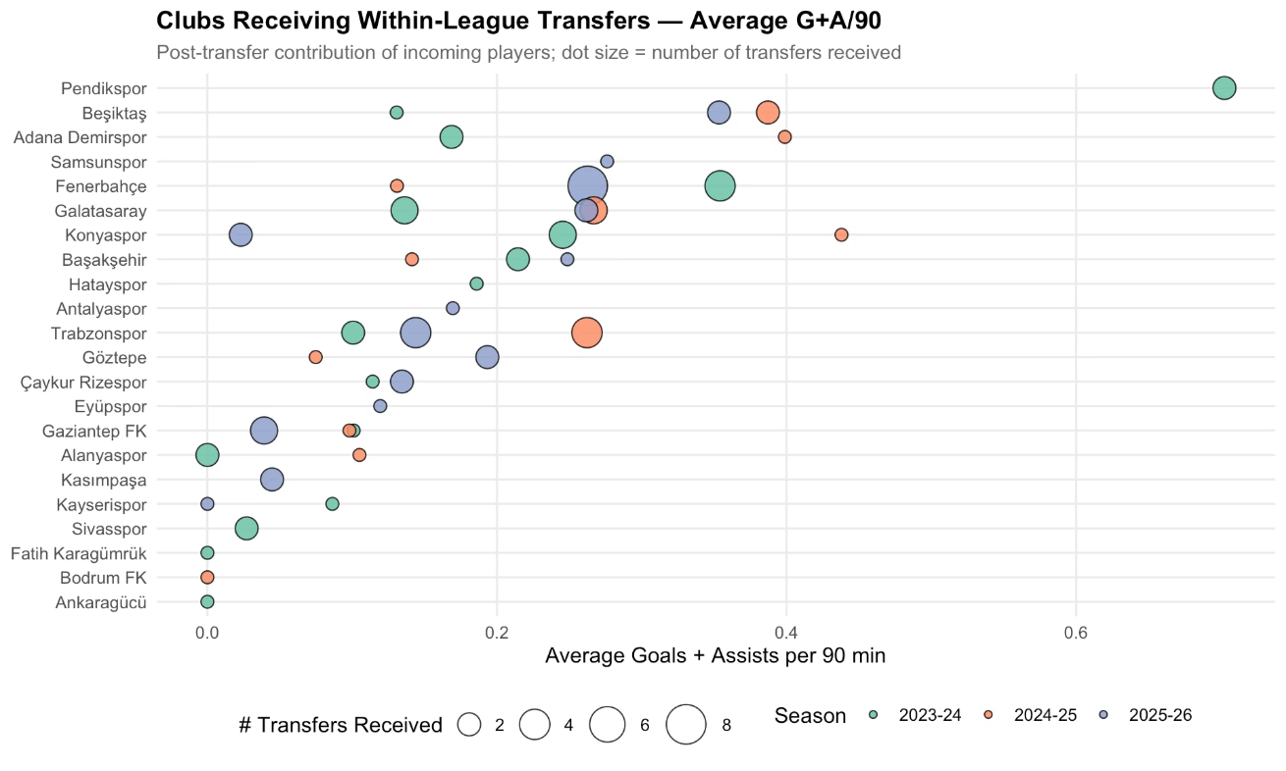
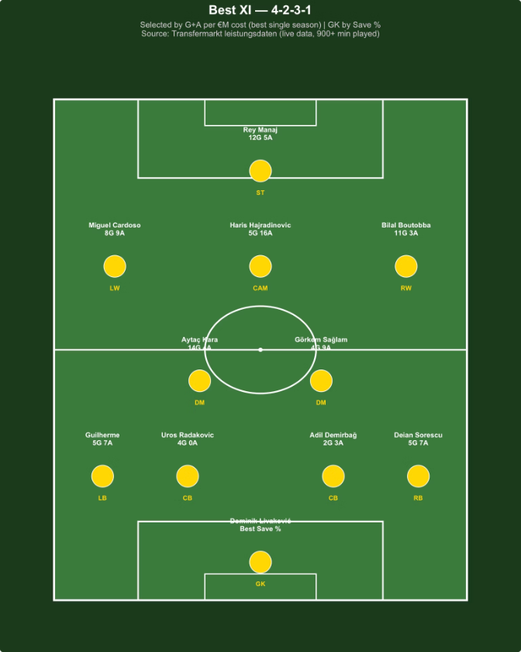
PLAYER ANALYSIS B & C
Mid-Season Transfers & Best XI
Within-League Transfers (Fig. 10)
Best XI Pitch (4-2-3-1)
Clubs receiving mid-season transfers show markedly different G+A/90 outcomes. Average performance of transferred players appears independent of club budget.
Selected by G+A per EUR million (min. 900 min, min. 1 G+A). GK by Save%.
Best XI Player Table
Pos.
Player
Club
Season
Stats
G+A/M EUR
GK
Dominik Livaković
Fenerbahçe
2023-24
Save%: 74.1
—
CB
Uros Radakovic
Sivasspor
2024-25
4G 0A
10.47
CB
Adil Demirbağ
Konyaspor
2024-25
2G 3A
9.33
LB
Guilherme
Konyaspor
2023-24
5G 7A
15.62
RB
Deian Sorescu
Gaziantep FK
2024-25
5G 7A
21.43
CDM
Aytaç Kara
Kasımpaşa
2023-24
14G 4A
26.71
CDM
Görkem Sağlam
Hatayspor
2024-25
4G 9A
24.95
CAM
Haris Hajradinovic
Kasımpaşa
2023-24
5G 16A
31.16
LW
Miguel Cardoso
Kayserispor
2024-25
8G 9A
31.14
RW
Bilal Boutobba
Hatayspor
2024-25
11G 3A
26.87
ST
Rey Manaj
Sivasspor
2024-25
12G 5A
44.5
The entire Best XI is drawn from mid-table clubs. "Most expensive player = best investment" does not hold in Turkish football.

Slide 10
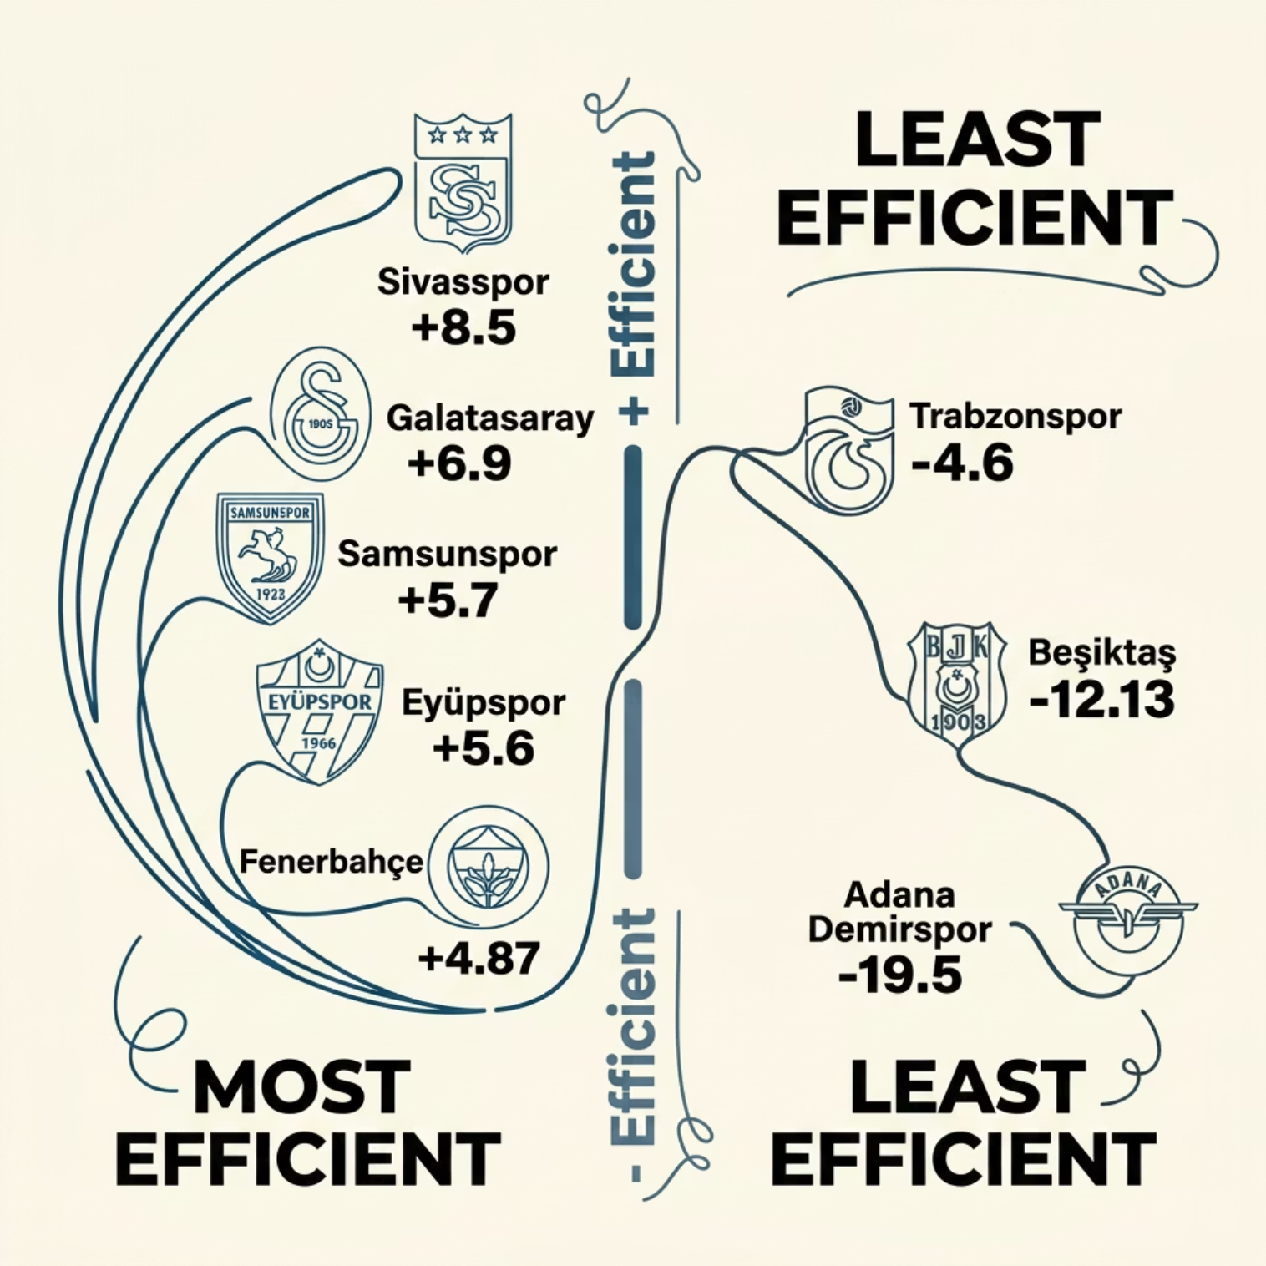

Overall Club Efficiency Rankings (3 Seasons)
TOP PERFORMERS
Club
Avg Squad Value
Avg Pts
Avg Eff.
Sivasspor
EUR 23.8M
44.5
+8.5
Galatasaray
EUR 305.9M
90.3
+6.9
Samsunspor
EUR 40.2M
51.7
+5.7
Eyüpspor
EUR 24.6M
41.0
+5.6
Fenerbahçe
EUR 245.3M
84.3
+4.87
BOTTOM PERFORMERS
Club
Avg Squad Value
Avg Pts
Avg Eff.
Beşiktaş
EUR 156.5M
59.0
-12.13
Adana Demirspor
EUR 36.6M
23.0
-19.5
Trabzonspor
EUR 116.9M
61.3
-4.6

Slide 11

CONCLUSIONS
Key Takeaways & Future Work
Limitations
Budget matters — but not everything
Galatasaray: efficient giant
2025-26 season may be incomplete as of May 2026
Club-level wage bills only; individual salaries approximated
Player market values proxied by team season average
Unobserved factors (coaching, injuries) not controlled
r = 0.855, R² = 0.72. 28% of variance explained by other factors.
Avg. efficiency +6.9 — earns more points than budget predicts, consistently.
Future Work
Mid-table clubs punch above weight
Expensive forwards ≠ more goals
Multi-variable regression: coaching tenure, fixture strength, home/away split
Age-performance interaction analysis
Tactical indicators: xG, pressing intensity, possession
Extend to Greek Super League, Belgian Pro League
Sivasspor (+8.5), Samsunspor (+5.7), Eyüpspor (+5.6) systematically over-perform.
r = −0.12. Mid-table clubs achieve comparable goal tallies at far lower cost.
Data: Transfermarkt · FBref · Capology.com
GitHub: emu-hacettepe-analytics/emu430-fall2024-team-smartspend
Star-player myth debunked
Best XI entirely from mid-table clubs. High-value stars underperform on cost-adjusted basis.

