Slide 1
PPU Player
breaknes/BreaksPPU/PPUPlayer at main · emu-russia/breaknes (github.com)

Slide 2
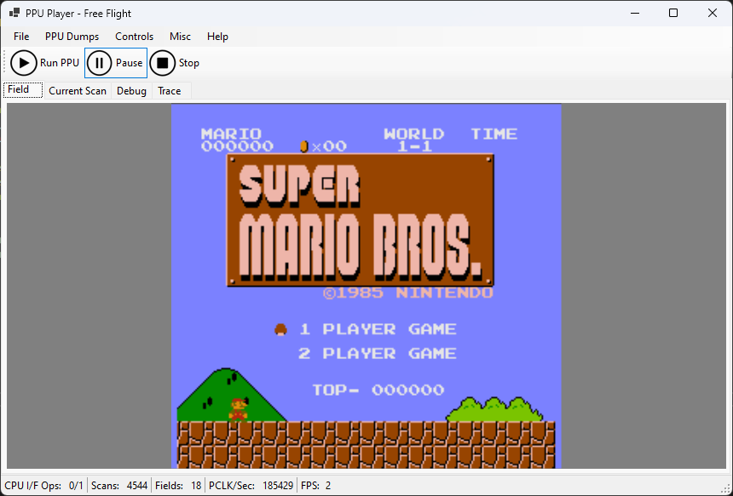
What is it
Essentially a PPU emulator

Slide 3
Architecture
PPU Regs Dump
PPU Player (managed UI)
PPUSim (native part)
.nes ROM

Slide 4
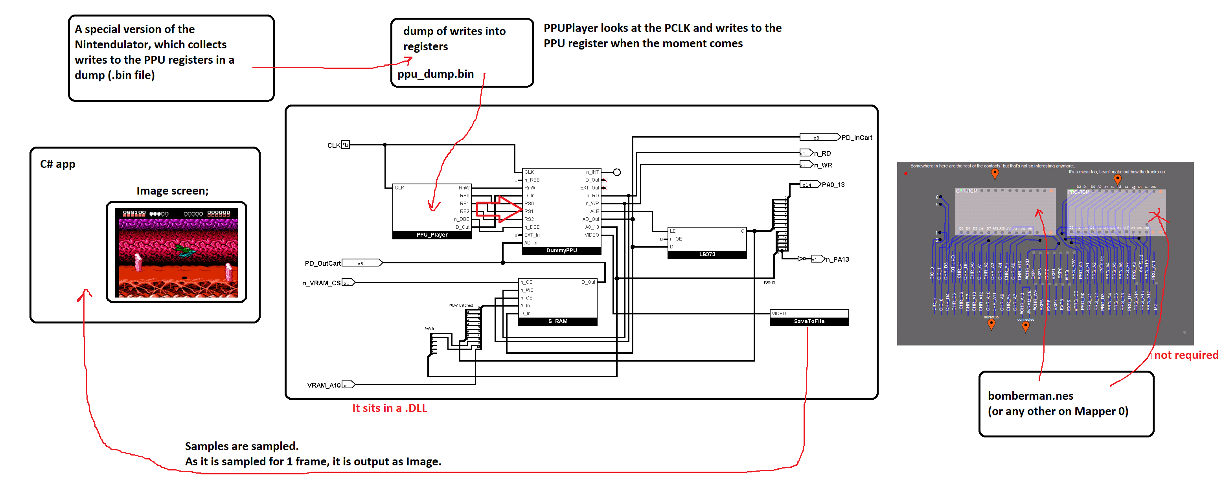
A little more to make it clearer

Slide 5
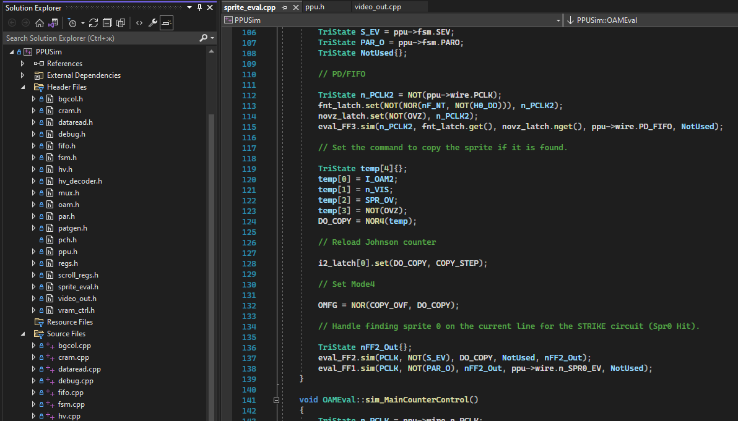
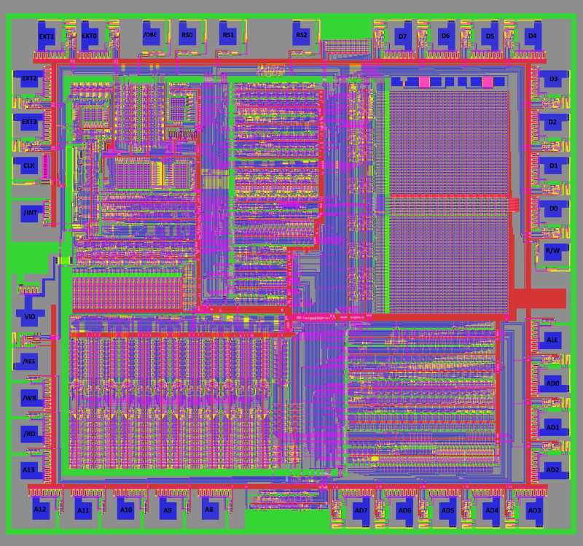
PPUSim
A full-fledged C++ PPU simulator at the logic gate level

Slide 6
.nes ROM image
Simple dumps are supported, based on mapper 0 (NROM)
Bomberman, Super Mario etc.

Slide 7
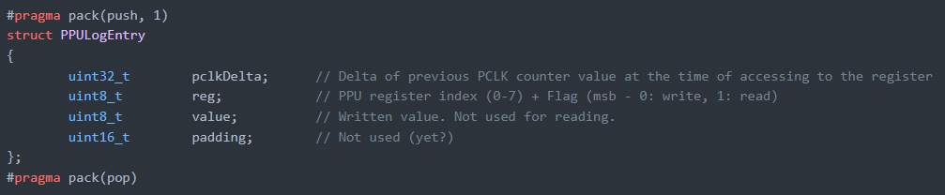
RegDump
Dump of access to PPU registers on the CPU side
Array of records in simple format

Slide 8
Free Flight Mode
Press «Run PPU» and go
PPU register dump or NES ROM are not required
PPU outputs what is loaded in VRAM / CHR / OAM

Slide 9
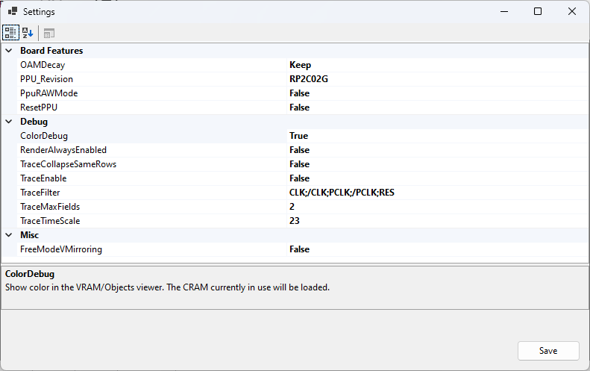
Settings

Slide 10
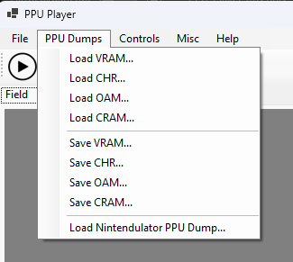
Working with PPU memory dumps
VRAM / CHR / OAM / CRAM can be loaded and saved
You can load a PPU memory dump from the Nintendulator

Slide 11
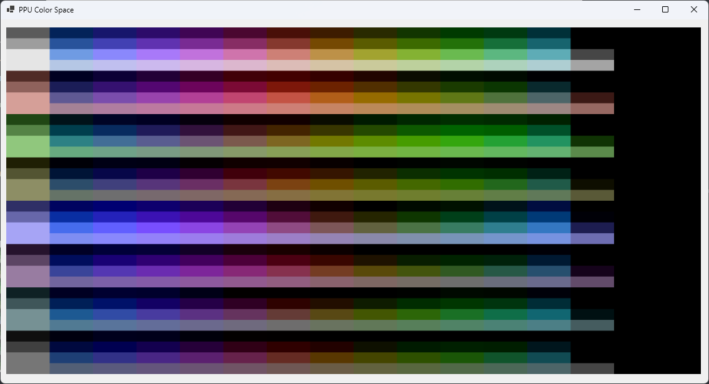
PPU Color Space
Shows the color space ("palette") of the PPU
Including Emphasis

Slide 12
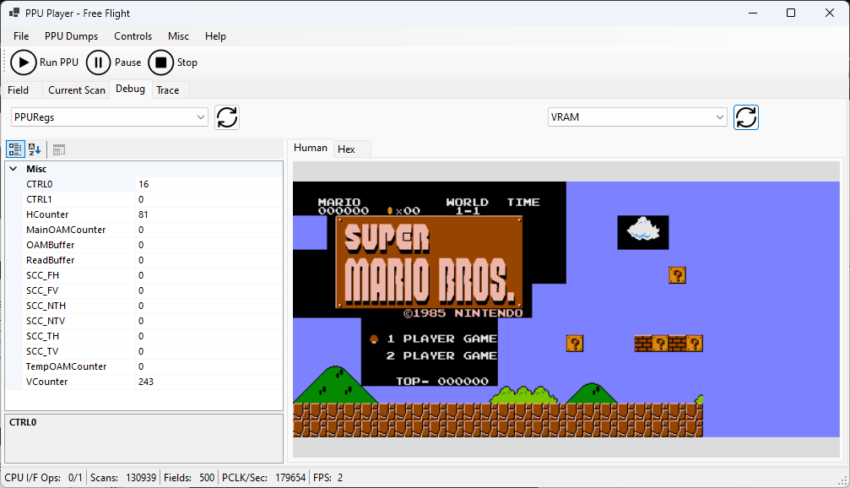
Debugging

Slide 13
Debugging capabilities
Watch the state of PPU signals
Watch the state of the PPU registers
Change the value of PPU registers $2000/$2001 on the fly
Watch VRAM / CHR / OAM / Temp OAM / CRAM memory in Hex
Watching memory in a "human" representation

Slide 14
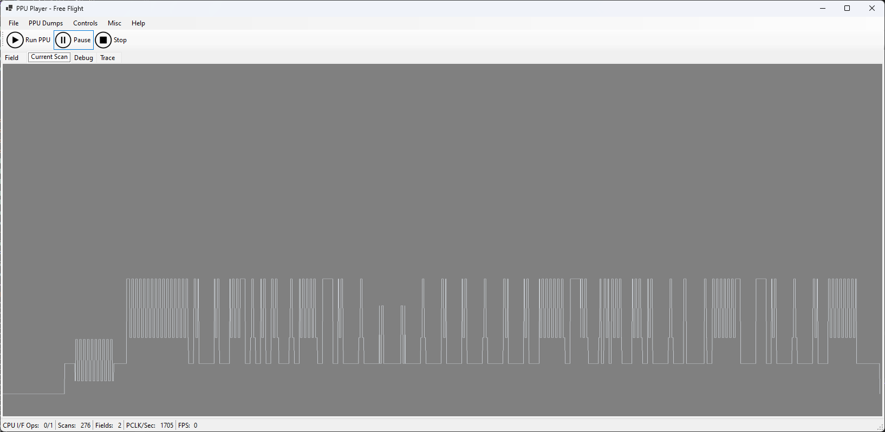
Current video scanline
(*) only for composite PPUs

Slide 15
Questions?
Ask @org / Discord

