Slide 1
PPU Player
breaknes/BreaksPPU/PPUPlayer at main · emu-russia/breaknes (github.com)

Slide 2
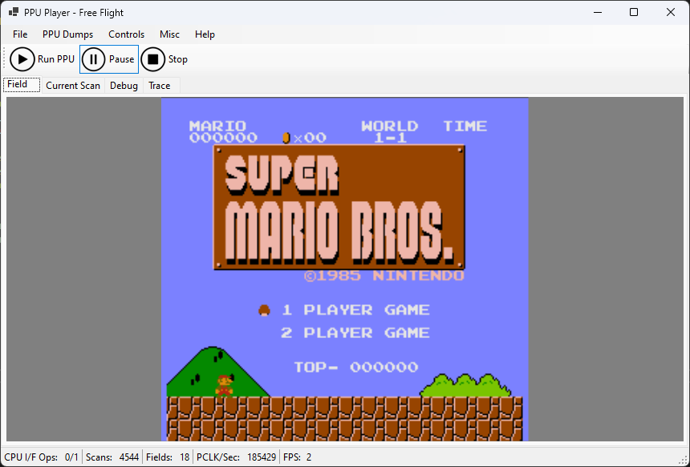
What is it
Essentially a PPU emulator

Slide 3
Architecture
PPU Regs Dump
PPU Player (managed UI)
PPUSim (native part)
.nes ROM

Slide 4
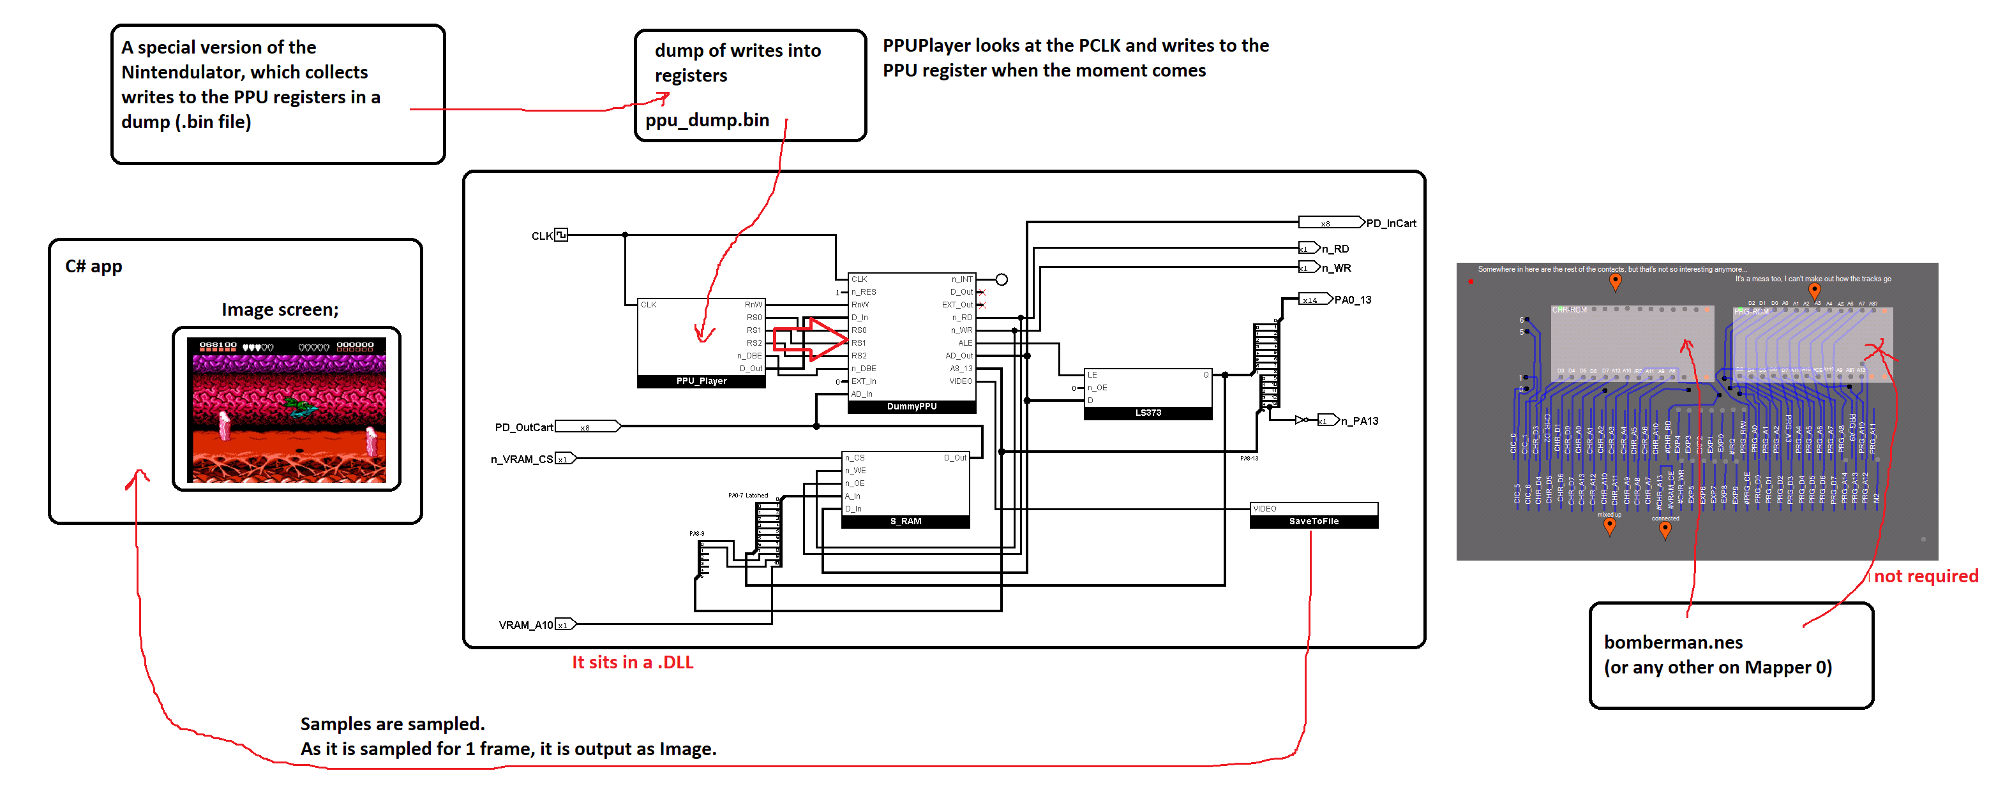
A little more to make it clearer

Slide 5
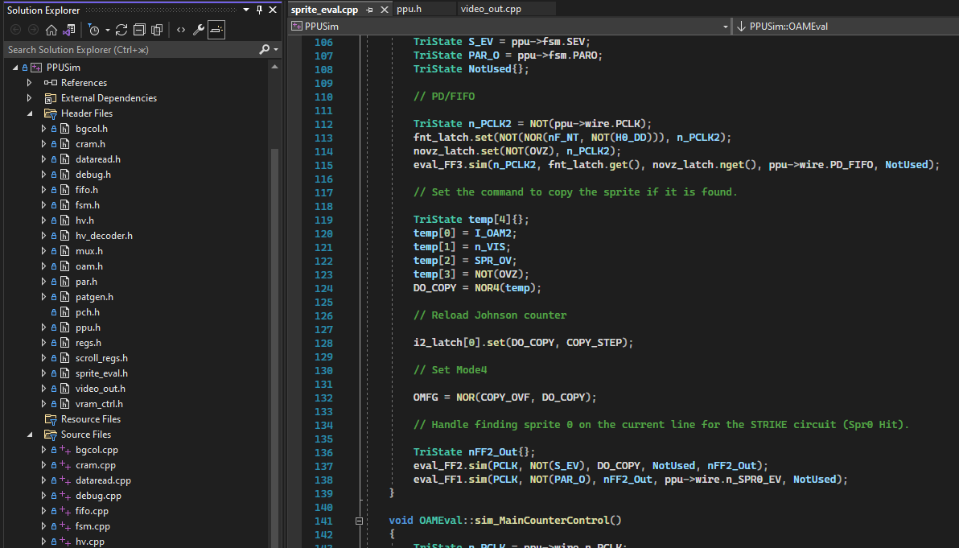
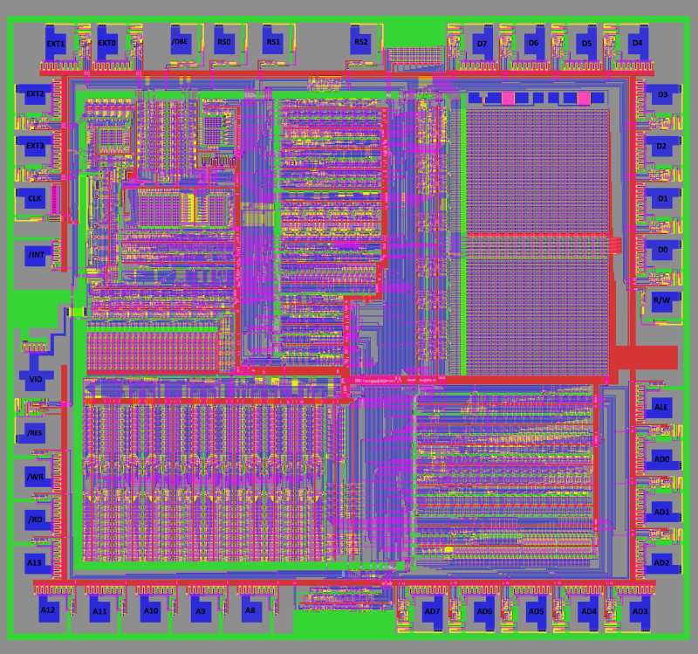
PPUSim
A full-fledged C++ PPU simulator at the logic gate level

Slide 6
NES ROM Images
Simple dumps are supported, based on mapper 0 (NROM)
Bomberman, Super Mario etc.

Slide 7
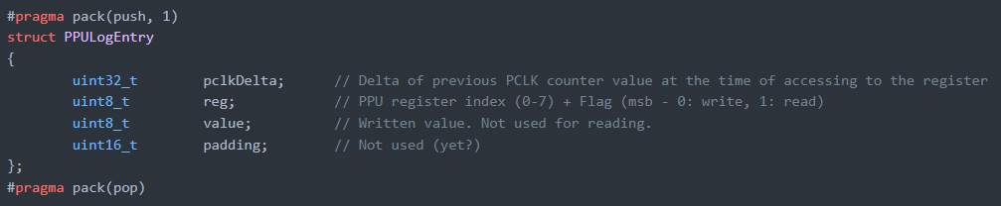
RegDump
Dump of access to PPU registers on the CPU side
Array of records in simple format

Slide 8
Free Flight Mode
Press «Run PPU» and go
PPU register dump or NES ROM are not required
PPU outputs what is loaded in VRAM / CHR / OAM

Slide 9
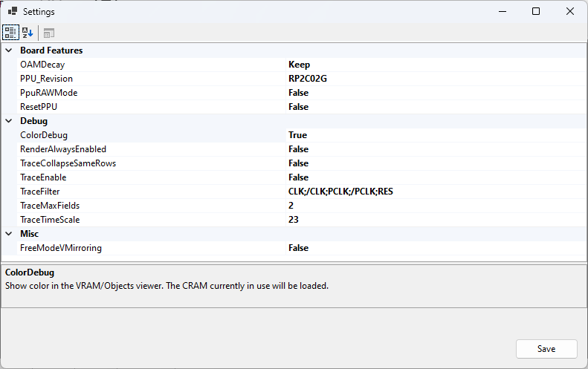
Settings

Slide 10
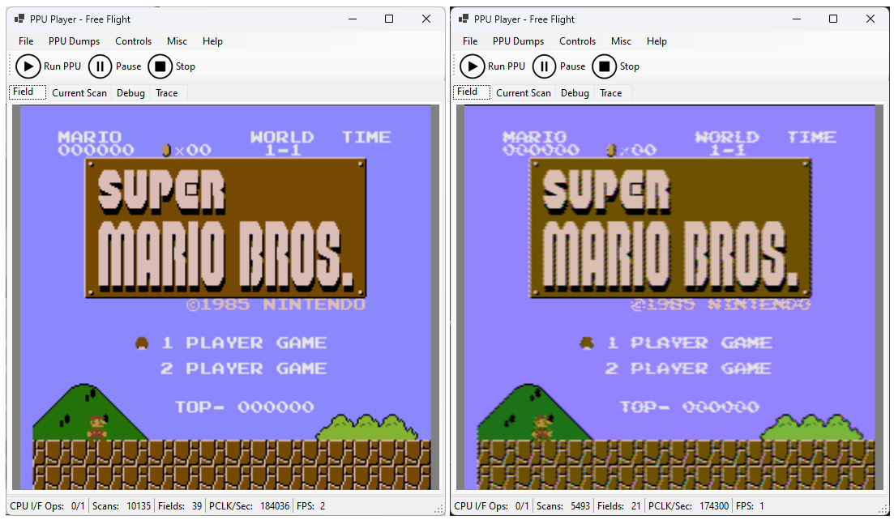
RAW vs Composite

Slide 11
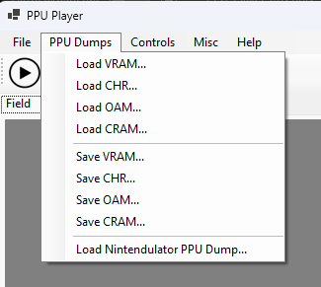
Working with PPU memory dumps
VRAM / CHR / OAM / CRAM can be loaded and saved
You can load a PPU memory dump from the Nintendulator

Slide 12
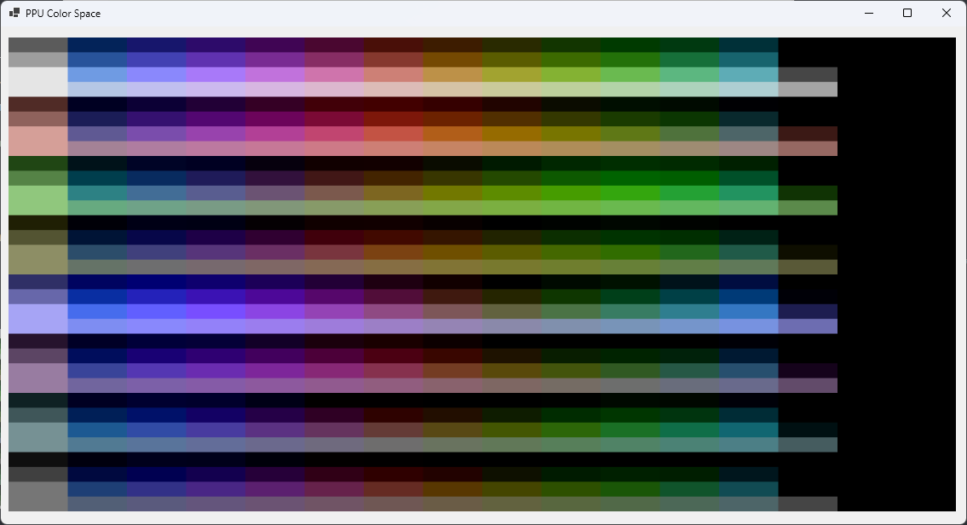
PPU Color Space
Shows the color space ("palette") of the PPU
Including Emphasis

Slide 13
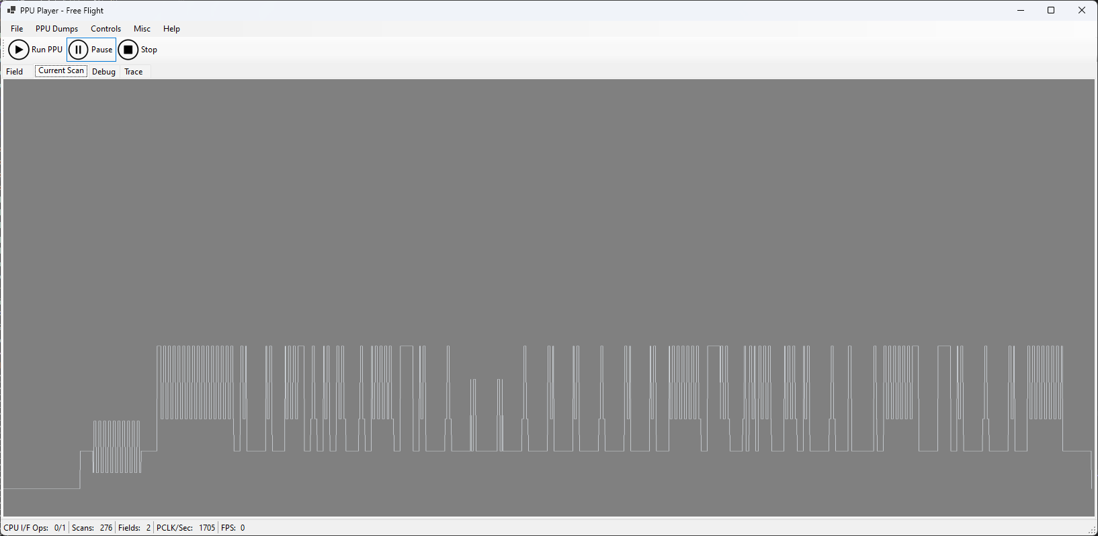
Current video scanline
Makes brrrrr
(*) only for composite PPUs

Slide 14
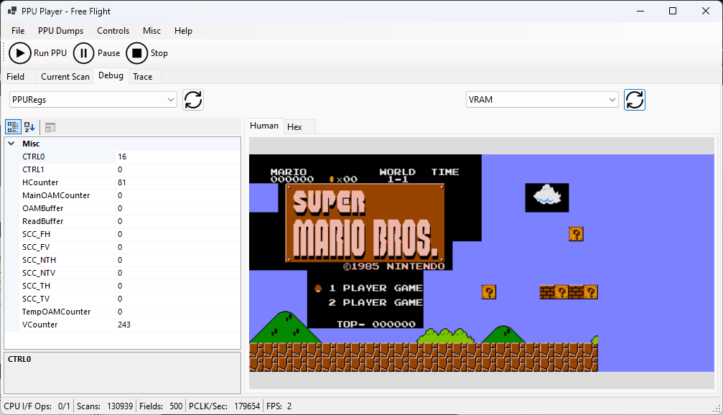
Debugging

Slide 15
Debugging capabilities
Watch the state of PPU signals
Watch the state of the PPU registers
Change the value of PPU registers $2000/$2001 on the fly
Watch VRAM / CHR / OAM / Temp OAM / CRAM memory in Hex
Watching memory in a "human" representation

Slide 16
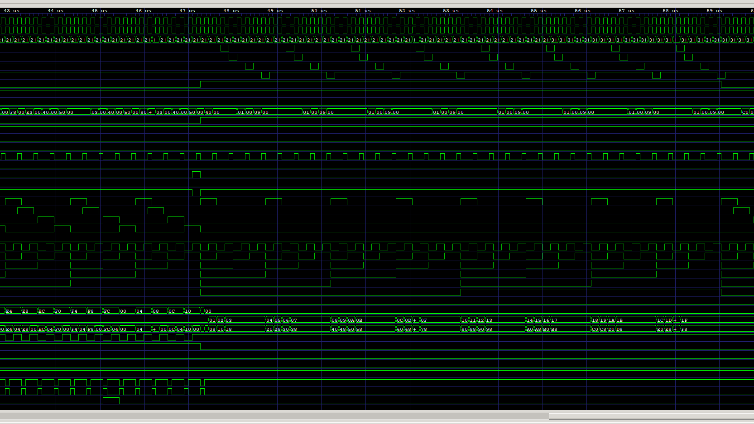
Trace
Dumping trace into VCD format for GTKWave. Become a PPU master.

Slide 17
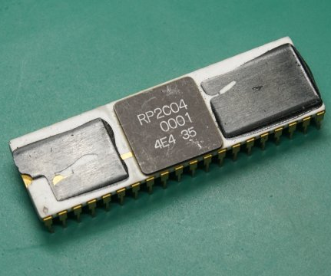
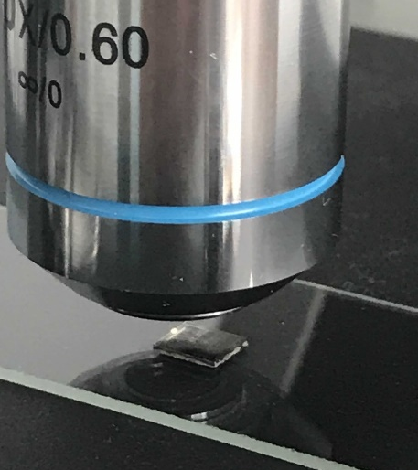
Other PPU Revisions
Not ready yet, stay tuned ;)

Slide 18
Questions?
Ask @org / Discord

