Slide 1
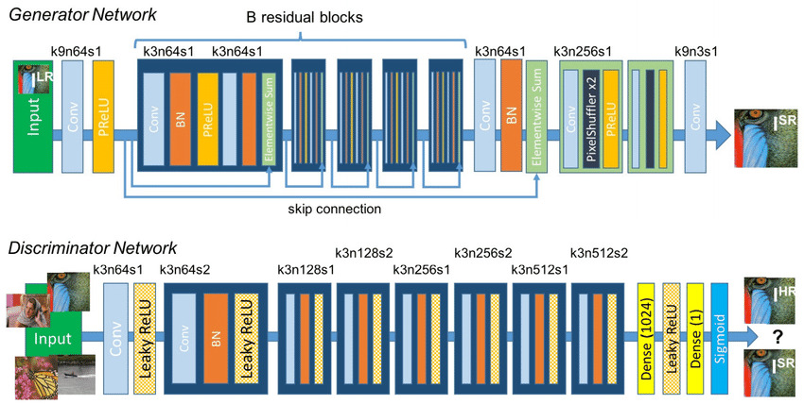
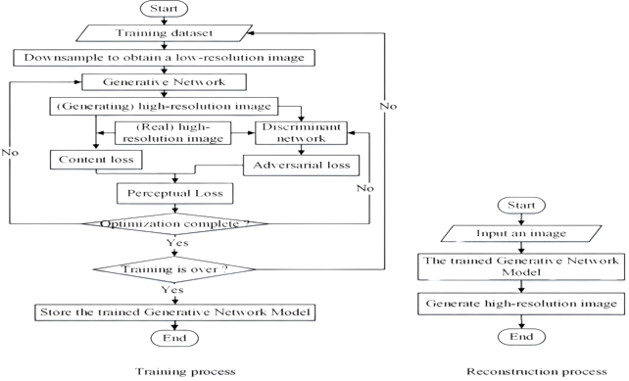
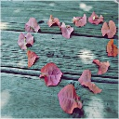

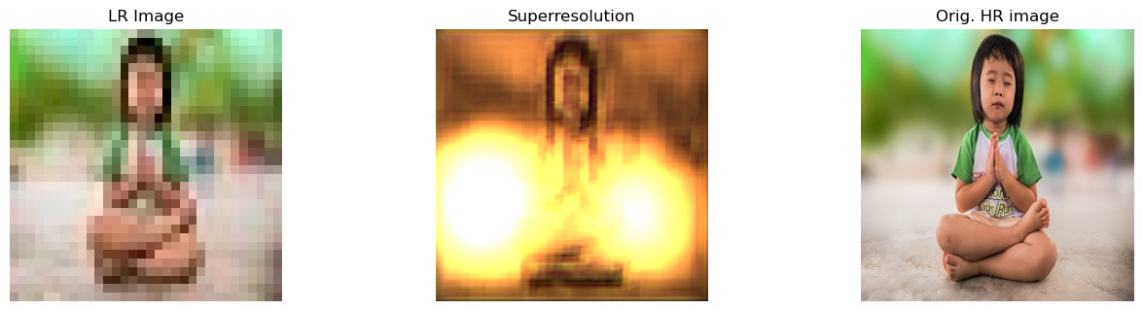




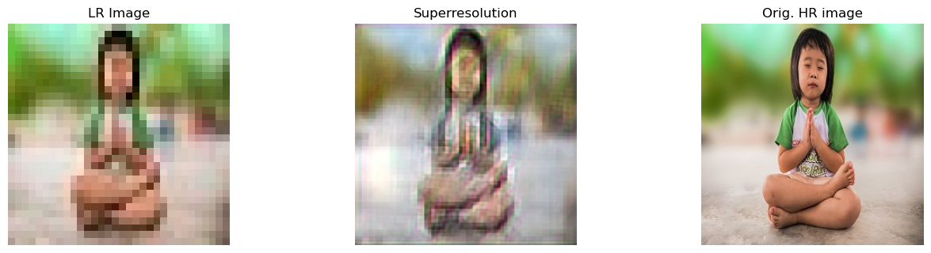
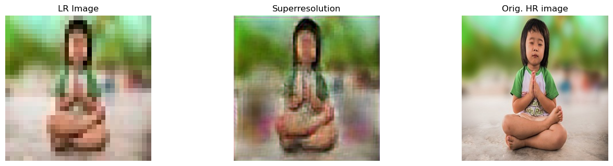
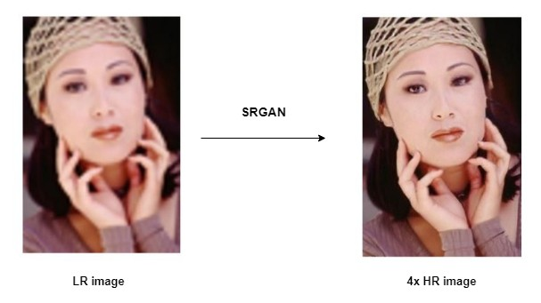
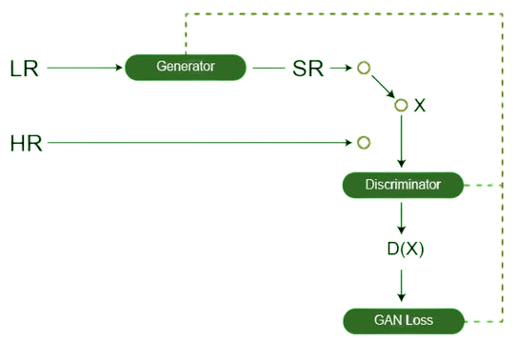

Super Resolution Image Generation Using SRGAN
Course Tittle : Digital Image Processing Lab
Course Code: CSE - 5211
Introduction
Welcome to our project on super resolution image generation using SRGAN (Super-Resolution Generative Adversarial Network). In this study, we delve into advanced techniques of image enhancement, aiming to reconstruct low-resolution images into high-resolution counterparts with enhanced visual fidelity. SRGAN harnesses the power of deep learning and adversarial training to produce compelling results surpassing conventional methods. Our research explores the capabilities of SRGAN, evaluating its performance against various benchmarks and showcasing its potential applications in diverse fields such as medical imaging, satellite imagery, and digital photography. Join us on this journey of pushing the boundaries of image resolution enhancement through innovative AI-driven technologies.
Project Goal
Develop and implement a system for Super Resolution Image Generation using SRGAN.
Generate high-quality, realistic high-resolution images from low-resolution inputs.
Address limitations of traditional super-resolution techniques through deep learning and adversarial training.
Achieve state-of-the-art performance in super-resolution tasks across diverse domains.
Provide an efficient solution for enhancing image resolution while preserving vital visual details.
Dataset
The dataset can be found here: [https://www.kaggle.com/datasets/matteocastrignano/mirflickr].
Size: The dataset contains 25000 images. During our work we use just 2000 random images for simplicity due to limitation of Hardware resource.
Features: The dataset includes a variety of type of image including clouds, sea, lake, river, night, tree, flower, dog, bird, car, people, baby, female, male, portrait
During the project we use two type of Image Low Resolution and High Resolution. We convert our original Image to two different size and save into two different folder.
We consider 32x32 format as Low Resolution and 128x128 format as High Resolution
Generator and Discriminator Architecture
Problem Overview
Our project addresses the common challenge of low-resolution image quality in various applications. Low-resolution images lack clarity and detail, hindering their usability in tasks such as image analysis, recognition, and visualization. Traditional upscaling methods often produce blurry results, failing to capture fine details crucial for accurate interpretation. To overcome this, we employ SRGAN (Super-Resolution Generative Adversarial Network), a state-of-the-art deep learning model. By harnessing the power of SRGAN, we aim to upscale low-resolution images while preserving and enhancing important details, thus revolutionizing image resolution enhancement techniques and enabling superior visual quality across a wide range of applications.
Methodology
Output
Sample Image of Low Resolution
5 Epoch
Sample Image of High Resolution
Architecture of SRGAN
The Super Resolution GAN contains two parts Generator and Discriminator where generator produces some data based on the probability distribution and discriminator tries to guess weather data coming from input dataset or generator. Generator than tries to optimize the generated data so that it can fool the discriminator.
50 Epoch
150 Epoch
Conclusion
In conclusion, our project demonstrates the effectiveness of SRGAN in addressing the challenge of low-resolution image quality. Through extensive experimentation and evaluation, we have showcased the remarkable capabilities of this state-of-the-art deep learning model in generating high-quality, super-resolved images. By preserving and enhancing important details, SRGAN surpasses traditional upscaling methods, offering superior visual fidelity and enabling enhanced image analysis, recognition, and visualization. Our research underscores the potential of SRGAN in revolutionizing image resolution enhancement techniques across diverse fields, paving the way for more accurate and impactful applications in areas such as medical imaging, satellite imagery, and digital photography..
References
Tensorlayer. (n.d.). GitHub - tensorlayer/SRGAN: Photo-Realistic Single Image Super-Resolution Using a Generative Adversarial Network. GitHub. https://github.com/tensorlayer/SRGAN
A super resolution algorithm based on attention mechanism and SRGAN network. (2021). IEEE Journals & Magazine | IEEE Xplore. https://ieeexplore.ieee.org/abstract/document/9496642
https://www.geeksforgeeks.org/super-resolution-gan-srgan/
Rangamati Science And Technology University
Department of Computer Science and Engineering
Submitted To
Md Mynoddin
Assistant Professor
Department of CSE
Submitted B
1. Nur Mohammad – 2017-14-35
2. Emu Barua – 2017- 14- 37

