Slide 1

Cornell University June 2017
Sponsored by Cornell Statistical Consulting Unit
Instructors
Erika Mudrak (CSCU)
Lynn Johnson (CSCU)
Stephen Parry (CSCU)
David Kent (Food Science)
Assistants
Emily Davenport (Molecular Biology and Genetics)
Francoise Vermeylen (CSCU)
Kevin Packard (CSCU)
Michael Ko (CSCU)

Slide 2
Goal:
A Data Carpentry workshop teaches the core skills for working with data effectively and reproducibly.

Slide 3

Community driven effort
Staff
Executive Director Tracy K. Teal, PhD, Michigan State University
Associate Director Erin Becker, PhD
Program Coordinator Maneesha Sane
Deputy Director of Assessment Kari Jordan, PhD
Steering Committee Members
Karen Cranston, PhD, Principal Investigator, Open Tree of Life
Hilmar Lapp, Director of Informatics, Duke Center for Genomic & Computational Biology
Aleksandra Pawlik, PhD, Training Lead, Software Sustainability Institute
Karthik Ram, PhD, rOpenSci co-founder, Berkeley Institute for Data Science Fellow
Ethan White, PhD, Associate Professor, University of Florida
Open source materials
https://github.com/datacarpentry/datacarpentry/

Slide 4
Sentiments on data within the NSF BIO Centers
(BEACON, SESYNC, NESCent, iPlant, iDigBio)
I usually manage data in Excel and it's terrible and I want to do it better.
I'm organizing GIS data and it's becoming a nightmare.
My advisor insists that we store 50,000 barcodes in a spreadsheet, and something must be done about that.
I'm having a hard time analyzing microarray, SNP or multivariate data with Excel and Access.
I want to use public data.
I work with faculty at undergrad institutions and want to teach data practices, but I need to learn it myself first.
I'm interested in going in to industry and companies are asking for data analysis experience.
I'm trying to reboot my lab's workflow to manage data and analysis in a more sustainable way.
I'm re-entering data over and over again by hand and know there's a better way.
I have overwhelming amounts of data.
I'm tired of feeling out of my depth on computation and want to increase my confidence.

Slide 5

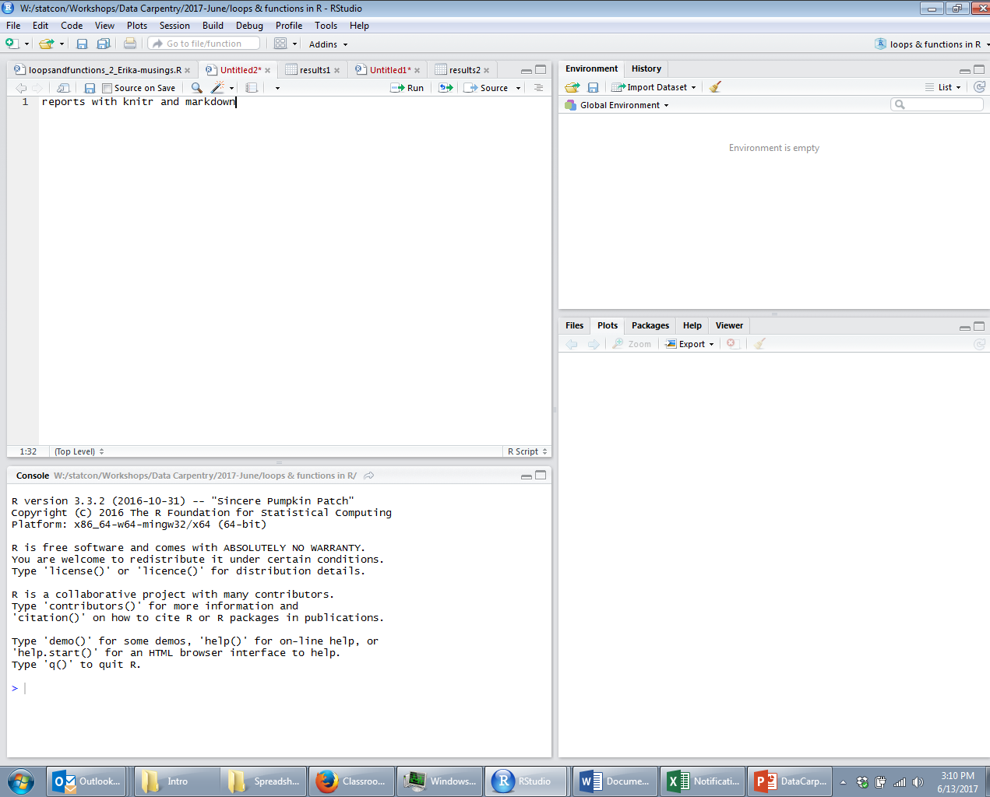
Notes before we start
Website: https://emudrak.github.io/2017-06-14-cornell/
Will have links to lessons after we go through them
Etherpad: http://pad.software-carpentry.org/2017-06-14-cornell
Instructor will update with current code and monitor questions,
Can you see the screen? Insight…
Bathrooms, breaks…

Slide 6


Two kinds of questions
Raise your hand for a question that everyone could benefit
Sticky note when your code doesn’t work and you need a helper to come

Slide 7
Reproducible Research
Well documented
and
Repeatable

Slide 8
Reproducible Research
Data analysis
Data and analysis can be re-created by anyone
Including you in the future!
Repeat analysis on updated data
Repeat analyses on similar datasets
Scripted data management and analysis
Manages and analyzes
Provides a record of what was done
Easy to edit and re-run

Slide 9
Raw Data
Data Cleaning Script
Cleaned Data
Summarizing Script
Working Data
Analysis Script
Analysis Results
Figure Script
Results Formatting Script
Figures
Tables
Publication
Fame

Slide 10
Updated Raw Data
Raw Data
Data Cleaning Script
Cleaned Data
Summarizing Script
Working Data
Analysis Script
Analysis Results
Figure Script
Results Formatting Script
Figures
Tables
Publication
Fame

Slide 11
Raw Data
Data Cleaning Script
Univariate & Bivariate EDA
Find/Replace values
Merge grouping labels
Re-code variables
Fix typos
Standardize entries
Convert dates
Convert variable formats
Missing values
Cleaned Data

Slide 12
Raw Data
Data Cleaning Script
Cleaned Data
Summarizing Script
Subset data for particular project
Transform variables
Average, min, max by group
imputation
Working Data

Slide 13
Raw Data
Data Cleaning Script
Cleaned Data
Summarizing Script
Working Data
Analysis Script
Linear Models
Mixed Models
Search for Correlates
Loop!
General Functions
Analysis Results

Slide 14
Raw Data
Data Cleaning Script
Cleaned Data
Summarizing Script
Working Data
Analysis Script
Analysis Results
Figure Script
Results Formatting Script
Plotting
Table making
Figures
Tables

Slide 15
Raw Data
Data Cleaning Script
Cleaned Data
Summarizing Script
Working Data
Analysis Script
Analysis Results
Figure Script
Results Formatting Script
Figures
Tables
Publication
Paper Writing Script

Slide 16
Raw Data
New Raw Data
Data Cleaning Script
Cleaned Data
Cleaned Data
Summarizing Script
Working Data
Working Data
Analysis Script
Analysis Results
Analysis Results
Figure Script
Results Formatting Script
Figures
Tables
Figures
Tables

Slide 17
Re-use and edit scripts for new projects
Raw Data
New Raw Data
Data Cleaning Script
Cleaned Data
Cleaned Data
Summarizing Script
Summarized Data
Working Data
Analysis Script
Analysis Results
Analysis Results
Figure Script
Results Formatting Script
Figures
Tables
Figures
Tables

Slide 18
Univariate & Bivariate EDA
Find/Replace values
Merge grouping labels
Re-code variables
Fix typos
Standardize entries
Convert dates
Convert variable formats
Missing values
Raw Data
Data Cleaning Script
Cleaned Data
Subset data for particular project
Transform variables
Average, min, max by group
imputation
Summarizing Script
Working Data
Linear Models
Mixed Models
Search for Correlates
Loop!
General Functions
Analysis Script
Analysis Results
Figure Script
Results Formatting Script
Plotting
Table making
Figures
Tables
Publication
Fame

Slide 19
Raw Data
Wednesday
morning
Data Cleaning Script
Excel
Univariate & Bivariate EDA
Find/Replace values
Merge grouping labels
Re-code variables
Fix typos
Standardize entries
Convert dates
Convert variable formats
Missing values
OpenRefine
Wednesday Afternoon
R: ggplot
R: dplyr
Summarizing Script
Subset data for particular project
Transform variables
Average, min, max by group
imputation
R: loops & functions
R: Rmarkdown, knitr and reports
Analysis Script
Thursday Morning
Linear Models
Mixed Models
Search for Correlates
Loops!
General Functions
Results Formatting Script
Thursday Afternoon
Plotting
Table making
Python

