Slide 1
Data Organization in Spreadsheets
Learning Objectives
Good data entry practices - formatting data tables in spreadsheets
How to avoid common formatting mistakes
Approaches for handling dates in spreadsheets
Basic quality control and data manipulation in spreadsheets
Exporting data from spreadsheets

Slide 2
Data Organization in Spreadsheets
What this lesson will not teach you
How to do statistics in a spreadsheet
How to do plotting in a spreadsheet
How to write code in spreadsheet programs
Why?
This requires a lot of manual work (lots of clicking!), is not very repeatable
It is also difficult to track or reproduce statistical or plotting analyses done in spreadsheet programs when you want to go back to your work or someone asks for details of your analysis.

Slide 3

“… he'd spotted a basic error in the spreadsheet.
The Harvard professors had accidentally only included 15 of the 20 countries under analysis in their key calculation (of average GDP growth in countries with high public debt).
Australia, Austria, Belgium, Canada and Denmark were missing.
Oops.”
http://www.bbc.com/news/magazine-22223190

Slide 4
Structuring data in spreadsheets
Structuring data in spreadsheets
The cardinal rules of using spreadsheet programs for data:
Put all your variables in columns - the thing you're measuring, like 'weight' or 'temperature'.
Put each observation in its own row.
Don't combine multiple pieces of information in one cell. Sometimes it just seems like one thing, but think if that's the only way you'll want to be able to use or sort that data.
Leave the raw data raw - don't mess with it!
Export the cleaned data to a text based format like CSV. This ensures that anyone can use the data, and is the format required by most data repositories.

Slide 5
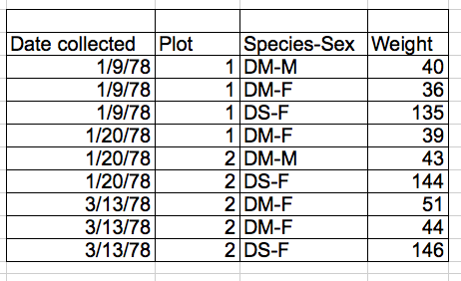
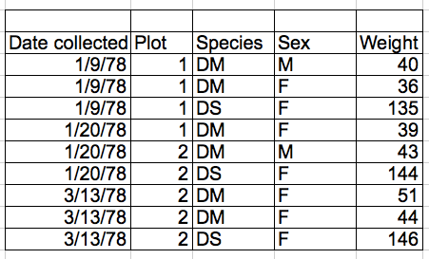

Slide 6
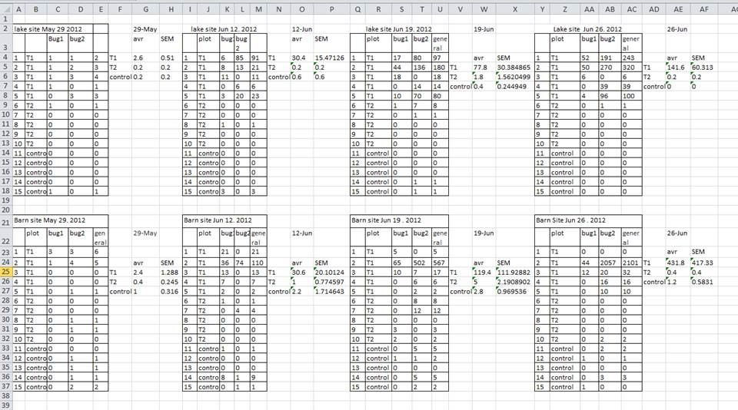

Slide 7
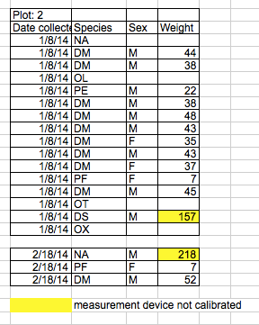
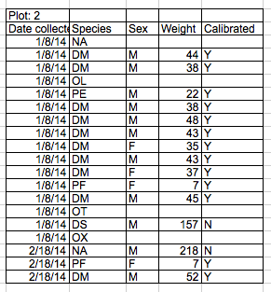

Slide 8
Exercise
15 min
Download and open survey_data_spreadsheet_messy.xls
Two field assistants conducted the surveys, one in 2013 and one in 2014, and they both kept track of the data in their own way.
Clean the messy data so that a computer will be able to understand it. Clean up the 2013 and 2014 tabs, and put them all together in one spreadsheet.
Do not forget of our first piece of advice, the create a new file (or tab) for the cleaned data, never modify the original (raw) data.

Slide 9
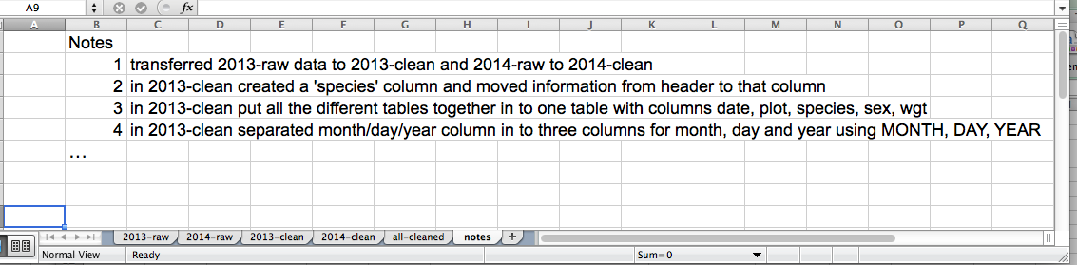

Slide 10
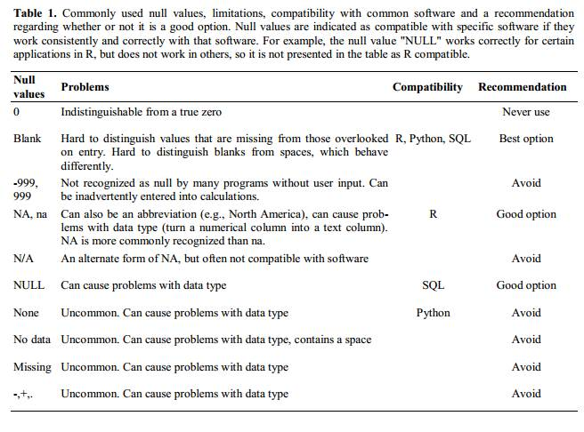

Slide 11
Field Names
good name | good alternative | avoid
Max_temp | MaxTemp | Maximum Temp (°C)
Precipitation | Precipitation_mm | precmm
Mean_year_growth | MeanYearGrowth | Mean growth/year
sex | sex | M/F
weight | weight | w.
cell_type | CellType | Cell type
first_observation | Observation_01 | 1st Obs.

Slide 12
Dates as data
Learning Objectives
Understand how dates are handled and formatted in spreadsheets
Manipulate dates stored in spreadsheets
Understand the caveats of the default formatting of the dates

Slide 13
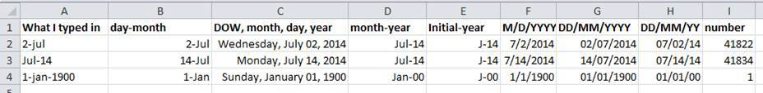

Slide 14
Exercise
What happens to the dates in the “dates” tab of our workbook if we save this sheet in Excel (in csv format) and then open the file in a plain text editor (like TextEdit or Notepad)? What happens to the dates if we then open the csv file in Excel?

Slide 15
Exercise
We’ve combined all of the tables from the messy data into a single table in a single tab. Download this semi-cleaned data file to your computer: survey_sorting_exercise
Once downloaded, sort the Weight_grams column in your spreadsheet program from Largest to Smallest.
What do you notice?

