Slide 1
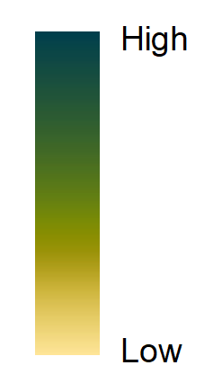


Land Cover
Forest Cover
The Greater Protected Ecosystem (GPE; outside of black lines) of a Park or Protected Area (PPA) includes the region surrounding it, connected through ecological and socioeconomic means. These were delineated by expanding into an area of equal size within the contiguous biogeoclimatic ecosystem classification zones.
Disturbances and Stressors
All layers are derived from 2015 satellite imagery. Forest data from 30m Landsat CFS NTEMS products; see Hermosilla et al. (2015). Human development data from VIIRS; see Elvidge et al. (2017).
Authors: Evan Muise, UBC (evanmuis@mail.ubc.ca), Dr. Nicholas Coops, UBC (Nicholas.coops@ubc.ca)

