Slide 1
Guide to use common_code
Dahmen Group
November 14, 2024

Slide 2
Summary
Common_code is a repository of commonly used functions for the Dahmen group that implements a variety of common functions.
The intent of common_code is to be a centralized living hub of these important functions.
As of November 2024, Jordan Sickle (sicklej0720@gmail.com) is the author and central maintainer of the code. By May 2025, this task will be covered by Ethan Mullen.

Slide 3
Git and github basics
Git is a local program that can track changes made in files on your system. This can be useful if you want to ensure you are able to track down issues with specific lines and stop having files named stuff like “analysis_working_v2_final_old.py”.
To make a repository, you need to tell Git which files to track changes in, add them to be possibly included in the repository (staged), and commit (save) the changes. These changes are tracked by a .git file which is contained in the root of the i.e. common_code directory.
You can access remote GitHub repositories if you are logged in via an email address and a local-remote SSH key pair. This connects your local git to the remote repository.
Some important functions:
git add x: Add file x (or the changes made to x) to be “staged” (i.e. ready to commit to the local GitHub repository)
git commit –m “Short description of change”: Commits the changes made to all added files with message “Short description of change”. All commits require a message, so please make sure it is short (~75 characters) and direct about what changes are made.
git status: Check which files have been changed compared to the last time you committed.
git diff x: Check the differences between your updated copy of x and the most recently committed version of x.
git restore x: Restore x to the state it was in the last time it was committed.
git remote add origin url: add branch “origin” to the remote repository (i.e. GitHub) at the given URL.
git pull: Pull the most recent version of the repository from the remote repository location.
Note that these commands must be called from within common_code!

Slide 4
How to use common_code: (1) Using Github
First, ensure that you have Git (the program that manages changes to repositories) installed and you are logged in to GitHub.
Git installed by default on Mac, but must be installed on Windows.
Git is the program, and GitHub is the online service that hosts the remote repository (code folder)
Create a GitHub account, then use Set up Git - GitHub Docs to create the local-remote SSH key pair for your account-computer pair.
See Set Up with Git and GitHub | Codecademy for more advice
Log into your GitHub account from the command line
By doing this, you’ll be able to “pull” (get code from) from a given GitHub URL into a local folder of your choosing.
The concept of Git is that you have a local key (for each computer) and a remote key (on your GitHub account) which are linked together so GitHub knows who you are.

Slide 5
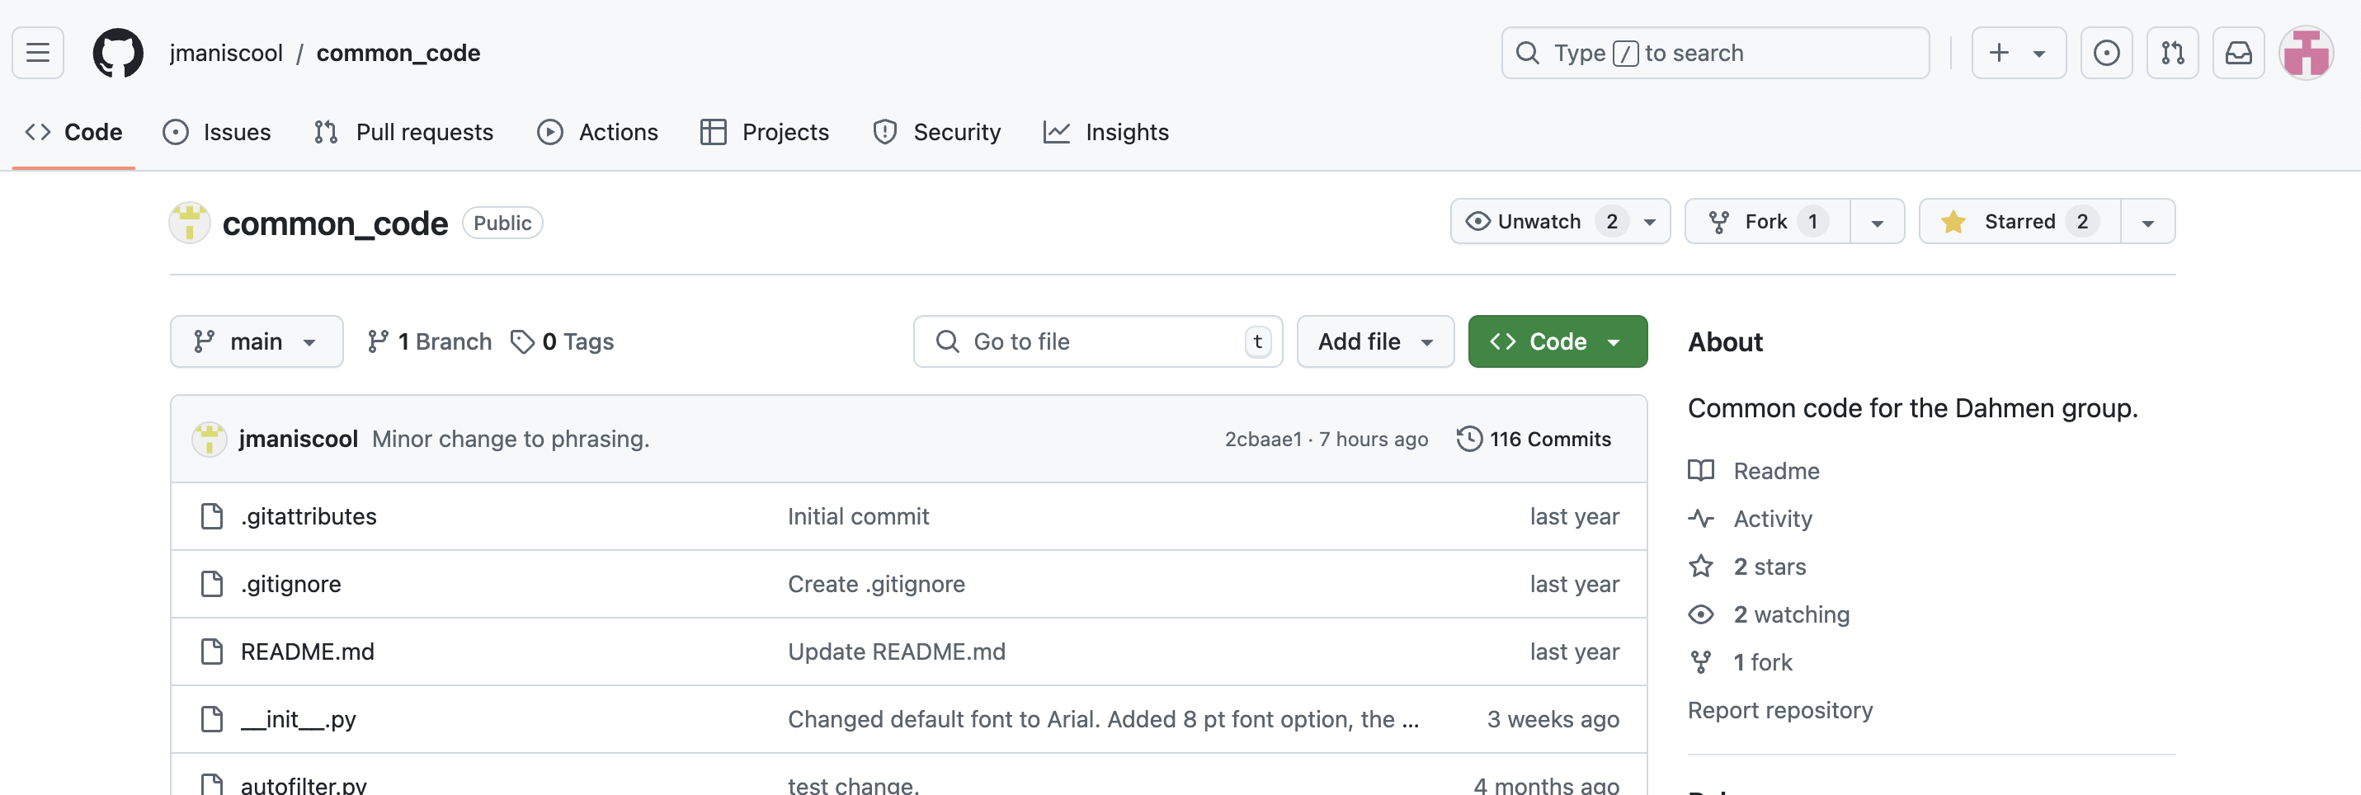
How to use common_code: (2) Forking the common_code repo to your GitHub account
“Forking” a repository (or “repo”) creates a copy of a package in your GitHub account that GitHub allows to be synced and compared with the original version
If you ever want to make a SAFE code upgrade suggestion in the future, this is necessary!
You can use forks to propose upgrades or fixes to the code which can be reviewed by Ethan + Jordan
On the common_code GitHub page (see below), click “fork”

Slide 6
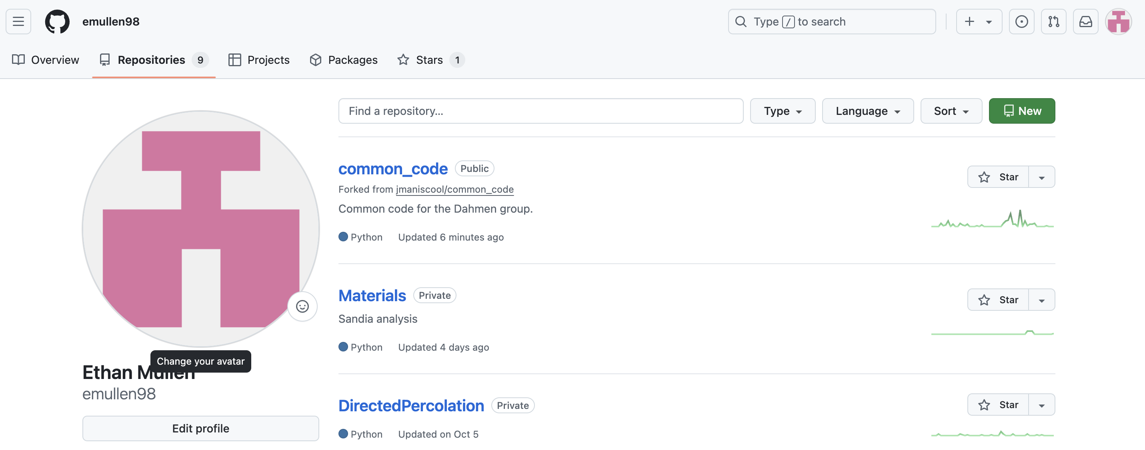
How to use common_code: (2) Forking the common_code repo to your GitHub account
Now if you go to “Your repositories”, you should see this:

Slide 7
How to use common_code: (2) Forking the common_code repo to your GitHub account
Every now and then, the owners of common_code will update the package with some edits, new files, etc.
Your forked version of the code will NOT automatically sync with the owners’ version!
So, you will need to occasionally check for updates

Slide 8
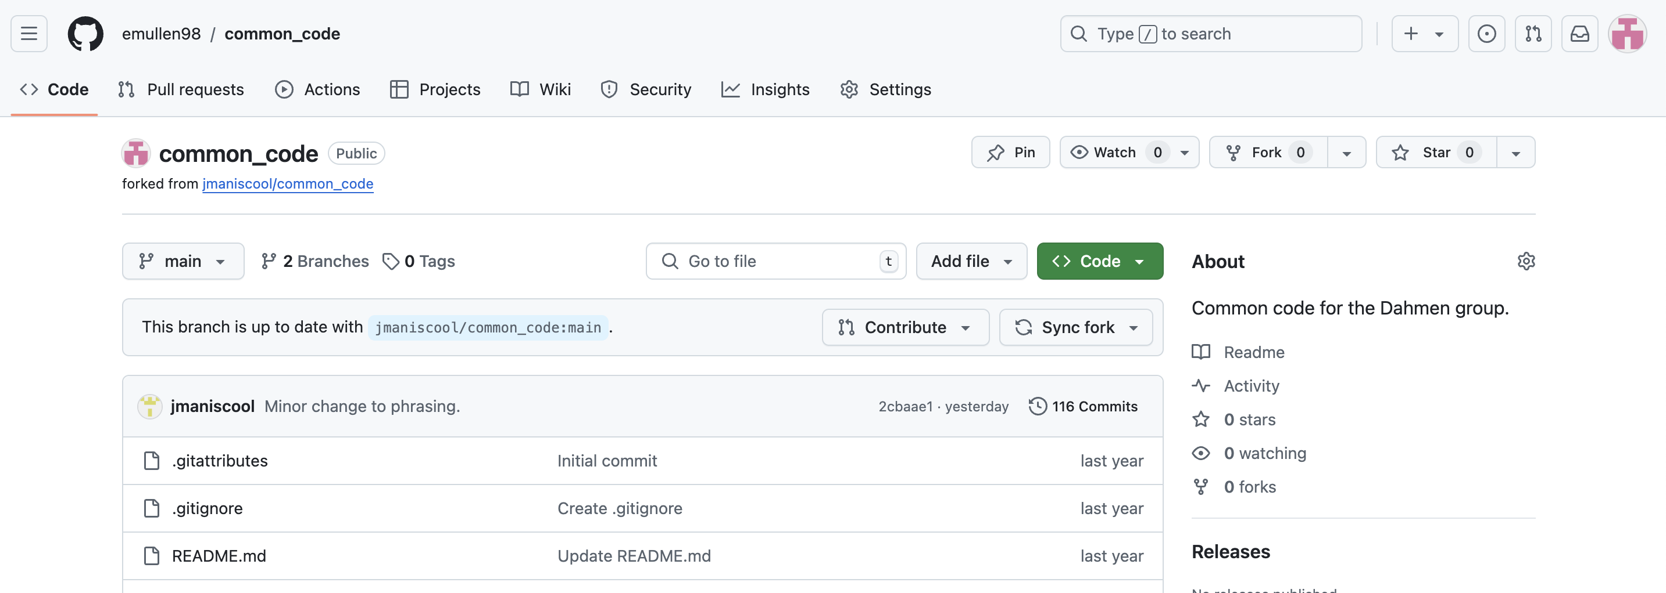
How to use common_code: (2) Forking the common_code repo to your GitHub account
Here is what my forked version of common_code looks like:
In my forked version of the repo
The main branch of my fork is up to date with Jordan’s

Slide 9
Aside: Full procedure for making safe edits to common_code
Fork the original repo to your GitHub account
Clone this forked repo to your local machine
Open a branch for making some edits
Consider a branch as a complete copy of the package; you can make edits in here safely without affecting the original forked repo (called the “main” or “master” branch)
When you’re done editing, push this new branch to your forked version of common_code
Submit a pull request to the owner(s) of common_code who will review the changes and merge everything if it looks OK
A “pull request” means that you are requesting the owner(s) of common_code to “pull” your edited version of the code into their version
Note that a “pull request” is different from the command “git pull”
Delete the temporary branch from BOTH your remote forked repo (in GitHub) and off your local machine IF the pull request gets approved & implemented

Slide 10
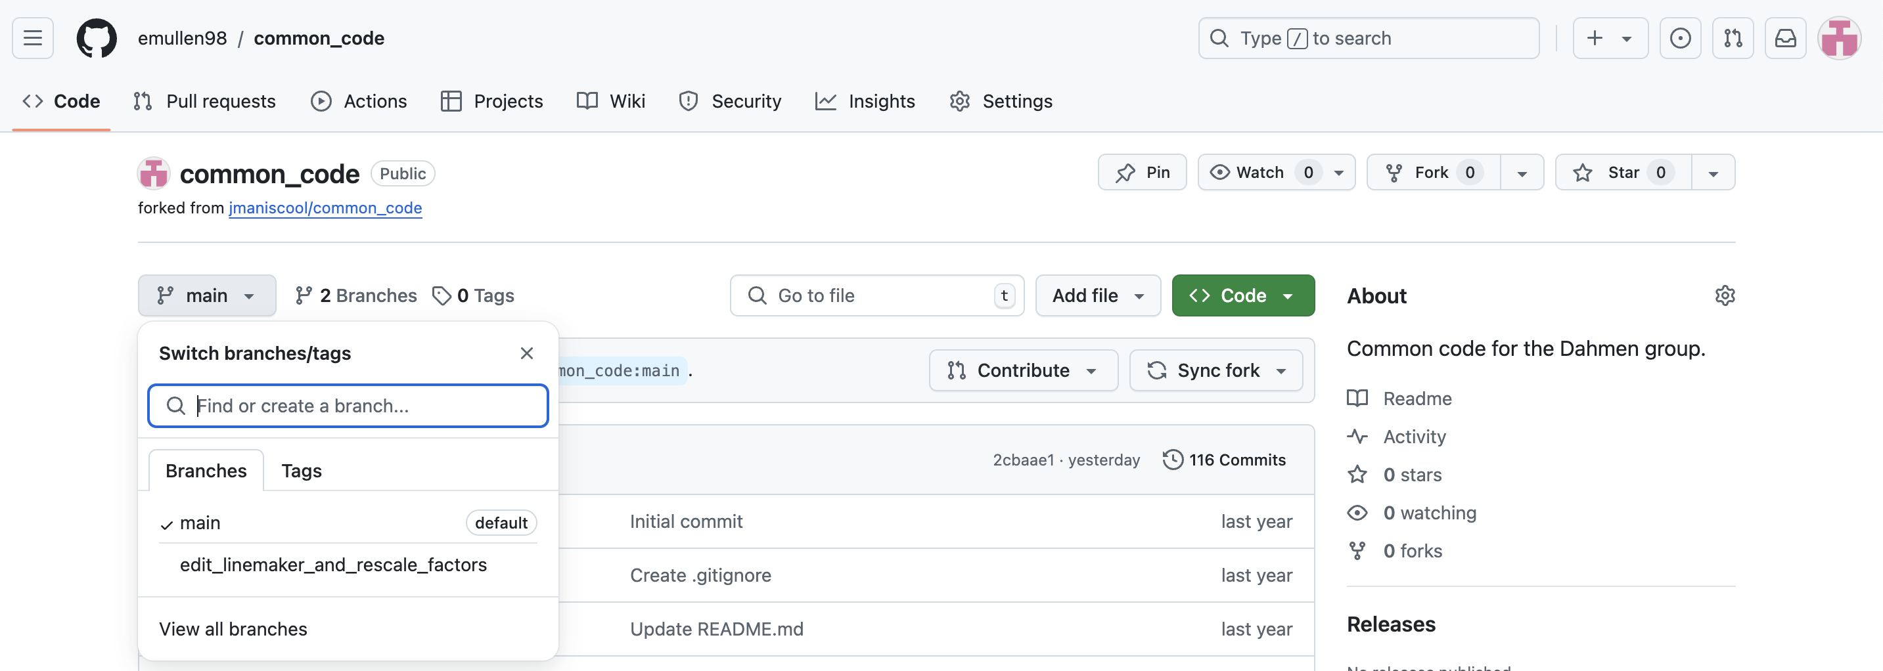
Aside: Full procedure for making safe edits to common_code
As an example, I’ve recently made a couple edits to two scripts in a branch I opened called “edit_linemaker_and_rescale_factors”
I have committed my changes to Git (updated the local repository) and pushed this branch (upload to github), so that now I have two branches in my forked version of common_code:
Currently my “main” branch is in sync with the original version of common_code

Slide 11
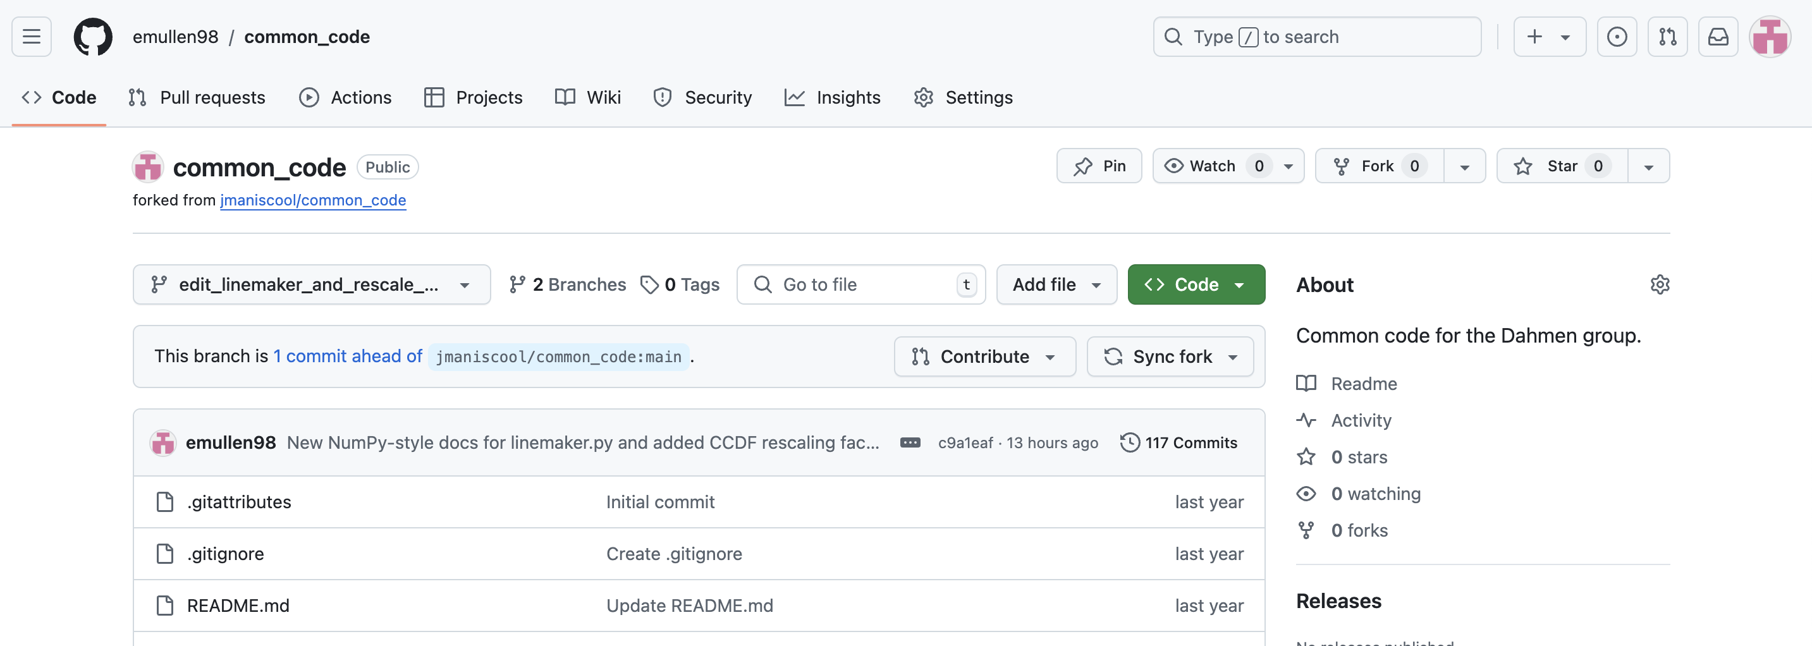
Aside: Full procedure for making safe edits to common_code
Now if I switch to this branch I made for my edits, you can see that my code is now slightly different from that in the original repo:

Slide 12
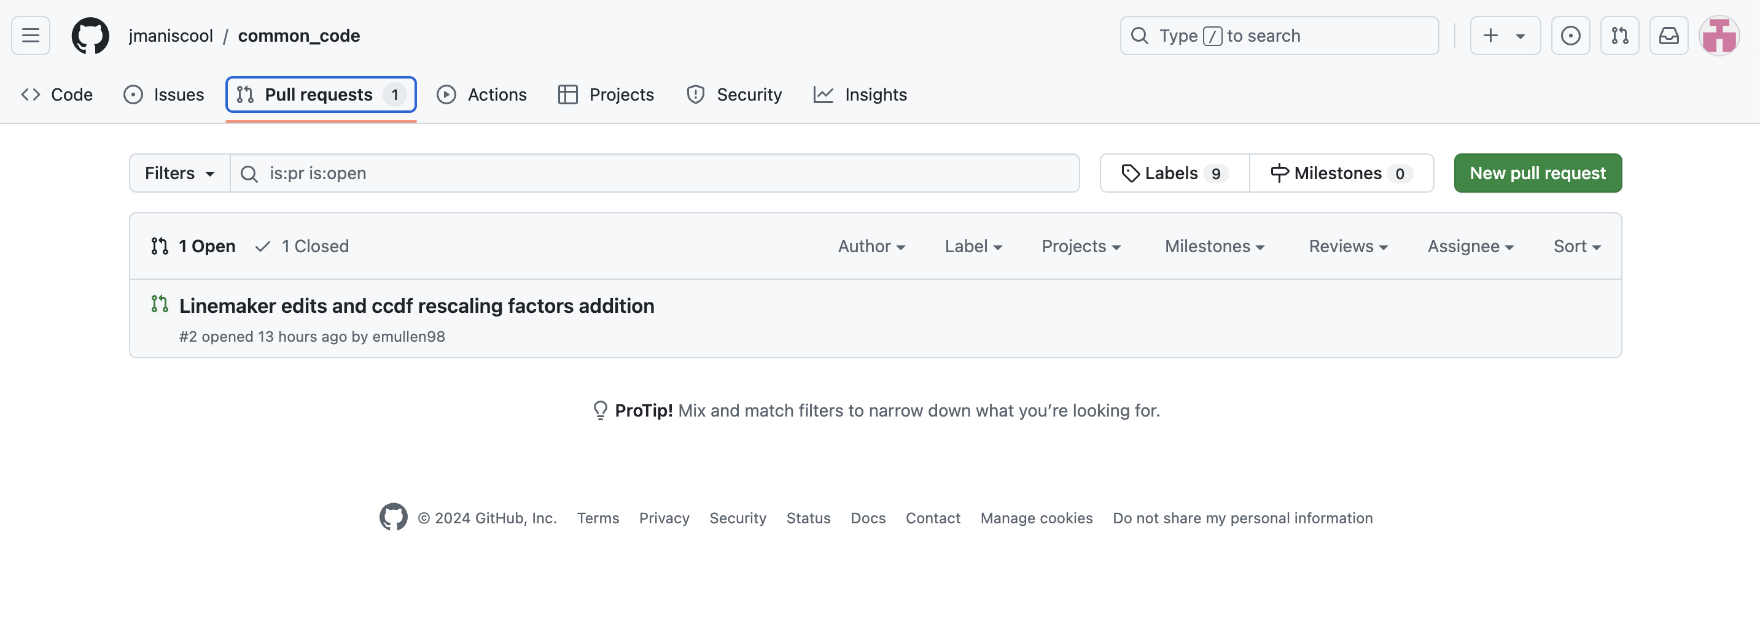
Aside: Full procedure for making safe edits to common_code
I have submitted a pull request to Jordan for him to implement these changes I have made, which I can check by going to the original repo:

Slide 13
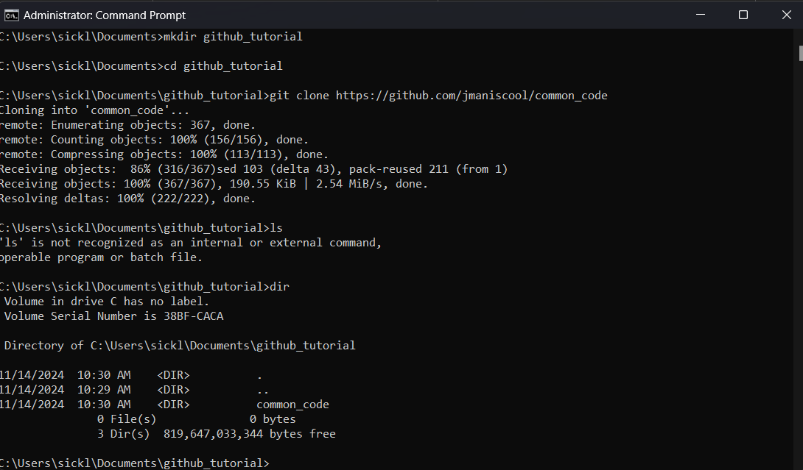
How to use common code: (3) Using a git pull to obtain a local copy of common_code
common_code should be cloned from the GitHub repository which is located at jmaniscool/common_code: Common code for the Dahmen group.
This will create a folder in wherever you run that command from.
Example on right shows Windows, but these will be minimally different in other OS.
While it is possible to clone a remote repo into multiple local folders, this can be cumbersome since each local copy needs to be individually synced via a “git pull” command.
The better way to do this is to clone common_code to a single master directory, then ensure that directory is on your Python’s system path every time you run it
This lets python “see” common_code so it can be imported from multiple locations. (i.e. how NumPy works)
To do this, at the beginning of every analysis script you must have:
import sys
sys.path.append(path_to_common_code)
Create the folder to hold common_code
Make a local copy (“clone”) the common_code repository from the URL it’s hosted at.
A common_code folder is created in the directory

Slide 14
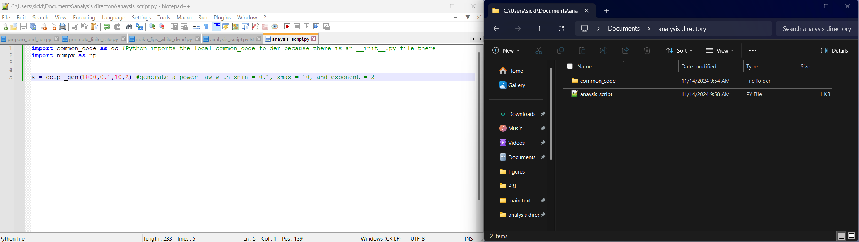
How to use common code: (4) accessing the functions
common_code is designed as a local library, which means it can be imported like other Python libraries but only if it can be seen by the analysis script.
The trick is that it has an __init__.py file which tells Python to treat the directory as a library. __init__.py also contains the names and locations for all functions accessible by common_code.
You can also access the functions from any analysis script if you have the following code at the beginning of the script (this is the suggested way!):
import sys
sys.path.append(path_to_common_code)

Slide 15
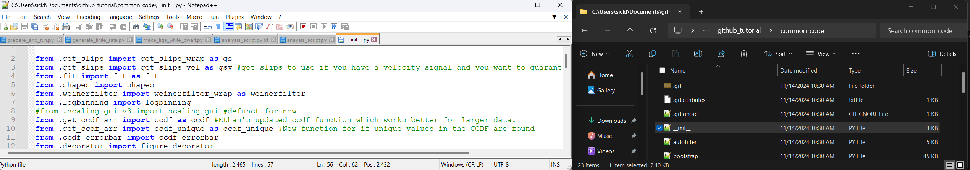
Understanding the functions defined in common_code
__init__.py tells Python the location and name of functions in each library
All libraries have at least one of these!
In example below, I show where get_slips() is defined.
If you import common_code, then you can access the get_slips_wrap() function defined in get_slips.py as common_code.gs().
I like to give common_code the local alias of cc so it can be more easily accessed. That is, I import common_code as cc.
If you make a change to common_code or have pulled a change from the repository, you will need to use importlib to reload the module as follows:
Import importlib
Importlib.reload(common_code)
Contents of __init__.py
How to call function from common_code.
.py file where the function is located (function is in common_code/get_slips.py)
Name of function in the .py file it’s defined in

Slide 16
Reporting issues
If you find any issues, you can report them by going to the common_code repo, then selecting the “issues” tab. This is located at Issues · jmaniscool/common_code.
When opening an issue, please include a minimal working example to show how the code is broken and what the expected behavior is.
The more specific you are, the better the fix will be (i.e. better documentation).

