Slide 1
Guide to use common_code
Dahmen Group
November 14, 2024

Slide 2
Summary
Common_code is a repository of commonly used functions for the Dahmen group that implements a variety of common functions.
The intent of common_code is to be a centralized living hub of these important functions.
As of November 2024, Jordan Sickle (sicklej0720@gmail.com) is the author and central maintainer of the code. By May 2025, this task will be covered by Ethan Mullen.

Slide 3
How to use common_code: (1) Using Github
First, ensure that you have Github installed and you are logged in.
Create a Github account, then use Set up Git - GitHub Docs to create the local-remote SSH key pair for your account-computer pair.
See Set Up with Git and GitHub | Codecademy for more advice
Log into your github account from the command line
By doing this, you’ll be able to “pull” (get code from) from a given github url into a local folder of your choosing.
The concept of git is that you have a local key (for each computer) and a remote key (on your Github account) which are linked together so github knows who you are.

Slide 4
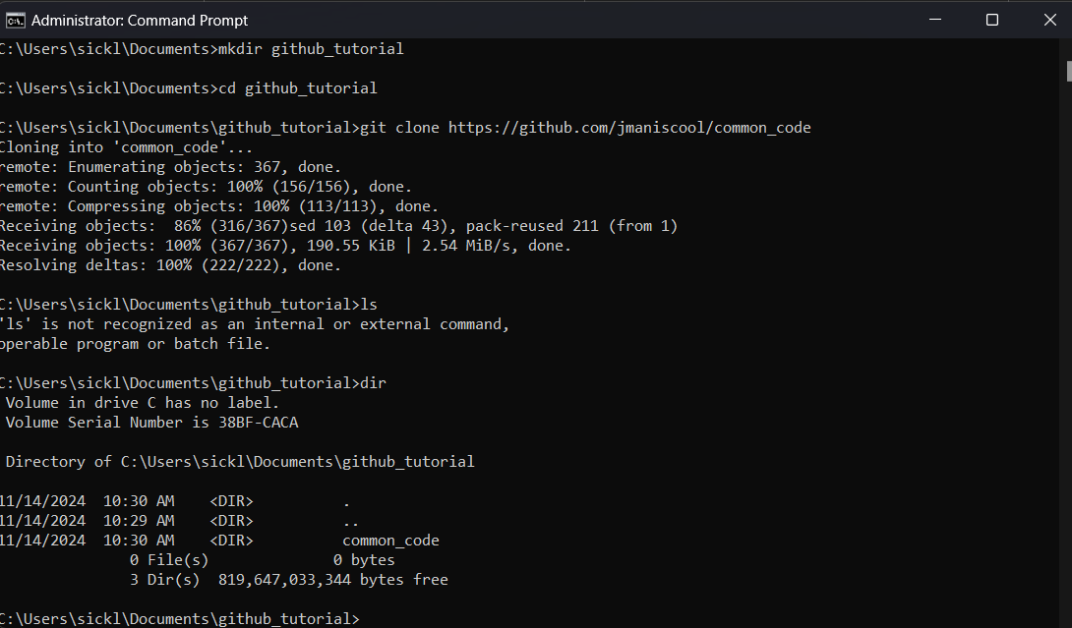
How to use common code: (2) Using a git pull to obtain a local copy of common_code
Common_code should be cloned from the github repository which is located at jmaniscool/common_code: Common code for the Dahmen group.
This will create a folder in wherever you run that command from.
Example on right shows Windows, but these will be minimally different in other OS.
Note that you can clone into multiple local repositories!
Jordan recommends that you have a different folder for each project, then clone common_code into each folder.
You will have to make sure your common_code is up to date in each copy by running “git pull” occasionally!
Create the folder to hold common_code
Make a local copy (“clone”) the common_code repository from the URL it’s hosted at.
A common_code folder is created in the directory

Slide 5
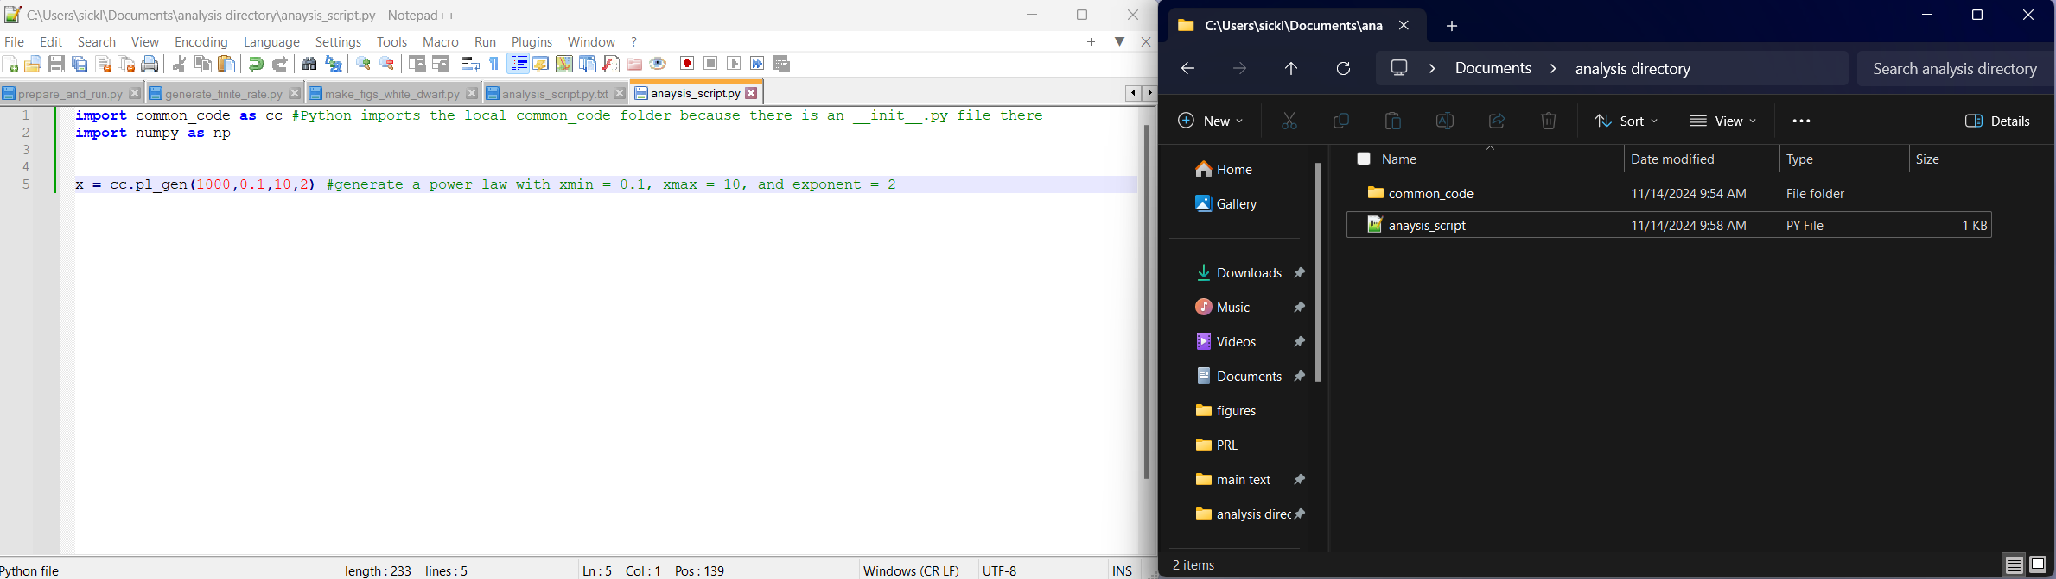
How to use common code: (3) accessing the functions
Common_code is designed as a local library, which means it can be imported like other Python libraries but only if it can be seen by the analysis script.
The trick is that it has an __init__.py file which tells Python to treat the directory as a library. __init__.py also contains the names and locations for all functions in common_code.

Slide 6
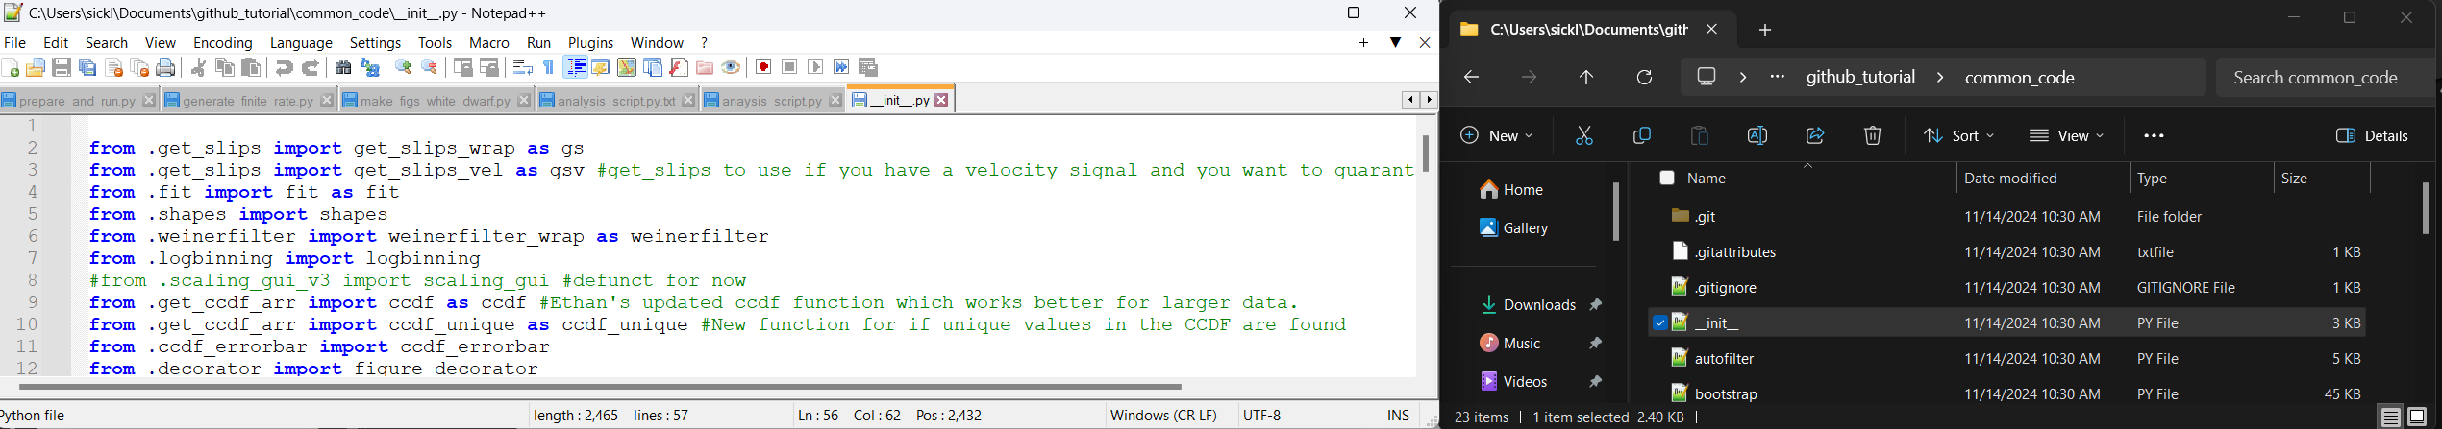
Understanding the functions defined in common_code
__init__.py tells Python the location and name of functions in each library
All libraries have at least one of these!
In example below, I show where get_slips() is defined.
If you import common_code, then you can access the get_slips_wrap() function defined in get_slips.py as common_code.gs().
I like to give common_code the local alias of cc so it can be more easily accessed. That is, I import common_code as cc.
If you make a change to common_code or have pulled a change from the repository, you will need to use importlib to reload the module as follows:
Import importlib
Importlib.reload(common_code)
Contents of __init__.py
How to call function from common_code.
.py file where the function is located (function is in common_code/get_slips.py)
Name of function in the .py file it’s defined in

Slide 7
Github basics
Git is a local program that can track changes made in files on your system. This can be useful if you want to ensure you are able to track down issues with specific lines and stop having files named stuff like “analysis_working_v2_final_old.py”.
To make a repository, you need to tell git which files to track changes in, add them to be possibly included in the repository (staged), and commit (save) the changes. These changes are tracked by a .git file which is contained in the root of the common_code directory.
You can access remote github repositories if you are logged in via an email address and a local-remote SSH key pair. This connects your local git to the remote repository.
Some important functions:
Git add x: Add file x (or the changes made to x) to be “staged” (i.e. ready to commit to the local github repository)
Git commit –m “Short description of change”: Commits the changes made to all added files with message “Short description of change”. All commits require a message, so please make sure it is short (~75 characters) and direct about what changes are made.
Git status: Check which files have been changed compared to the last time you committed.
Git diff x: Check the differences between your updated copy of x and the most recently committed version of x.
Git restore x: Restore x to the state it was in the last time it was committed.
Git remote add origin url: add branch “origin” to the remote repository (i.e. github) at the given url.
Git pull: Pull the most recent version of the repository from the remote repository location.
Note that these commands must be called from within common_code!

Slide 8
Reporting issues
If you find any issues, you can report them by going to the common_code repo, then selecting the “issues” tab. This is located at Issues · jmaniscool/common_code.
When opening an issue, please include a minimal working example to show how the code is broken and what the expected behavior is.
The more specific you are, the better the fix will be (i.e. better documentation).

