Slide 1
New Jersey
In-Store Sales Analysis
Data Analytics Capstone | SQL + Excel
Prepared by: Ezekiel E. Munoz-Perez
New Jersey Sales Capstone • 1/6

Slide 2
Project Overview
A four-year look at New Jersey in-store sales
Territory
Time Period
Sales Records
In-Store Revenue
New Jersey
Jan 2022 – Dec 2025
38,195
$5.18 million
Goal: compare sales performance across store locations and product categories.
Use SQL to query and summarize the sales database, then Excel to visualize patterns.
Focus: identify differences between stores and categories for further investigation.
New Jersey Sales Capstone • 2/6

Slide 3
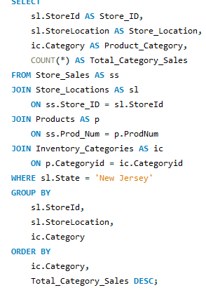
SQL Analysis
Example query used to summarize category sales by store
Joins sales records to store locations, products, and category names.
Filters to New Jersey stores only.
COUNT(*) totals sales records for each category at each location.
New Jersey Sales Capstone • 3/6

Slide 4
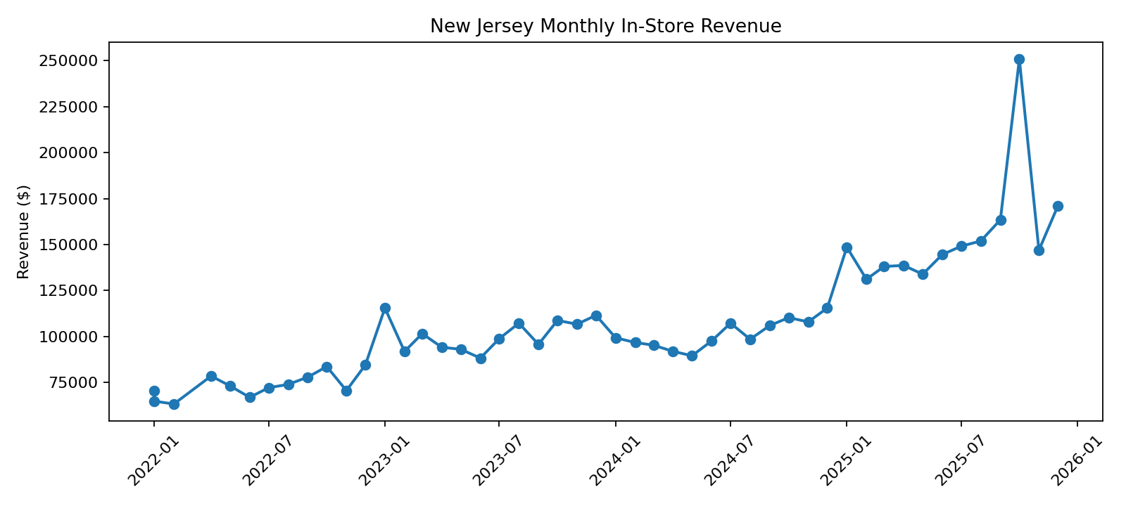
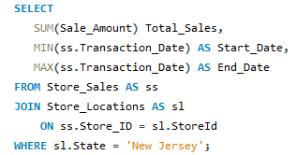
Revenue Trend
Monthly in-store revenue across the project period
Total NJ in-store revenue: $5,175,405.87
Data spans January 2022 through December 2025.
Monthly variation can help identify seasonal patterns and periods for follow-up.
New Jersey Sales Capstone • 4/6

Slide 5
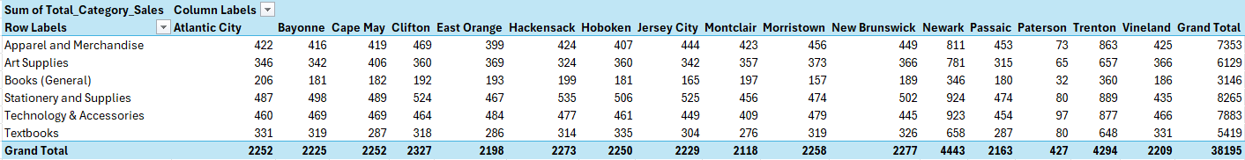
Category Comparison by Store
Excel PivotTable: sales records by category and location
PivotTable shows category totals by store.
Grand totals help compare overall category volume.
Large differences can flag areas to investigate—not automatically problems.
New Jersey Sales Capstone • 5/6

Slide 6
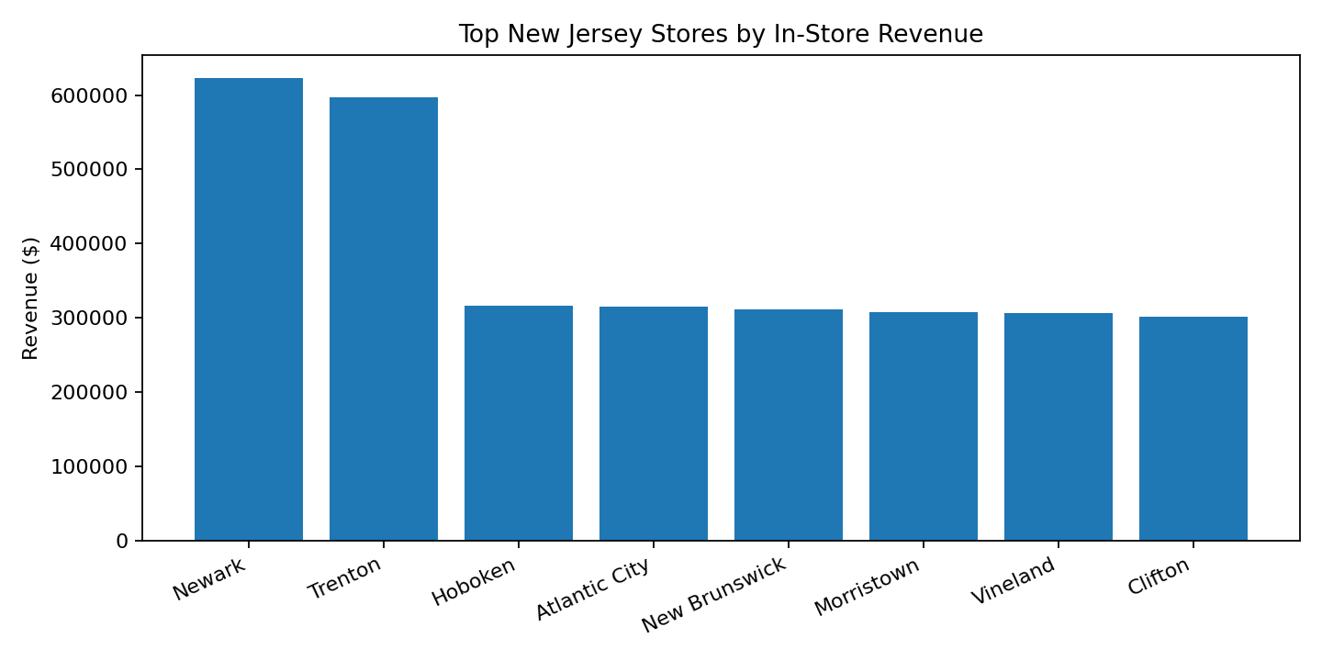
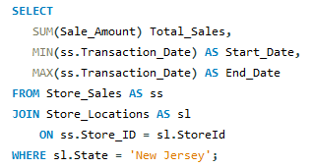
Store Performance & Recommendations
Use the results to guide next steps
Newark leads the store revenue ranking in the dataset.
Compare category-level differences before recommending inventory or promotion changes.
Validate whether sales records represent individual transactions; the source has no unique transaction ID.
Next: review the Excel PivotTable and discuss findings with stakeholders.
New Jersey Sales Capstone • 6/6

