Slide 1
MY SHOP MY WORLD
PREPARED BY:R.dileep
v.v.prudhveeraj

Slide 2
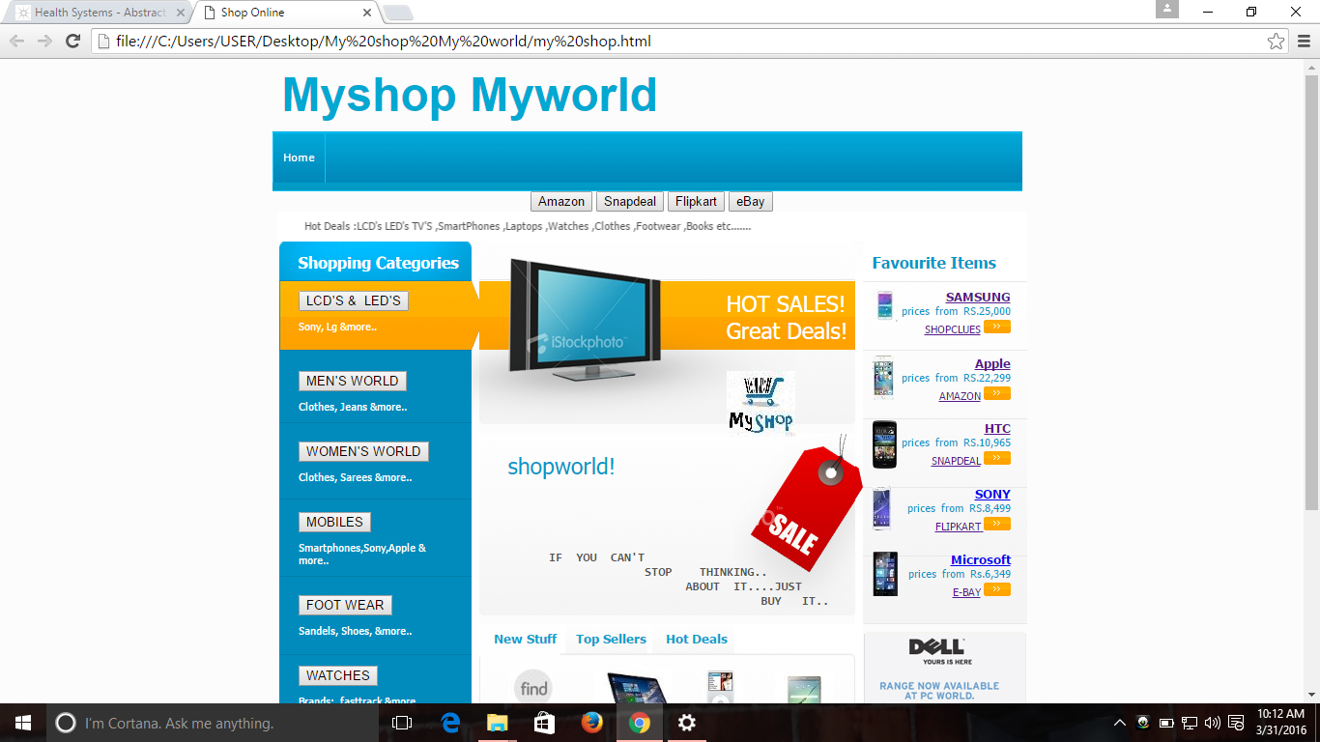
Select any button and go to particular website

Slide 3
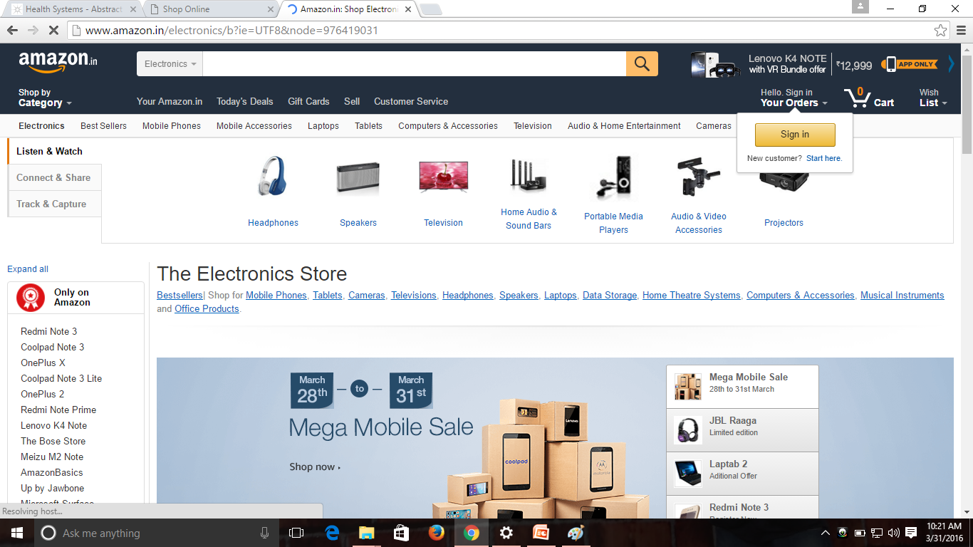
We are click for mobiles it will be connect to Amazon

