Slide 1

SIDDARTHA INSTITUTE OF SCIENCE AND TECHNOLOGY
Review on
“VIDYA SAHAY”
Under the Esteemed guidance of
Mr.M.Lokesh, M.Tech.
Presented By
R.Indhuja(124E1A0519)
G.Pavani(124E1A0531)
M.Sudhakar(134E5A0501)
K.Prashanthi(124E1A0533)
K.Jayanthi(124E1A0520)

Slide 2
Abstract:
Intention->Specifying the particular donors
Needy students
Types of scholarships
Students can directly apply for the scholarships
Job seeking websites

Slide 3
Existing:
Websites like “www.scholarships in india.com”, ”www.ngos.com”.
Individual websites for each domain
It lists all the donors throughout India

Slide 4
Disadvantages of Existing :
No particular specification for the organizations
It doesn’t group the organizations based on the criteria
Website url’s won’t be provided in the existing websites

Slide 5
Proposed:
“Vidya Sahay” provides the category of scholarships
Scholarships with respective organization
Google map
“Self employment”
“Job seeking websites”
“Google search engine”

Slide 6
Advantages of Proposed:
Students can be easily benefited
Organization url’s can be provided
Domain based scholarships
Google search engine
Google map shows the address of particular organization

Slide 7
Technologies:
Linux in vmware
Zorin
Genie editor
Front end: HTML5 with Bootstrap framework
Back end: PHP
Database: Postgresql

Slide 8
Hardware requirements:
Minimum I3 processor
Minimum 100gbHard disk
Minimum Ram should be 3gb
1)2gb for vmware
2)1gb for disk space

Slide 9
Modules
User
Admin
Scholarship Organization Detail
Search engine support
Job Seeking Websites

Slide 10
Vidya sahay
Fill the registration form
Database
Displays list of organizations with apply button
Domain and categories
Job seeking websites
Back to home page
Architecture

Slide 11
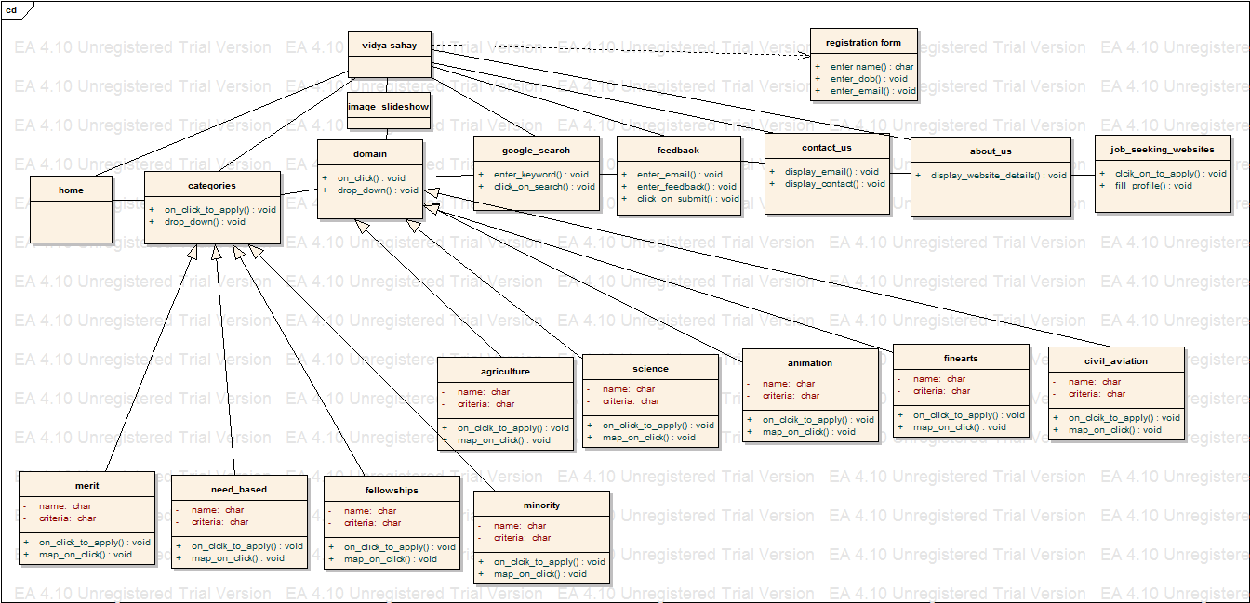
UML diagrams:
Figure: Class diagram

Slide 12
Figure:Use case diagram

Slide 13
Sequence diagram

Slide 14
Figure:Collaboration diagram

Slide 15
Figure:Activity Diagram

Slide 16
Figure:State chart diagram

Slide 17
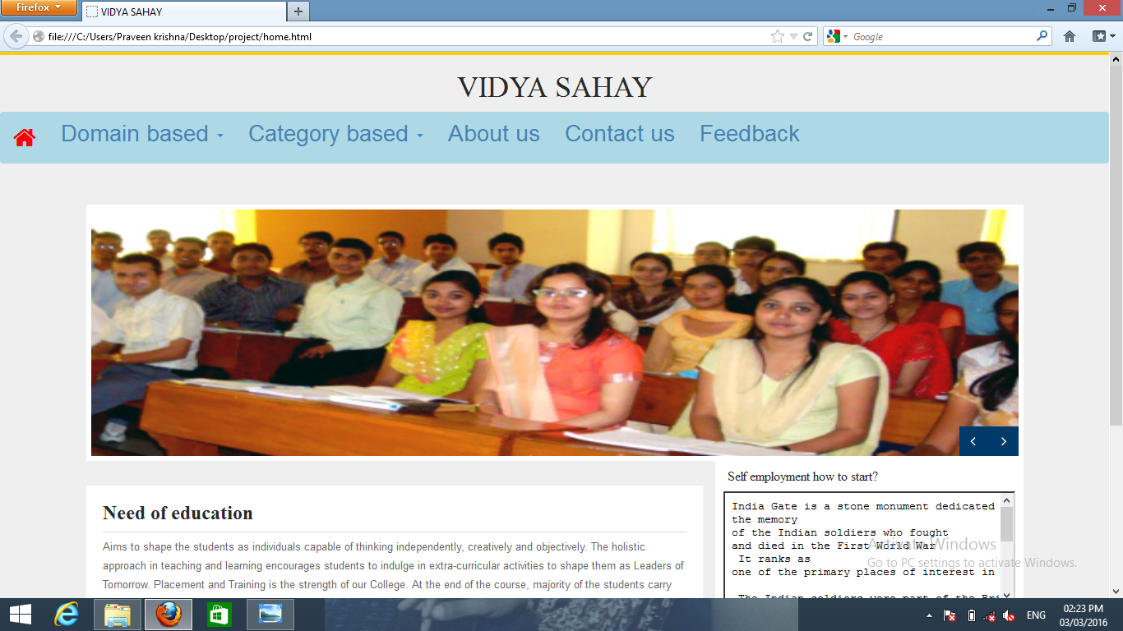

Slide 18
Conclusion:
Students can continue their higher education with good future
Direct interaction
Tips for memory power and self employment

Slide 19
THANK YOU

