Slide 1
PROJECT ON
FOOD RECIPES

Slide 2
TEAM NAME
7 TB

Slide 3
ABSTRACT
Our website templates are created with inspiration, checked for quality and originality and meticulously sliced and coded. What's more, they're absolutely free! You can do a lot with them. You can modify them. You can use them to design websites for clients, so long as you agree with the Terms of Use. You can even remove all our links if you want to.
If you're experiencing issues and concerns about this website template, join the discussion on our forum and meet other people in the community who share the same interests with you.

Slide 4
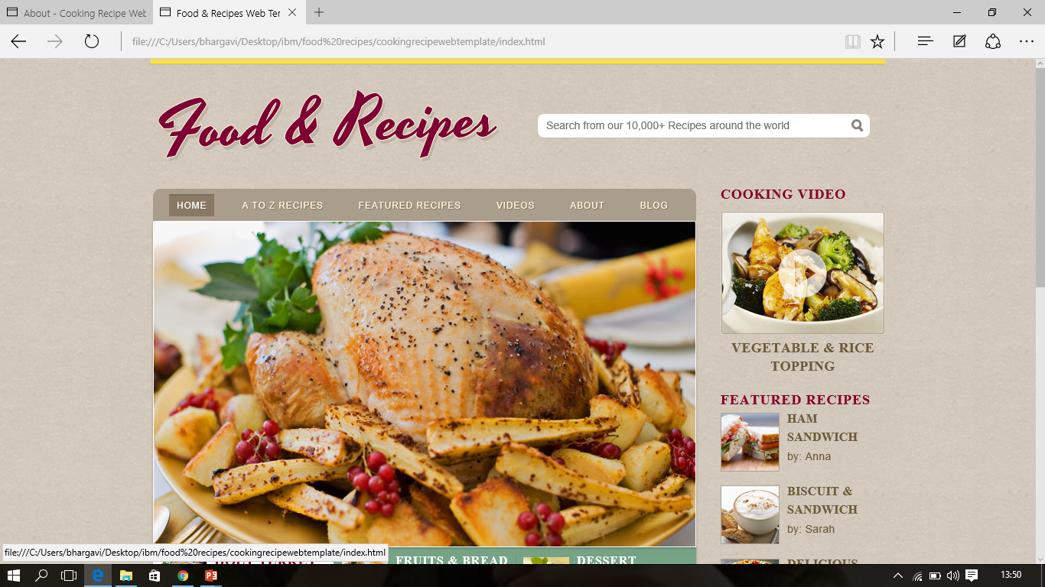

Slide 5
THANK
YOU

