Slide 1
PROJECT ON
FROZEN YOGURTSHOP

Slide 2
TEAM NAME
GOLDEN STRIKERS

Slide 3
ABSTRACT
Our website templates are created with inspiration, checked for quality and originality and meticulously sliced and coded. What’s more, they’re absolutely free! You can do a lot with them. You can modify them. You can use them to design websites for clients, so long as you agree with the Terms of Use. You can even remove all our links if you want to.

Slide 4
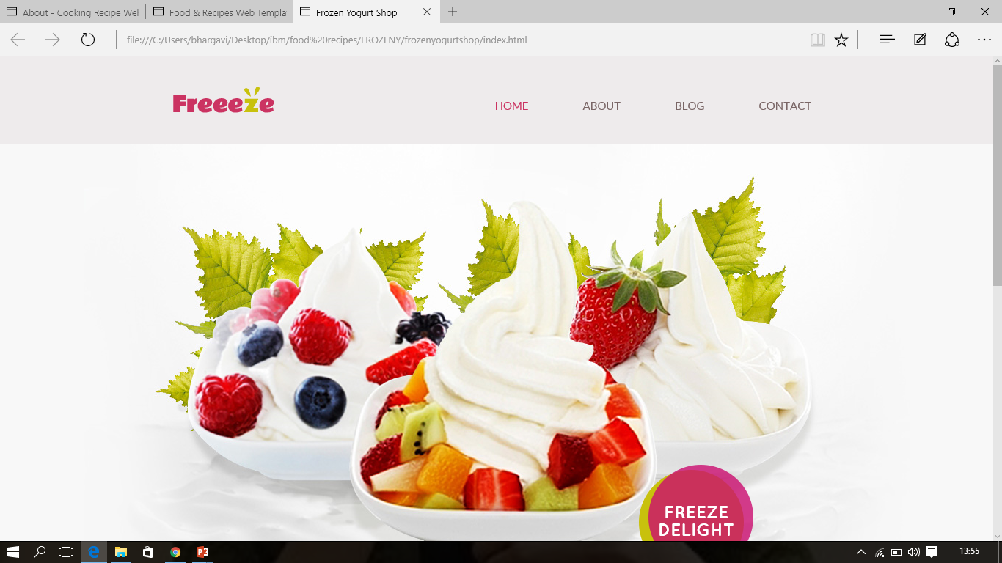

Slide 5
THANK YOU

