Slide 1
PERSONAL STORAGE
Presented by
K. DEVI

Slide 2
TEAM NAME
Creative Changers

Slide 3
Abstract
This is the web application for to store the personal details, like certificates, photos, resumes, and all family information and etc. This application used for each and every people personally.
In this application also we can store the secret passwords and mail ids for the feature purposes. And this application build by using the HTML, Bootstrap, and JavaScript.

Slide 4
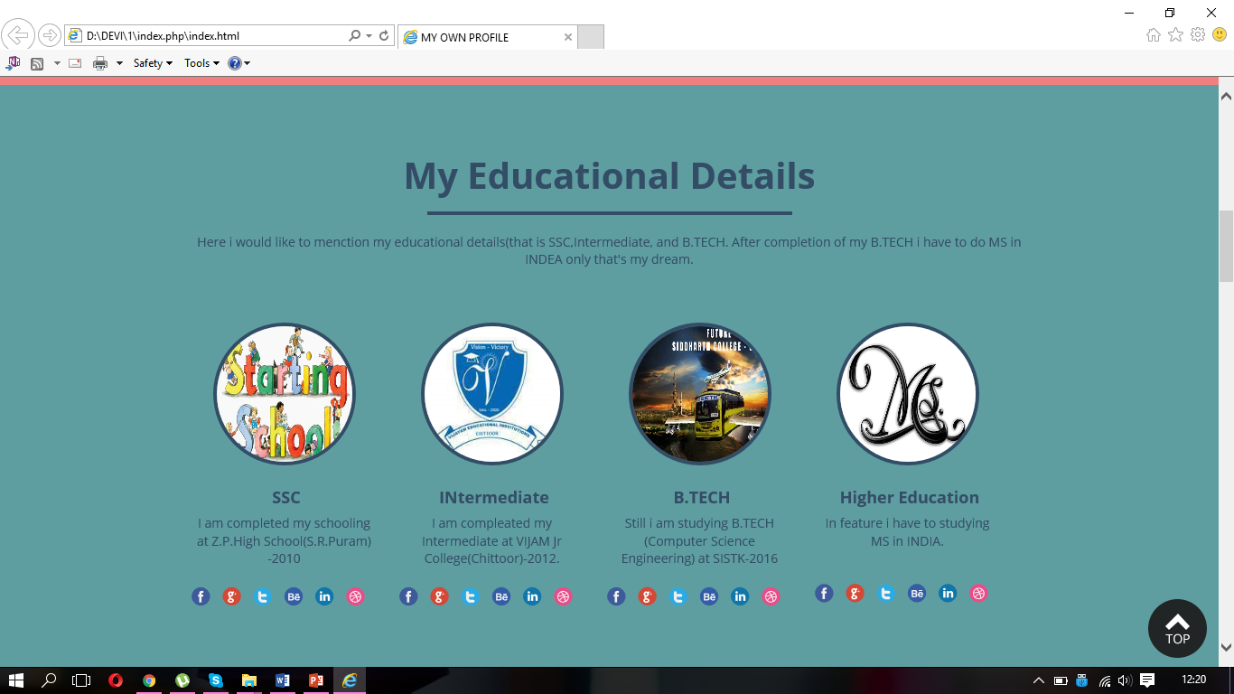

Slide 5
Thank You

