Slide 1
SAHAYA
Developed By
S.Suneel Kumar,
114E1A0549.

Slide 2
Abstract
Intention->Pass the details of “The Government schemes” to the “society”.
Many people not aware of government schemes and subsidies.
Both central and state government schemes are here.

Slide 3
Abstract continue…
Our main intention is to reach that information to them in a single source of website.
This website was developed on HTML .

Slide 4
Introduction
India is still in developing stage.May be “Illiteracy” is one of the reason.
“Sharing” is one of the better way to make changes.
The main theme of our application is to share the information regarding Gov.schemes.

Slide 5
Architecture
Schemes
provider
Schemes
data
Data
base
Queries?
Beneficiary

Slide 6
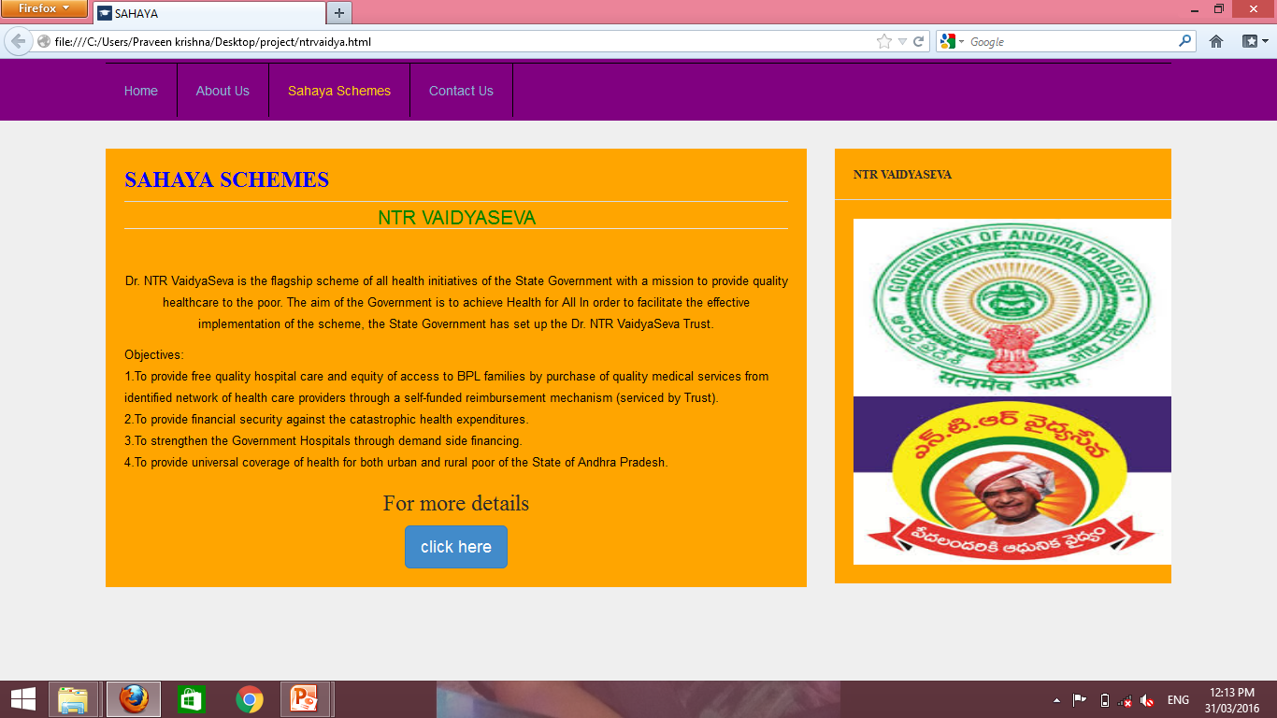

Slide 7
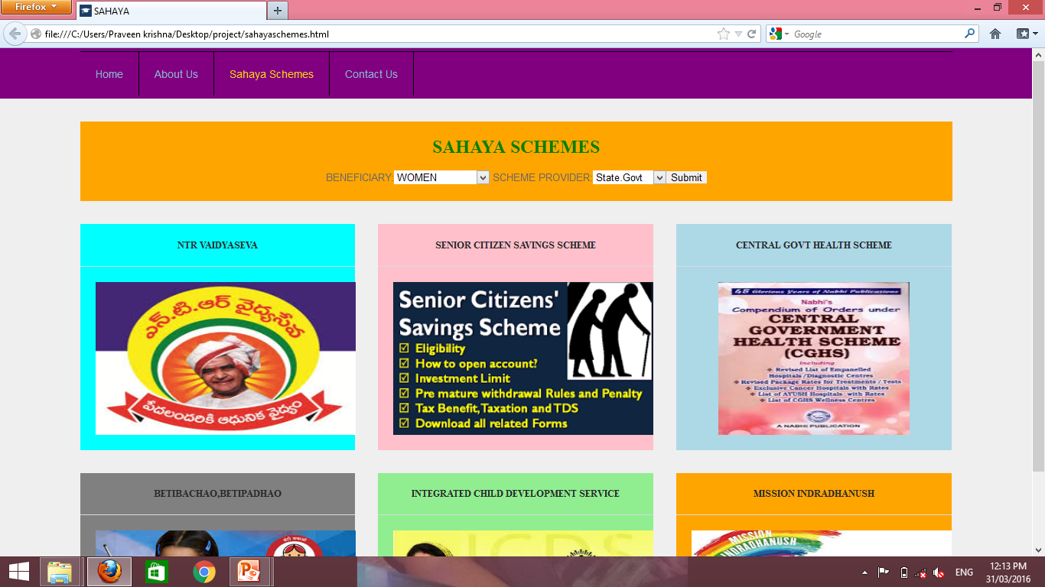

Slide 8
THANK YOU

