Slide 1




Rocking Trials with Clinical Data Literacy
Melanie Hullings and Emily Murphy

Slide 2
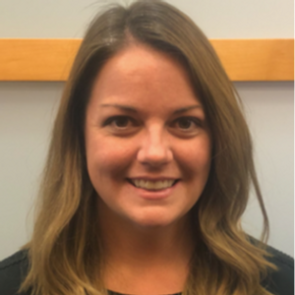
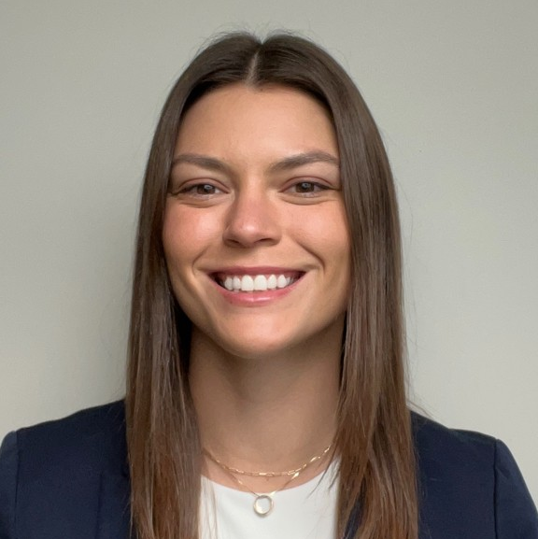
Melanie Hullings
Director, Clinical Data Analytics & Programming
Emily Murphy
Sr. Statistical Data Analyst, Formation Bio
Notes:
[Mel] Hi I’m Mel Hullings, Director of Clinical Data Analytics & Programming at Formation Bio, a tech-enabled drug development company. My prior experience was primarily in implementing bioinformatics solutions at clinical research sites to optimize clinical data quality and the clinical trial experience. I lead a team of clinical data scientists using Posit and other tools to unlock real-time data insights for our clinical trial and drug development teams. And this is my team member Emily.
[Emily] Hi I’m Emily… Emily Murphy is an accomplished Sr. Statistical Data Analyst who champions the mission of data-driven clinical decision making at Formation Bio. Emily combines her background in traditional pharma at Pfizer with her experience in tech to drive the company’s growth and innovation. At Formation Bio, Emily is using R-based solutions to optimize critical aspects of clinical drug development, enabling more efficient trial design, faster trial completion, and higher quality trial data.

Slide 3





Welcome to the jungle… of miscommunication
Clinical Operations
Engineering, Tech, & IT
Notes:
Analogy: like playing in a band w musicians from diff genres. They both are talented musicians individually & have overlapping core skill sets BUT are having communication problems across genres
Akin to the relationship between clinical and technical teams in a pharma company. Clinical doesn't understand technical language and technical does not understand clinical language

Slide 4


Welcome to the jungle… of collaboration!
Internship
Clinical Operations
Engineering, Tech, & IT
Notes:
What if you gave both musicians a way to align themselves. In case of the analogy that could be sheet music. Both musicians can read sheet music regardless of genre to get on the same page
That’s the idea behind the internship we ran internally

Slide 5
Biometrics teams share skills with clinical & technical orgs
Clinical Operations
Biometrics
Engineering, Tech, & IT
Notes:
Biometrics positioned well to help with the translation: have clinical background and hard tech skills: programming & advanced degrees

Slide 6

Goal #1: increase visibility of Biometrics team
Clinical Operations
Biometrics
Engineering, Tech, & IT
Notes:
Work very cross functionally and cover wide scope of clinical data from conception & creation to analysis & interpretation. Often overlooked/hand-waived org at a company - our goal was to show the value of the skills a biometrics team has

Slide 7
Goal #2: cross-train Clinical & Technical teams…
Clinical Operations
Biometrics
Engineering, Tech, & IT
Goal
Goal
Notes:
Goal to increase understanding of what each other function does

Slide 8
…resulting in an org with more shared understanding
Clinical Operations
Biometrics
Engineering, Tech, & IT

Slide 9

A new function on Biometrics catalyzed this movement
Typical Biometrics Team
New Function
Biostatistics
Clinical Data Analytics & Programming (CDAP)
Data Management
Advanced Analytics
Data Science
Statistical Programming
Notes:
New function in biometrics that’s more technical identified the need for this shared understanding. Pull clinical to be more technical and tech to have deeper understanding of clinical

Slide 10



Internship curriculum to drive understanding of clinical data lifecycle & to provide technical skills
Clinical Data Lifecycle
Notes:
Clinical data lifecycle: data conception & creation to data analysis & interpretation
Protocol → data capture → data analysis (SP & CDAP) → results (FDA submission & data driven decisions)
Also R prog skills to augment workflows

Slide 11

Internal program open to all teams increased transparency
Leadership Team
Research & Development
Tech
Biometrics
ClinOps
Product
Engineering

Slide 12

Clinical context empowers teams and increases impact
Before Internship
Engineering
CDAP
Product
Result
Impact
VS
After Internship
Engineering
CDAP
Product
Clin Ops
Result
Impact
Notes:
Add to results?

Slide 13




R programming skills augment workflows to increase efficiency & quality of clinical teams
Before Internship
Translate needs
Backlog
Analysis
Clarify request
Data-driven insight
VS
After Internship
Analysis
Data-driven insight
Notes:
Reduce need to translate request to service desk - can have lots of back and forth - not efficient
Just have requester program themselves since now they have the skills to!

Slide 14
Questions?

Slide 15
Thank You
Melanie Hullings (melanie@formation.bio)
Emily Murphy (emurphy@formation.bio)

