Slide 1

Making the RAs Happy!
Peak Project | MATH 335 |Murun Enkhtaivan

Slide 2
Introduction
Concordia Residence Life office is in charge of six traditional halls.
Director’s Assistant creates a schedule based on RAs weekly availability.
AVAILABLE VS NOT AVAILABLE
RAs are sometimes assigned to shifts that they do not like and have to work the same shift for the entire semester.
Causing an uneven distribution of desk hours.
AVAILABLE VS UNAVAILABLE
AVAILABLE UNAVAILABLE PREFERRED

Slide 3
Modelling Process - Constraints
1. All shifts should be filled by exactly 1 person.
2. A worker is not allowed to work more than 5 consecutive hours.
3. Student workers’ availability as from the survey (figure (i)).
4. Each student worker cannot work more than 5 hours in a week

Slide 4
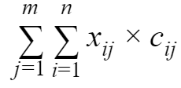
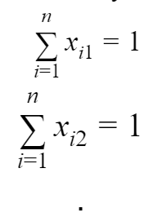
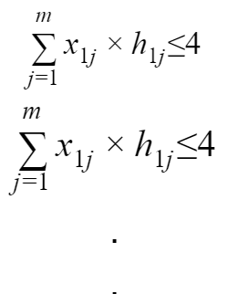
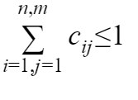
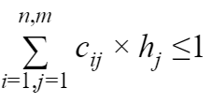
Modelling -Detailed
Max:
s.t.
i = RAs (1…….n);
j = Available Shifts (1……..m);
k = Days (1(for Monday)………(7 for Sunday))
C_{ij} = Preference/Availability/Unavailability from RAs
X_{ij} = Solution for preferred schedule
H_{j} = Hours in a shift;
H_{kj} = Hours of all shifts in a day;
C_{ij} x X_{ij} = Satisfaction/Happiness
All shifts should be filled by exactly one person:
Any worker is not allowed to work 5 or more consecutive hours:
Student worker’s availability:
Each student worker cannot work more than 5 hours in a week:

Slide 5
Implementation
My model is beneficial and flexible as it allows DAs to make changes to the schedule whenever required.
By implementing operations research technique known as the Big M method, our model penalizes the unavailability option with a higher value and renders it ineffective in the model. Moreover, ‘1’ and ‘0’ are assigned to preferred times and available (but not preferred) times respectively.
After the juicy part of finding the best shift for an employee, the model’s objective function calculates the happiness level of the group by multiplying the resulted value from the model of either ‘0’ or ‘1’ for each employee with the preferred value (‘0’ or ‘1’) provided in the schedule for the shift and adding the same for all employees.

Slide 6
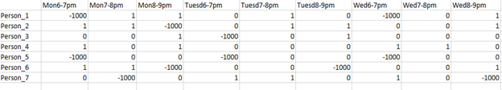

Implementation- Example

Slide 7
Implementation- Example

Slide 8
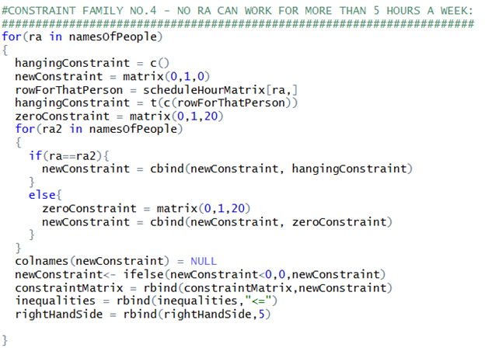

Implementation Example

Slide 9
Implementation Example

Slide 10
Implementation Example

Slide 11

Implementation Example

Slide 12
Critique
The model will target to get maximum result except in the case of unexpected scenario like no RA preferring to work in a shift although available.
The model can only break if no one is available to work a shift thus giving indication for the DAs to hire someone who is not in Res Life. Ex: Weekly staff meeting time.
The model model can get complicated if there are more complicated student schedules or there are schedules that change days in the calendar.
My program is not functioned with the option for workers to work under five hours between two days because the current schedule restricts that event.
However, the program is robust in the sense that it does what it needs to and in a effectively and satisfying manner.

Slide 13
Conclusion/ Recommendation
The final optimal solution is binary assigning values of 1 for which the worker should take the shift and 0 for which they should not and someone else should be preferred before them without any conflict
Although, it might be difficult for DAs to adjust to the program, there is a mutual benefit for the RAs and DAs in a long term basis as the RAs get their preferred shifts and the DAs do not have to stress about doing it on their own.
From results, I would recommend the Residence life to this our model in the future to assign the workers at the desk. This model seamlessly works to erase all potential conflicts of the workers and assign an appropriate time slots to work.

