Slide 1
BELLABEAT
Presented by: Elvis Musonera
Last Updated: February 21st , 2023

Slide 2
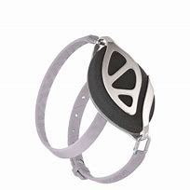
Agenda
Objective
Short Introduction.
My story (Data)/ Trends
Conclusion/Recommendations
Appendix

Slide 3

Objective
Conduct research on current trends in smart device usage and determine how these trends can be applied to Bellabeat’s customers and marketing strategy.

Slide 4
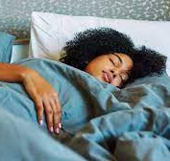
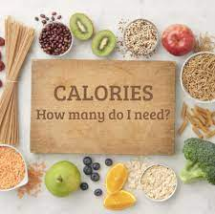

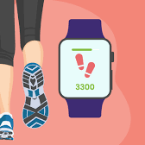
DataSet
Sample size : 33
What Fitbit tracks:
Sleep
Heart Rate
Intensity
Calories
Weight
Sleep
Steps
Year of Collection: 2016

Slide 5
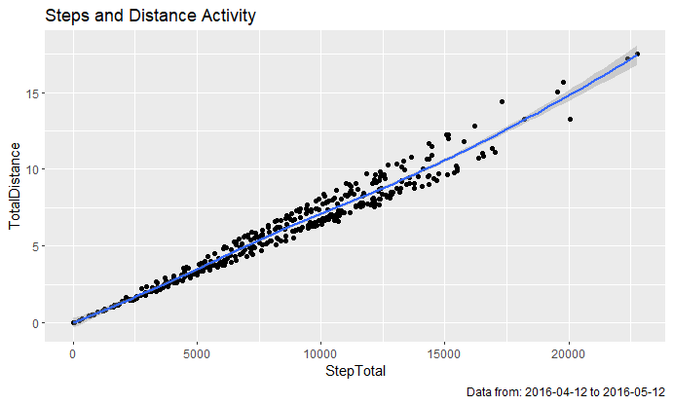
Steps vs Distance
Trends.
A positive linear correlation between the amount of steps taken and the Distance.
Some individuals go beyond 15000 steps.

Slide 6
User goal steps
Trends.
A big number is attaining a 10,000 step goal.

Slide 7
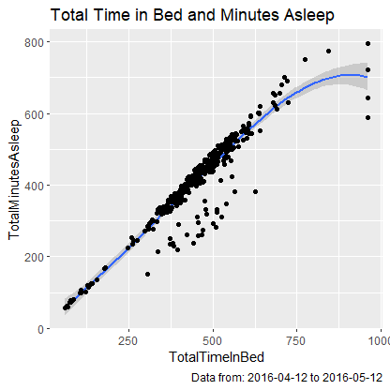
Sleep
Trends.
Most of the Fitbit Users are getting a healthy amount of sleep which is 7 hours.

Slide 8
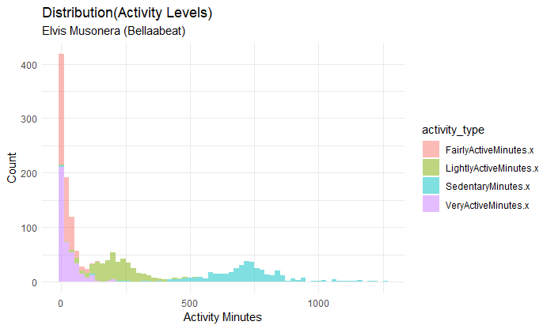
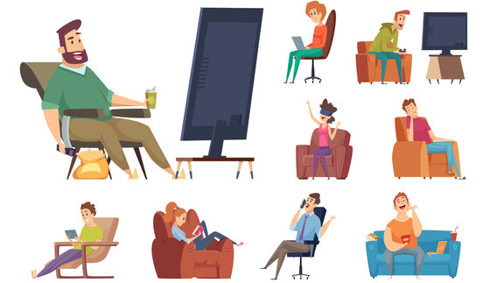
Activities
Trends.
the distribution indicates that the duration of physical activity for people is relatively short. Most users are inactive for a period of at least 8.33 hours or more.

Slide 9

Recommendations for the bellabeat app.
Create fitness challenges to close the void of inactivity
Enable users to connect with friends to be active together and motivate each other.
Set a small award for user’s getting up to 10000 steps a day
Create alerts to make sure that users get 7 hours of sleep

Slide 10

Recommendation for Bellabeat Membership
Givre a 30 day free trial to evey user.
Offer discounts especially in the summer so that people can exercise a lot.
Friend reference discount on membership

Slide 11




Thank you
Elvis Musonera
emusoner@norwich.edu

