Slide 1

Vehicle
Service Center Collection
CST – Group 11
Computer Science and Technology
Department of Computer Science and Informatics
Uva Wellassa University
Project I

Slide 2
Table of Contents
01
02
03
System Design Diagrams
Introduction
Project Objectives
04
Progress
06
Future Works
06
Individual Contribution
05
Group members

Slide 3

Introduction
This is not a website of a single service center or garage.
This is a collection of all kinds of service centers and garages
The main purpose of this web site to make a connection between garages and vehicle users.

Slide 4
Project Objectives
Find the nearest garage in case of sudden breakdowns happened
on vehicles
Find the garage that provides the better customer service and quality service
Garage owners can promote
their garages and spare
parts shops
Allow users to make an appointments and build the relationship between customers and garages.

Slide 5
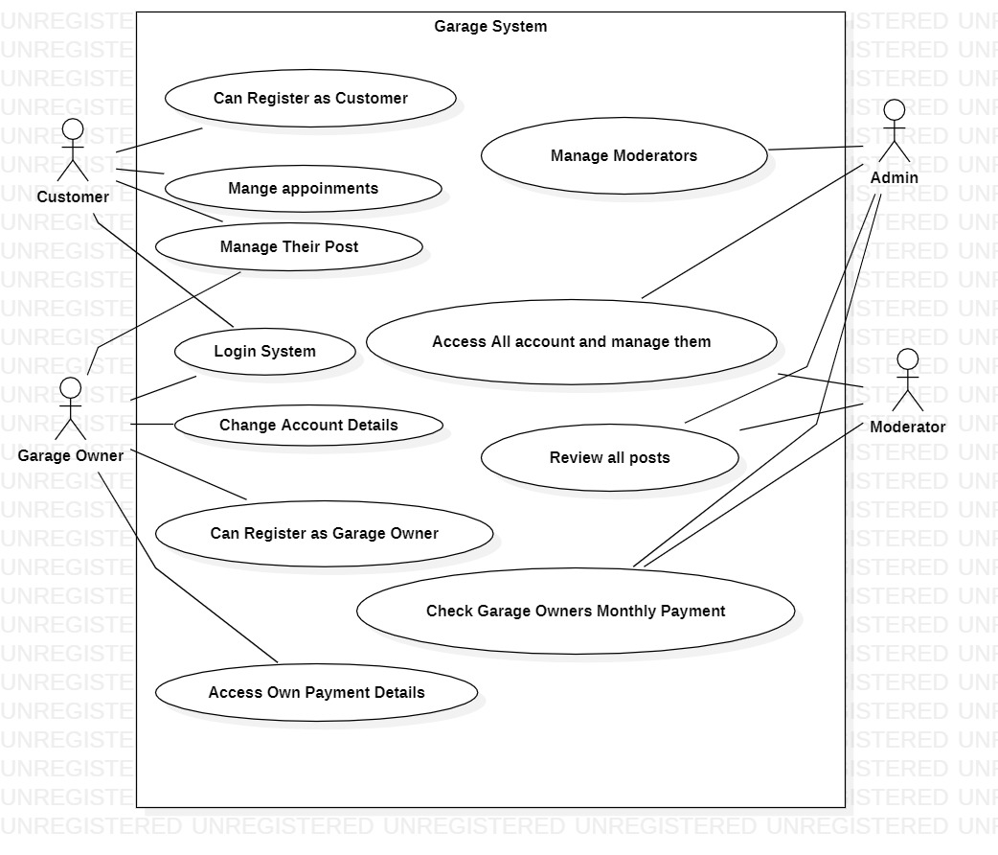
System Design Diagrams
UML Diagrams
Use Case Diagram

Slide 6
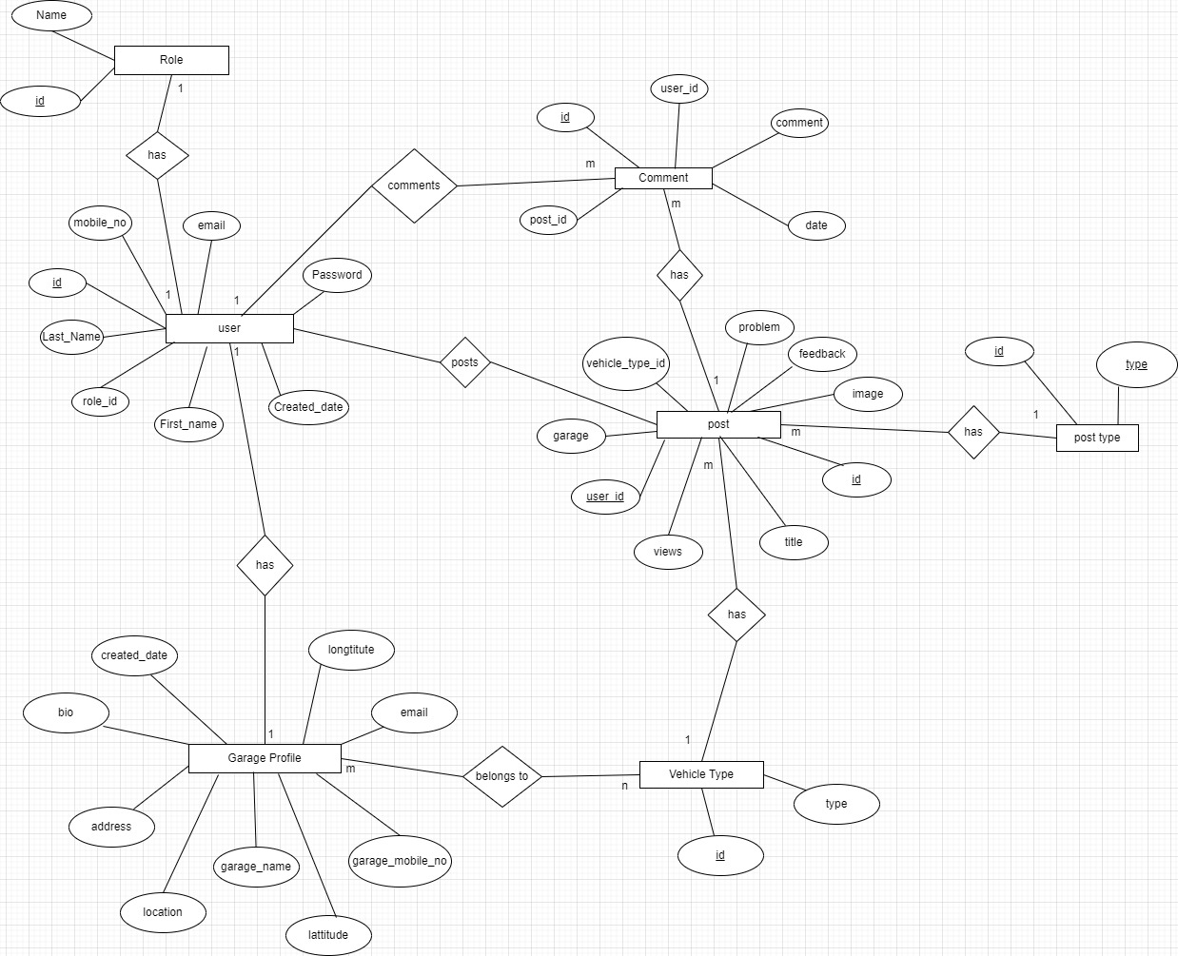
System Design Diagrams
ER Diagram

Slide 7
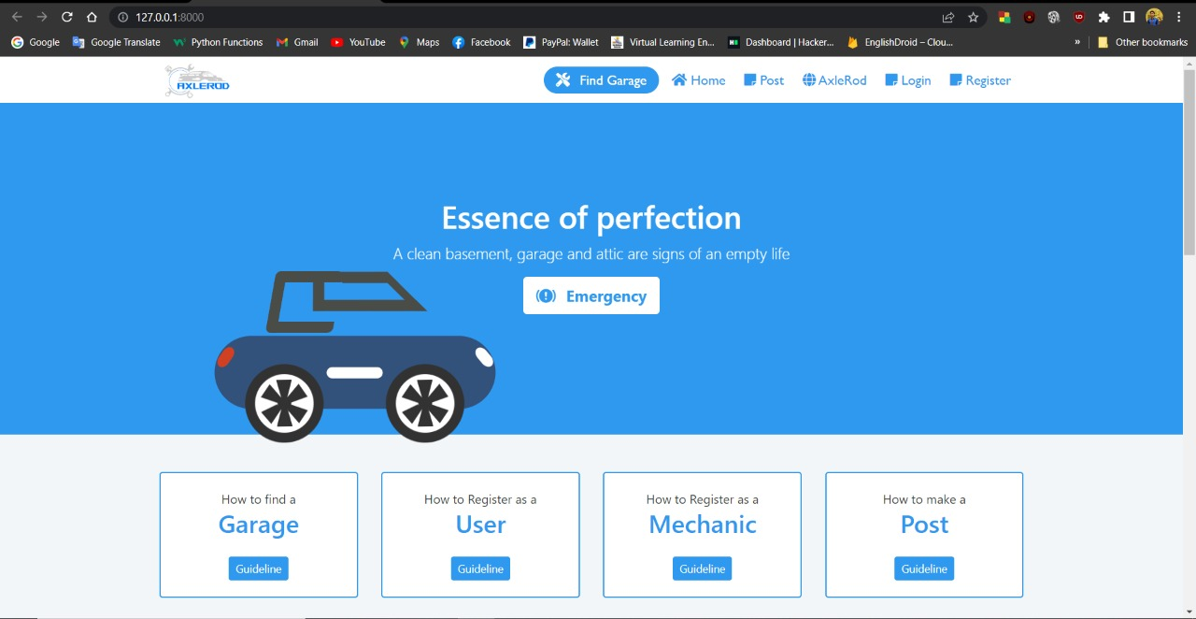
Progress

Slide 8

Future works
Create an app for the website
Send an alerts to the customers about suitable and best garage information according to their previous searchers
Considering customers previous search data
and try to show most suitable contents related on user

Slide 9




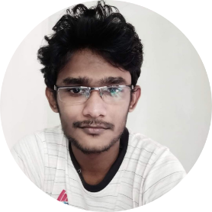
Team Members
Sachindu Malshan
UWU/CST/19/035
Naween Sandeepe
UWU/CST/19/027
Ranidu Harshana
UWU/CST/19/033
Danilka Shalinda
UWU/CST/19/059
Heshan Ravidu
UWU/CST/19/002

Slide 10
Individual Contribution
Registration Number | Name | Contribution
UWU/CST/19/035 | A.S.M. Rodrigo | Post page, Find garage page, Home page create and optimize all the front end pages
UWU/CST/19/033 | M.A.R.H. Manamendra | Post page, Find garage page, Profile pages back end creation
UWU/CST/19/002 | R.A.H.R. Senarath | Payment gateway pages, garage owner profile front end and backend creation
UWU/CST/19/027 | S.M.N.S. Samarakoon | Payment gateway pages front end and backend creation
UWU/CST/19/059 | M.D.S. Dissanayaka | User profile, Admin , about us ,Contact us pages frontend creation

Slide 11

THANK
YOU

