Slide 1
Wind – Attendance API development

Slide 2
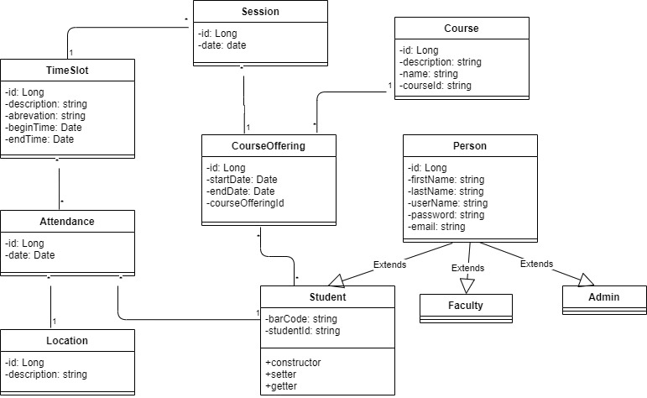
Class Diagram

Slide 3
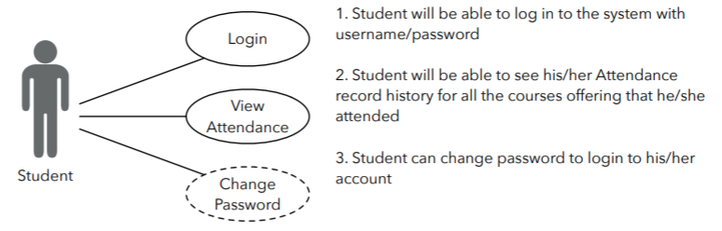
Student Use Case

Slide 4
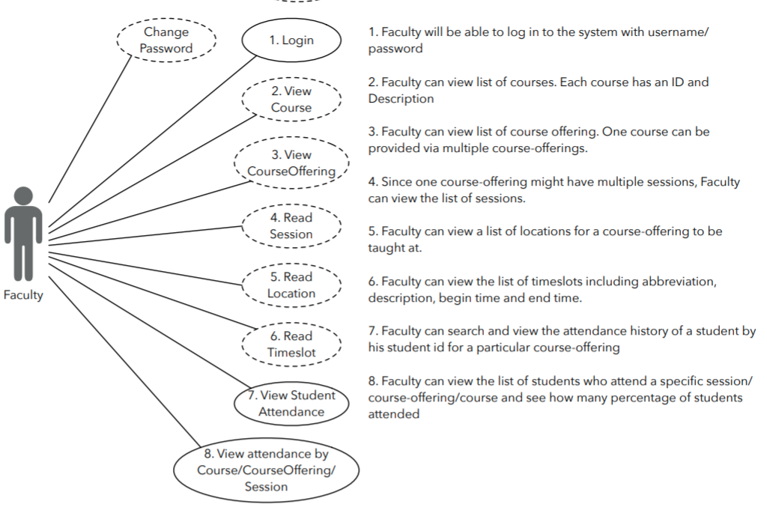
Faculty Use Case

Slide 5
Admin Use Case

Slide 6
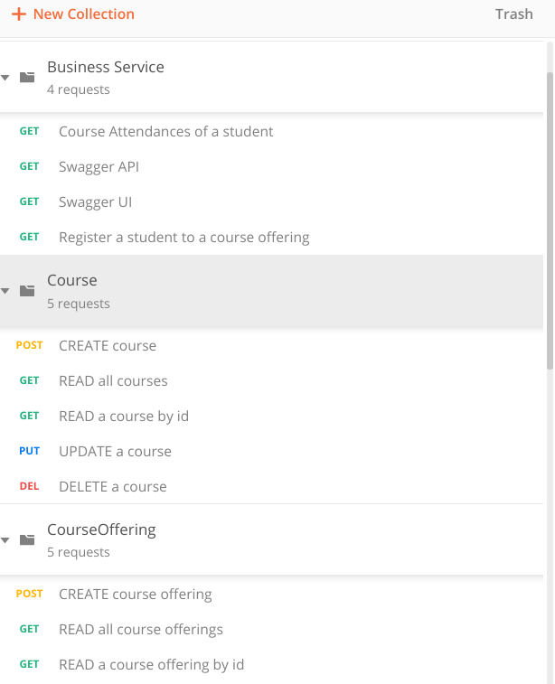
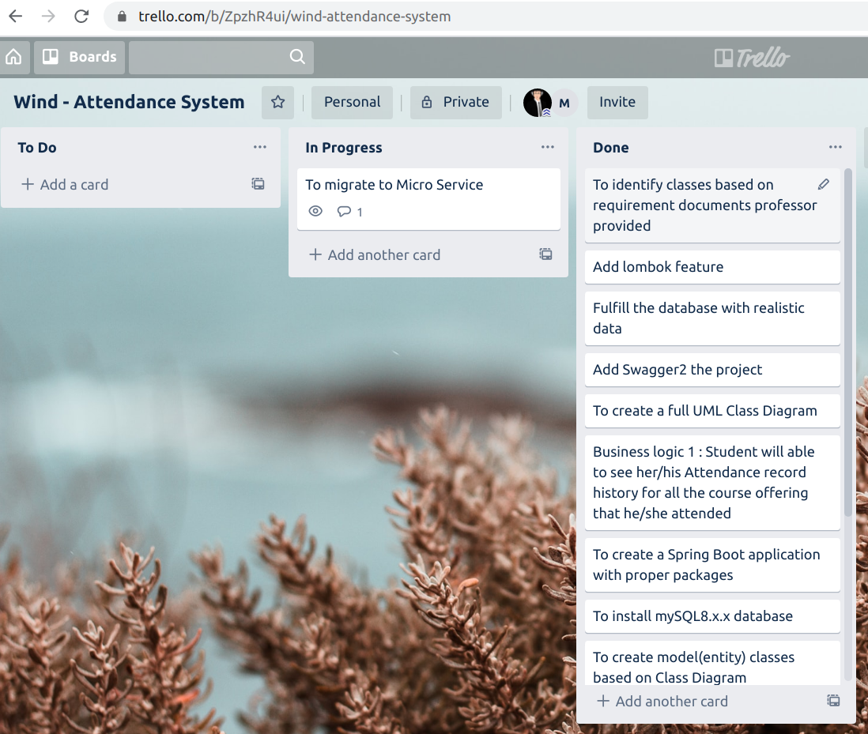
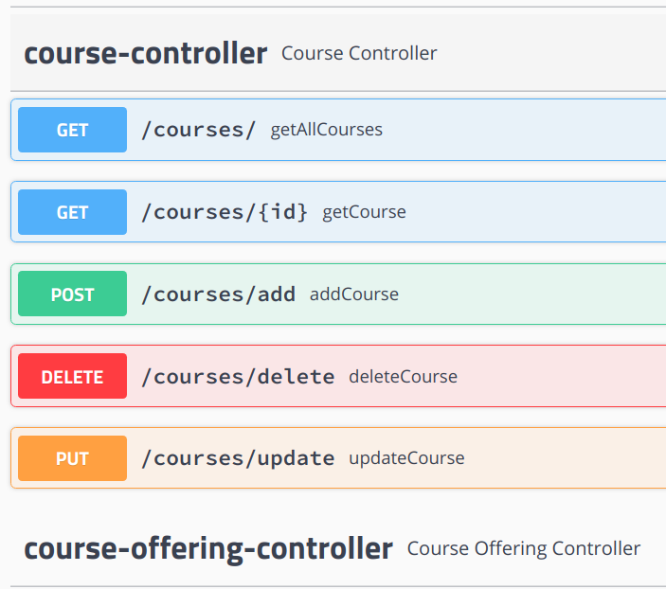
Postman, Github, Trello, Swagger

Slide 7
Thank you!
Code review
Q&A

