Slide 1
Temperature PID Control
A practical approach using Ziegler-Nichols
Caramon Pi
Håkan Brolin, 2017-02-27

Slide 2
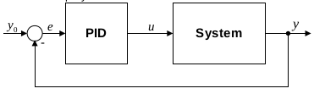




Closed Loop System
PID algorithm
Discrete form
Improved controller, by basing the derivative term on the process value only

Slide 3
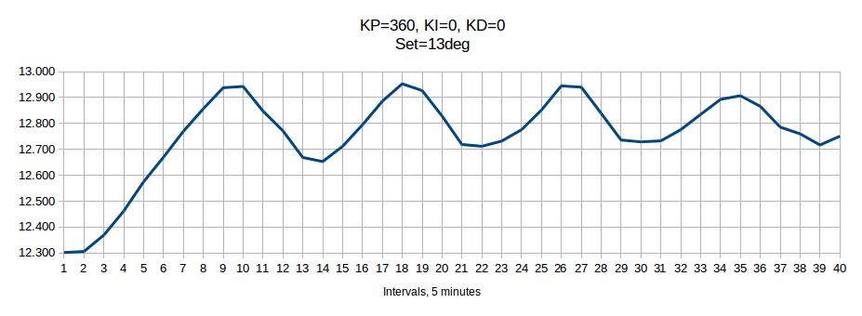
Ziegler-Nichols
Closed-loop tuning method
Ulitmate gain, Ku=360
Ultimate period, Pu=35 minutes = 2100 sec
Sample time, Ts = 10 minutes = 600 sec (*)
(*) Values measured 2016 using CMON R1Axx
 | Kp | Ti | Td
P | Ku / 2 | - | -
PI | Ku / 2.2 | Pu / 1.2 | -
PID | Ku / 1.7 | Pu / 2 | Pu / 8

Slide 4
Controller Parameters
Ku | 360
Pu [s] | 2100
Ts [s] | 60
 | Kp | Ti [s] | Td [s]
P | 180.00 | - | -
PI | 163.64 | 1750 | -
PID | 211.76 | 1050 | 262.50
Z-N
Sample time decreased from 600s to 60s.
Possible due to new hardware with SSR.
Ki = (Kp x Ts) / Ti
Kd = (Kp x Td) / Ts
 | Kp | Ki | Kd | Comment
PID-1 | 163.64 | 5.61 | - | Z-N, PI
PID-2 | 211.76 | 12.10 | 926.45 | Z-N, PID
PID-3 | 163.64 | 28.05 | - | PID from CMON R1Axx

Slide 7
Conclusions
PID-2 is a “true” ZN PID using Ts=60s.
PID-3 was derived 2016 using Ts=600s.
Not fitted for the new hardware using SSR and with less Ts.
Is a PI and not PID.
PID-2 has less overshot compared to PID-3.
PID-2 settles faster than PID-3.
PID-2 seems less “aggressive” on step-up.
Both PIDs perform well on step-down.
The slower decrease of temperature on step-down for PID-2 can be explained by the fact that outdoor temperature was higher during this experiment.
Some questions can be raised about using the old values for Ku and Pu, as they were derived using Ts=600s. It could be necessary to perform new
experiments using the new hardware with Ts=60s.

