Slide 1
Temperature PID Control
A practical approach using Ziegler-Nichols
Caramon Pi
Håkan Brolin, 2016-01-23

Slide 2
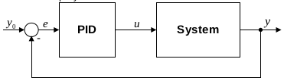




Closed Loop System
PID algorithm
Discrete form
Improved controller, by basing the derivative term on the process value only

Slide 3
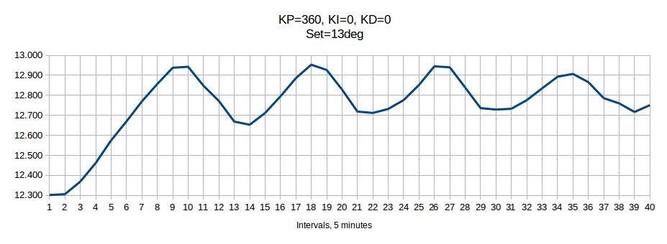
Ziegler-Nichols
Closed-loop tuning method
Ulitmate gain, Ku=360
Ultimate period, Pu=35 minutes = 2100 sec
Sample time, Ts = 10 minutes = 600 sec
 | Kp | Ti | Td
P | Ku / 2 | - | -
PI | Ku / 2.2 | Pu / 1.2 | -
PID | Ku / 1.7 | Pu / 2 | Pu / 8

Slide 4
Controller Parameters
Ku | 360
Pu [s] | 2100
Ts [s] | 600
 | Kp | Ti [s] | Td [s]
P | 180.00 | - | -
PI | 163.64 | 1750 | -
PID | 211.76 | 1050 | 262.50
Z-N
Ki = (Kp x Ts) / Ti
Kd = (Kp x Td) / Ts
 | Kp | Ki | Kd | Comment
PID-5 | 163.64 | 56.10 | - | Z-N, PI
PID-6 | 211.76 | 121.01 | 92.65 | Z-N, PID
PID-7 | 163.64 | 42.10 | - | PID-5, Ki decreased 25%
PID-8 | 163.64 | 28.05 | - | PID-5, Ki decreased 50%

Slide 5
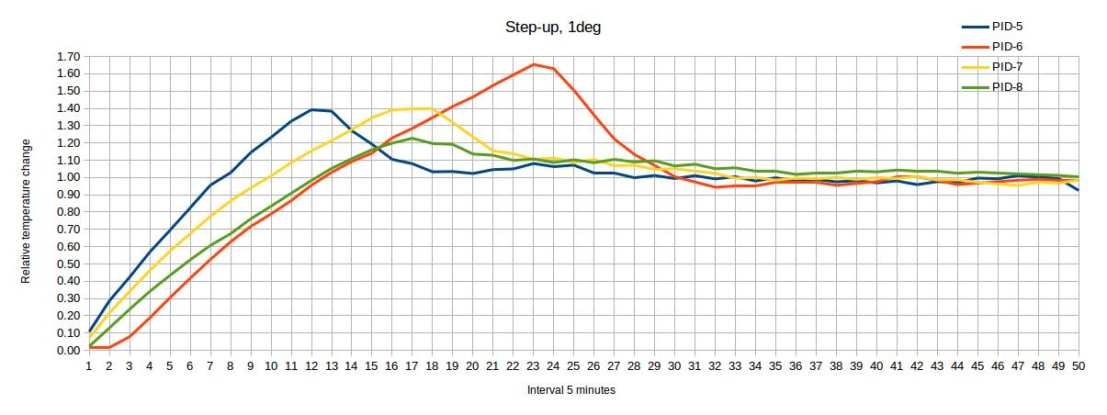
Comparison, Step-up

Slide 6
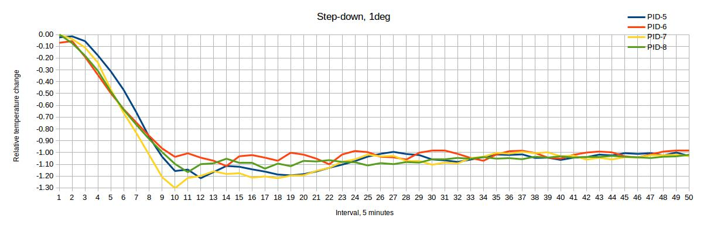
Comparison, Step-down

Slide 7
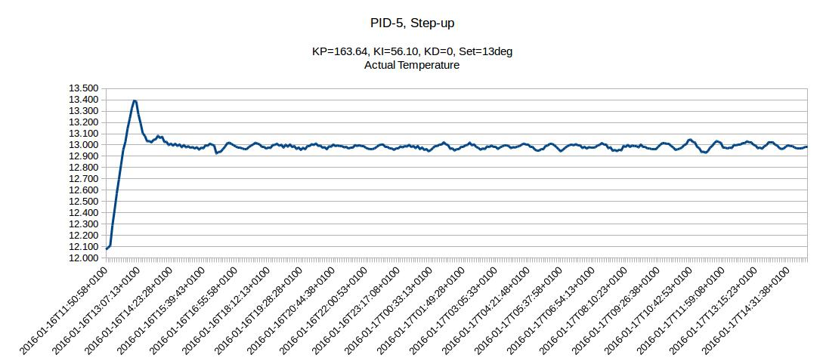

Slide 8
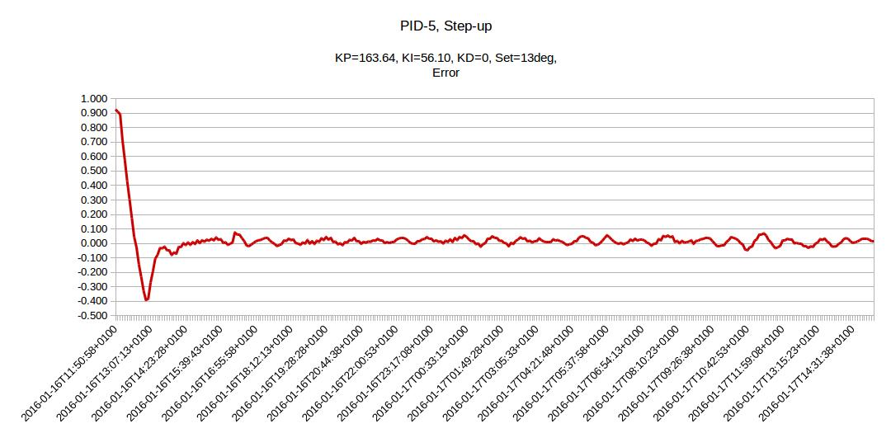

Slide 9
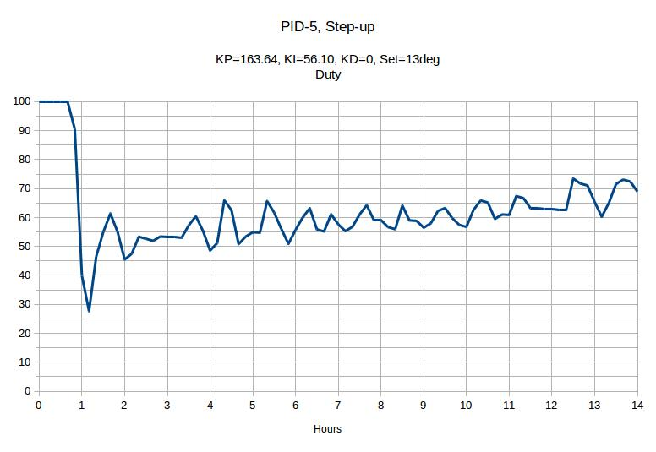

Slide 10
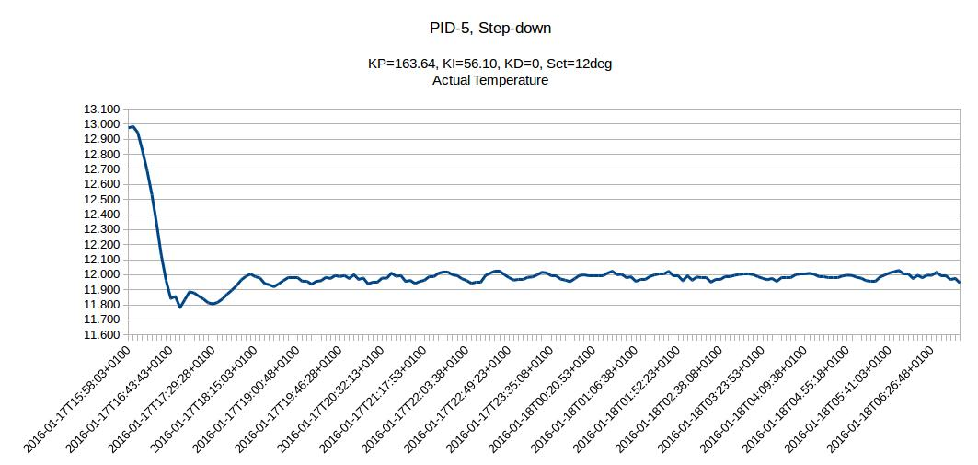

Slide 11
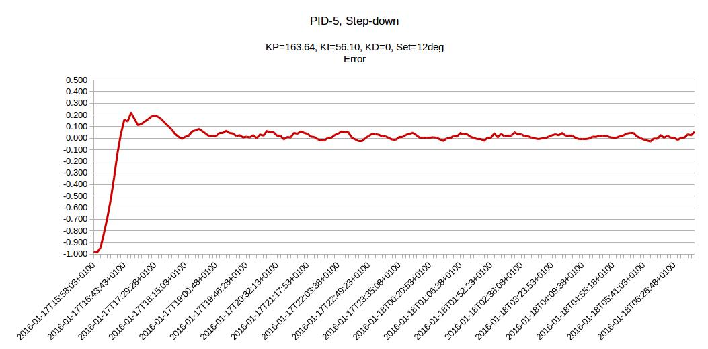

Slide 12
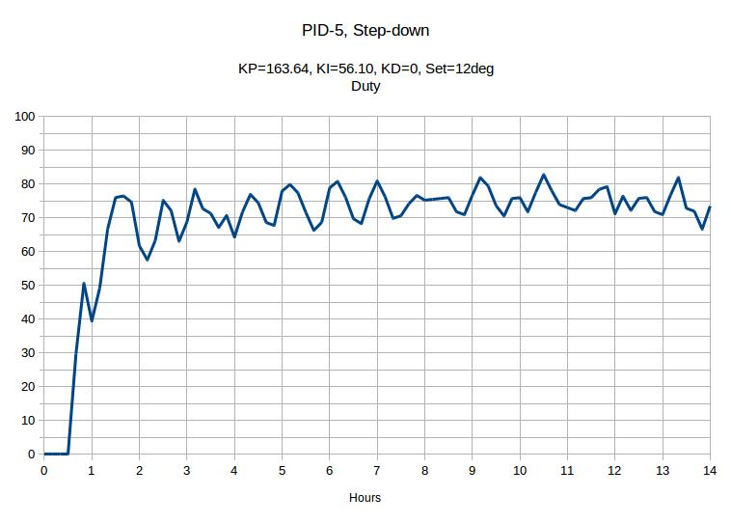

Slide 13
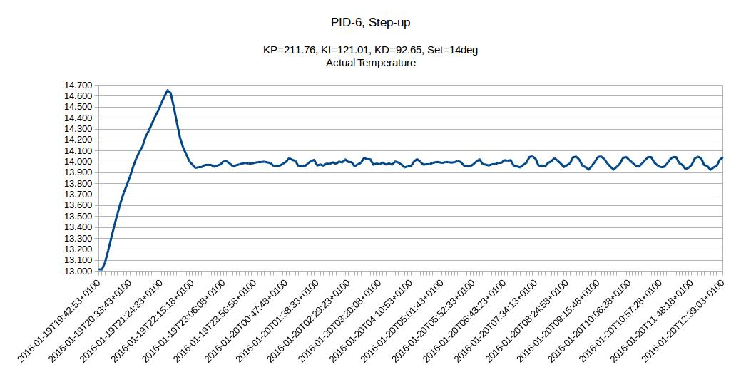

Slide 14
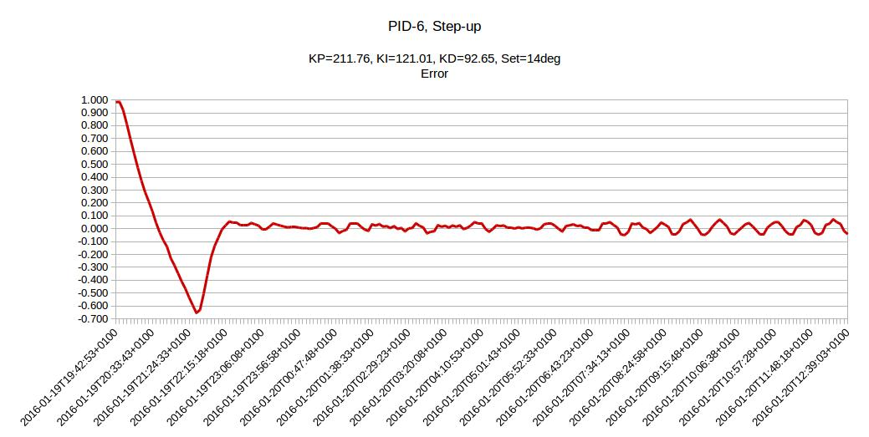

Slide 15
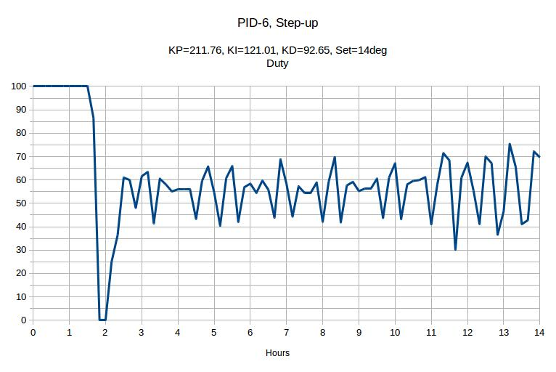

Slide 16
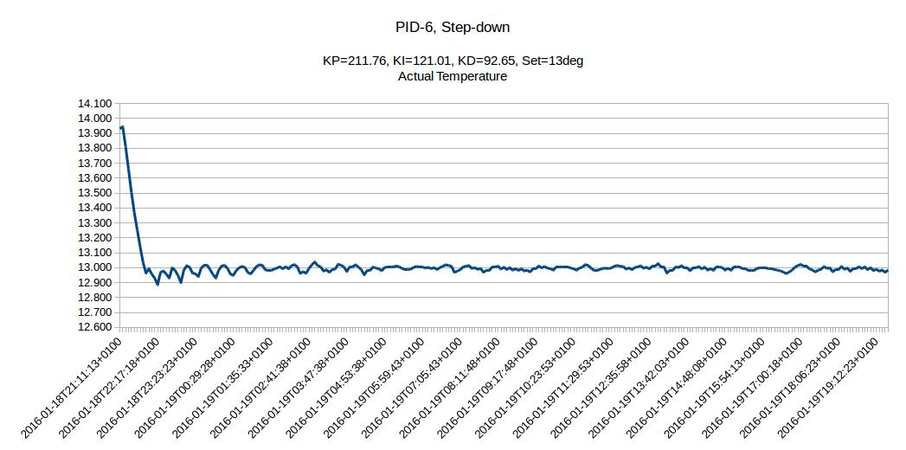

Slide 17
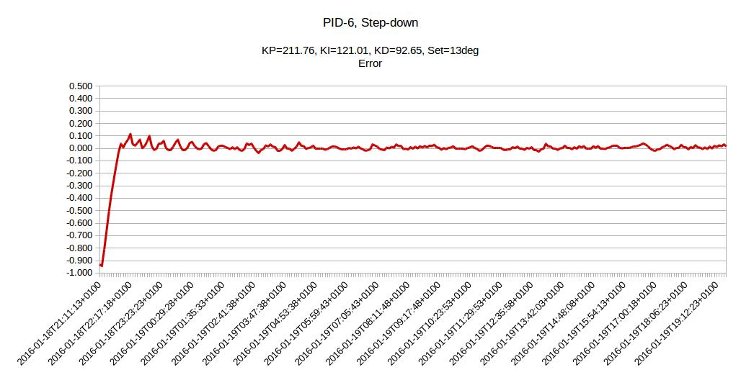

Slide 18
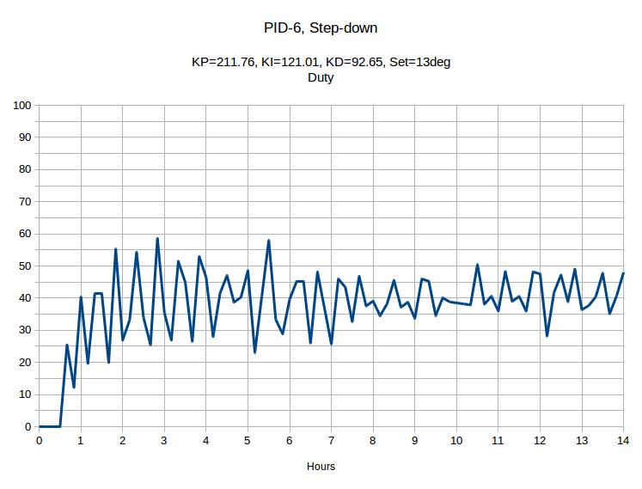

Slide 19
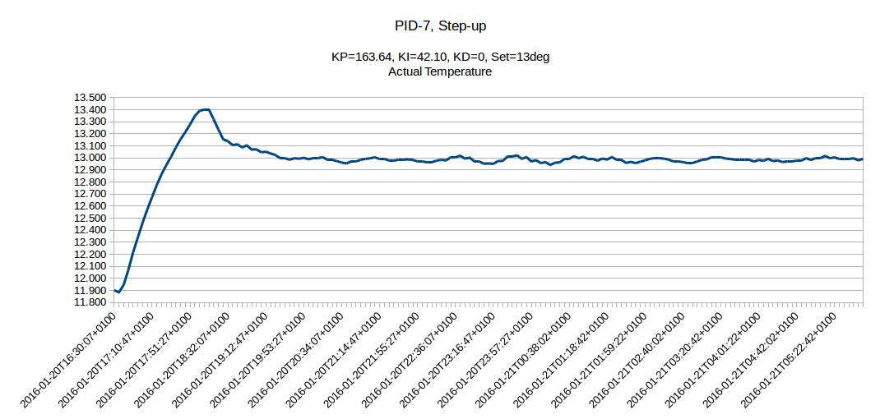

Slide 20
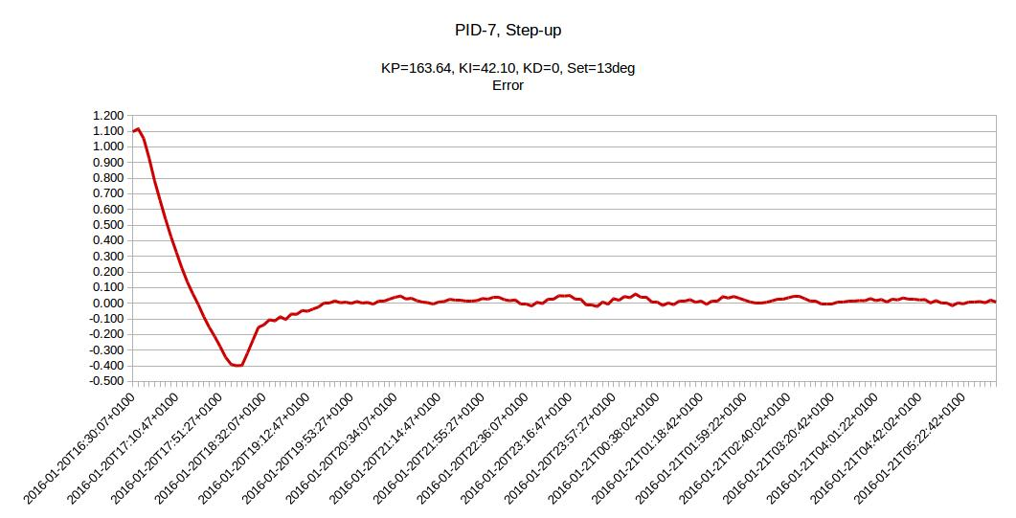

Slide 21
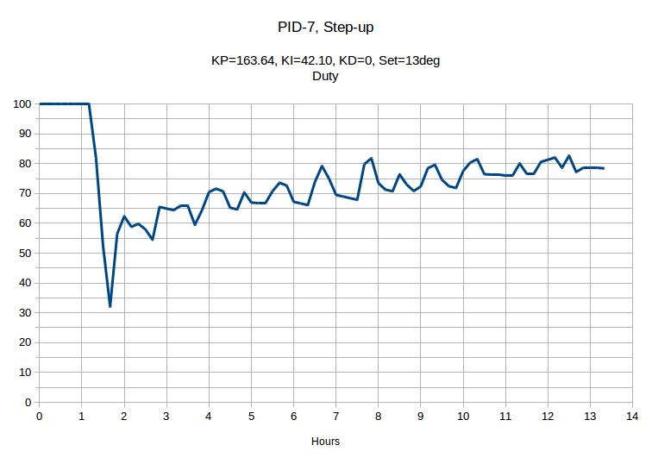

Slide 22
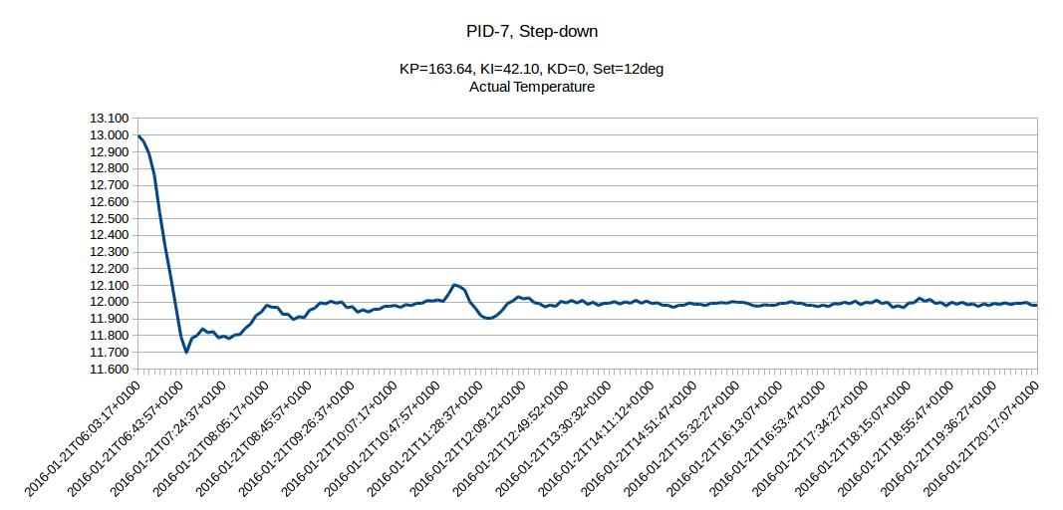

Slide 23
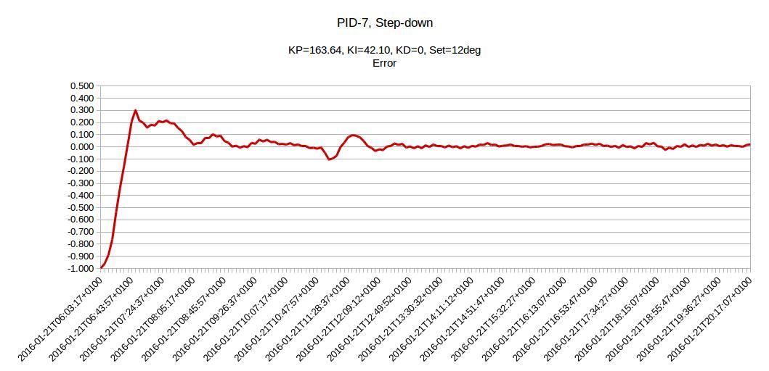

Slide 24
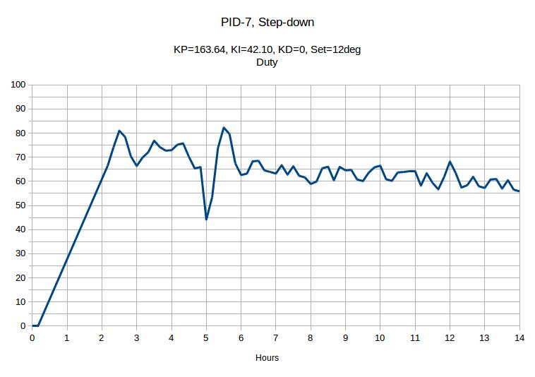

Slide 25
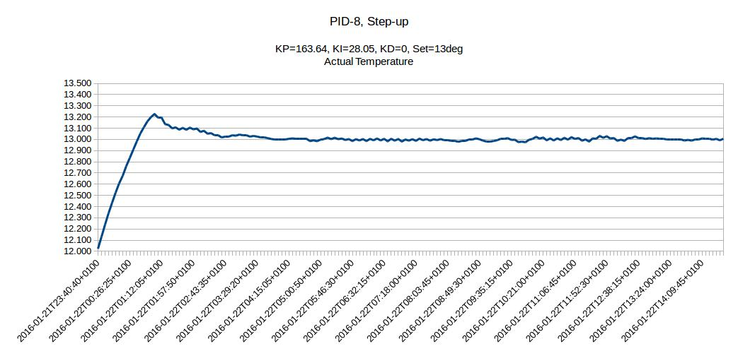

Slide 26
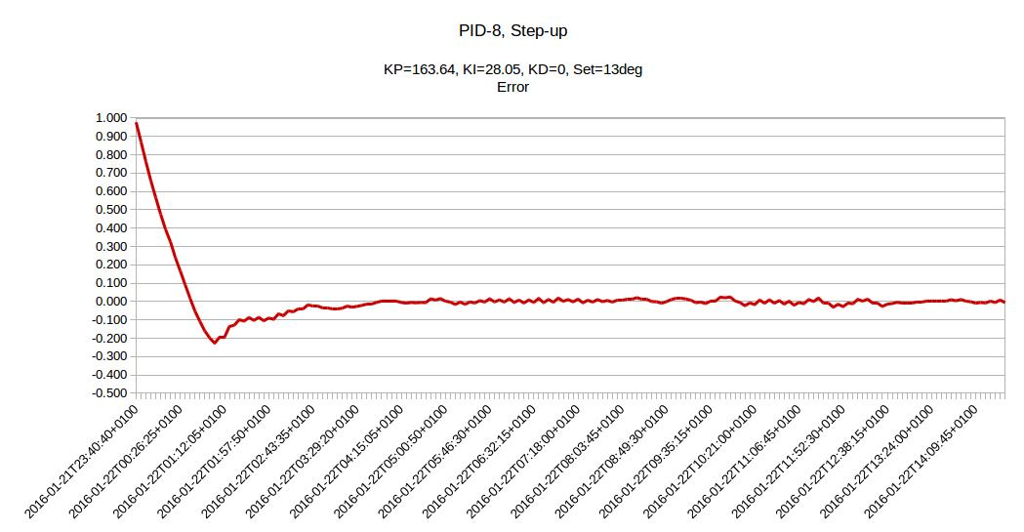

Slide 27
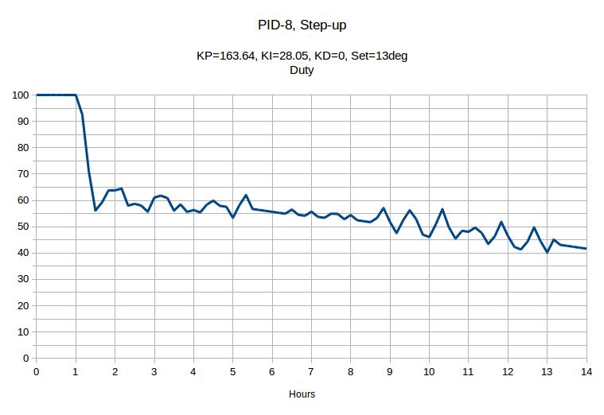

Slide 28
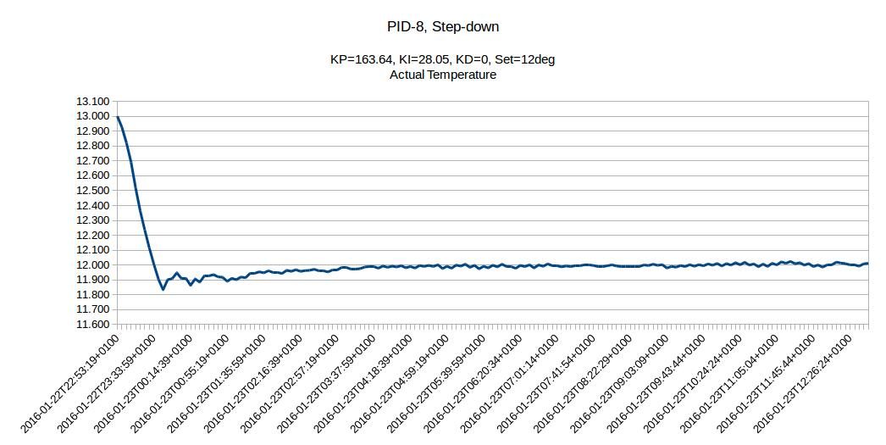

Slide 29
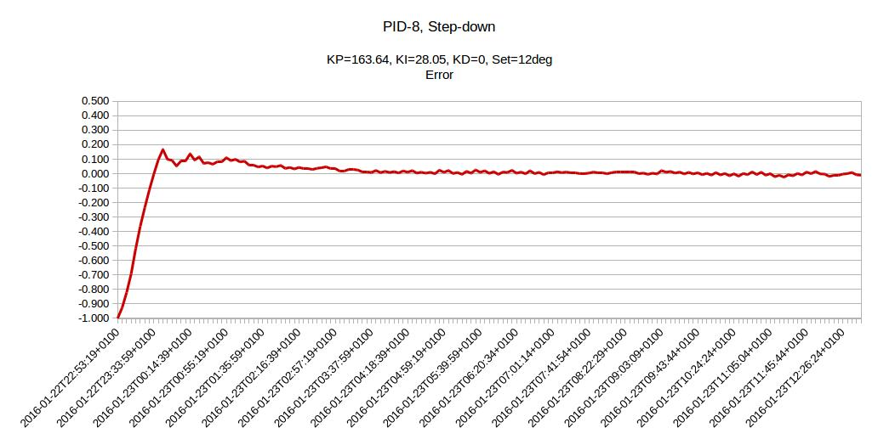

Slide 30
