Slide 1

exsa’S MATERIALS PLANIFICATION PROCESS

Slide 2
Key principle
SILENCE MEANS CONSENT

Slide 3
Integrated business planification process
3rd workday of the month
New Products
18th workday of the month
5th workday of the month
P.I.N.
Integrated business plan
Demand review
Demand plan
16th work day of the month
11th work day of the month
Material’s review meeting
Offer review
Plans and offer restrictions
15th workday of the month
Conciliación meeting
Plans and alternatives valued

Slide 4
Material’s Planification process
Material Production Schedule cofirmation (MPS)
MRP’s run, review and adjustment
Creation & sending Purchase Orders
Follow up the entry of materials
Generation y sending the Supplier’s Program

Slide 5

MRP’s run, review and adjustment
MPS
BOM
Material needs

Slide 6
Material’s Planification process
Material Production Schedule cofirmation (MPS)
MRP’s run, review and adjustment
Creation & sending Purchase Orders
Follow up the entry of materials
Generation y sending the Supplier’s Program

Slide 7
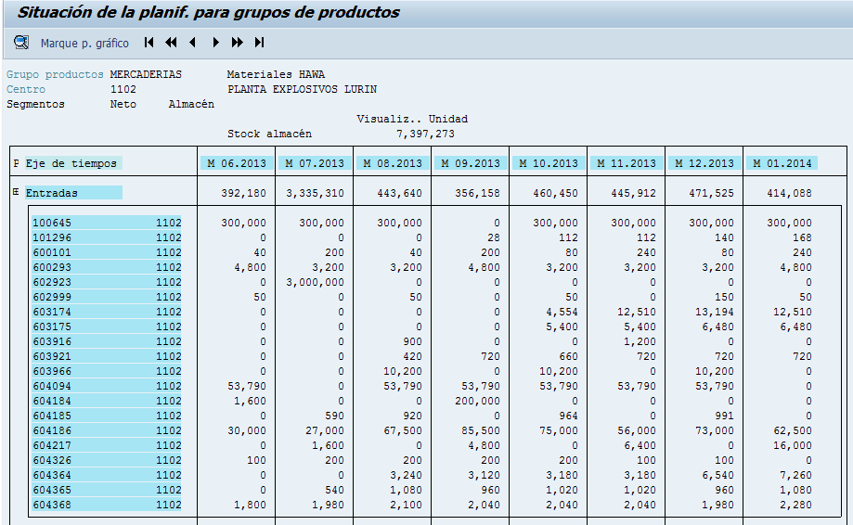
Supplier’s program of imported materials
FIRM ZONE
NEGOTIATION ZONE
FREE ZONE

Slide 8
Material’s Planification process
Material Production Schedule cofirmation (MPS)
MRP’s run, review and adjustment
Creation & sending Purchase Orders
Follow up the entry of materials
Generation y sending the Supplier’s Program

Slide 9
service metrics - OTIF
Society | Measurement | dec-12 | ene-13 | Total
EX10 | (1) N° of positions scheduled for delivery | 1 | 51 | 52
EX10 | (2) N° of positions delivered | 1 | 51 | 52
EX10 | (3) N° of positions with the required quality delivered | 1 | 48 | 49
EX10 | (4) N° of positions completes with required quality delivered | 1 | 48 | 49
EX10 | (5) N° of positions on time, completes and with the required quality delivered | 1 | 48 | 49
EX10 | (6) Average days of delay
EX10 | (7) OTIF % | 100% | 94% | 94%
Quantity
Quality
Date
Goal: 99%

Slide 10
Thank you

Slide 11
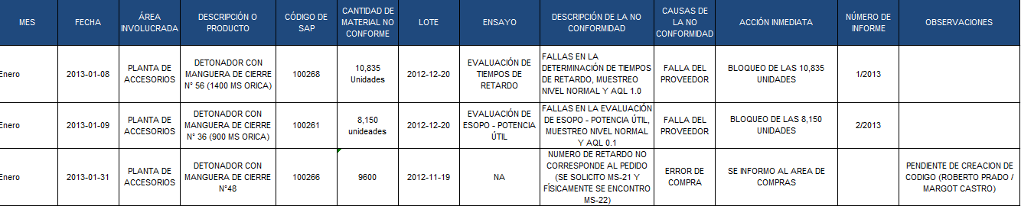

Slide 12
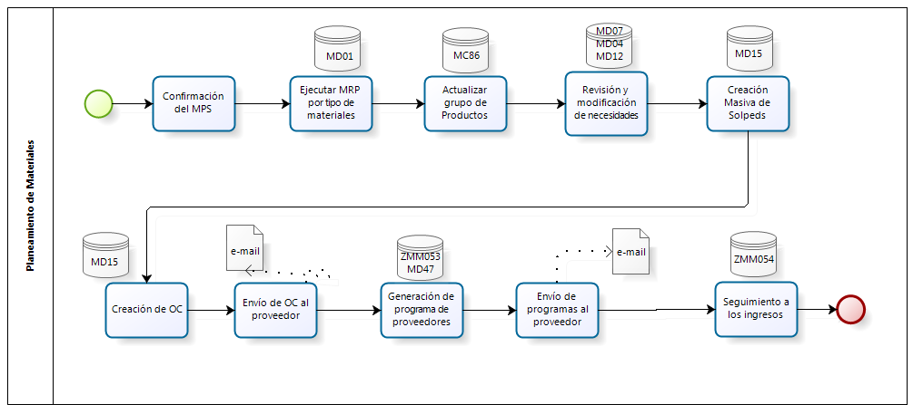

Slide 13
Programa de proveedores de materiales NACIONALES
Centro | Material | Descripción | Denom. clase doc. | Stock | Ingr. Ret. | Miér. | Juev. | Vier. | Lune. | Mart. | Miér. | Juev. | Vier. | Sem1 | Sem2 | Sem3
1102 | 200122 | CJ 31,5x31,5x61,5 cm DET ENSAMBLADO | OrdPrv | 1,956 | 0 | 0 | 0 | 1,000 | 0 | 0 | 100 | 0 | 0 | 0 | 100 | 100
Centro | Material | Descripción | Denom. clase doc. | Sem4 | Sem5 | Sem6 | Mayo | Junio | Julio | Agos | Sept | Oct | Nov | Dic | Enero | Febr
1102 | 200122 | CJ 31,5x31,5x61,5 cm DET ENSAMBLADO | OrdPrv | 200 | 0 | 0 | 700 | 500 | 200 | 200 | 200 | 500 | 300 | 400 | 200 | 400

