Slide 1
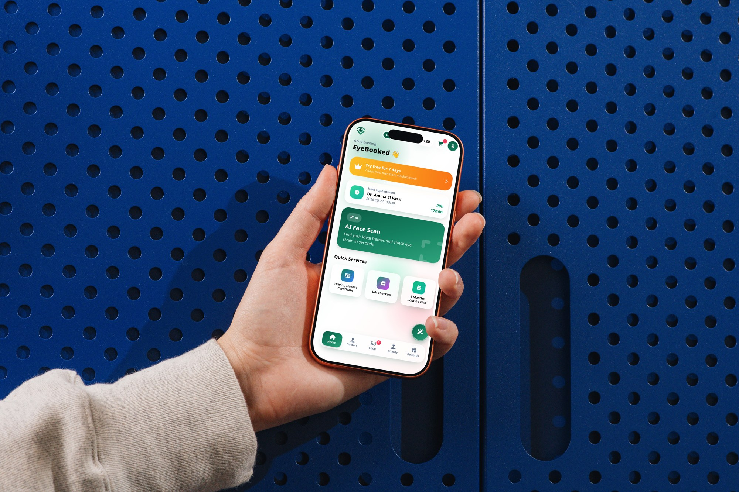
EYEBOOKED
Your eye care,
booked.
Mobile App Preview
Eye-care booking · AI frame recommendations
Glasses shop · Rewards
EN · FR · AR | Morocco · MAD

Slide 2
THE PRODUCT
One mobile home for eye care
A mobile-first concept connecting everyday eye health with local services and eyewear.
Find eye-care services and book appointments
Explore AI-assisted frame inspiration and eye-strain tips
Shop ready-made frames or explore custom design
Return through rewards, reminders and practical eye-health tools
English · Français · العربية
RTL support
Morocco-focused · MAD
EYBOOKED · MOBILE APP PREVIEW
02

Slide 3
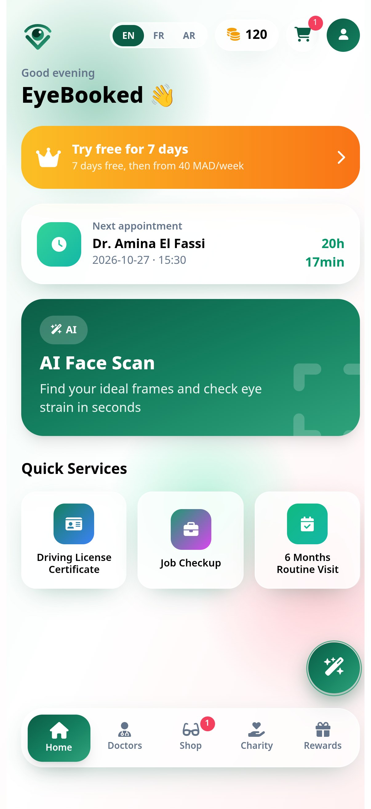
01 · LOGIN & HOME
A clear start, then a useful dashboard
Sign in with email or phone, then reach the app’s core actions from Home.
EyeBooked · Your eye care, booked.
Email or phone · Password · Sign in
Good afternoon
Try free for 7 days
AI Face Scan and Quick Services
EYBOOKED · MOBILE APP PREVIEW
03

Slide 4
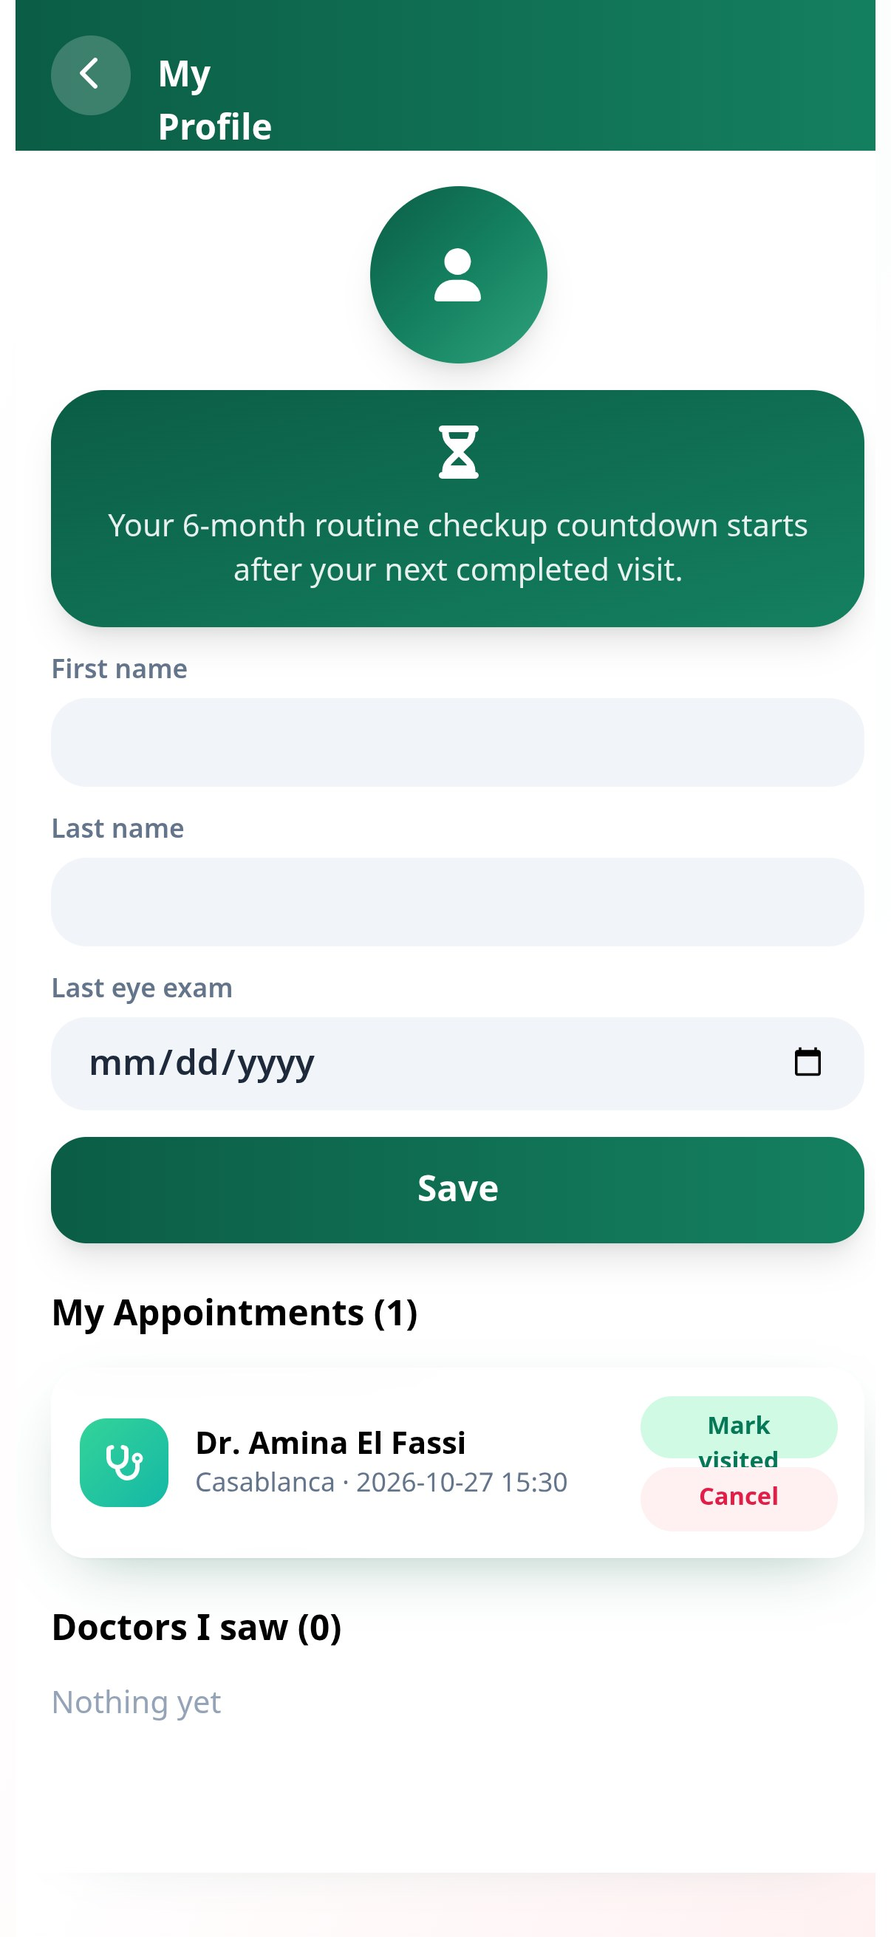
02 · DOCTOR BOOKING
Find care by city and proximity
The concept targets 30+ ophthalmologists across major Moroccan cities. This profile screen demonstrates appointment management; doctor listings use sample data.
Casablanca: Amina El Fassi · Maarif · ★ 4.9
Casablanca: Youssef Bennani · Gauthier · ★ 4.8
Casablanca: Salma Idrissi · Ain Diab · ★ 4.7
Rabat: Karim Alaoui · Agdal · ★ 4.9
Sort by nearest · Browse by city · Book
EYBOOKED · MOBILE APP PREVIEW
04

Slide 5
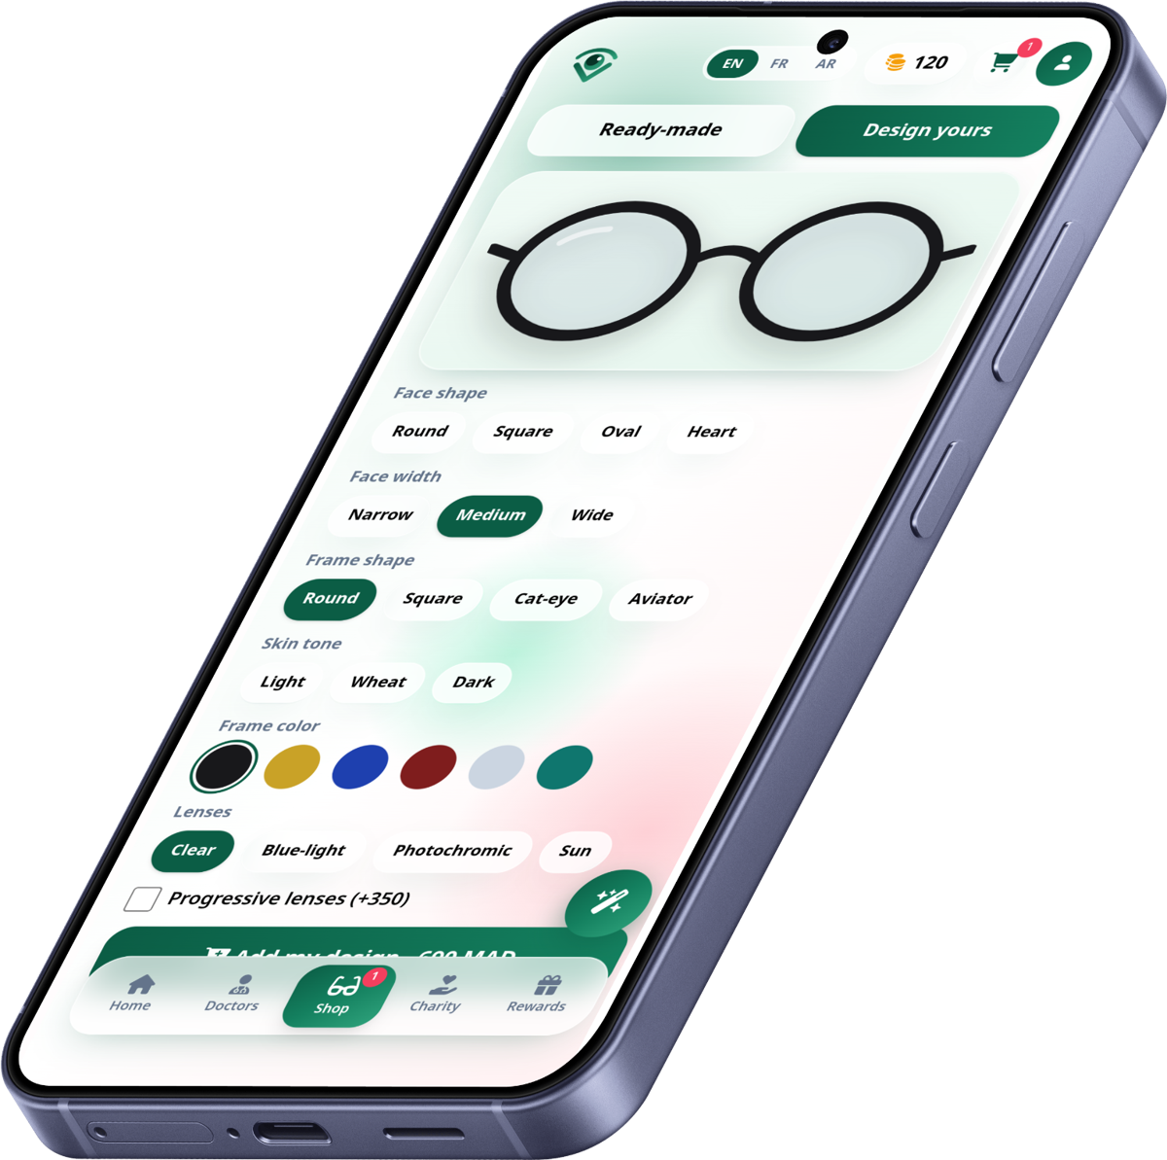
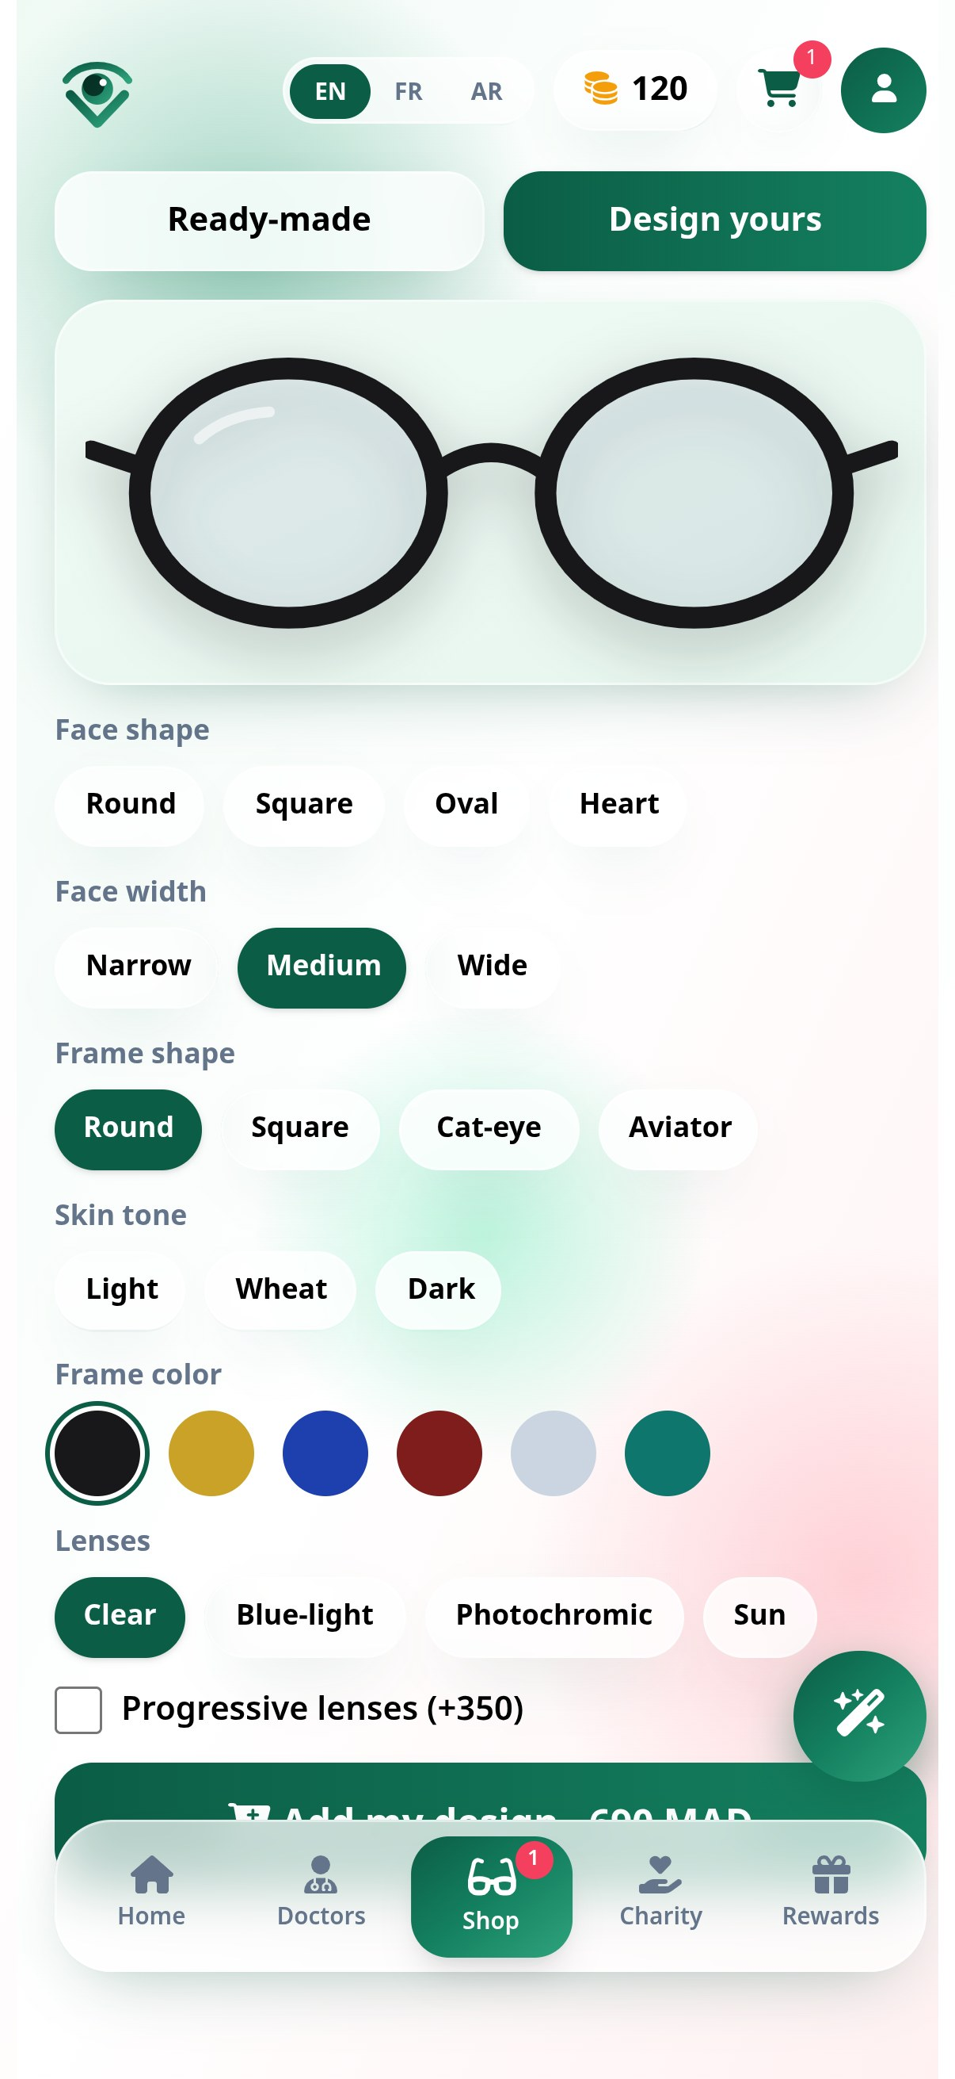
03 · GLASSES SHOP
Browse ready-made or design your own
A product path from frame discovery to custom designs and progressive lens options.
Ray-Ban RX6489 · 1,090 MAD
Persol PO3007V · 1,690 MAD
Clubmaster · 950 MAD
Oakley OX8046 · 890 MAD
EYBOOKED · MOBILE APP PREVIEW
05

Slide 6
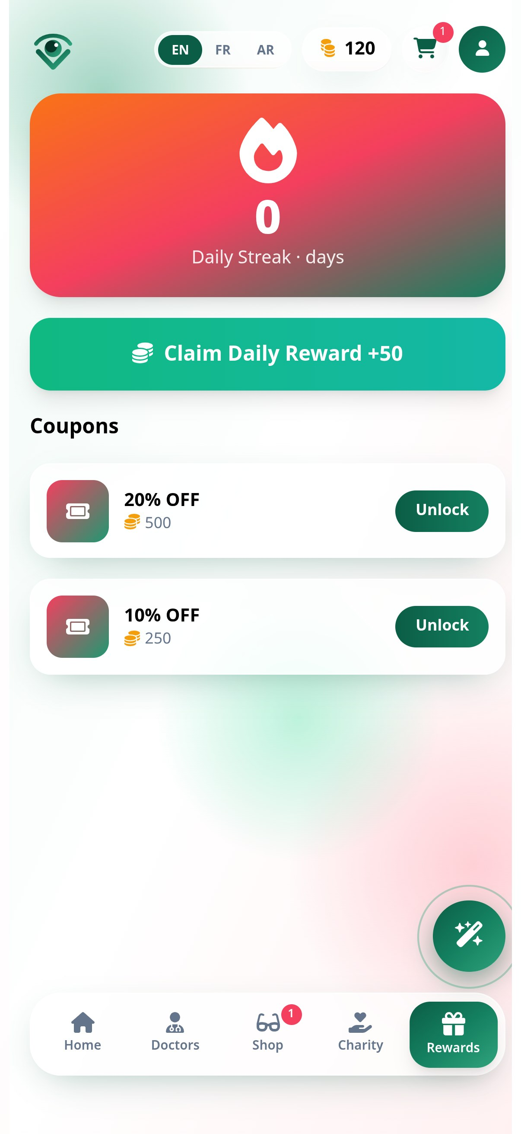
04 · REWARDS & EYE HEALTH
Small habits, useful tools
Build reasons to return while keeping eye-health features easy to find.
Rewards & Coins: daily streaks, coupons and free-Friday consultation promotions
Premium Eye Lab: 20-20-20 rest timer and Amsler grid self-check
Charity concept: sponsor free eye exams for low-income patients
EYBOOKED · MOBILE APP PREVIEW
06

Slide 7
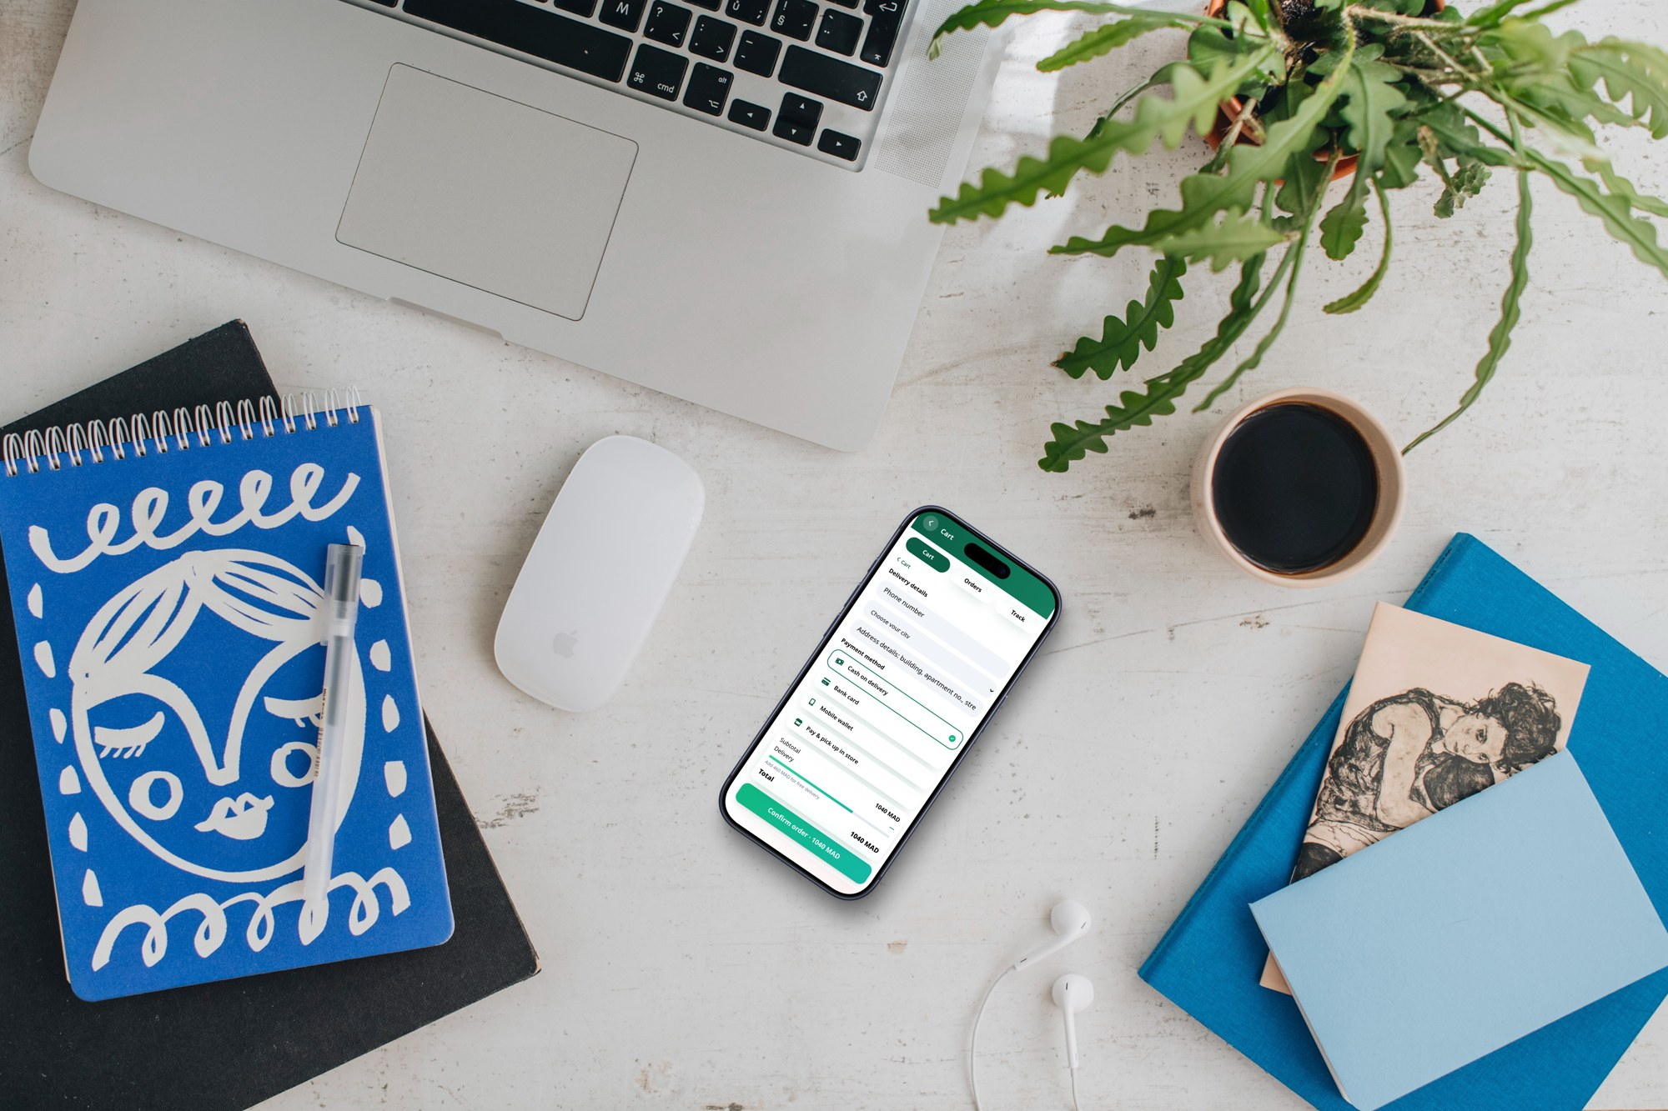
05 · ORDER JOURNEY
Checkout with order status in view
A guided cart for eyewear, with delivery stages envisioned from preparation through arrival.
Shop frames and configure an order
Review cart and delivery details
Follow order stages in real time (planned service integration)
EYBOOKED · MOBILE APP PREVIEW
07

Slide 8
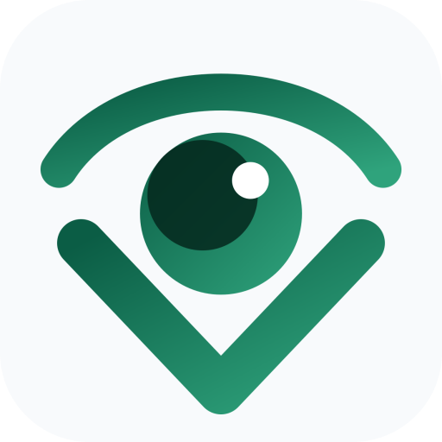
MOBILE-FIRST · MULTILINGUAL
Ready for a phone-sized experience
English · Français · العربية with right-to-left layout support. Morocco-focused examples in MAD.
DEMO SCOPE
No real payments
The current build is a front-end prototype. Authentication, booking, AI recommendations, checkout, rewards and live order tracking require production services and integrations before launch.
EyeBooked
Your eye care, booked.
EYBOOKED · MOBILE APP PREVIEW
08

