Slide 1
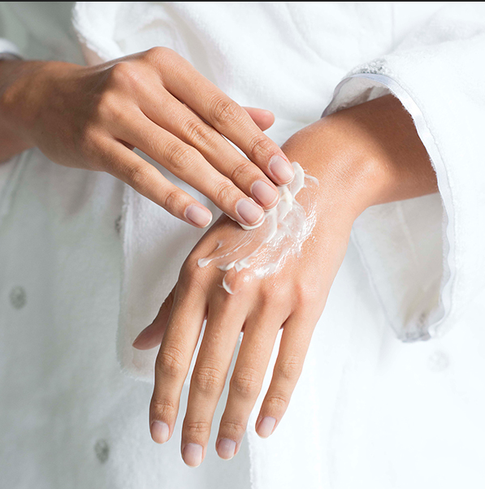
Eczamine

Slide 2
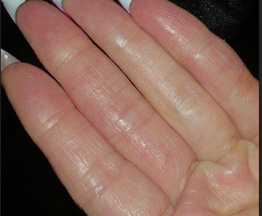
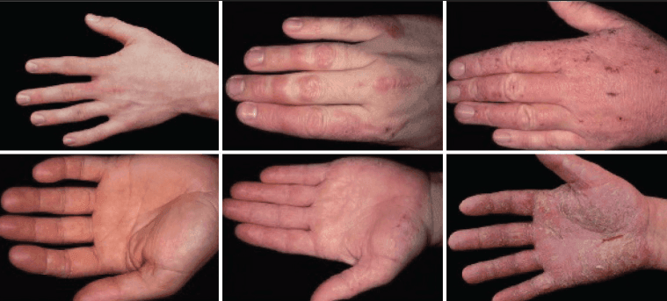
Data Preparation and Data Collection
Filtering and separating dataset (Identifying wrongly classified images)
After this the result is 137 of eczema images and 158 of not eczema

Slide 3
Data scrapping
scrapped 95 images of hands eczema from Derment
scrapped 74 images of Not eczema hands from Unsplash

Slide 4

Model Comparison
RESNET50
EFFICIENTNET
INCEPTIONV3

Slide 5
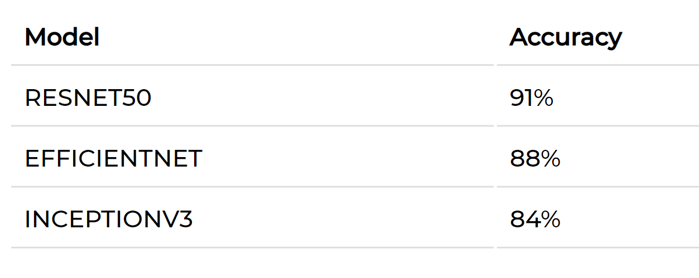
Result

Slide 6

Evaluation Idea

