Slide 1


Slide 2


Slide 3
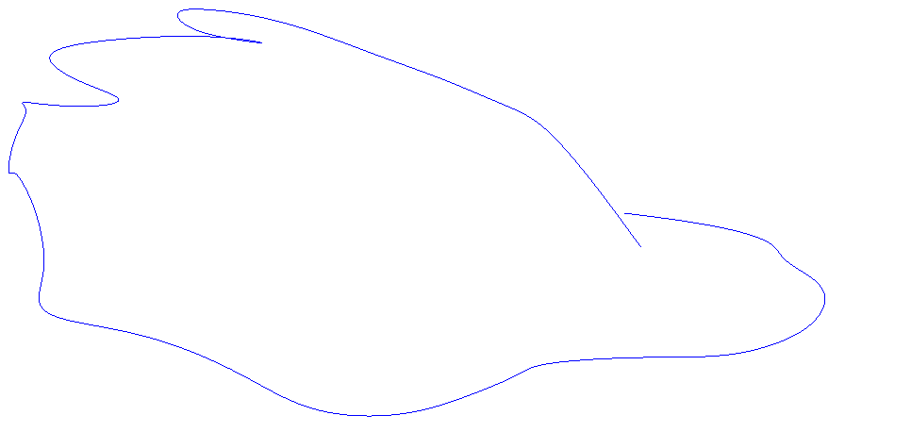
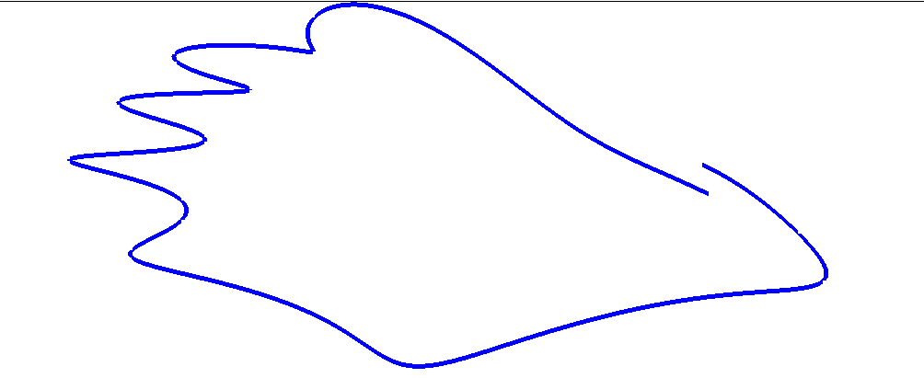
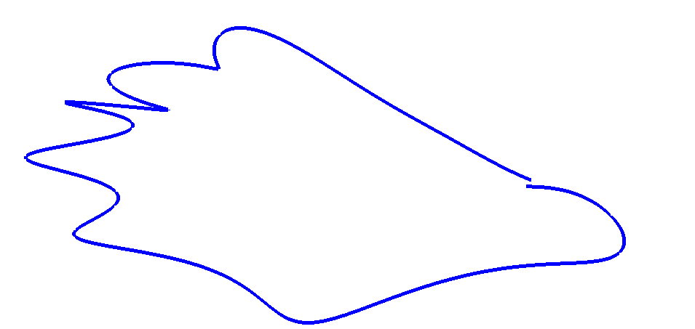

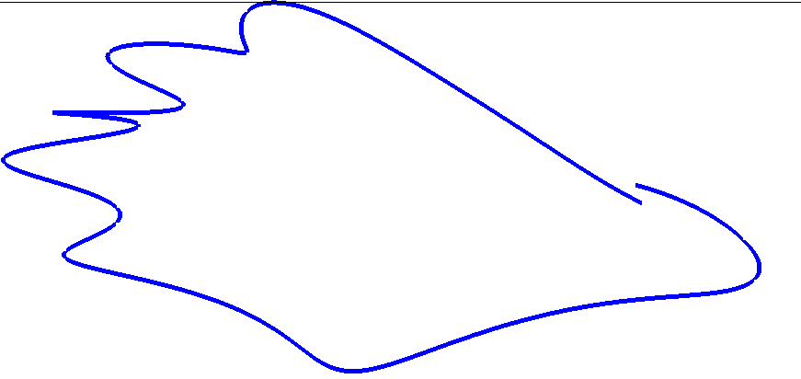
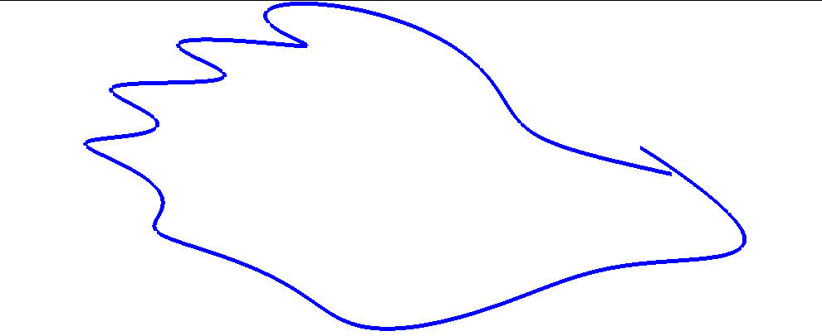

Slide 4
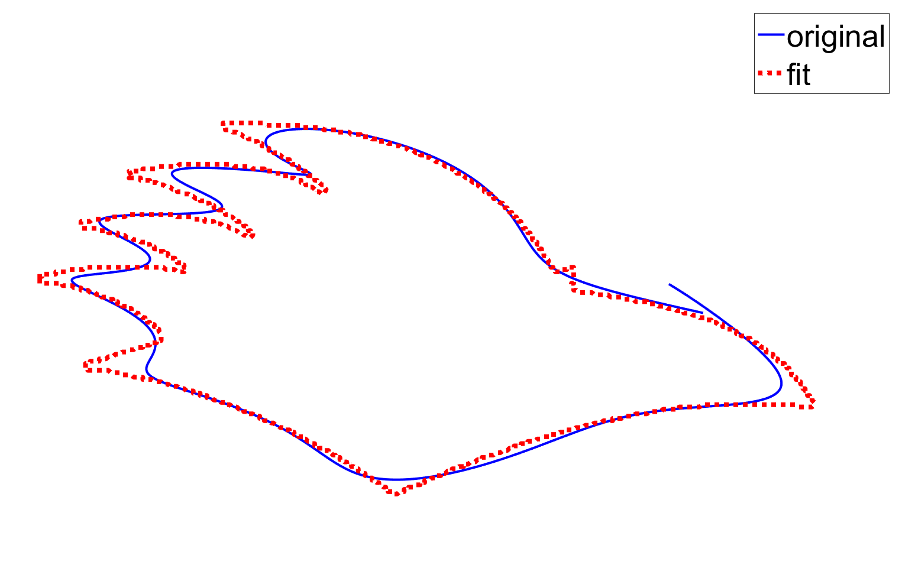

Slide 5
Rowdy curve?
t=linspace(0,pi,1000);
X = 369.289952366726 + 868.097877893622.*t.^2 + 355.885451199134.*sin(1.80851770543267.*t) + 1.80851770543267.*exp(t).*sin(1.01940232088457 + 14.9409026016358.*t - 1.80851770543267.*sin(1.80851770543267.*t)) - 1050.6292596086.*t - 229.582690842127.*exp(t) - 24.3720475907521.*sin(1.01940232088457 + 14.9409026016358.*t - 1.80851770543267.*sin(1.80851770543267.*t));
Y = 197.771135039485.*sin(t) + 12.2725932807796.*sin(4.55931255905606.*t) + 0.000353251212376122.*sin(t).*exp(10.6716820645944.*sin(t)).*sin(5.64900764980555 + 11.4302916545718.*t) - 7.12454145678416 - 111.322673046081.*t.*sin(t) - 8.71761475813689.*sin(5.64900764980555 + 11.4302916545718.*t);

