Slide 1

Write the answers for the following Questions
What is hardware?
What is software?
What are peripheral devices?
What is input device?
What is output device?
What is storage device?
List any 10 input device.
List any 4 output devices.
List any 4 storage devices.

Slide 2
Introduction

Slide 3
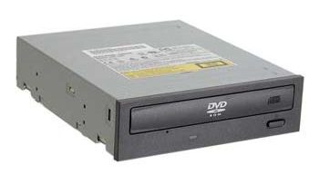
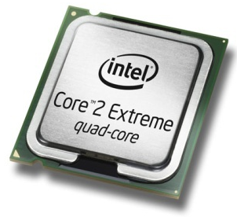
Hardware & Software
Hardware
All of the electronic and mechanical equipment in a computer is called the hardware. Examples include:
  Motherboard
  Hard disk
  RAM
  Power supply
  Processor
  Case
  Monitor
  Keyboard
  Mouse

Slide 4
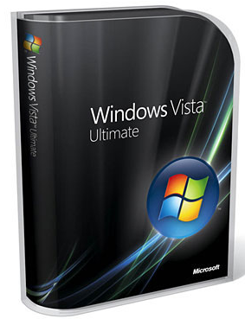


Hardware & Software
Software
The term software is used to describe computer programs that perform a task or tasks on a computer system. Software can be grouped as follows:
  System software - Operating System etc.
  Utility programs - Antivirus etc.
  Applications Software - Word, SolidWorks etc.

