Slide 1
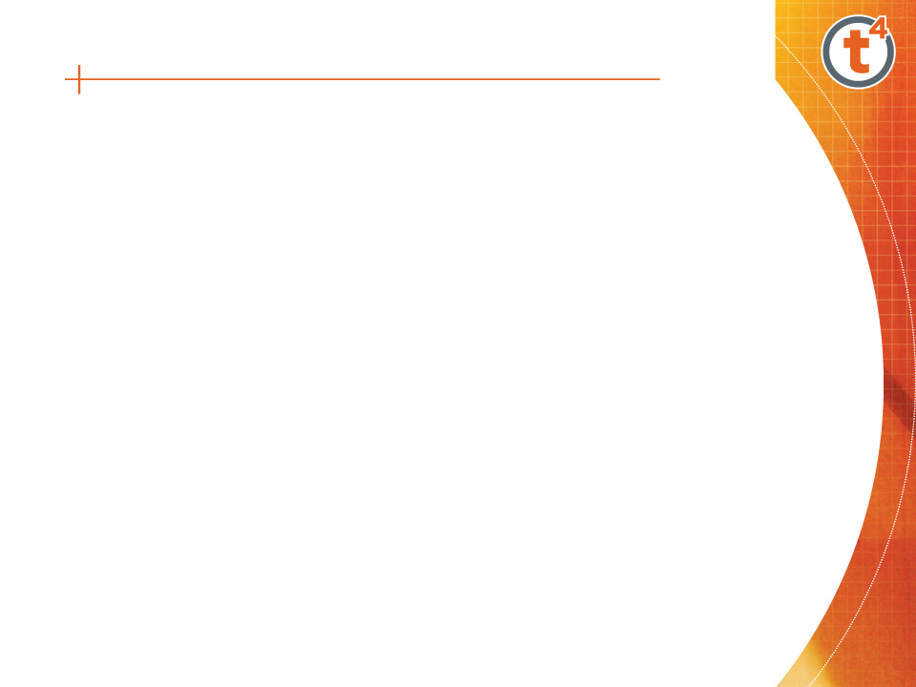
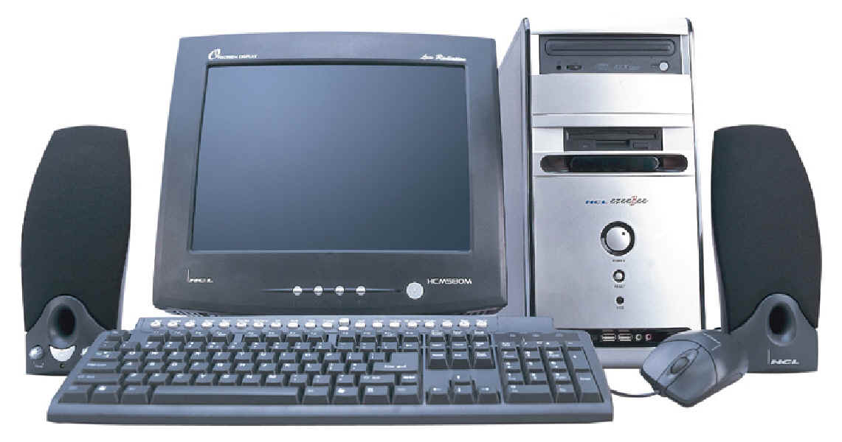
PC Components
Computer system - collection of electronic and mechanical devices operating as a unit. The main parts are:
System unit
Monitor
Keyboard
Mouse
Speakers
2
1
5
3
4
Notes:
<number>

Slide 2
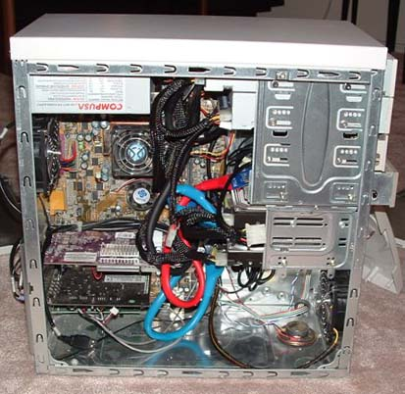
System Unit
The system unit is the main container for system devices. It protects the delicate electronic and mechanical devices from damage. Typical system unit devices include:
Motherboard
CPU (Processor)
Memory
Disk drives
Ports - USB etc.
Power supply
Expansion cards - sound card, network card, graphics card etc.
Notes:
<number>

Slide 3
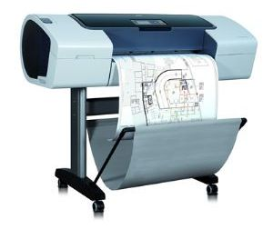
Peripherals
Peripherals are devices that connect to the system unit using cables or wireless technologies. Typical peripherals include:
Monitor
Keyboard
Printer
Plotter
Scanner
Speakers
Plotter
Notes:
<number>

Slide 4
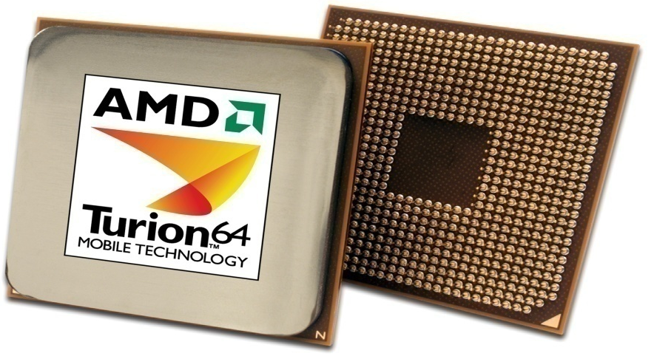
System Devices
Processor
An integrated circuit (IC) supplied on a single silicon chip. It’s function is to control all the computers functions. The main processor manufacturers are:
AMD - Athlon and Turion (mobile)
Intel - Pentium and Centrino (mobile)
AMD
Processor
Notes:
<number>

Slide 5
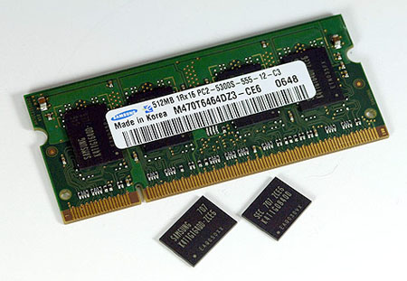
System Devices
Random Access Memory (RAM)
Primary storage - main computer memory. Data, programs currently in use are held in RAM
Volatile - contents of memory are lost if the computer is turned off
Memory
Module
IC’s
Notes:
<number>

Slide 6
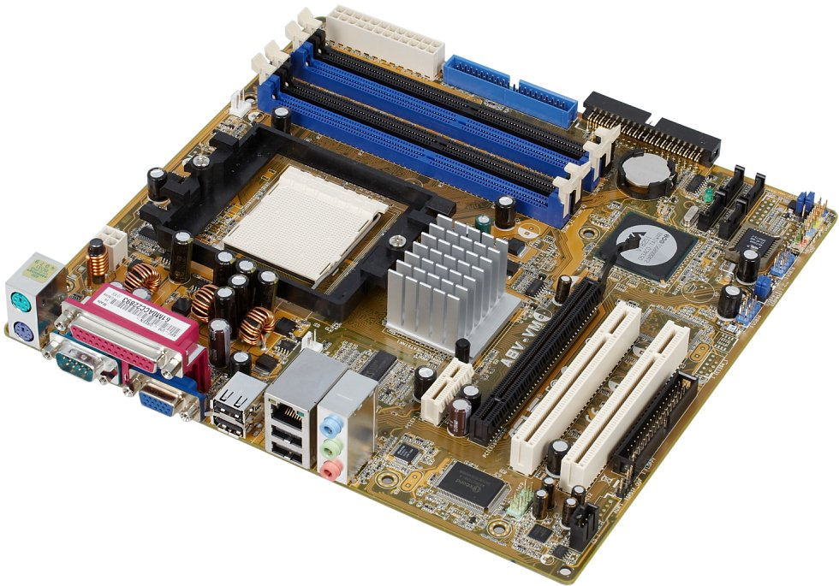
System Devices
Motherboard
Mainboard or system board - the main circuit board for the computer system. All device in the computer system will either be part of the motherboard or connected to it.
Memory Sockets
Processor Socket
Chipset
PCI Slots
Ports
Graphics Slot
Notes:
<number>

Slide 7

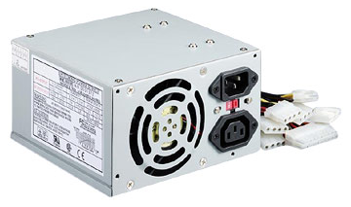
System Devices
Power Supply
A computer power supply has a number of functions:
Converts Alternating current (AC) to Direct current (DC)
Transforms mains voltage (240 Volts) to the voltages required by the computer. The main voltages are:
12 volts for the disk drives as they have motors
3.3 and 5 volts for the circuit boards in the computer
Notes:
<number>

Slide 8
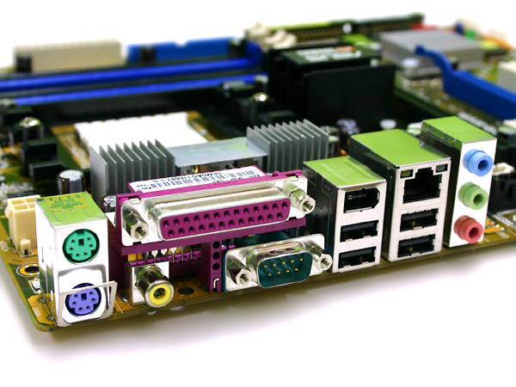
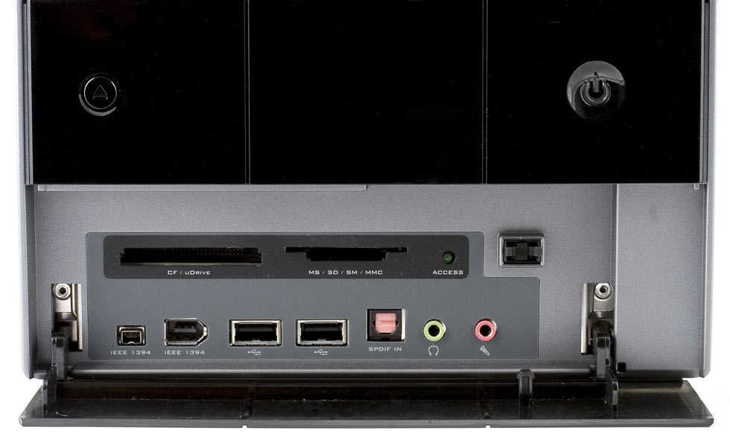
System Devices
Ports
Computer ports are interfaces between peripheral devices and the computer. They are mainly found at the back of the computer but are often also built into the front of the computer chassis for easy access.
Ports at the rear of the computer
Ports at the front of the computer
Notes:
<number>

Slide 9
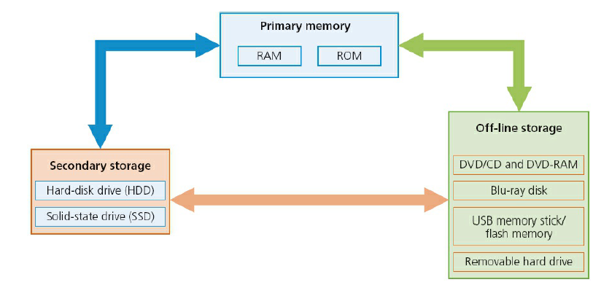
STORAGE DEVICES

Slide 10
INPUT DEVICES
Keyboard
Mice
Trackerball
Joystick
Numeric Keypad
Barcode Reader
MICR
OMR
Touch Screen

Slide 11
OUTPUT DEVICES
Monitors
Printers
Speakers
LCD Projectors

Slide 12
Activity
Divide into two groups(Boys and Girls)
The group should prepare 10 quiz questions from the topics.(with three options for each question)

