Slide 1
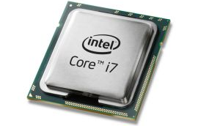
Processor

Slide 2
Processor
Process data
Searching,sorting,calculating and decision making takes place
measured in megahertz (MHz) or Gigahertz (GHz)
Latest trend - multi-core processors can have two, three or four processor cores on a single chip.

Slide 3
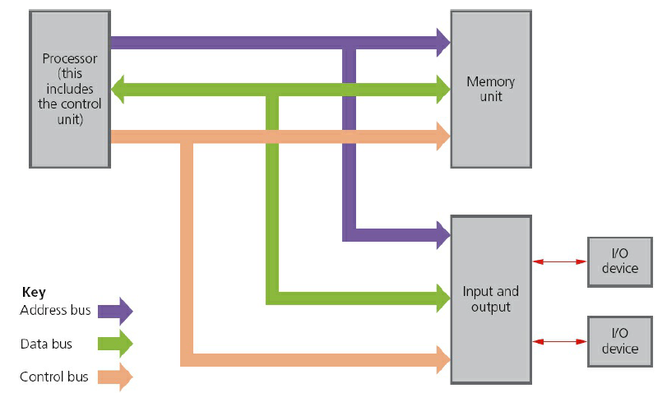
Computer Architecture

Slide 4
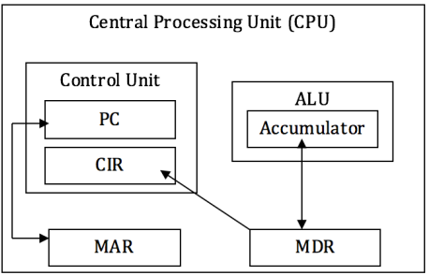
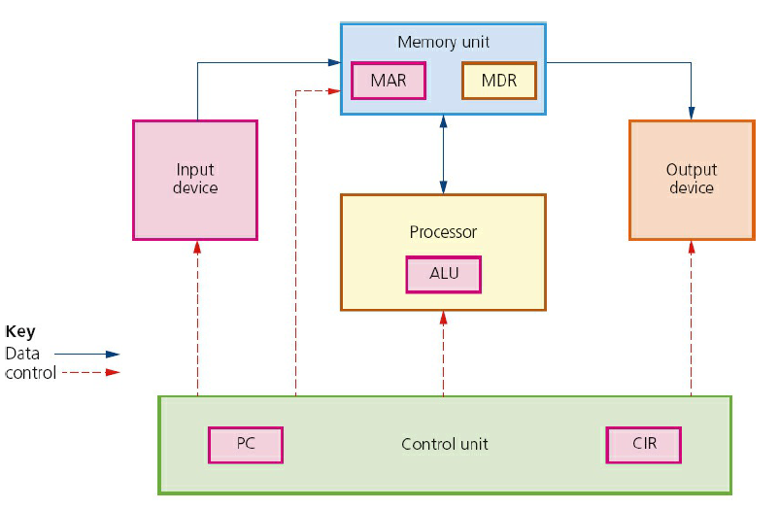
Detailed

Slide 5
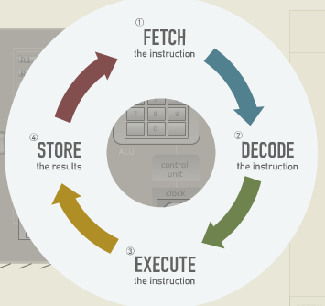
Fetch-Execute Cycle

Slide 6
Reference
http://web.eecs.utk.edu/research/cs100modules/module1/index.html

