Slide 1
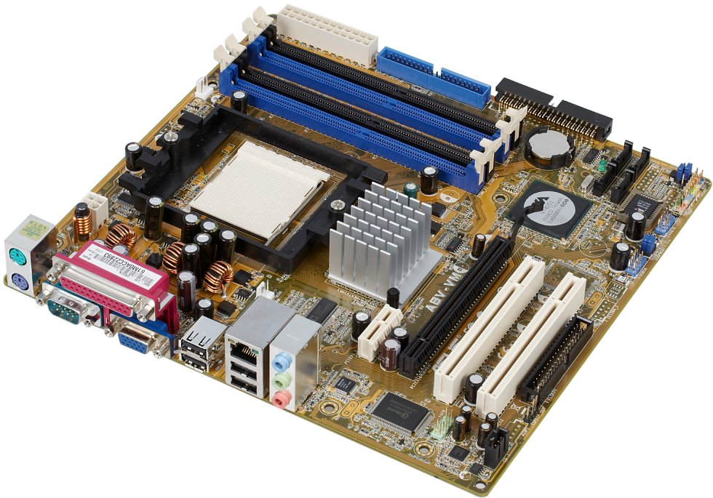
System Devices
Motherboard
Mainboard or system board - the main circuit board for the computer system. All device in the computer system will either be part of the motherboard or connected to it.
Memory Sockets
Processor Socket
Chipset
PCI Slots
Ports
Graphics Slot
Notes:
<number>

Slide 2
System Devices
Processor socket - different processors require different sockets and a motherboard must be chosen to suit the processor intended for use:
Socket 478 - Intel Pentium IV
Socket 775 - Intel Dual Core and Core Duo
Socket 754 - AMD Athlon
Socket 939 - AMD Athlon 64
Socket AM2 - AMD Athlon X2
Notes:
<number>

Slide 3
System Devices
Chipset - controls data flow around the computer. It consists of two chips:
Northbridge - data flow between memory and processor - data flow between the processor and the graphic's card
Southbridge - controls data flow to the devices - USB, IDE, SATA, LAN and Audio - controls PCI slots and on-board graphics
Notes:
<number>

Slide 4
System Devices
Buses - a path through which data can be sent to the different parts of the computer system. Main buses:
Processor
Front Side Bus
RAM
Northbridge
All Memory
Graphics Slot
PC-Express or AGP
Memory Bus
Graphics Bus
Internal Bus
Southbridge
IDE
SATA
USB
LAN
Audio
PCI Bus
Onboard
Graphics
PCI Slots
PCI Bus
Notes:
<number>

