Slide 1
CSS Padding
The CSS padding properties are used to generate space around content.
The padding clears an area around the content (inside the border) of an element.

Slide 2
Padding - Individual Sides
CSS has properties for specifying the padding for each side of an element:
padding-top
padding-right
padding-bottom
padding-left

Slide 3
Example
<!DOCTYPE html>
<html>
<head><style>
div {
border: 1px solid black;
background-color: lightblue;
padding-top: 50px;
padding-right: 30px;
padding-bottom: 50px;
padding-left: 80px;
}
</style></head>
<body>
<h2>Using individual padding properties</h2>
<div>This div element has a top padding of 50px, a right padding of 30px, a bottom padding of 50px, and a left padding of 80px.</div>
</body></html>

Slide 4
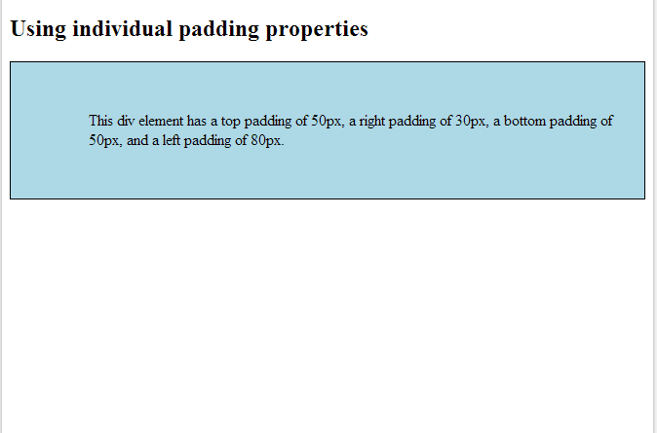
Output

Slide 5
Example 2
div.ex3 {
padding: 25px 50px;
}
div.ex4 {
padding: 25px;
}
</style>
</head>
<body>
<h2>Using the padding shorthand property</h2>
<div class="ex1">This div element has a top padding of 25px, a right padding of 50px, a bottom padding of 75px and a left padding of 100px.</div><br>
<div class="ex2">This div element has a top padding of 25px, a left and right padding of 50px, and a bottom padding of 75px.</div><br>
<div class="ex3">This div element has a top and bottom padding of 25px, and a left and right padding of 50px.</div><br>
<div class="ex4">This div element has a top, right, bottom and left paddding of 25px.</div>
</body>
</html>
<!DOCTYPE html>
<html>
<head>
<style>
div {
border: 1px solid black;
background-color: lightblue;
}
div.ex1 {
padding: 25px 50px 75px 100px;
}
div.ex2 {
padding: 25px 50px 75px;
}

