Slide 1
CSS Margins

Slide 2
CSS Margins
The CSS margin properties are used to generate space around elements.
The margin properties set the size of the white space outside the border.

Slide 3
Margin - Individual Sides
CSS has properties for specifying the margin for each side of an element:
margin-top
margin-right
margin-bottom
margin-left

Slide 4
Example-1
<!DOCTYPE html>
<html><head><style>
div {
border: 1px solid black;
margin-top: 100px;
margin-bottom: 100px;
margin-right: 150px;
margin-left: 80px;
background-color: lightblue;
}
</style></head>
<body>
<h2>Using individual margin properties</h2>
<div>This div element has a top margin of 100px, a right margin of 150px, a bottom margin of 100px, and a left margin of 80px.</div>
</body></html>

Slide 5
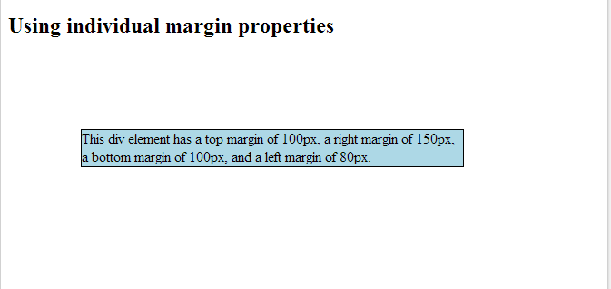
Output

Slide 6
Example -2
<!DOCTYPE html>
<html>
<head>
<style>
div {
border: 1px solid black;
margin: 100px 150px 100px 80px;
background-color: lightblue;
}
</style>
</head>
<body>
<h2>Using the margin shorthand property</h2>
<div>This div element has a top margin of 100px, a right margin of 150px, a bottom margin of 100px, and a left margin of 80px.</div>
</body>
</html>

Slide 7
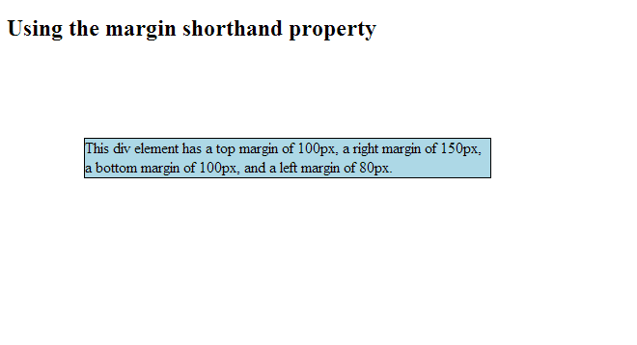
Output

Slide 8
Example 3
<!DOCTYPE html>
<html>
<head><style>
div {
width:300px;
margin: auto;
border: 1px solid red;
}
</style></head><body>
<h2>Use of the auto Value</h2>
<p>You can set the margin property to auto to horizontally center the element within its container.
The element will then take up the specified width, and the remaining space will be split equally between the left and right margins:</p>
<div>
This div will be centered because it has margin: auto;
</div></body></html>

Slide 9
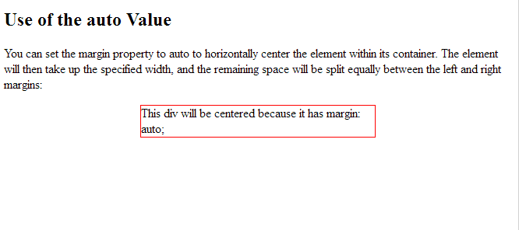
Output

