Slide 1
Lists
A list is a collection of items, which might be organized in a sequential or unsequential manner.

Slide 2
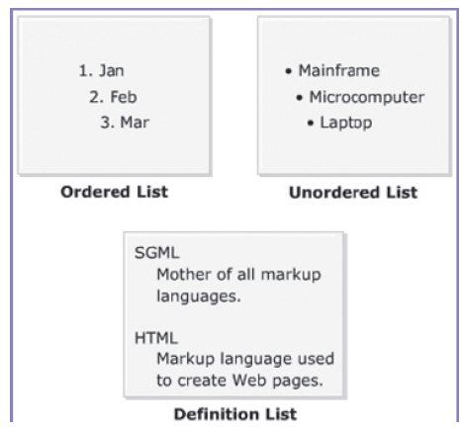
Different Types of Lists

Slide 3
Ordered List
An ordered list is a list of items arranged in a particular order. Here, the order of the items is important as it indicates a sequential flow.

Slide 4
Elements
HTML provides two elements for creating an ordered list. These are as follows:
OL: Creates an ordered list.
LI: Specifies an item and it is a sub-element of the OL element.

Slide 5
Example
<!DOCTYPE html>
<html>
<head>
<title>Days in a Week</title>
</head>
<body>
<h2>Days in a Week:</h2>
<ol>
<li>Sunday</li>
<li>Monday</li>
<li>Tuesday</li>
<li>Wednesday</li>
<li>Thursday</li>
<li>Friday</li>
<li>Saturday</li>
</ol>
</body>
</html>

Slide 6
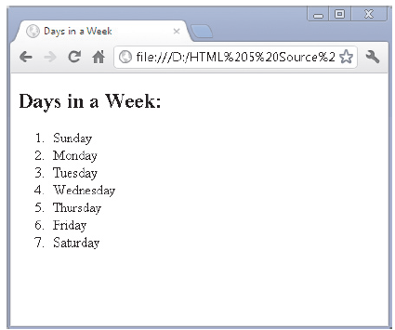
OUTPUT

Slide 7
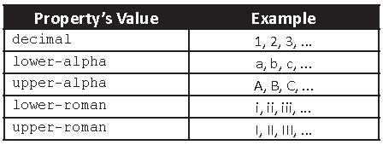
Different numbering styles

Slide 8
Property
The list-style-type property is used to specify a numbering style for the ordered list.
Example
<ol style=list-style-type:lower-roman>

Slide 9
Example
<ol style=list-style-type:lower-roman>
<li>Sunday</li>
<li>Monday</li>
<li>Tuesday</li>
<li>Wednesday</li>
<li>Thursday</li>
<li>Friday</li>
<li>Saturday</li>
</ol>

Slide 10
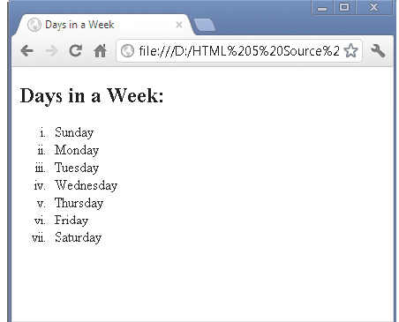
OUTPUT

Slide 11
Unordered List
An unordered list is a list where the items are arranged in a random order. This means that
you will create an unordered list when the order of related items is not important.

Slide 12
Example
<!DOCTYPE html>
<html>
<head>
<title>Features of EasyPad</title>
</head>
<body>
<h2>Features of EasyPad</h2>
<ul>
<li>Opens many files at a time</li>
<li>Unlimited undo and redo</li>
<li>Reads and writes both Windows and Unix files</li>
</ul>
</body>
</html>

Slide 13
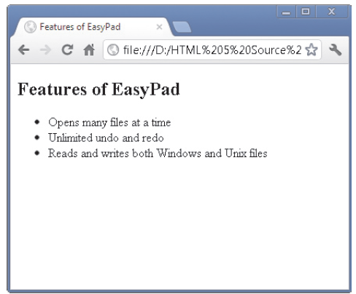
OUTPUT

Slide 14
Property
These bullet types are namely, disc, square, and circle.
The default value is disc, which is applied to the unordered list, even if the list-style-type property is not specified.

Slide 15
Example
<!DOCTYPE html>
<html>
<head>
<title>Wild Animals</title>
</head>
<body>
<h2>Wild Animals</h2>
<ul style=”list-style-type:square”>
<li>Lion</li>
<li>Tiger</li>
<li>Leopard</li>
<li>Wolf</li>
</ul>
</body>
</html>

Slide 16
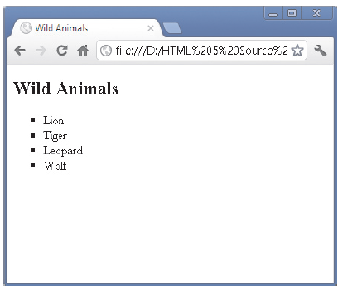
OUTPUT

Slide 17
Definition List
A definition list refers to a collection of terms with their corresponding descriptions.
You can specify a single line or multiple lines of description for each term.
HTML provides three elements to create a definition list.

Slide 18
Elements
DL
Is a container element that consists of the DT and DD sub-elements. It specifies that a definition list will be created using these elements.
DT
Specifies the term to be defined or described.
DD
Specifies the definition or description of the term.

Slide 19
Example
<!DOCTYPE html>
<html>
<head>
<title>Types of Nouns</title>
</head>
<body>
<h2>Types of Nouns</h2>
<dl>
<dt><b>Common Noun:</b></dt>
<dd>It is a name of an object in general, such as
pencil, pen, paper, and so on.</dd>
<dt><b>Proper Noun:</b></dt>
<dd>It is the unique name of a person or a place.
</dd>
</dl>
</body>
</html>

Slide 20
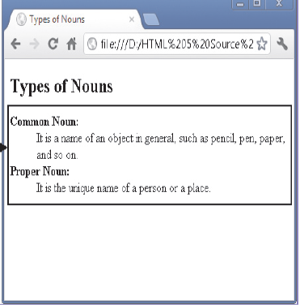
OUTPUT

Slide 21
Background Colors
Syntax:
<body bgcolor=”color_name|hex_number|rgb_number”>

Slide 22
Example
<html>
<body bgcolor=”#E6E6FA”>
<h1>Hello world!</h1>
<p><a href=”http://www.w3schools.com”>
Visit W3Schools.com!</a></p>
</body>
</html>

Slide 23
Way 2
Syntax
style=”background-color: color” attribute.
Example
<body style=”background-color: yellow”>

Slide 24
Foreground color
The default text color of the page is specified as the foreground color.
Syntax
style=”color: color” attribute
Example:
<body style=”background-color: navy; color: yellow”>

