Slide 1
HTML Entities
Entities are special characters that are reserved in HTML.
Syntax:
&entity_name;
OR
&#entity_number

Slide 2
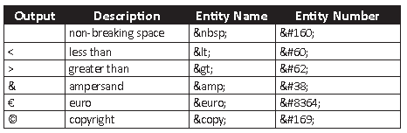
Entities

Slide 3
Container Tags
A container element includes the start tag, contents, sub-elements, and end tag.
All the basic

Slide 4
Standalone Tags
A standalone element consists of the start tag

Slide 5
HGROUP
The <hgroup> element is a new element defined in HTML5. It is used to group titles and their subtitles.
The element is used to group a set of h1–h6 elements.
The main advantage of using the <hgroup> tag is to create a document outline.
<hgroup>
<h1>Title of Post One </h1>
<h2>Subtitle of Post One </h2>
</hgroup

Slide 6
Formatting
The content format determines how the content will appear in the browser
B
I
SMALL
U

Slide 7
Sample Code
<!DOCTYPE html>
<html>
<head>
<title>Formats</title>
</head>
<body>
<h2>Using HTML Formatting Elements</h2><br>
<b>This text is displayed in bold.</b><br>
<i>This text is displayed in italic.</i><br>
<u>This text is underlined.</u><br>
<small>This text is displayed smaller.</small>
</body>
</html>

Slide 8
DEL
The DEL element encloses text, which has been deleted from the document.
The text to

Slide 9
INS
The INS element encloses text, which has been inserted in the document. The text to

Slide 10
Sample Code
<!DOCTYPE html>
<html>
<head>
<title>Updating and Shifting Text</title>
</head>
<body>
<h3>Updating, Emphasizing, and Shifting Text</h3>
This is an example of <del>deleted</del> <ins>inserted
</ins> text.<br/>
This is an example of <strong>Strong</strong> text.<br/>
This is an example of <sub>subscript</sub>text.<br/>
This is an example of <sup>superscript</sup> text.<br/>
</body>
</html>

Slide 11
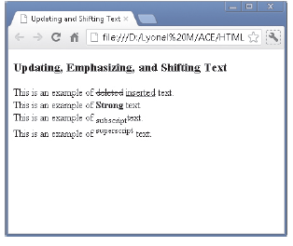
OUTPUT

Slide 12
<q>
The HTML <q> element defines a short quotation.
Browsers usually insert quotation marks around the <q> element.

Slide 13
Sample Code
<!DOCTYPE html>
<html>
<body>
<p>Browsers usually insert quotation marks around the q element.</p>
<p>WWF's goal is to: <q>Build a future where people live in harmony with nature.</q></p>
</body>
</html>

Slide 14
Format a Block Quotation
To define a long quotation or block quotation, the <blockquote> tag can be used.
When the <blockquote> tag is used, the quotation is indented in browsers.
<blockquote>
“When one door closes, another opens; but we often look so long
and so regretfully upon the closed door that we do not see the
one which has opened for us.” -Alexander Graham Bell
</blockquote

Slide 15
<abbr> for Abbreviations
The HTML <abbr> element defines an abbreviation or an acronym.
Marking abbreviations can give useful information to browsers

Slide 16
Sample Code
<!DOCTYPE html>
<html>
<body>
<p>The <abbr title="World Health Organization">WHO</abbr> was founded in 1948.</p>
</body>
</html>

Slide 17
<address> for Contact Information
The HTML <address> element defines contact information (author/owner) of a document or an article.
The <address> element is usually displayed in italic. Most browsers will add a line break before and after the element.

Slide 18
Sample Code
<!DOCTYPE html>
<html>
<body>
<p>The HTML address element defines contact information (author/owner) of a document or article.</p>
<address>
Written by John Doe.<br>
Visit us at:<br>
Example.com<br>
Box 564, Disneyland<br>
USA
</address>
</body>
</html>

Slide 19
HTML Colors
<!DOCTYPE html>
<html>
<body>
<h1 style="background-color:Tomato;">Tomato</h1>
<h1 style="background-color:Orange;">Orange</h1>
<h1 style="background-color:DodgerBlue;">DodgerBlue</h1>
<h1 style="background-color:MediumSeaGreen;">MediumSeaGreen</h1>
<h1 style="background-color:Gray;">Gray</h1>
<h1 style="background-color:SlateBlue;">SlateBlue</h1>
<h1 style="background-color:Violet;">Violet</h1>
<h1 style="background-color:LightGray;">LightGray</h1>
</body>
</html>

Slide 20
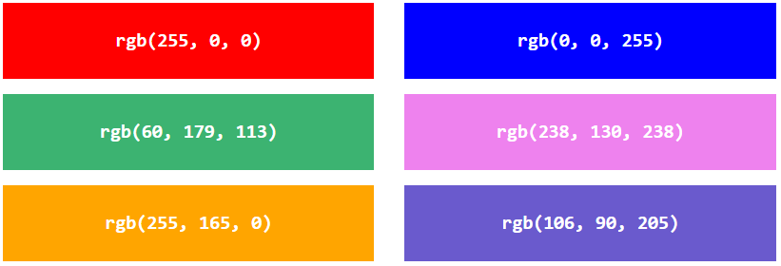
RGB Value

Slide 21
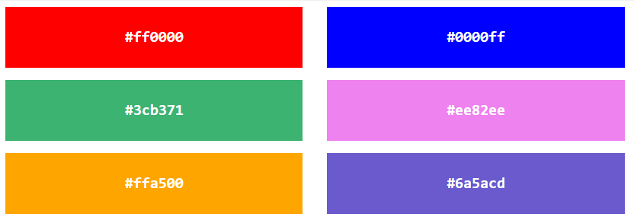
HEX Value

Slide 22
HSL Value
hsl(hue, saturation, lightness)
Hue is a degree on the color wheel from 0 to 360. 0 is red, 120 is green, and 240 is blue.
Saturation is a percentage value, 0% means a shade of gray, and 100% is the full color.
Lightness is also a percentage, 0% is black, 50% is neither light or dark, 100% is white

Slide 23
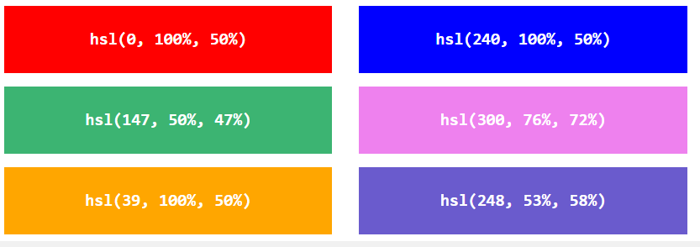
Example

Slide 24
RGBA Value
rgba(red, green, blue, alpha)
The alpha parameter is a number between 0.0 (fully transparent) and 1.0 (not transparent at all):

Slide 25
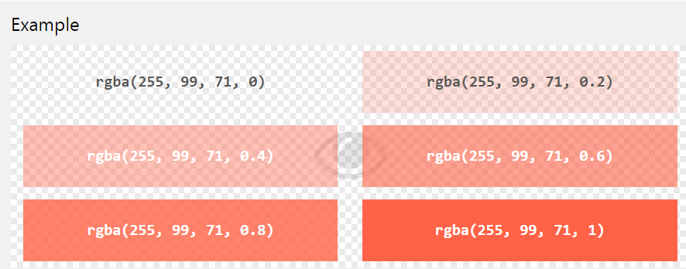
Example

Slide 26
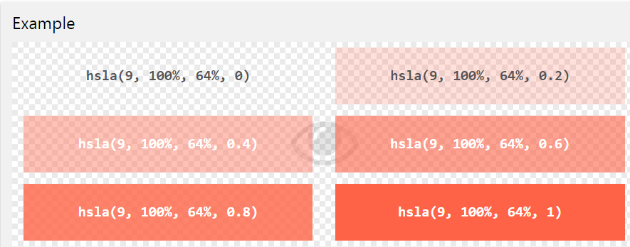
HSLA Value

