Slide 1
Diploma in Information Technology

Slide 2
SEMESTER I
Building Next Generation Websites.
Web Page Development Using Adobe Dreamweaver CS
Computer Statistics
Photoshop
eProject (Website Development)

Slide 3
SEMESTER-II
Database Management
Effective Communication Skills
Hardware and Networking
Programming Logic and Practices
eProject (RDBMS)

Slide 4
Subject Details
Subject Name: Building Next Generation Websites
Subject Code Number: DBW
Credits: 18, learning hours: 180 and contact hours: 60

Slide 5
HTML
HTML stands for Hypertext Markup Language, and it is the most widely used language to write Web Pages.
Hypertext refers to the way in which Web pages (HTML documents) are linked together. Thus, the link available on a webpage is called Hypertext.
As its name suggests, HTML is a Markup Language which means you use HTML to simply "mark-up" a text document with tags that tell a Web browser how to structure it to display.

Slide 6
Evolution of HTML
HTML(I) was created in 1990 as a way to electronically connect documents via hyperlinks.

Slide 7
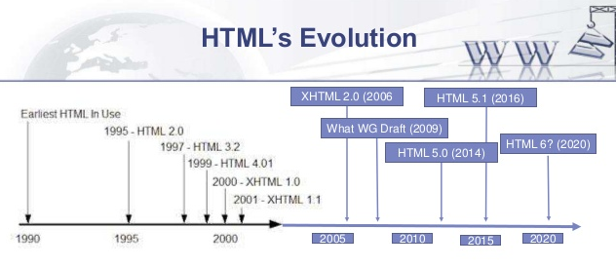

Slide 8
HTML
HTML, or Hypertext Markup Language, is used to create the basic structure and content of a webpage

Slide 9
CSS
CSS, or Cascading Style Sheets, is used for the design of a webpage – where everything is placed and how it looks.

Slide 10
Java Script
JavaScript is used to define the interactive elements of a webpage that help to engage users.

Slide 11
Activity 1
History of HTML

Slide 12
Activity 2
Disadvantages of XHTML and HTML 4

