Slide 1
Static Web Pages
A static Web page consists of contents specified by the Web page designer.
These contents include text, images, audios, and videos. The same content is displayed to each user on the Internet each time the page is requested.

Slide 2
Dynamic Web Pages
A dynamic Web page generates content ‘on-demand’ when user provides certain inputs.
It accepts the inputs from the user based on which it displays the content in the browser.
Example
Online Store

Slide 3
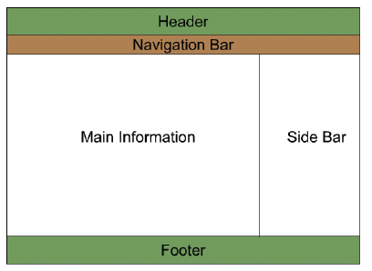
Layout of a Page in HTML5

Slide 4
New Features of HTML5
The <canvas> element is used for 2D drawing.
New content-specific elements, such as <article>, <nav>, <header>, <footer>,<section>, and so on helps to structure the document.
HTML5 has local storage support.
The <audio> and <video> elements is available for media playback.
New form controls, such as calendar, date, time, e-mail, URL, search, and so on have been provided by HTML5.

Slide 5
New Features of HTML5-Continued
The Web workers API is added to support background processes without disturbing the main process.
Easier access to location specific data which is made available by devices having Global Positioning System (GPS) capabilities

Slide 6
HTML Element
An HTML element usually consists of a start tag and end tag, with the content inserted in between:

Slide 7

HTML Attributes
All HTML elements can have attributes
Attributes provide additional information about an element
Attributes are always specified in the start tag
Attributes usually come in name/value pairs like: name="value"

Slide 8
Doctype
The DOCTYPE element informs the browser the HTML version number of your document.
It is the first declaration in the HTML5 document before any other HTML code is written.
Example
<!DOCTYPE html>

Slide 9
BASIC TAGS

Slide 10
HTML
The HTML element is the root element that marks the beginning of an HTML document.
It contains the start and end tag in the form of <HTML> and </HTML> respectively.
It is the largest container element as it contains various other elements.

Slide 11
HEAD
The HEAD element provides information about the Web page such as keywords and language used, which is not displayed on the Web page.

Slide 12
TITLE
The TITLE element allows you to specify the title of the Web page under the <TITLE> and </TITLE> tags.
The title is displayed on the Title bar of the Web browser.
The TITLE element is included within the HEAD element.

Slide 13
Link
The <link> tag is used to define the association between a document and an external resource.
It is used to link stylesheets.

Slide 14
BODY
The BODY element enables you to add content on the Web page specified under the <BODY> and </BODY> tags.
Content can include text, hyperlinks, and images.
You can display the content using various formatting options such as alignment, color, and background.

Slide 15
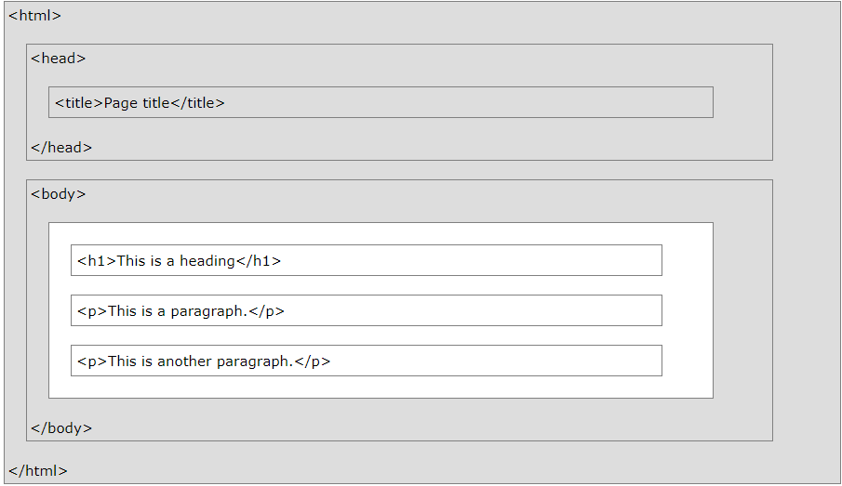
HTML Page Structure

