Slide 1
Network Attached Storage (NAS)
Mohamed usman

Slide 2
What will be covered
Introduction
Example Use Cases
File Sharing Protocols Used

Slide 3
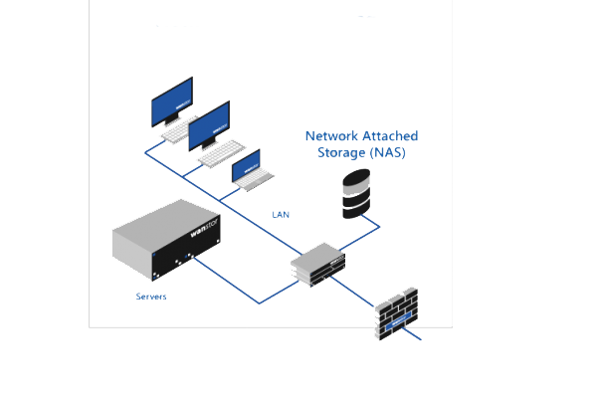
Introduction
A computer connected to a network
Provides file-based data storage services to other devices on the network
It’s not a general purpose server
It can run other applications which are also usually related to file sharing
Usually do not have input/output devices like keyboard and monitor
All configurations are done through the network, often using the built-in web console
Runs an Operating System specifically developed for the purpose
Contains one or more hard disk drives usually configured as arrays of redundant storage containers

Slide 4
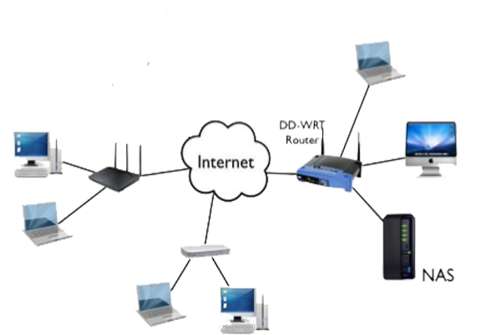
Example Use Cases
Provide centralized storage solution to store and share files to devices and PCs in a small network like in an office or a classroom
Use as a simple low-cost email and web server with load balancing
Use as a media server to store and share photos, movies and TV shows with members in a family

Slide 5
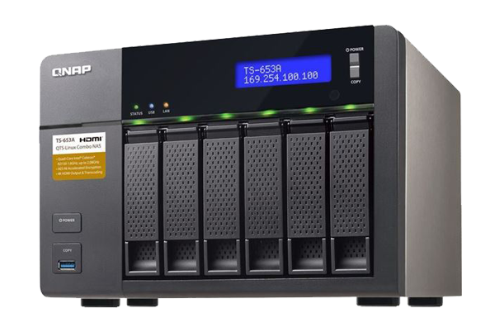
List of Network Protocols Used
Andrew File System (AFS)
Apple Filing Protocol (AFP) – used in Apple devices
Server Message Block (SMB) – mostly used in Windows Operating System (supported in other OSes too)
File Transfer Protocol (FTP) – a universal protocol (insecure)
Hypertext Transfer Protocol (HTTP) – a universal protocol to serve web pages
Network File System (NFS) – mostly used in Linux clients
rsync – ideal for incremental backups
SSH File Transfer Protocol (SFTP) – a universal protocol (more secure choice of FTP)
Universal Plug and Play (UPnP) – supported in most media players like VLC and Handheld media players

Slide 6
Advantages
Easier to install
No server downtime
Economical (relatively low-cost to setup and maintain)
Dedicated for storage services only
User authentication and authorization is built-in

Slide 7
Disadvantages
Takes up network resources like bandwidth and IP addresses
Expansion is limited to hardware resources
Performance is limited to network capabilities

