Slide 1
Grouping HTML Elements
There are two important tags which we use very frequently to group various other HTML tags
(i) <div> tag and
(ii) <span> tag

Slide 2
The <div> tag
Grouping various other HTML tags and applying CSS on group of elements.
Syntax:
<div>
Contents
</div>

Slide 3
Example
<!DOCTYPE html>
<html>
<head>
<title>HTML div Tag</title>
</head>
<body>
<!-- First group of tags -->
<div style="color:red">
<h4>This is first group</h4>
<p>Following is a list of vegetables</p>
<ul>
<li>Beetroot</li>
<li>Ginger</li>
<li>Potato</li>
<li>Radish</li>
</ul>
</div>
<!-- Second group of tags -->
<div style="color:green">
<h4>This is second group</h4>
<p>Following is a list of fruits</p>
<ul>
<li>Apple</li>
<li>Banana</li>
<li>Mango</li>
<li>Strawberry</li>
</ul>
</div>
</body>
</html>

Slide 4
The <span> tag
The HTML <span> is an inline element and it can be used to group inline-elements in an HTML document.
The difference between the <span> tag and the <div> tag is that the <span> tag is used with inline elements whereas the <div> tag is used with block-level elements.

Slide 5
Example
<!DOCTYPE html>
<html>
<head>
<title>HTML span Tag</title>
</head>
<body>
<p>This is <span style="color:red">red</span> and this is <span style="color:green">green</span></p>
</body>
</html>

Slide 6
CSS Margins

Slide 7
CSS Margins
The CSS margin properties are used to generate space around elements.
The margin properties set the size of the white space outside the border.

Slide 8
Margin - Individual Sides
CSS has properties for specifying the margin for each side of an element:
margin-top
margin-right
margin-bottom
margin-left

Slide 9
Example-1
<!DOCTYPE html>
<html><head><style>
div {
border: 1px solid black;
margin-top: 100px;
margin-bottom: 100px;
margin-right: 150px;
margin-left: 80px;
background-color: lightblue;
}
</style></head>
<body>
<h2>Using individual margin properties</h2>
<div>This div element has a top margin of 100px, a right margin of 150px, a bottom margin of 100px, and a left margin of 80px.</div>
</body></html>

Slide 10
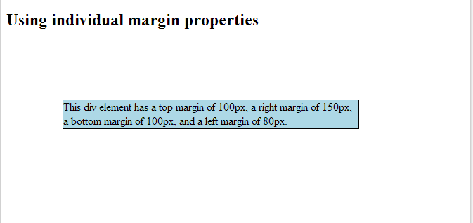
Output

Slide 11
Example -2
<!DOCTYPE html>
<html>
<head>
<style>
div {
border: 1px solid black;
margin: 100px 150px 100px 80px;
background-color: lightblue;
}
</style>
</head>
<body>
<h2>Using the margin shorthand property</h2>
<div>This div element has a top margin of 100px, a right margin of 150px, a bottom margin of 100px, and a left margin of 80px.</div>
</body>
</html>

Slide 12
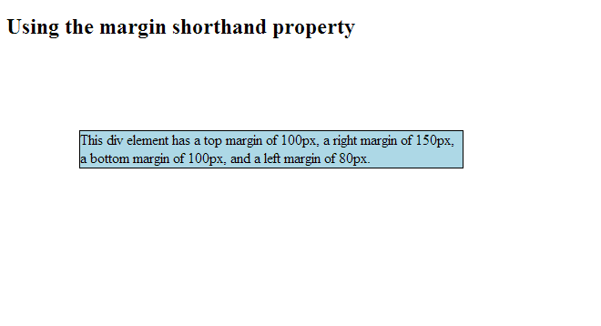
Output

Slide 13
Example 3
<!DOCTYPE html>
<html>
<head><style>
div {
width:300px;
margin: auto;
border: 1px solid red;
}
</style></head><body>
<h2>Use of the auto Value</h2>
<p>You can set the margin property to auto to horizontally center the element within its container.
The element will then take up the specified width, and the remaining space will be split equally between the left and right margins:</p>
<div>
This div will be centered because it has margin: auto;
</div></body></html>

Slide 14
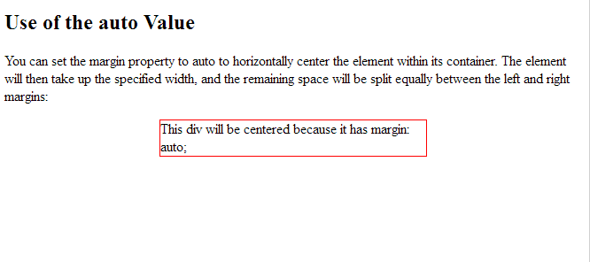
Output

Slide 15
CSS Padding
The CSS padding properties are used to generate space around content.
The padding clears an area around the content (inside the border) of an element.

Slide 16
Padding - Individual Sides
CSS has properties for specifying the padding for each side of an element:
padding-top
padding-right
padding-bottom
padding-left

Slide 17
Example
<!DOCTYPE html>
<html>
<head><style>
div {
border: 1px solid black;
background-color: lightblue;
padding-top: 50px;
padding-right: 30px;
padding-bottom: 50px;
padding-left: 80px;
}
</style></head>
<body>
<h2>Using individual padding properties</h2>
<div>This div element has a top padding of 50px, a right padding of 30px, a bottom padding of 50px, and a left padding of 80px.</div>
</body></html>

Slide 18
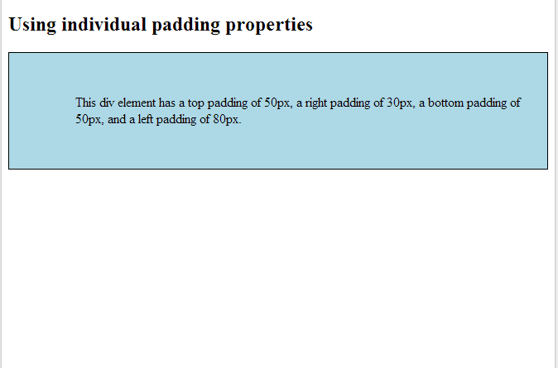
Output

Slide 19
Example 2
div.ex3 {
padding: 25px 50px;
}
div.ex4 {
padding: 25px;
}
</style>
</head>
<body>
<h2>Using the padding shorthand property</h2>
<div class="ex1">This div element has a top padding of 25px, a right padding of 50px, a bottom padding of 75px and a left padding of 100px.</div><br>
<div class="ex2">This div element has a top padding of 25px, a left and right padding of 50px, and a bottom padding of 75px.</div><br>
<div class="ex3">This div element has a top and bottom padding of 25px, and a left and right padding of 50px.</div><br>
<div class="ex4">This div element has a top, right, bottom and left paddding of 25px.</div>
</body>
</html>
<!DOCTYPE html>
<html>
<head>
<style>
div {
border: 1px solid black;
background-color: lightblue;
}
div.ex1 {
padding: 25px 50px 75px 100px;
}
div.ex2 {
padding: 25px 50px 75px;
}

Slide 20
CSS Height and Width
The height and width properties are used to set the height and width of an element.
The height and width can be set to auto (this is default. Means that the browser calculates the height and width), or be specified in length values, like px, cm, etc., or in percent (%) of the containing block.

Slide 21
Example 1
<!DOCTYPE html>
<html>
<head>
<style>
div {
height: 200px;
width: 50%;
background-color: powderblue;
}
</style>
</head>
<body>
<h2>Set the height and width of an element</h2>
<p>This div element has a height of 200px and a width of 50%:</p>
<div></div>
</body>
</html>

Slide 22
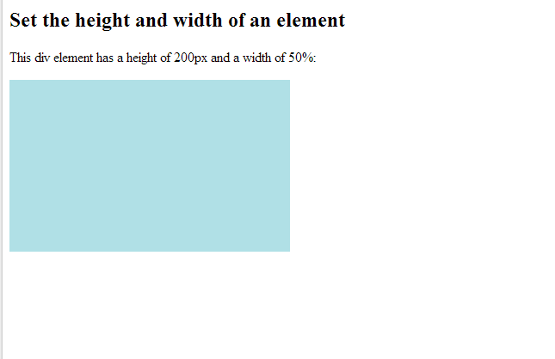
Output

Slide 23

CSS Box Model
The CSS box model is essentially a box that wraps around every HTML element. It consists of: margins, borders, padding, and the actual content.

Slide 24
Example
<!DOCTYPE html>
<html><head><style>
div {
background-color: lightgrey;
width: 300px;
border: 25px solid green;
padding: 25px;
margin: 25px;
}
</style></head><body>
<h2>Demonstrating the Box Model</h2>
<p>The CSS box model is essentially a box that wraps around every HTML element. It consists of: borders, padding, margins, and the actual content.</p>
<div>This text is the actual content of the box. We have added a 25px padding, 25px margin and a 25px green border. Ut enim ad minim veniam, quis nostrud exercitation ullamco laboris nisi ut aliquip ex ea commodo consequat. Duis aute irure dolor in reprehenderit in voluptate velit esse cillum dolore eu fugiat nulla pariatur. Excepteur sint occaecat cupidatat non proident, sunt in culpa qui officia deserunt mollit anim id est laborum.</div>
</body></html>

