Slide 1
CSS background properties
background-color
background-image
background-repeat
background-attachment
background-position

Slide 2
Background Color
The background-color property specifies the background color of an element.

Slide 3
Example 1
<html>
<head>
<style>
body {
background-color: lightblue;
}
</style>
</head>
<body>
<h1>Hello World!</h1>
<p>This page has a light blue background color!</p>
</body>
</html>

Slide 4
Example 2
<!DOCTYPE html>
<html>
<head>
<style>
h1 {
background-color: green;
}
div {
background-color: lightblue;
}
p {
background-color: yellow;
}
</style>
</head>
<body>
<h1>CSS background-color example!</h1>
<div>
This is a text inside a div element.
<p>This paragraph has its own background color.</p>
We are still in the div element.
</div>
</body>
</html>

Slide 5
Background Image
The background-image property specifies an image to use as the background of an element.

Slide 6
Example
<!DOCTYPE html>
<html>
<head>
<style>
body {
background-image: url(“Type your image name");
}
</style>
</head>
<body>
<h1>Hello World!</h1>
<p>Strange background image...</p>
</body>
</html>

Slide 7
Background Image - Repeat Horizontally or Vertically
By default, the background-image property repeats an image both horizontally and vertically.
Some images should be repeated only horizontally or vertically

Slide 8
Example
<!DOCTYPE html>
<html>
<head>
<style>
body{
background-image: url("gradient_bg.png");
}
</style>
</head>
<body>
<h1>Hello World!</h1>
<p>Strange background image...</p>
</body>
</html>

Slide 9
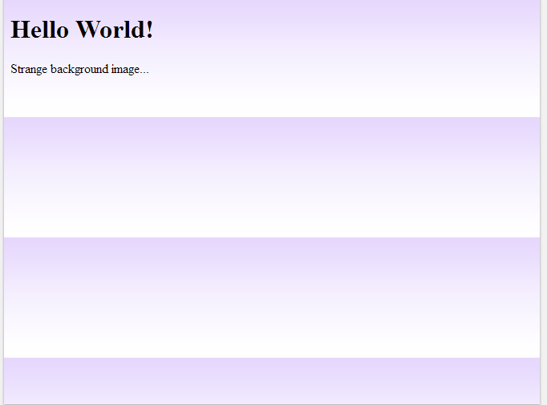
Output

Slide 10
Example-Using Repeat
<!DOCTYPE html>
<html>
<head>
<style>
body {
background-image: url("gradient_bg.png");
background-repeat: repeat-x;
}
</style>
</head>
<body>
<h1>Hello World!</h1>
<p>Here, a backgound image is repeated only horizontally!</p>
</body>
</html>

Slide 11
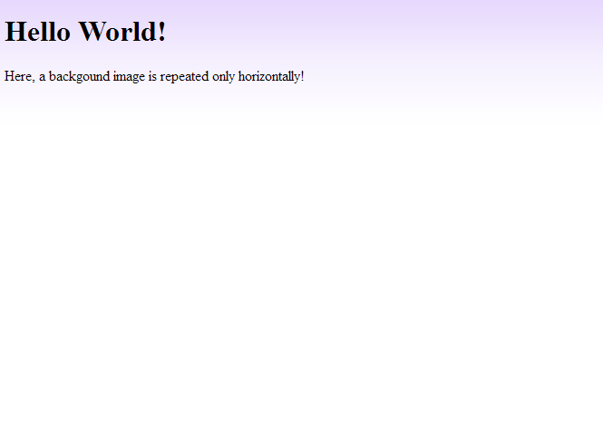
Output

Slide 12
Background Image - Set position and no-repeat
Showing the background image only once is also specified by the background-repeat property.
The position of the image is specified by the background-position property:

Slide 13
Example-No Repeat
<!DOCTYPE html>
<html>
<head>
<style>
body {
background-image: url("img_tree.png");
background-repeat: no-repeat;
}
</style>
</head>
<body>
<h1>Hello World!</h1>
<p>W3Schools background image example.</p>
<p>The background image is only showing once, but it is disturbing the reader!</p>
</body>
</html>

Slide 14
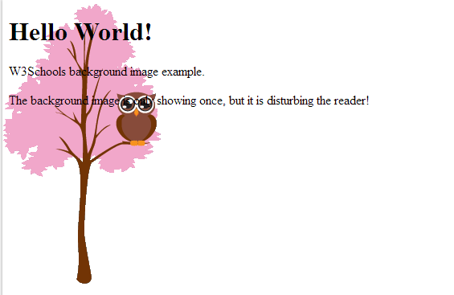
Output

Slide 15
Example-Set position
<!DOCTYPE html>
<html>
<head>
<style>
body {
background-image: url("img_tree.png");
background-repeat: no-repeat;
background-position: right top;
margin-right: 200px;
}
</style>
</head>
<body>
<h1>Hello World!</h1>
<p>W3Schools background no-repeat, set position example.</p>
<p>Now the background image is only shown once, and positioned away from the text.</p>
<p>In this example we have also added a margin on the right side, so the background image will never disturb the text.</p>
</body>
</html>

Slide 16
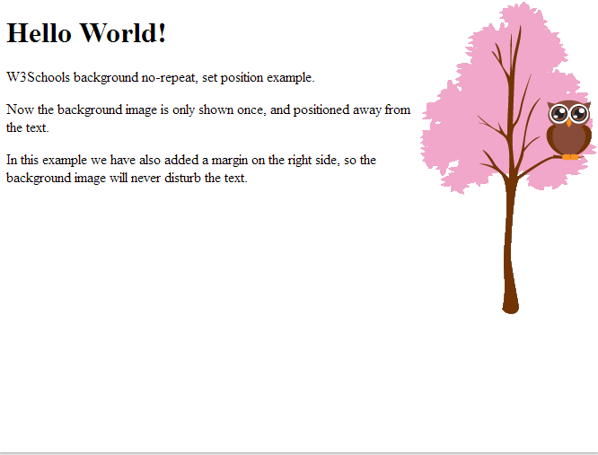
Output

Slide 17
Background Image - Fixed position
To specify that the background image should be fixed (will not scroll with the rest of the page), use the background-attachment property:

Slide 18
Example
body { background-image: url("img_tree.png"); background-repeat: no-repeat; background-position: right top; background-attachment: fixed; }

Slide 19
Background - Shorthand property
To shorten the code, it is also possible to specify all the background properties in one single property. This is called a shorthand property.
The shorthand property for background is background

Slide 20
Example
<!DOCTYPE html>
<html>
<head>
<style>
body {
background: #ffffff url("img_tree.png") no-repeat right top;
}
</style>
</head>
<body>
<h1>Hello World!</h1>
<p>Now the background image is only shown once, and it is also positioned away from the text.</p>
<p>In this example we have also added a margin on the right side, so that the background image will not disturb the text.</p>
</body>
</html>

