Slide 1
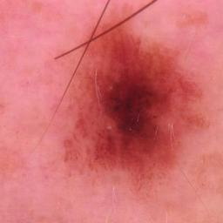
Inputs
Metadata-Guided
Gated Fusion
Outputs
Image Encoder
fᵥ = Eᵥ(x)
Dermoscopic
image x
EfficientNet-B0
Evidential
Classification Head
1 Concatenate features
Dirichlet Modeling
Class
→
→
{
;
}
→
α = e + 1
...
[ fᵥ ; fₘ ]
e = softplus(Wef + be)
Prob.
dᵥ
2 Gate generation
pk = αk / Σαk
→
→
→
g = sigmoid(Wg [fᵥ ; fₘ] + bg)
evidence for each class
Unc.
Clinical metadata m
0.12
0.76
…
0.31
0.85
Metadata Encoder
fₘ = Eₘ(m)
Refer
Age
3 Gated visual feature
→
p1 p2 pk
Sex
→
→
⊗
e1 e2 ... eK
u = K / Σαk
...
→
→
Linear
ReLU
Linear
ReLU
Linear
f_g = g ⊙ fᵥ
Anatomical site
4 Final fused representation
⋮
f = [ fᵥ ; fₘ ; f_g ]
dₘ
;
;
Uncertainty-Guided Selective Prediction
Low u: diagnose
High u: refer
Evaluation: ISIC2018 internal test | PAD-UFES-20 external validation | Ablation | Calibration | Grad-CAM++ | DCA
Metadata-guided fusion, evidential uncertainty, and selective referral are evaluated as the main reliability evidence.

