Slide 1
GLOBAL FUEL
PRICING
A data story of prices, taxes, income levels and subsidies
Dataset period: 6 Jan 2020 – 6 Apr 2026 | 84 countries | 27,468 records
STORY-DRIVEN ANALYSIS

Slide 2
1. The question behind the numbers
INTRODUCTION
Research question
Data & approach
• Why do fuel prices differ so widely across countries and regions?
• How did average fuel prices move from 2020 through the available part of 2026?
• How are taxes, income levels and subsidy categories associated with prices?
• 27,468 weekly records across 84 countries and 7 regions.
• Fuel measures: petrol, diesel and LPG in USD per litre; Brent crude in USD; tax percentage and subsidy category.
• Compare group averages and annual averages; use correlation as association, not proof of cause.
Source: supplied global_fuel_prices_Dataset(2).csv
02

Slide 3
2. What the dataset covers
SCOPE & INTERPRETATION
27,468
84
7
2020–2026
records
countries
regions
2026 data ends 6 April
Important reading note
The final year is partial, so its average is not a full-year result. The file contains no missing values in the checked columns. Tax and subsidy fields are treated as recorded categories/measurements; the dataset alone cannot prove policy causes.
All findings below are descriptive averages from this file, not live market quotations.
Source: supplied global_fuel_prices_Dataset(2).csv
03

Slide 4
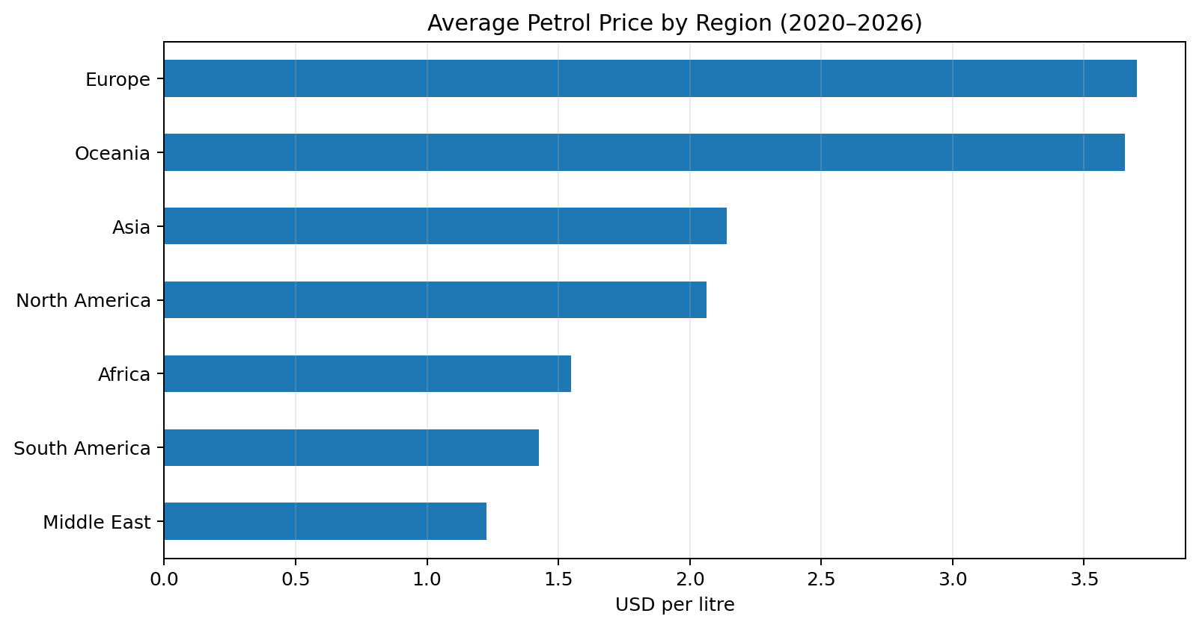
3. Geography changes the price at the pump
GEOGRAPHIC DISPARITY
What stands out
• Europe has the highest regional average petrol price: $3.70/L.
• Middle East has the lowest regional average: $1.23/L.
• Europe's average is about 3.0× the Middle East average.
• Differences can reflect taxes, market structure, logistics and policy—not crude prices alone.
Source: supplied global_fuel_prices_Dataset(2).csv
04

Slide 5
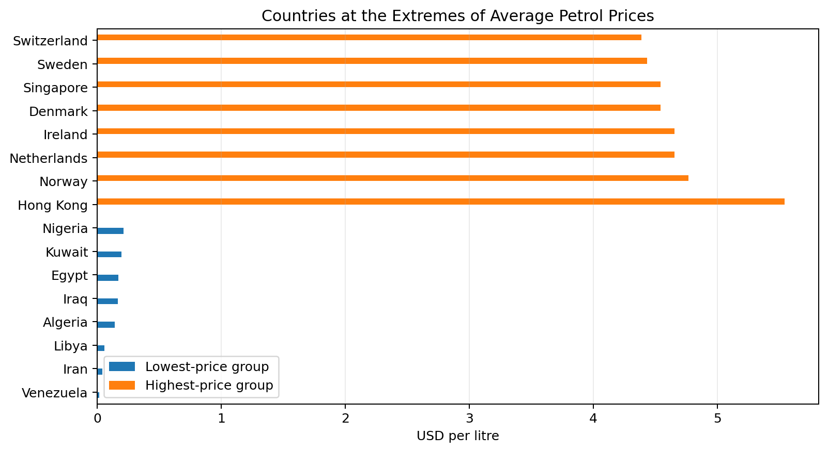
4. Country-level extremes
SAME PRODUCT, DIFFERENT PRICE
Interpretation
• Lowest average-price examples include Venezuela, Iran, Libya, Algeria.
• Highest average-price examples include Denmark, Singapore, Sweden, Switzerland.
• These are dataset averages over the available observations, not a statement about today's pump price.
• Country comparisons are more useful when paired with taxes, subsidies and income context.
Source: supplied global_fuel_prices_Dataset(2).csv
05

Slide 6
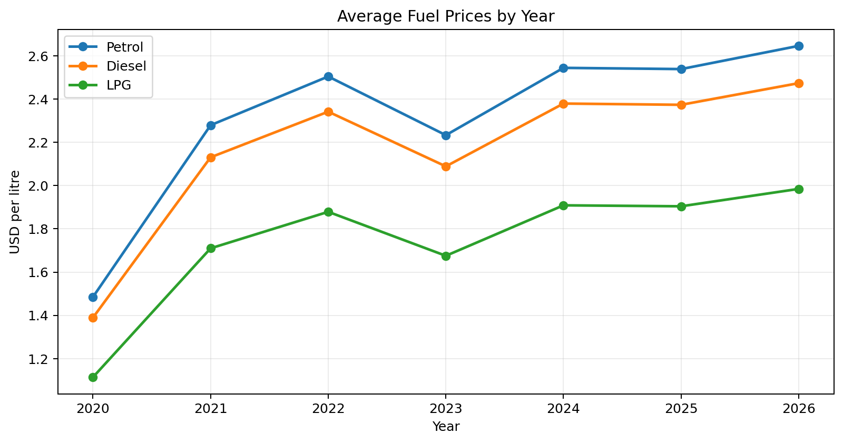
5. Prices rose, eased, then climbed again
TEMPORAL TRENDS: ANNUAL AVERAGE
Story in the trend
• Petrol average: $1.48/L in 2020 → $2.51/L in 2022.
• It eased to $2.23/L in 2023, then rose again in later observations.
• The partial 2026 average is $2.65/L; 2026 only runs through 6 April.
• Diesel and LPG broadly follow the same direction in this dataset.
Source: supplied global_fuel_prices_Dataset(2).csv
06

Slide 7
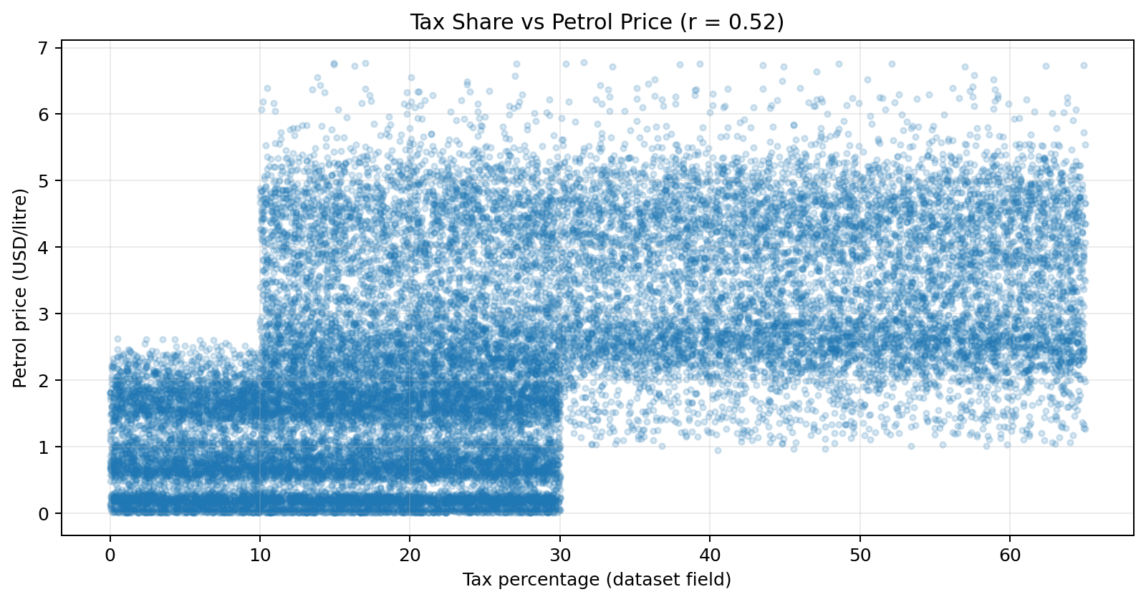
6. Taxation is associated with higher prices
TAXATION POLICY
What the data suggests
• Petrol price and tax percentage show a positive correlation (r = 0.52).
• In this dataset, observations with higher tax percentages tend to have higher petrol prices.
• Correlation does not establish that tax alone caused the price difference.
• A stronger policy study would compare countries over time and control for crude costs, exchange rates and subsidies.
Source: supplied global_fuel_prices_Dataset(2).csv
07

Slide 8
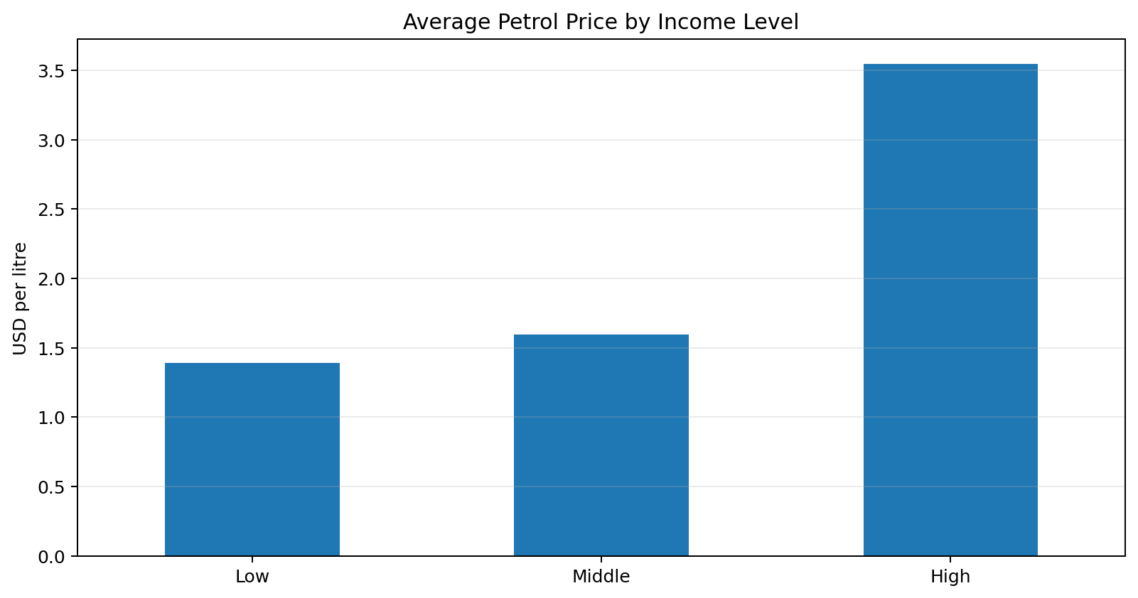
7. Income level and fuel price
ECONOMIC CONTEXT
Key comparison
• High-income group average: $3.55/L.
• Middle-income group average: $1.59/L.
• Low-income group average: $1.39/L.
• This is a group-level association; it does not mean income alone determines retail prices or affordability.
Source: supplied global_fuel_prices_Dataset(2).csv
08

Slide 9
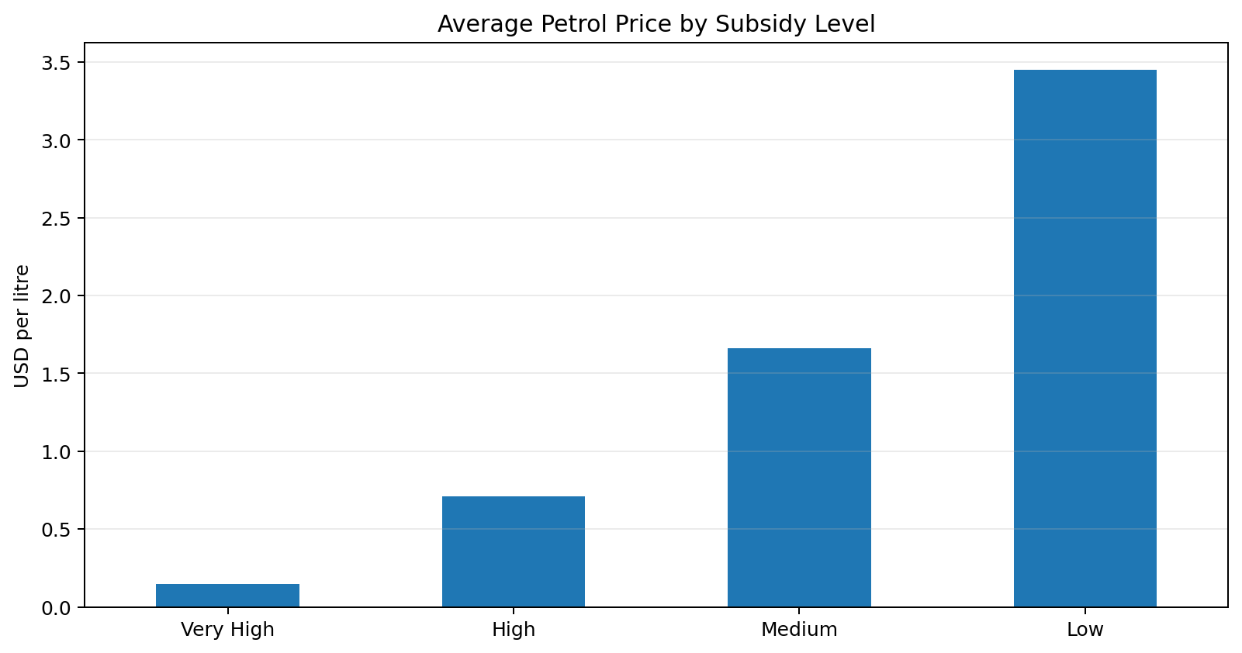
8. Subsidy categories and observed prices
GOVERNMENT SUPPORT
What stands out
• Very-high-subsidy group average: $0.15/L.
• Low-subsidy group average: $3.45/L.
• Lower average prices appear in the higher-subsidy categories in this dataset.
• This is not causal proof: subsidy labels may co-vary with country, tax policy and market conditions.
Source: supplied global_fuel_prices_Dataset(2).csv
09

Slide 10
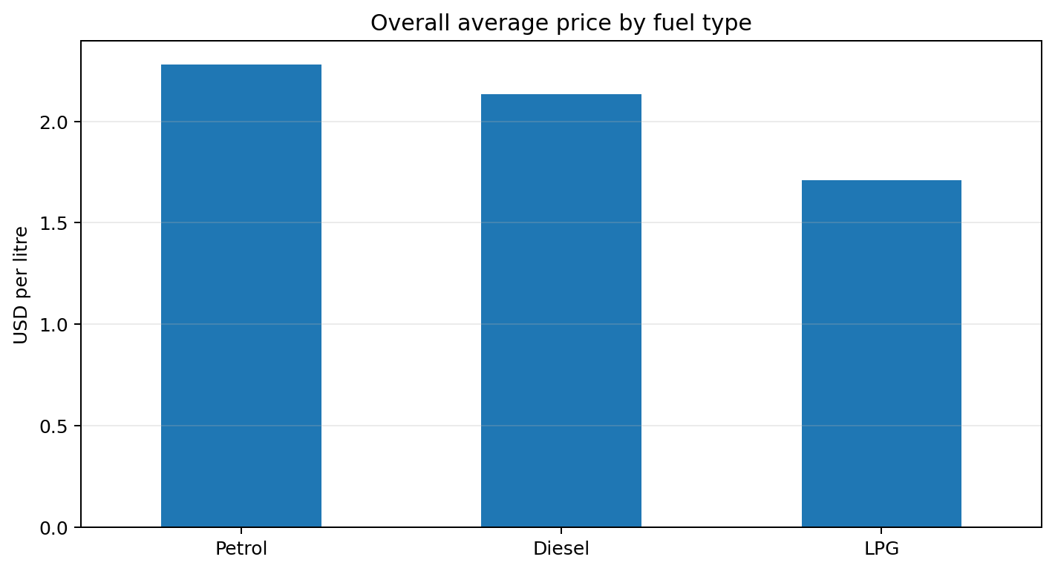
9. Petrol, diesel and LPG
FUEL-TYPE COMPARISON
Reading the comparison
• Petrol overall mean: $2.28/L.
• Diesel overall mean: $2.13/L.
• LPG overall mean: $1.71/L.
• Across the dataset, LPG is the lowest-priced of these three fuels on average.
Source: supplied global_fuel_prices_Dataset(2).csv
10

Slide 11
10. Conclusions & recommendations
FROM DATA TO DECISIONS
What the story tells us
Recommendations
• Fuel prices differ sharply by region and country.
• Annual averages show a rise after 2020, a dip in 2023, and higher readings afterward.
• Tax percentage and subsidy category are meaningfully associated with observed prices.
• Income groups also differ, but affordability requires income-to-fuel-cost measures—not price alone.
• Publish transparent fuel-price breakdowns: crude, refining, distribution, tax and subsidy.
• Target support to vulnerable households and essential transport where needed.
• Assess subsidies against fiscal cost, access and environmental goals.
• Use monthly/weekly monitoring and control for exchange rates and crude benchmarks before causal claims.
Source: supplied global_fuel_prices_Dataset(2).csv
11

Slide 12
THE TAKEAWAY
Fuel prices are not just about oil.
Geography, taxation, income context and government support all appear alongside large differences in observed prices.
Limitations
This is a descriptive analysis of the supplied file. 2026 is partial; fields are not independently verified here; correlations do not prove causation. Affordability also depends on household income and fuel consumption.
Thank you | Questions?

