Slide 1
A Randomized Approach To Extract New Words From Social Media
Ravee Khandagale
Cs 255

Slide 2
Agenda
Motivation
Basics to know- Data set Information and Terms
Approaches used: Existing and Randomization
Implementation
Analysis: Time Vs Accuracy
Conclusion
Future Work

Slide 3
Motivation and Application
There is massive generation of data on social media. For Twitter, this data is in the form of tweets, each tweet consists of trending words.
The main application of this approach is to identify tweets and topics related to the topics on which we have posted by searching through the dictionaries to which the words in our tweet belong.
For this, we need to relate words to a appropriate topics in a timely manner.

Slide 4
Things to Remember
We want to assign New Words to appropriate dictionaries. We would like to do this in as less time as possible.
The proposed approach of randomization tries to reduce the time required to find the appropriate dictionary for a new word with a tradeoff on accuracy.
Because, we lose out on accuracy, this approach can be used as a filter applied before subjecting the data/ tweets to some sophisticated algorithms like those of machine learning/ sentimental analysis.

Slide 5
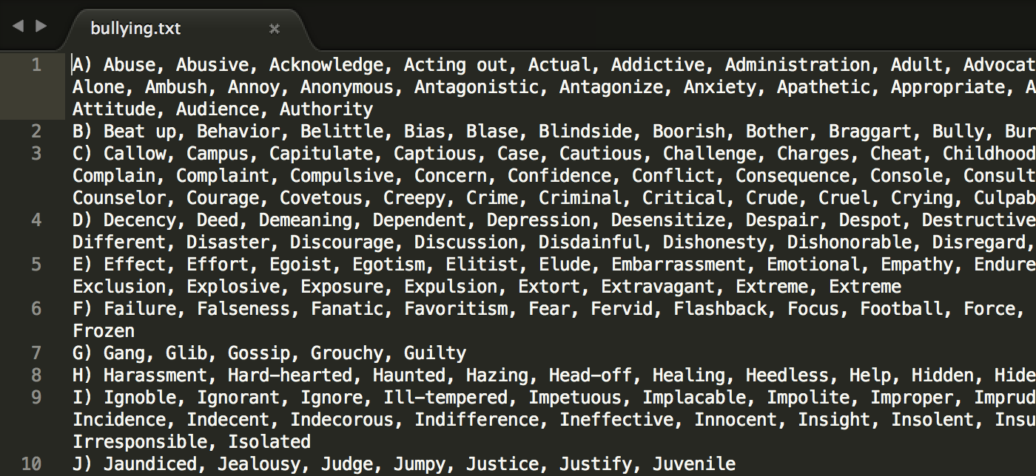
Terms
Dictionary: A set of words that are closely related to each other in meaning /topics. There are many dictionaries in social media. Examples of dictionaries are:
Bullying (This dictionary represents all negative connotation words)
Philanthropy (This dictionary includes words with positive connotation)
Sports (This includes sports- related terms)
Education (This includes words related to learning and education)
There are two types of words: New words and Existing Words
Existing Word: Already identified to belong to a particular dictionary.
E.g.: Golf belongs to the dictionary of Sports (
New word :A word which does not belong to pre-existing Social-media dictionaries.
E.g.: When ISIS was trending in social media, it did not belong to/ was not defined in any of the pre-existing social-media dictionaries.
Bullying Dictionary Snapshot

Slide 6
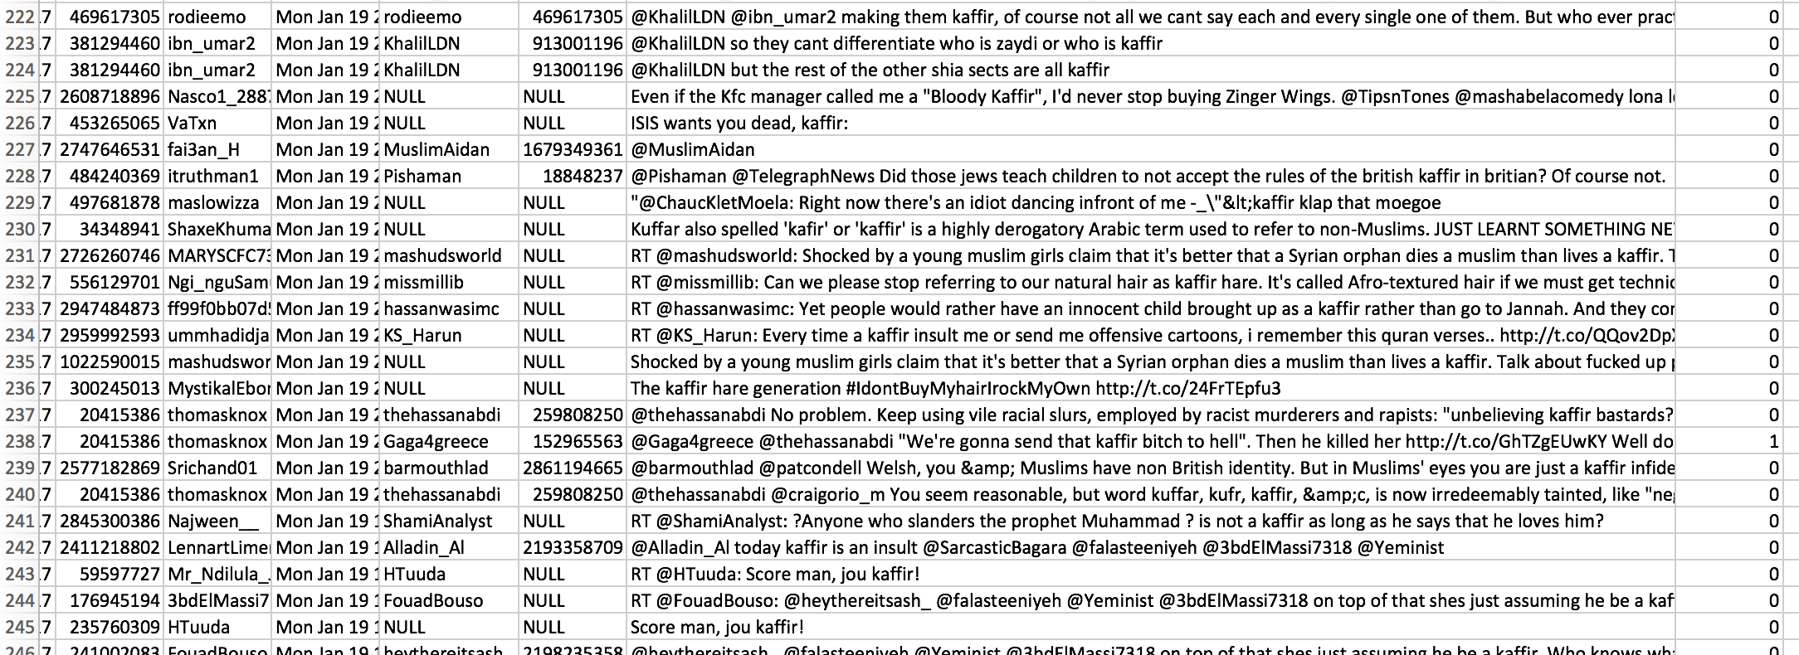
Data Set: Twitter Data Set

Slide 7
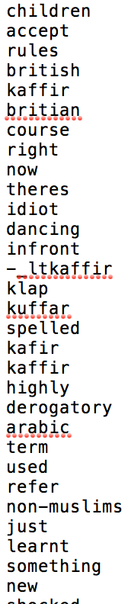
Data Cleaning
Use Data Crawling to generate Data Set from Twitter
Extracting Tweets from the data
Extracting words from data
Tokenizing
Removing stop words from the set of words generated
Stemming Words to its original form, e.g. Worrying->Worry
This is the basic approach before starting this Algorithm

Slide 8
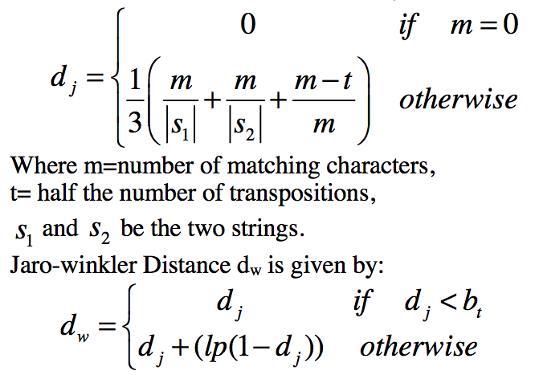
An Important Concept: Jaro Winkler Distance(JW)
After stemming words to their original form, we have to find out if the words already exists to pre-existing dictionaries or not.
I, as well as the authors of the paper proposing the existing solution have used Jaro Winkler distance to calculate this.
Jaro Winkler distance finds the likelihood of two strings being similar.
It is a number between 0 and 1, the greater number indicating higher likelihood.
E.g.: JW between love and beloved is 0.812

Slide 9
Existing Solution Approach
Existing solution compares every incoming word from tweets with each word in all the dictionaries. (hold on to this thought- I have introduced Randomization here)
It then assigns it to the dictionary if the Jaro Winkler distance for it is greater than the defined threshold.
Example Output for identifying the group of the word birthday.
For a particular tweet, there are going to be two sets of words generated:
New Words (Nw)
Existing Words (Ne) {The word birthday is not identified as an existing word.}
Next Step: Generate the network of nodes.

Slide 10
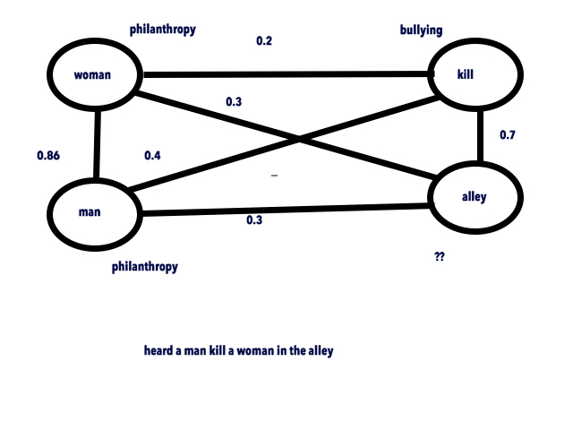
Generate Network of Nodes
Nodes: All the words identified as new and existing in a particular tweet
Woman belongs to dictionary Philanthropy
Kill belongs to dictionary Bullying
Man belongs to dictionary Philanthropy
Alley does not belong to any dictionary
Edges: An edge exists between the nodes if:
probability between two nodes is more than zero.
0.2 is the Jaro Winkler distance between woman and kill. The edge between woman and kill is weighted 0.2.
Accordingly form a network of nodes to form a
Weighted graph

Slide 11
Updating the Dictionary
For any node containing a new word, select the best neighboring node such that:
The probability between the new node and the neighboring node is greater than 0.5 and
The probability between the new node and the neighboring node is greater than the probability between the new node and any other neighboring node
Update Dictionary: Add the word to the dictionary to which the existing word belongs.

Slide 12
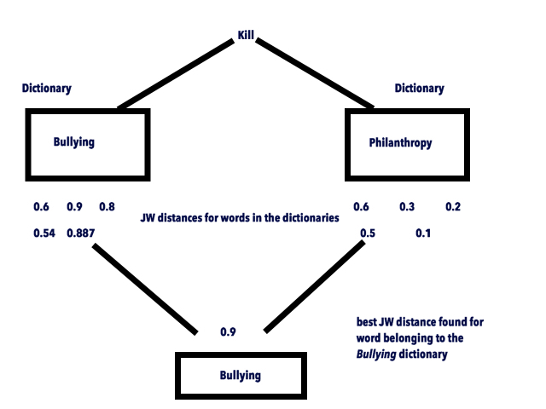
Why I used Randomization
Remember "hold on to this thought?"…
Existing solution compares each word with each word in all the dictionaries and assign it to the dictionary if the Jaro Winkler distance for it is greater than the defined threshold.
This requires a linear search and compare
For the number of words in dictionaries summing to 10 million, it would require to compare 10 million words.
Is there a way to improve this?

Slide 13
Randomization Algorithm: On-line Hiring Problem Inspired Approach
1. For four dictionaries containing 500 words in total, we choose 500/3 number of words randomly from the four dictionaries. Let’s call this as SampleList
2. Set WordWithBestDistance= null
3. For an incoming streaming word W, calculate JaroWinkler(W, SampleList[i]) where SampleList[i] is a word from the SampleList created in step 1.
3. if JaroWinkler(W, SampleList[i])> JaroWinkler(WordWithBestDistance, W)
Assign WordWithBestDistance=SampleList[i]
4. set ThresholdDistance= WordWithBestDistance.distance
5. Now remove words from SampleList from all the dictionaries

Slide 14
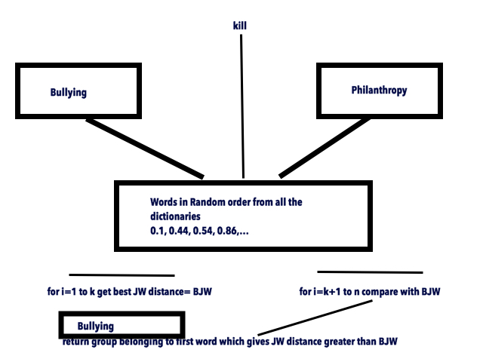
Randomization Algorithm: On-line Hiring Problem Inspired Approach
6. UpdatedList -obtained after removing SampleList words from the dictionaries
7. Compare JaroWinkler(UpdatedList[i], W) to ThresholdDistance
8. Stop if JaroWinkler(UpdatedList[i], W) >ThresholdDistance
9. Identify the word as existing or new and assign Jaro Winkler distance and proceed

Slide 15
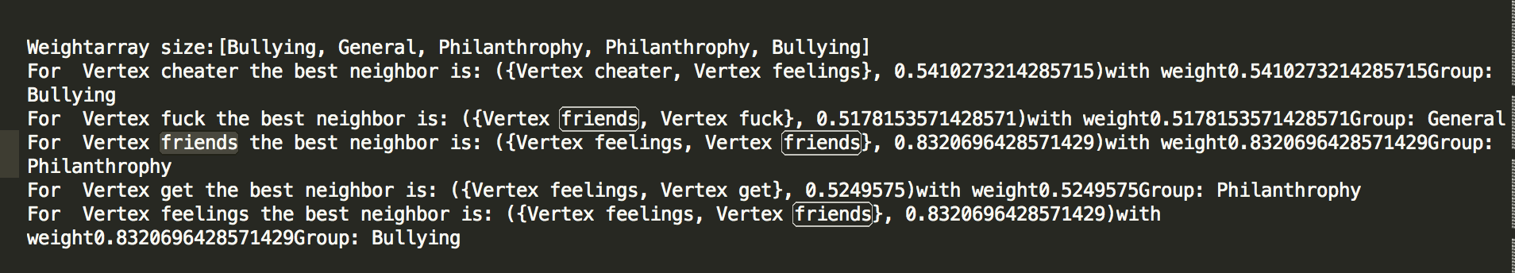


Running the Program
This output is for the tweet words: cheater, fuck, friends, feelings

Slide 16
Analysis
Existing Solution:
For each incoming streaming word,
Compare to all words in the dictionaries ,
For n words in dictionary, Compare n times each word
Therefore, for m words, there will be m *n comparisons
My Solution: Online-hiring inspired approach
For each incoming streaming word:
For n words in dictionary, Compare at least (n/3 times + 1) each word
How?
K=n/3 times for calculating threshold
Best case: k+1st word will be returned for Jaro winkler distance greater than the threshold
For m words, there will be m *(k+1)= m*(n/3+1) comparisons for best case

Slide 17
Analysis: Time Reduction
In implementing the existing solution,
For n=4990 words in the dictionary and incoming words m=50,230,
We will need 50,230*4990=250,647,700 comparisons
Time Taken for processing 50,230 words: 137365 milliseconds
For the modified randomized approach, and incoming words m=50,230, for 4990 words in dictionaries
Minimum comparisons:(4990/3)~1663-, 50,230*1663=83,532,490 + i number of comparisons at most
Now, 1<i<n-k… k=1663, n=4990
1<i<3327
Time Taken: 117622 milliseconds
Total Reduction in time: 14.31 %

Slide 18
Analysis: Time Graph
ms
Number Of Words

Slide 19
Analysis: Accuracy
We can see that the time taken for modified randomization approach is lesser than the time taken by existing solution
However, this has incurred a cost
This cost is in terms of accuracy.
We will see in the following graph slide how accuracy is getting affected by randomization approach.
Note: In fact, the authors of the original paper claim to have less accuracy too!
Accuracy based on the data set I used:
Existing Solution:
Total words mapped correctly: 41,690
Total words processed: 50,230
Accuracy: 82.998%
Randomization Approach:
Total words mapped correctly: 36991
Total words processed: 50,230
Accuracy: 73.690%

Slide 20
Accuracy Graph

Slide 21
Conclusion
By applying Randomization, we have achieved the following results in comparison to existing solution
Processing time is reduced by 14.31 % at the cost of
Accuracy which is 73.690%
This approach is very good for applications which are time-sensitive which can afford a compromise on accuracy.

Slide 22
Future Work
Study/look up practical issues or difficulties for this approach
Can we drop any tweets/ Messages to analyze within an x- time window?
An alternative to Jaro Winkler method to find similarity between strings
Machine Learning implementation on the data after these primary results

Slide 23
References
[1] Geetika Sarna, MPS Bhatia, “A Probalistic Approach to Automatically Extract New Words from Social Media”
[2] Li, Z., Zhou, D., Juan, Y. and Han, J. 2010, “ Keyword Extraction for Social Snippets”, WWW Raleigh, North Carolina, USA. ACM
[3] Turney, P.,” Learning Algorithms for Keyphrase Extraction”, 1999. Information Retrieval — INRT National Research Council Canada.
[4] http://www.wordstream.com/articles/keyword-research-for-social-media-guide

Slide 24
Questions?

