Slide 1
Supporting Multitenancy on a Cloud Platform
Ravee Khandagale
Sahil Motadoo Advisor: Dr. Melody Moh

Slide 2
Contents
Multitenancy in cloud
RBAC
Tomcat
Scalability
Workflow
References

Slide 3
Multitenancy on Cloud
Multitenancy helps tenants to use a common application workflow at the same time.
● Tenants have their own personal instance of the application that they use or deploy
● They ideally should not have knowledge or access to other tenants and their instances
of the application
● This includes the data and configuration details about the instances of the other tenant’s
application

Slide 4
Why Multitenancy?
● Tenants can modify the following attributes:
➔ UI
➔ Workflow
➔ Data Schema
➔ Access Privileges
● Characteristics
➔ The behaviour of one tenant does not affect the other’s ➔ Security
➔ Scalability
➔ Pay per usage
➔ Tenants can have individual databases and/or schemas ➔ Recovery

Slide 5
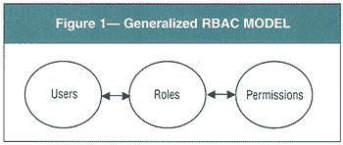
Role Based Access Control
assigning resources based on the role in a particular organization
assigning resources to a particular tenant based on the role that is defined to him/her.
First, we need to study what resources should be accessed by what group of people/tenants.
Accordingly, the roles that are defined are given a certain set of resources.
set of users which have a particular role are given a particular set of resources
For example, say, there are two applications- Airbnb and Tripping. There are many user accounts associated to these two applications.
The users of Airbnb should not have access to the resources in Tripping.
Similarly, the users of Tripping should not be able to access the resources of Tripping.
Moreover, each user has various roles such as renter, home-host, admin etc.
A renter cannot have write permissions for the house listings given in a particular area, only the home-host has that permission.

Slide 6
RBAC
Role based access helps in doing so.
Moreover, it provides a strict couple to access given for each role
Thereby, access is clean to implement.
Now, one way to do provide clean access is to provide a list of users to each resource and whenever a query is fired to access that resource, check in the control list of that resource to see if the user who is firing the query has access to that resource.
Now, this will work fine for a limited number of users and a good amount of resources in comparison to the number of resources.
But, in a system where the number of users is much greater than the number of resources, it would be wise to define resources for a particular user.
To optimize this more, we can define roles for each user and give access to a role instead of a user.

Slide 7
Tomcat – Realm Configuration
A database of users who have authority along with their passwords in a web application/s.
There are also various roles that are assigned to each user.
A particular user can have many roles associated to them, but for simplicity, we have defined only one role for each user.
Each role will then have access to the list of resources which are mentioned in the database.
The high level description on implementation will describe realm configuration.
On a high level, this gives tomcat access to interact with the database and authenticate the users based on their role and give them access based to the various resources in their system.

Slide 8
Scalability in RBAC
There are two ways in which an application or system can be scalable:
Scale-up:
This is also called as vertical scaling.
It involves faster CPU, more RAM, more disk space
Here, one has to test the limit of the application in terms of how many resources or users are being added in the system.
Adding more users or resources is going to stress your system more and the application is going to scale up only till a limit due to the limited number of resources.
For example, if you scale up by putting more users, at some point you're going to reach the hard disk limits.

Slide 9
Scalability in RBAC
Scale-out:
This is also called horizontal scaling.
It involves adding more cores CPUs and servers
Data can be parallely processed and it might be distributed physically
The communication between the nodes should be limited.
Actually, communication in nodes means sabotaging some parts of ACID
One cannot have entire ACID and scale up
NoSQL Solutions are the popular solutions
The key-value are scalable
However, you can query only on primary key.

Slide 10
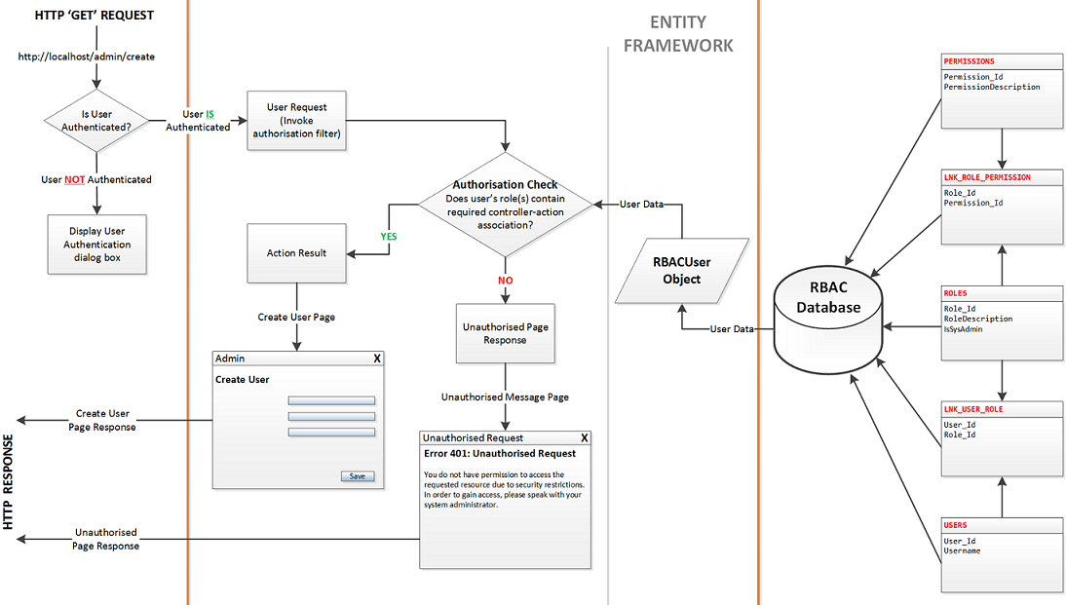
Work-flow

Slide 11
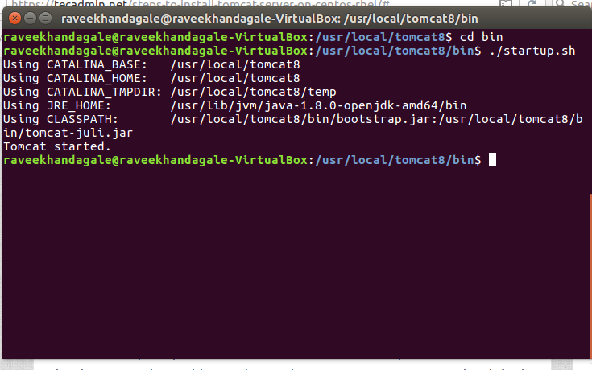
Launching A Tomcat Server
1. We downloaded Apache Tomcat from the official download page of Apache Tomcat:
https://tomcat.apache.org/download-70.cgi
2. We then unzipped and then started tomcat service
3. We then defined the admin role in tomcat-users.xml to log in to the tomcat server as shown in the below screenshot.

Slide 12
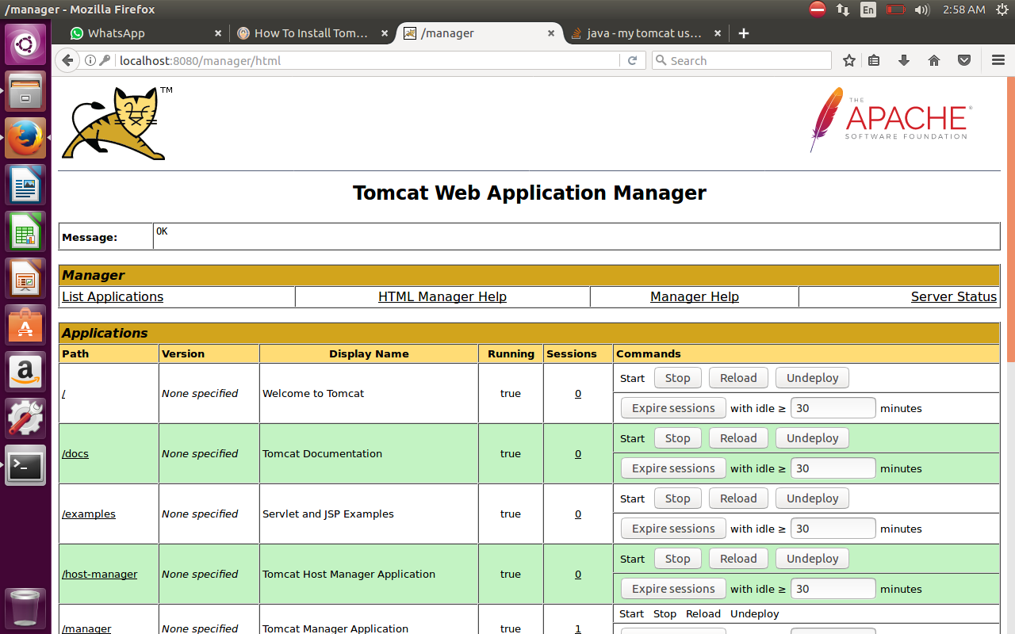
Launching A Tomcat Server
6. The following is the GUI which can be used by users of different roles like admin, user etc.

Slide 13
Launching Tomcat
7. You can deploy a WAR (Web Archive) file and can specify a context path to the WAR file
8. It can also be used to specify the deployment descriptor which is read by tomcat in order
the render the web pages
9. We created a sample web page login to demonstrate the use of Tomcat server It goes Login->Submit->Success

Slide 14
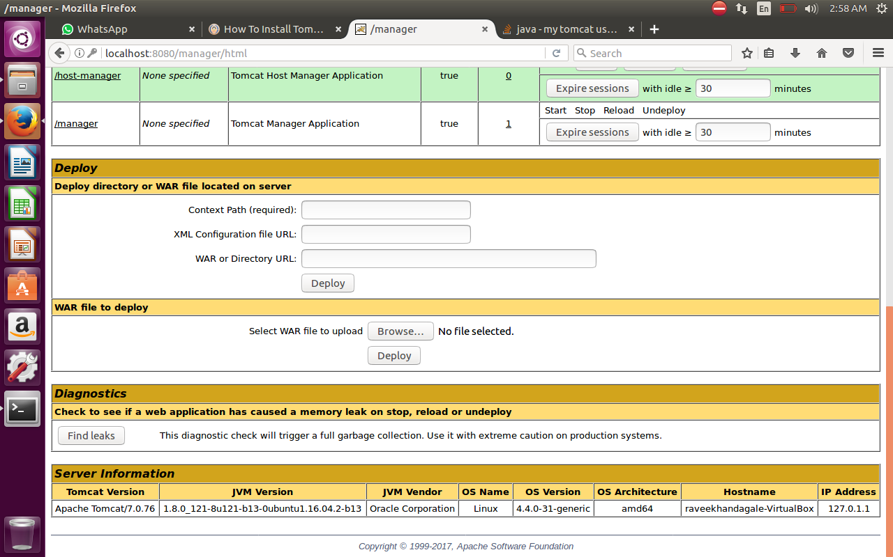

Slide 15
Realm Configuration
The realm configuration uses JDBC to connect to the database.
Therefore, there needs no new connection to the database and this feature can be plugged in as is using JDBC
The realm configuration also ensures access to the database according to the role that you have in the system.
We have to mention the column and table names that we are using in our database in the realm configuration.
Then accordingly, we edit this file- server.xml to include the authentications that we want in order to give access

Slide 16
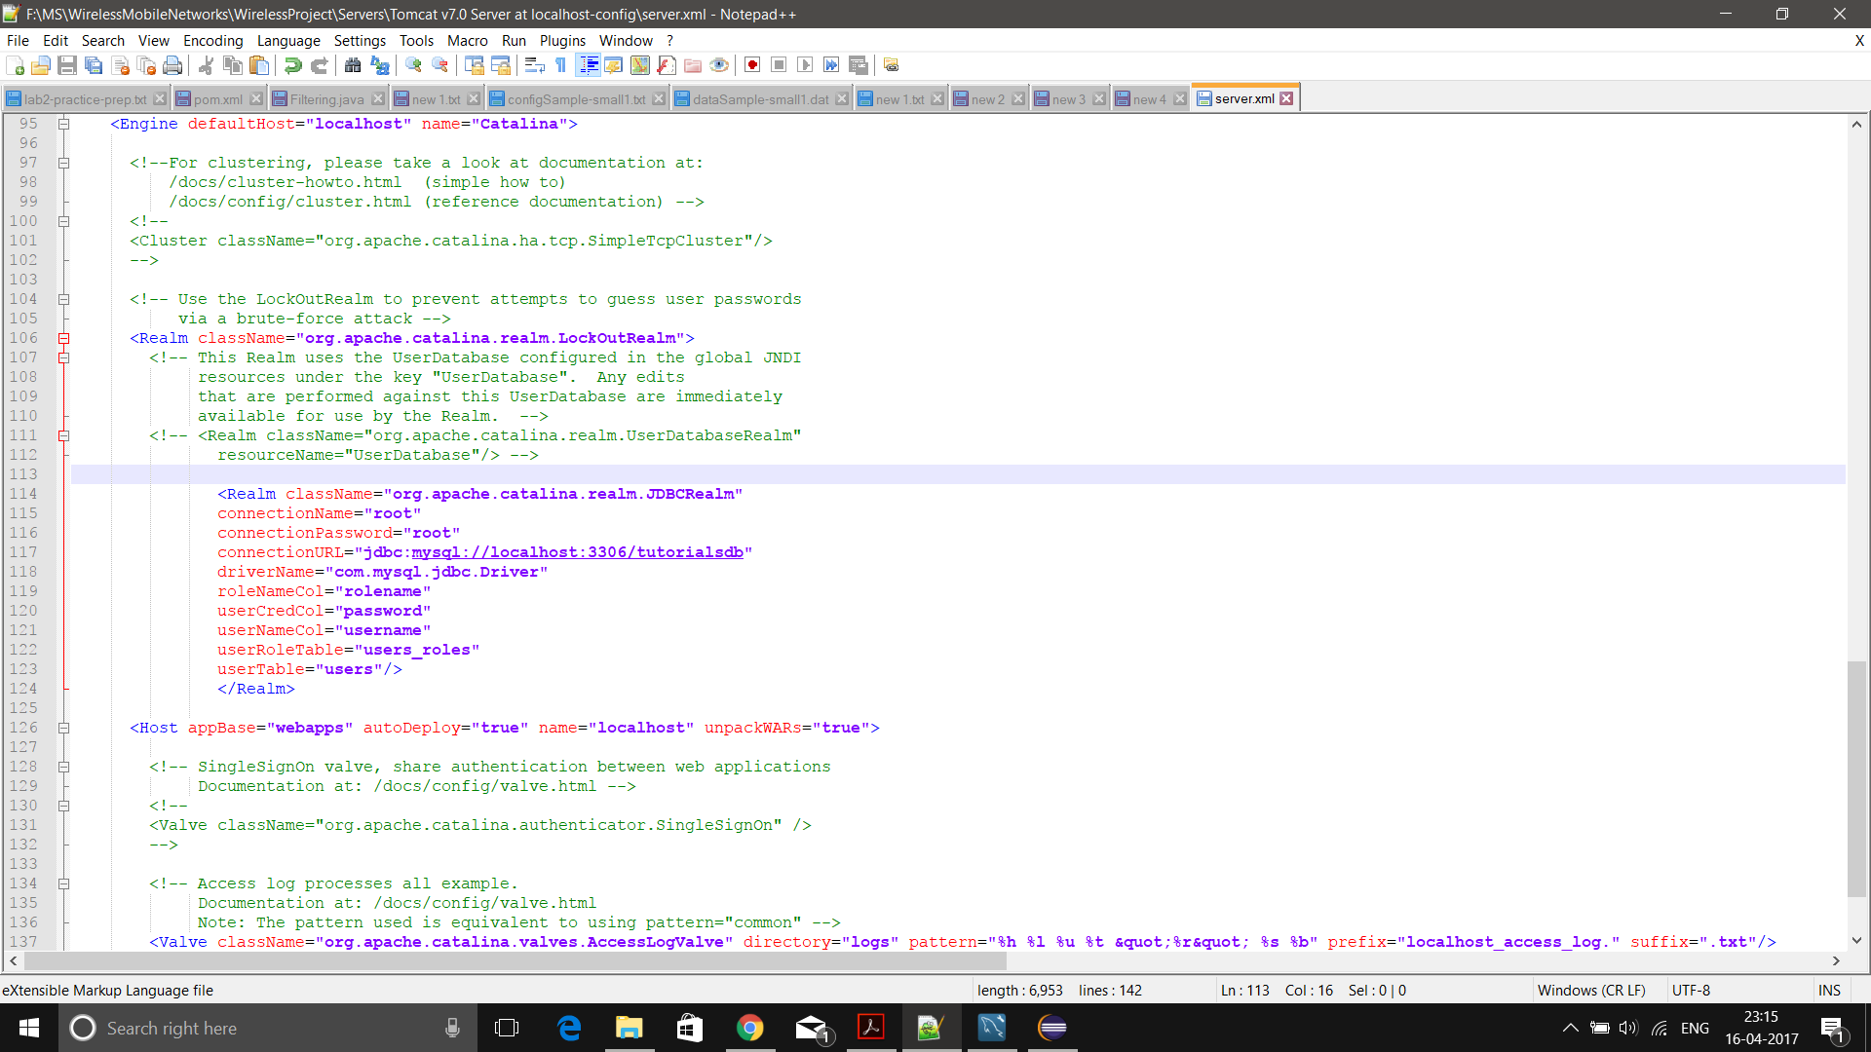
Realm Configuration

Slide 17
GUI
The login page has two buttons-
1)Login Button- The user can log in using his credentials.
After clicking this, you will be directed to your own page which displays your information and the projects you are authorized to see
2)Display Projects Button
Only the users of the system can see the Projects name and nothing more than the project name.
All users in the system can see the project name by default, that is, all users have access to see the project name.
Role based access will be given to view the project description in addition to seeing the project names.
After clicking this, you will be authorized to see all the project names (not the description).

Slide 18
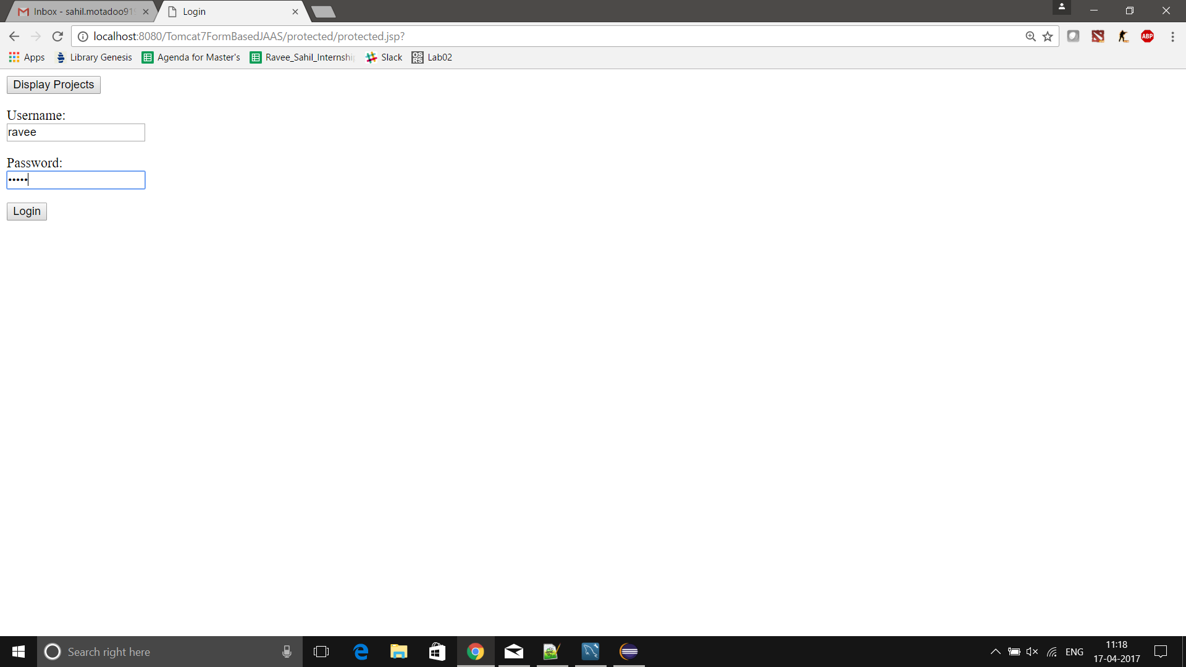
UI - Login

Slide 19
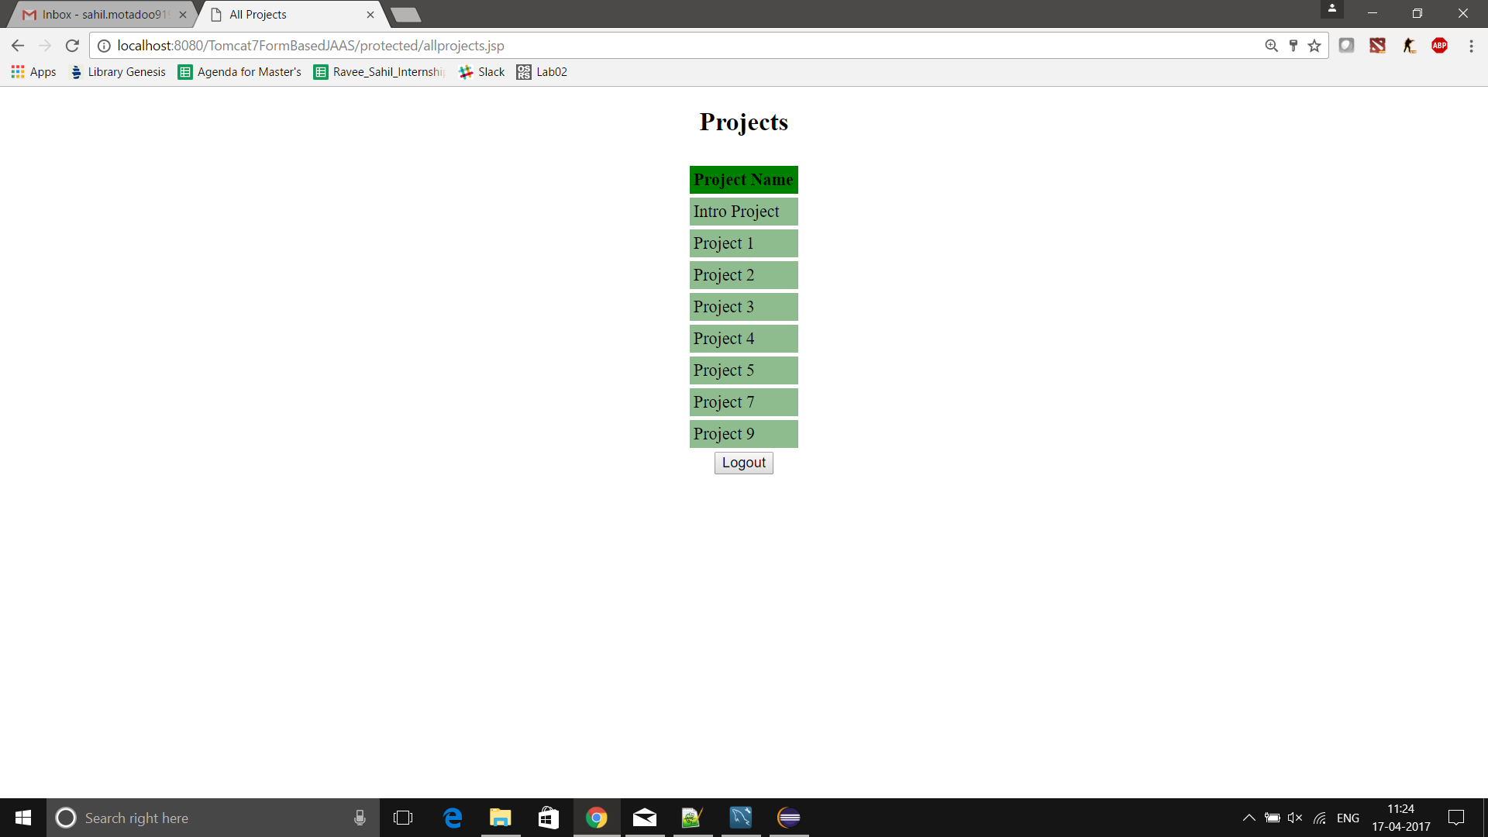
UI - Projects

Slide 20
After Logging In
After logging in, you will see a list of only those projects that you own along with their descriptions.
You will see a message saying that the you are authenticated to your role and your role is displayed
There is also a feature of creating a project that you want to own. That details of that project can only be seen by you.

Slide 21
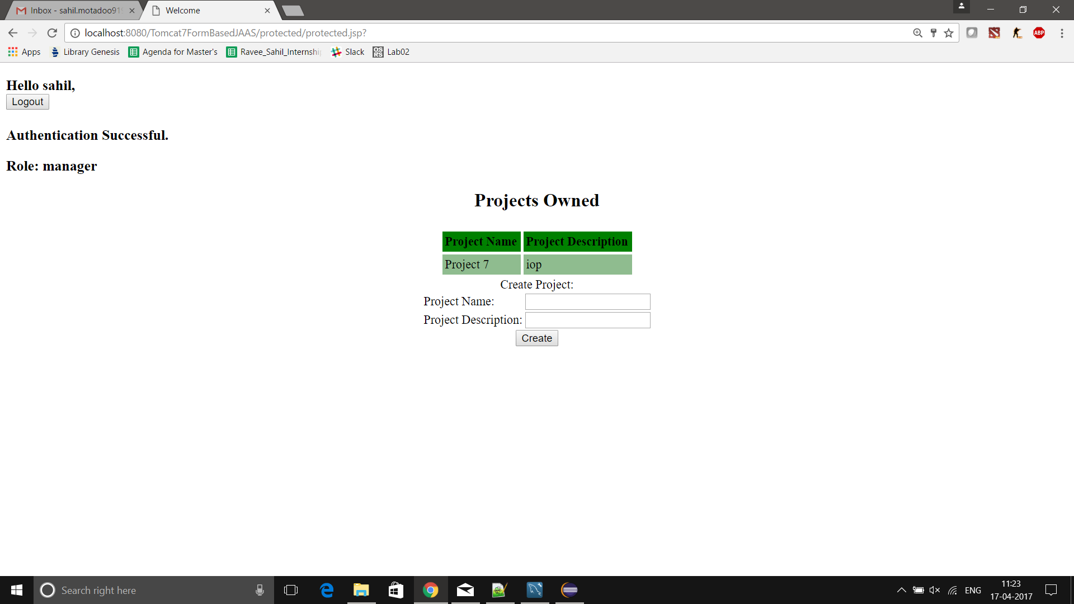
Manager Role Login

Slide 22
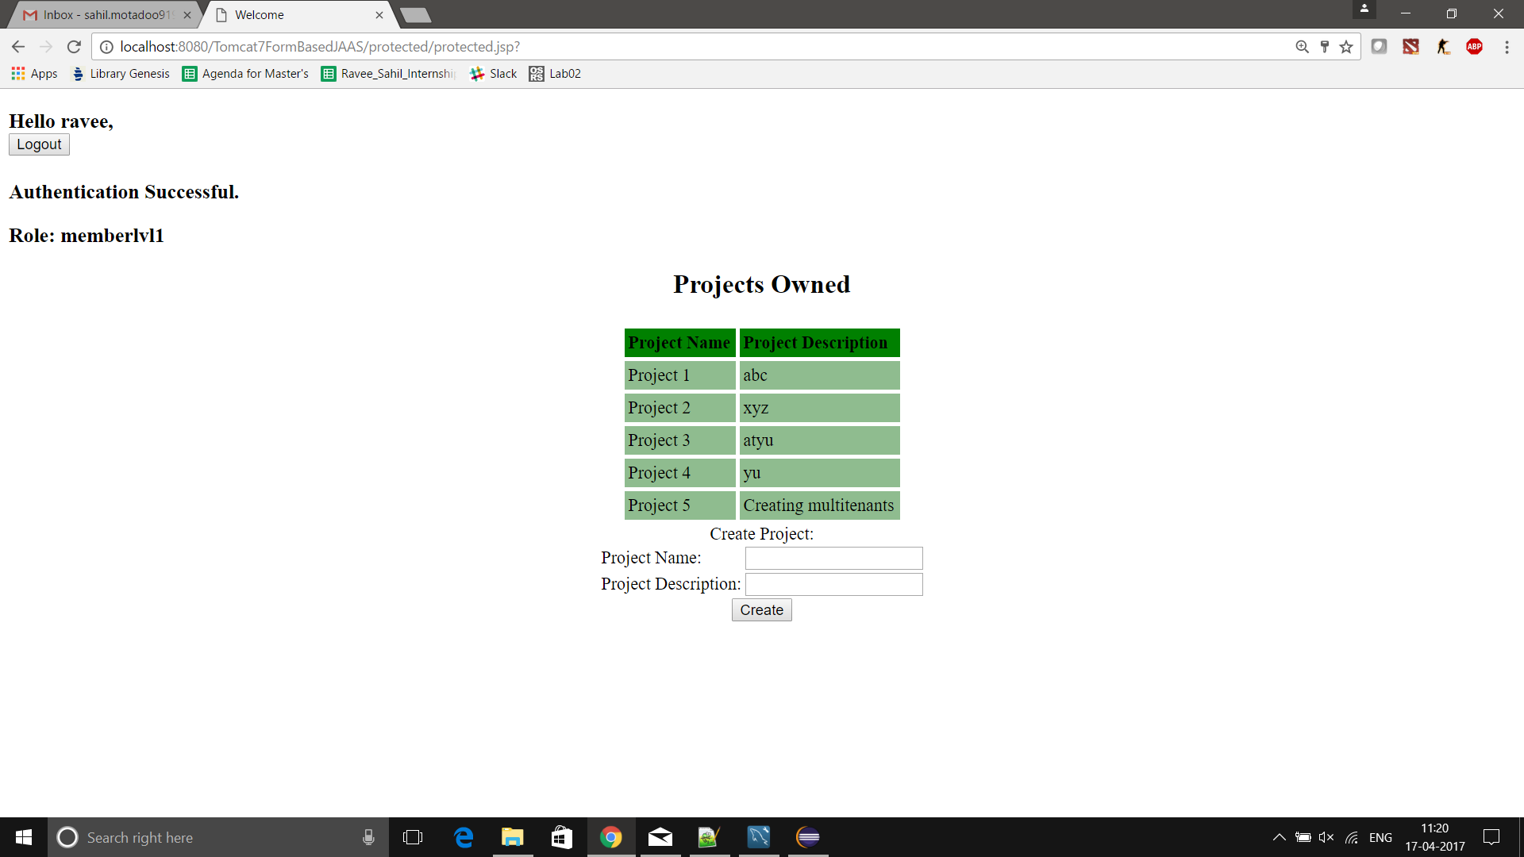
Normal User Login

Slide 23
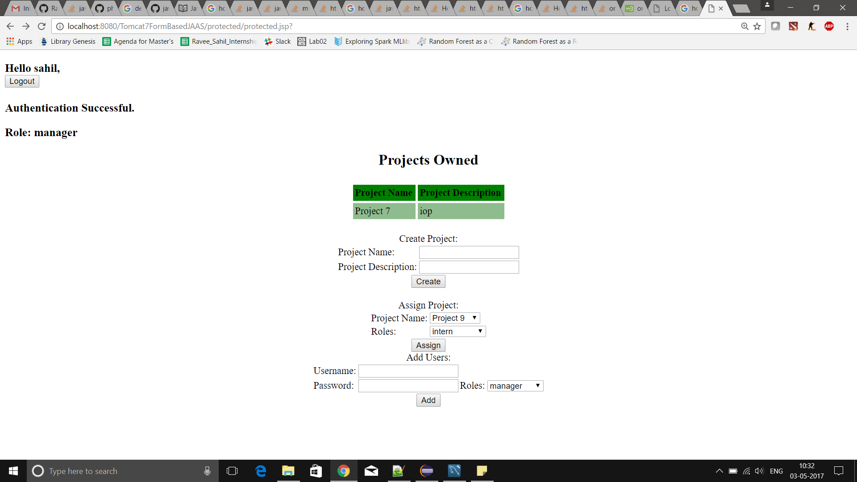
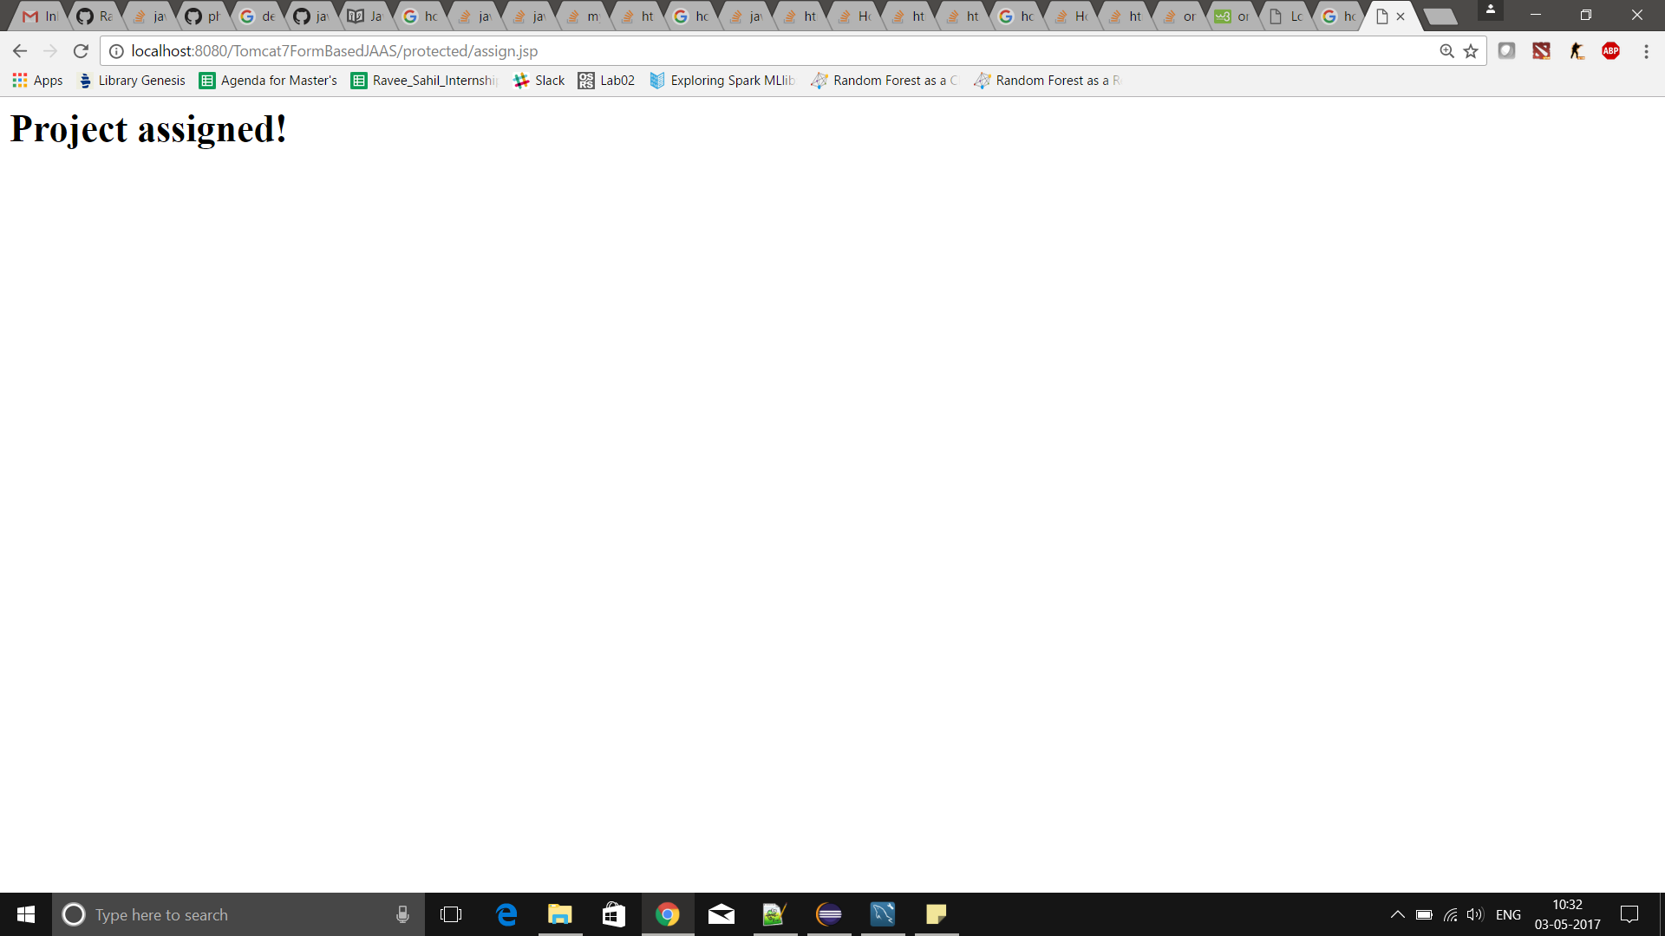
Manager can assign Project
Similarly, only the manager can assign project.
Here, only, the user “Sahil” who is the manager can assign project to a particular user.

Slide 24
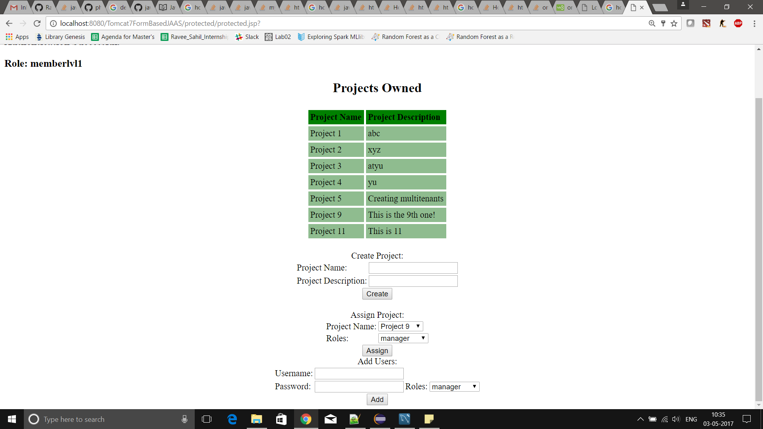
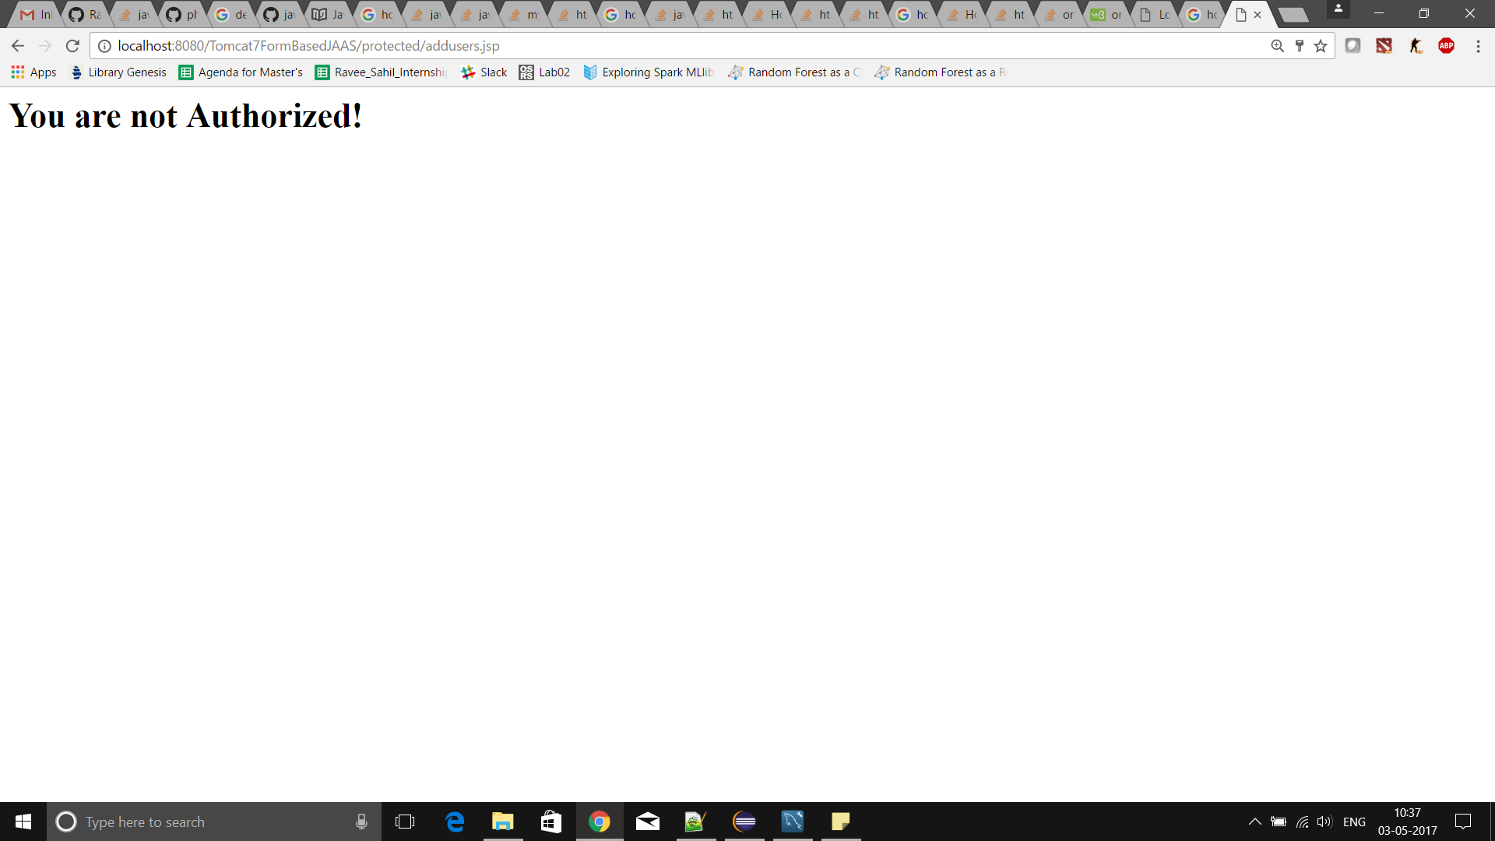
No one else can assign!
Now, “Ravee” who has only memberlvl1 access (that is, she is not an admin) does not have the authority to add user.
She is now denied access if she tries to add user

Slide 25
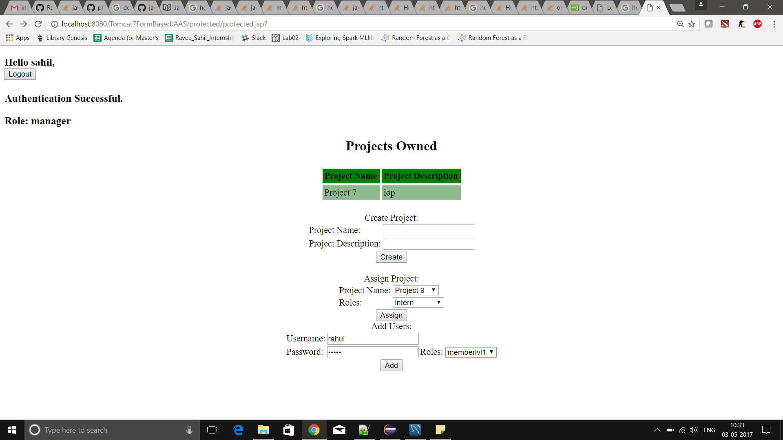
Scalability – Add User

Slide 26
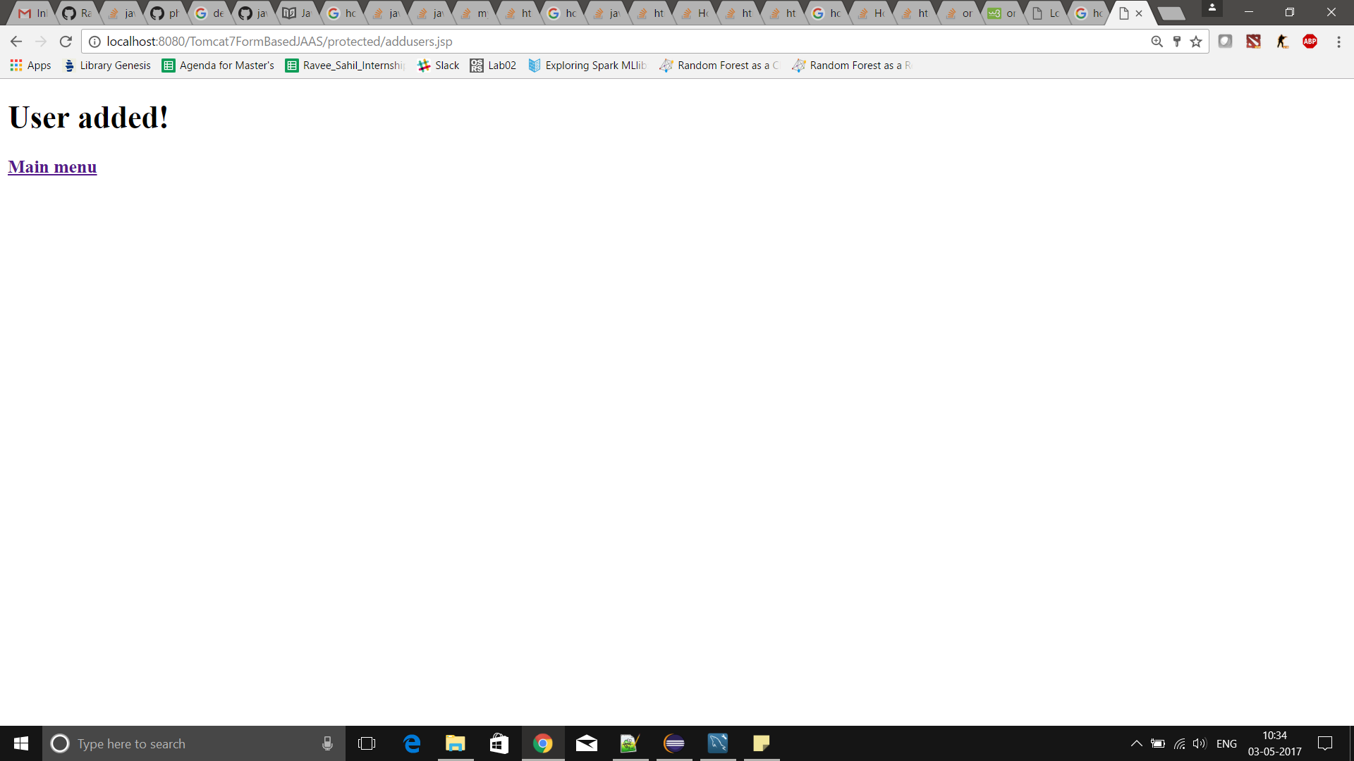
Only manager can add!

Slide 27
References
http://sixteenventures.com/saas-multi-tenancy
https://support.rackspace.com/how-to/overview-role-based-access-control-rbac/
https://developer.salesforce.com/page/Multi_Tenant_Architecture
https://tomcat.apache.org/tomcat-7.0-doc/realm-howto.html
https://pdfs.semanticscholar.org/7e7c/de48f727e2b606fd6a19492d15824331fead .pdf

