Slide 1
Recommending Diverse Movies from Social Network Movie Sites
Presenter: Ravee Khandagale
Advisor: Dr. Teng Moh
Notes:
Please check out notes here in the rest of the ppt for more comprehensive explanations on the slide!

Slide 2
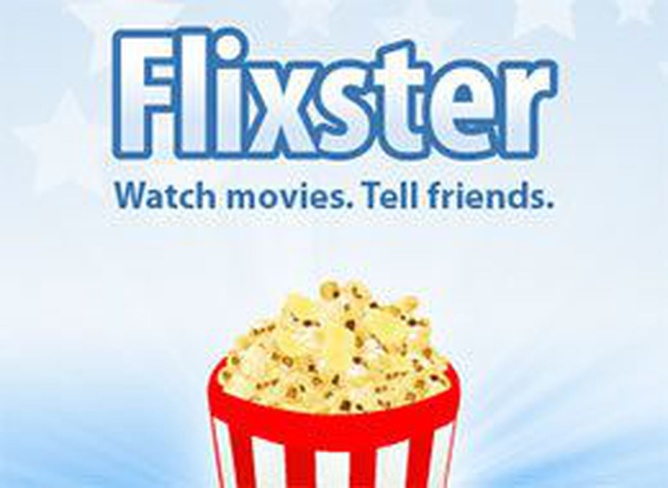

Social Networking Movie Sites
Discover movies
Meet Other People with similar taste
Connect with friends over movies
Notes:
Douban: Data set: http://smiles.xjtu.edu.cn/Download/Download_Douban.html
Flixster: http://socialcomputing.asu.edu/datasets/Flixster

Slide 3
Measures for evaluating recommendation systems
Accuracy in terms of how close the recommended movie is to the kind of movie that you like
Accuracy in terms of how close the recommended movie is to the kind of movie similar users like
Accuracy in terms of how popular the suggested movie is
What about diverse movies?
How about covering movies which might interest the user but do not fall in the same genre he likes?
Notes:
What does the model predict ?
What is the its actual value in training data
Accuracy is calculated using these two results/values

Slide 4
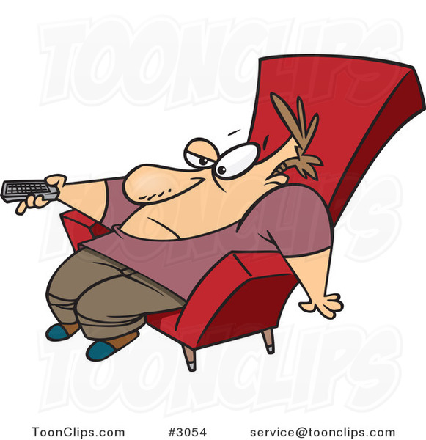
What Content based and collaborative filtering solutions lack
Less suggestions about different movie genres
Some movies which might be known already come up as suggestions
No diversity
Less coverage
Notes:
More about Importance of diversity :
http://www.sciencedirect.com/science/article/pii/S0950705117300680

Slide 5
Project aim
To increase diversity of recommendations
For this, using data from social groups and their likes as a parameter for recommendation
In addition to this, consider ratings ( mainly surprising ratings ) from similar users ( use collaborative filtering )
Analyse the model

Slide 6
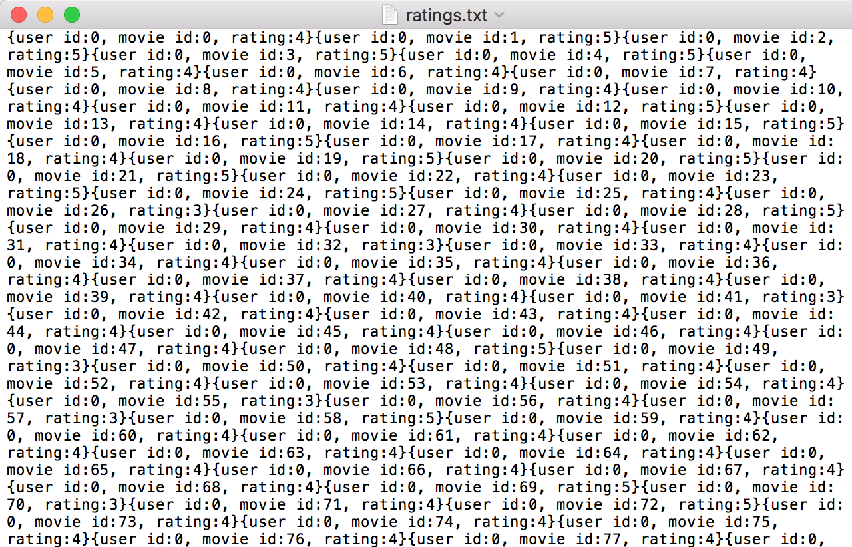
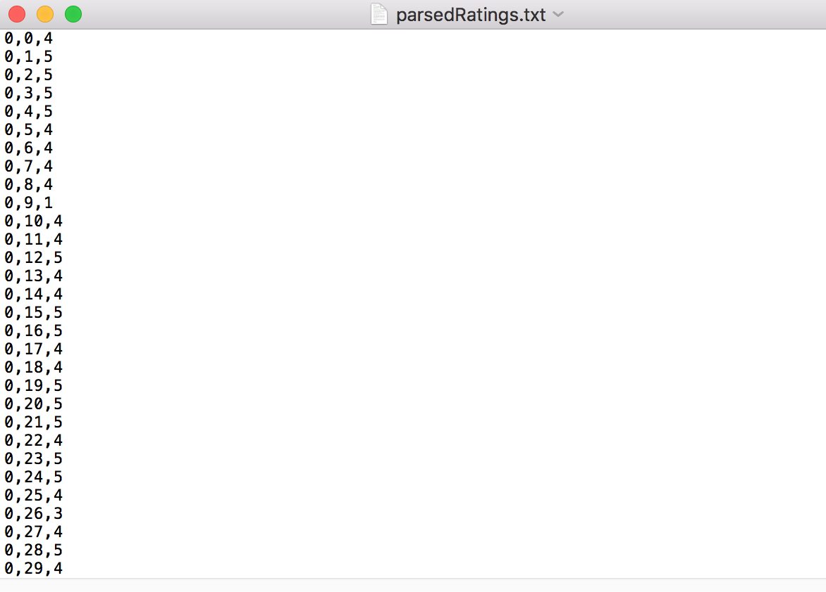
Data Set
After parsing
Original format
{user_id:u_id, movie_id=m_id, rating:r}
u_id,m_id,r
Notes:
Douban: Data set: http://smiles.xjtu.edu.cn/Download/Download_Douban.html
Flixster: http://socialcomputing.asu.edu/datasets/Flixster

Slide 7
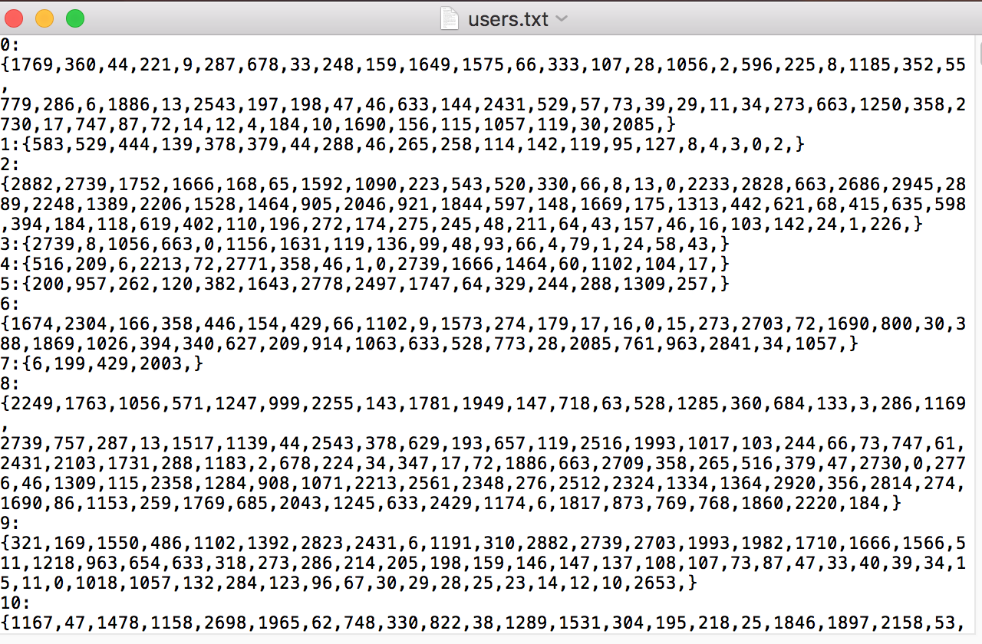
Data set – Social Groups / friends
Format
User 1 : { friend1,friend2,friend3 etc}

Slide 8
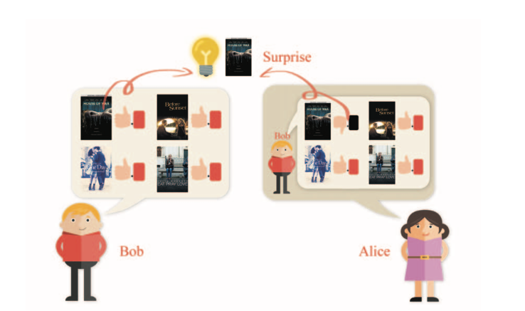
Psychology inspired solution for recommendation- existing approach
Bob and Alice are friends
Bob hates horror movies
Bob one day likes or watches a House of Wax
(gives high rating to this movie)
Alice wonders why?
Induces social curiosity in Alice
If Bob and Alice are friends

Slide 9
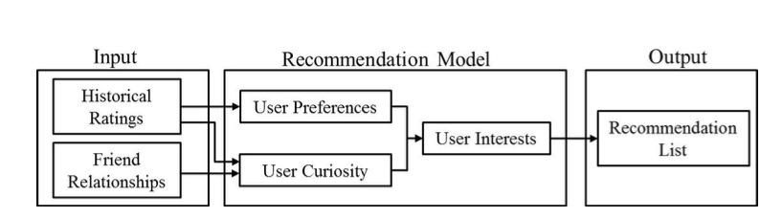
Existing Approach
Content Based
+
Surprise elements from social groups

Slide 10
Algorithm- finding surprising rating by social groups/friends
For each user i in users
For each friend j,
Determine friend j’s movies with high ratings
Find movies (m) with high rating given by friend j but which do not fall under friend j’s fave movies
Return m as recommendations to user i
What’s missing though? Could we add something else?

Slide 11
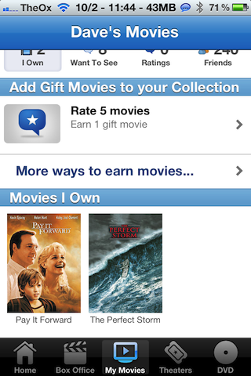
Find surprising ratings from similar users
But, User might already knows what his/her friends watch
How can we make our recommendations more diverse?
What if…
( Hypothesis )
In similar users, search for items which
they normally would not rate high
(Existing solution uses this approach only in social groups
Or friends)

Slide 12
Psychology inspired solution for recommendation- Enhanced
Bob and Alice are NOT friends
BUT they are similar users
Bob hates horror movies
Bob one day likes or watches House of Wax
(gives high rating to this movie)
It is likely that,
because Bob and Alice are similar users,
an anomaly that Bob likes, will be liked by Alice
So we could recommend this movie to Alice as a diverse
recommendation!
Bob and Alice do not know each other but are similar users

Slide 13
Algorithm- finding surprising ratings by similar users
For each user i in users
Find similar users jsim to the user i
Determine jsim’s fave movies
Find movies m with high rating given by similar user but are NOT jsim’s fave movies
Return m as recommendations to user i

Slide 14
Tools / techniques
Spark MLlib- Alternate Least Squares
Divided the data set into two kinds of data – training data and deciding data
Training Data: (u_id, m_id, rating) where u_id -> user’s id and m_id-> movie id
Deciding Data: (u_id, m_id, rating) where u.id-> similar user’s id, m.id-> movie id
Create a model : train the model to get model M
Decide whether a recommendation is diverse in nature for that particular user : Deciding data - pass the similar users’ info as parameters for predicting diversity from the deciding data and predict its rating values
Predicted Rating = model.predict (u_id,m_id) (passing similar user’s parameters!)
Actual Rating = DecidingData.Rating
Diversity factor= Actual Rating- Predicted Rating
If Diversity Factor>2, return as a diverse rating!
Notes:
Only training data is used in the training phase. The deciding data is used in the prediction phase. There is also testing data, but that is used only while calculating the accuracy of the system. Slide number 19 and 20 talk about accuracy

Slide 15
To recommend or to not recommend?
How to decide whether to recommend the movie or not? Thresholds used for deciding this are:
If predicted movie rating > 3.5 recommend movie as a normal recommendation
If actual movie rating – system predicted movie rating > 2 , recommend the movie as a diverse recommendation
Notes:
This slide mentions the predicted movie rating thresholds that are used by the system designed.
(This slide is added in revision to set a base for the further slides more)

Slide 16
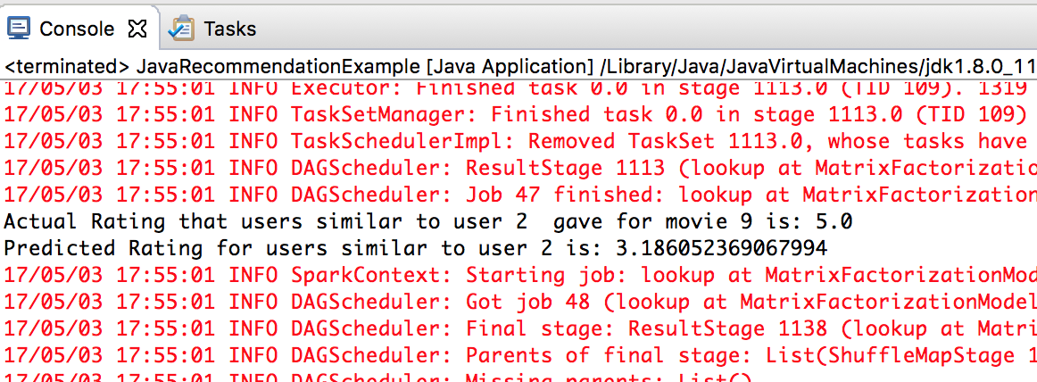
OUTPUT
Predicted Rating is 3.18
Does not recommend this movie!
Notes:
Predicted rating = 3.18
<3.5
Hence this movie is not recommended !

Slide 17
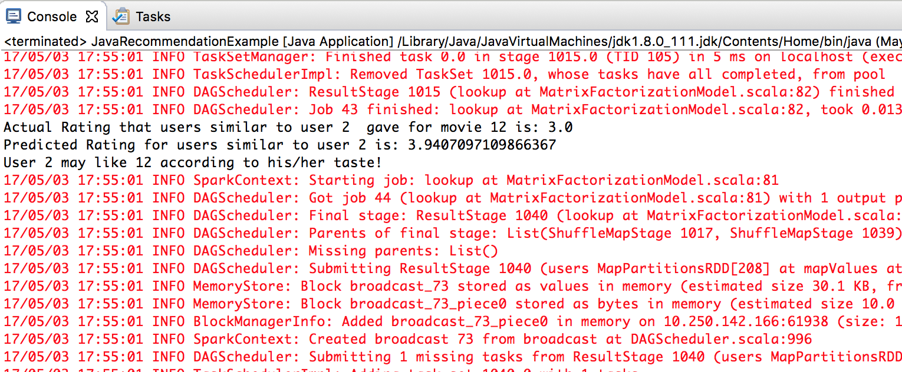
Output
This is a valid recommendation (accurate to the system), predicted movie rating > 3.5,
Recommends as a normal recommendation
Notes:
Predicted Rating: 3.9
>3.5
Hence, Recommend this movie as a normal recommendation !

Slide 18
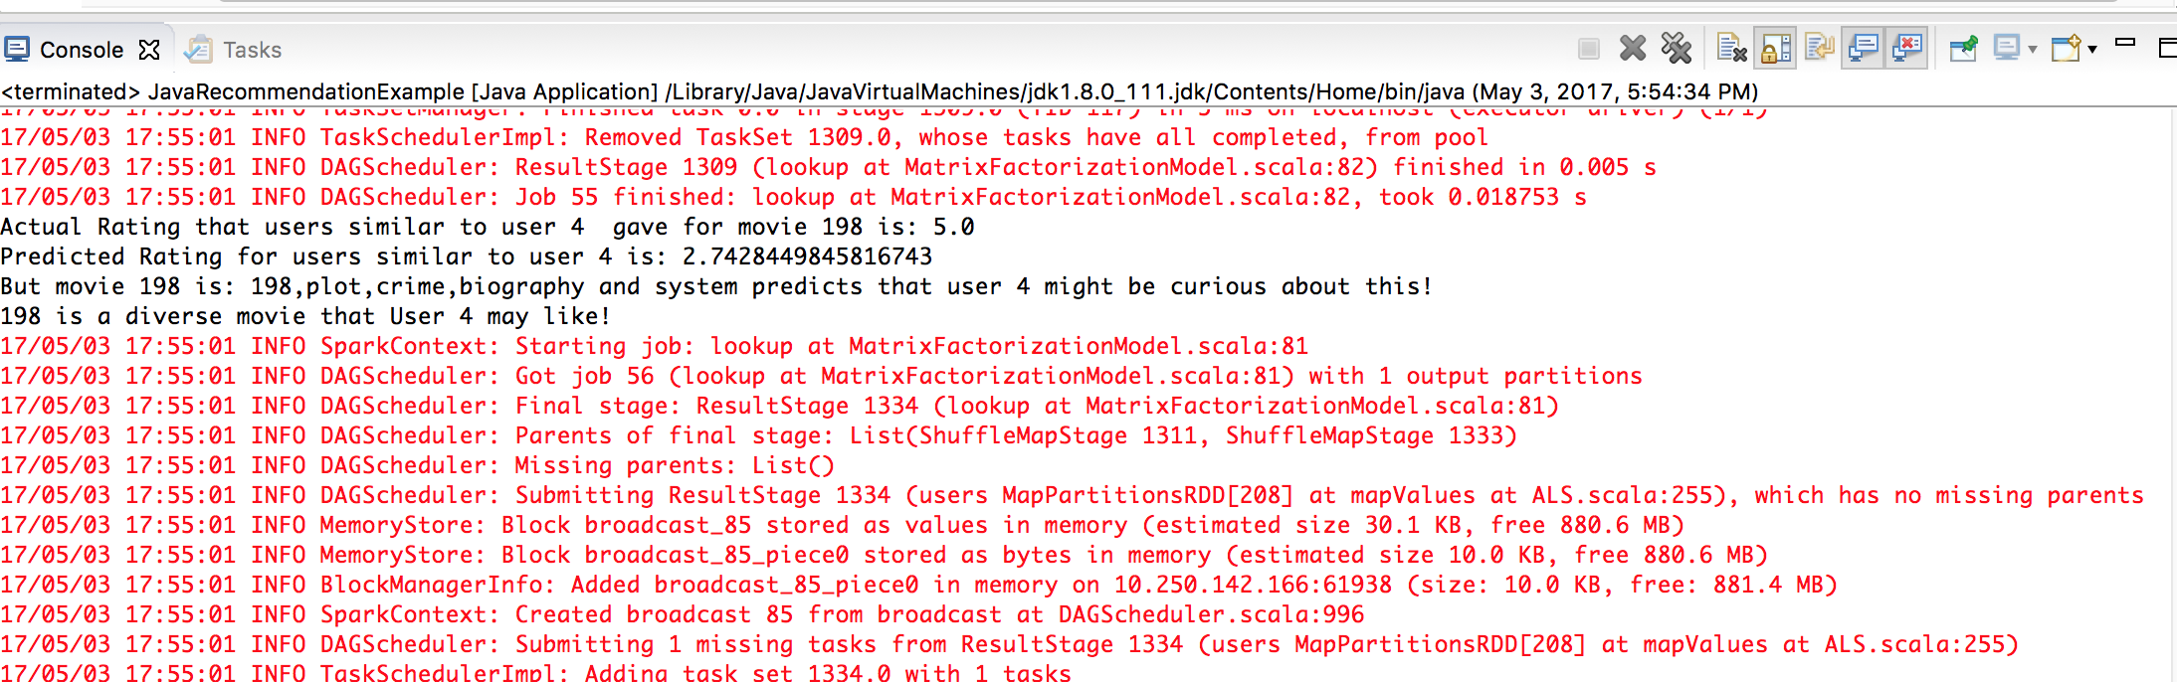
output
Recommend as a diverse recommendation!
Notes:
Actual Movie Rating=5.0
Prediction Movie rating = 2.7
actual movie rating – system predicted movie rating = 5 - 2.7 = 2.3 > 2 ,
Hence recommend as a diverse recommendation!

Slide 19
Table: number of accurate and diverse recommendations
Number of reviews | Accurate Predictions | Diverse Predictions (Social Based) | Diverse Predictions (Collaborative Filtering)
1000 x 254 | 190500 | 51896 | 52999
10,000 x 254 | 2032156 | 528934 | 634579
100,000 x 254 | 21561985 | 5191234 | 7892421
2 million * 254 | 416500154 | 186513245 | 215614235
Number of reviews: Number of users X number of movies -> As per the rating matrix
Notes:
1000 and 10,000 are tagged as relatively few users for analysis
100,000 and 2 million are tagged as relatively more users for analysis

Slide 20
Analysis- relatively few users
Notes:
Number of users - 1000 and 10,000

Slide 21
Analysis- relatively more users
Notes:
Number of users - 100,000 and 2 million
(This slide is added in revision)

Slide 22
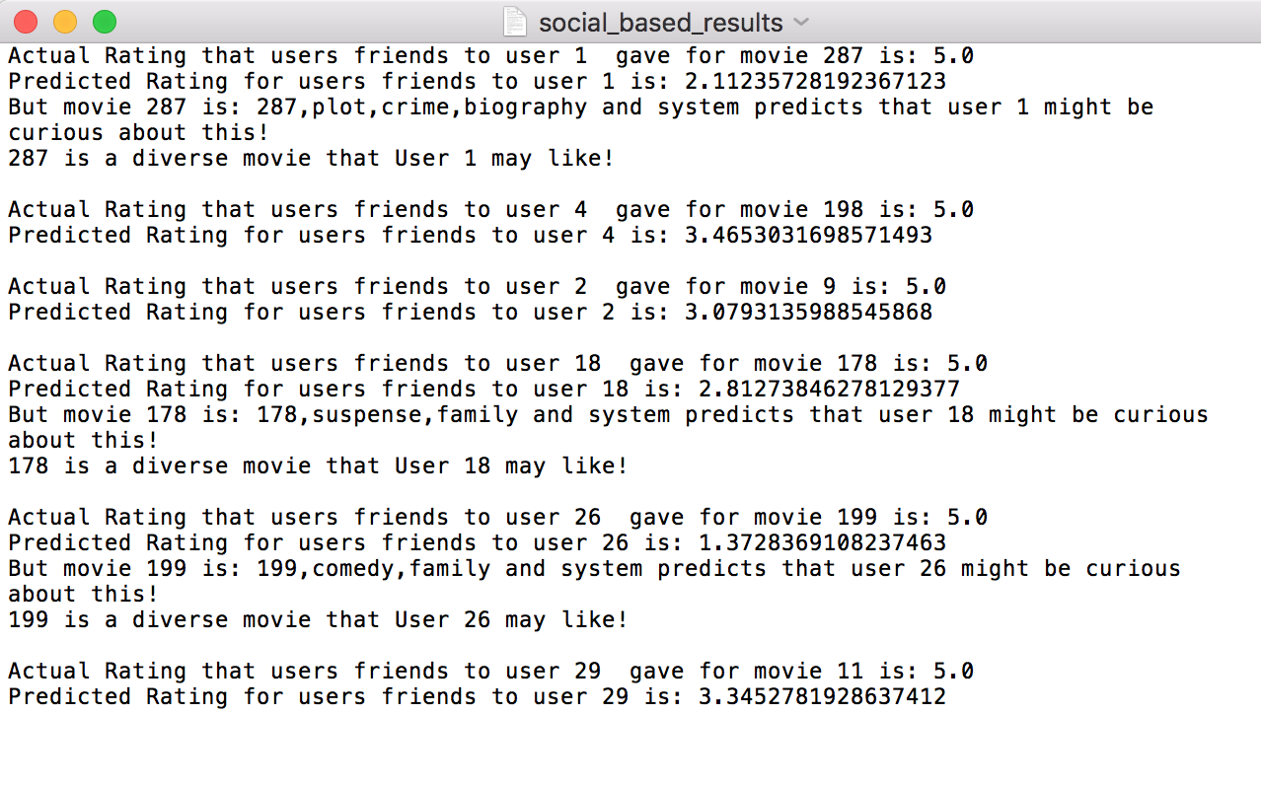
What recommendations made the difference? Why?
These are a few example results of the social based recommendation systems
Notes:
These are the predictions of the social based approach. Notice movie 198 user 4 and movie 11 user 29 and compare it with the next slide
(This slide is added in revision)

Slide 23
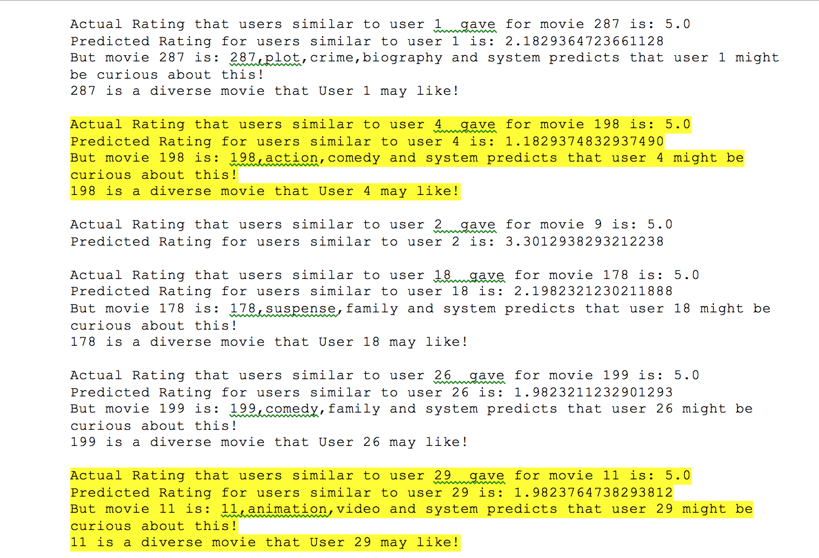
Few recommendations that were missed by the original approach
These are the recommendations that did not turn up in social based system but turned up in
collaborative filtering based diverse approach (See why in notes below)
Notes:
Movie 198 for user 4 (highlighted)
Movie 29 for user 11 (highlighted)
These are the examples of movies which the original approach failed to give, however, the new collaborative filtering approach gave these and improved the diversity of the recommendation system
Why? because the system only considers the social circle in approach 1. However, because of collaborative filtering, users similar to the user resemble a profile closer to the user and it is more likely that an actual high rating (when predicted is low) will impact the quality of recommendation as compared to that of social circle
(This slide is added in revision – Question: Add examples which show the difference where recommendations were termed as diverse in the new approach vs the old approach)

Slide 24
Accuracy Vs Diversity
Combining the data from 1000, 10,000, 100,000, 2 million users against 1254 movies, we use 254 movies for testing
Total no of predictions =536194000
Accuracy = 190500+2032156+21561985+416500154 = 440284795 / 536194000 = 0.82
Diversity for social based approach= 51896+528934+5191234+186513245 = 192285309 / 536194000 = 0.35
Diversity for similar user’s approach = 52999+63457+7893421+215614235= 223624112 / 536194000 =0.41
Out of every 100 movies, 41 diverse movies are suggested
However, this will introduce few irrelevant ones as well
Workaround: Change diversity factor
If Diversity Factor>3, return as a diverse rating!
Check out explanations in notes below!
Notes:
Accuracy is calculated using the following:
Sum(number of correct predictions using different size of data)/sum(total size of data)
Diversity = sum (total number of diverse predictions)/ sum (total size of data)

Slide 25
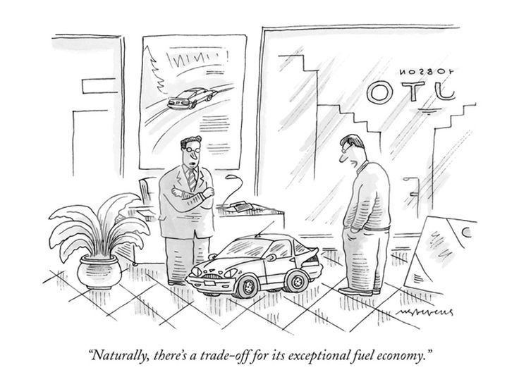
What might ruin it
Model might be complex and might require higher computation
Result is a gamble- user may or may not like movie which falls out of his genre plate
Exactly how diverse should the recommendation be?
(See slide 29)

Slide 26
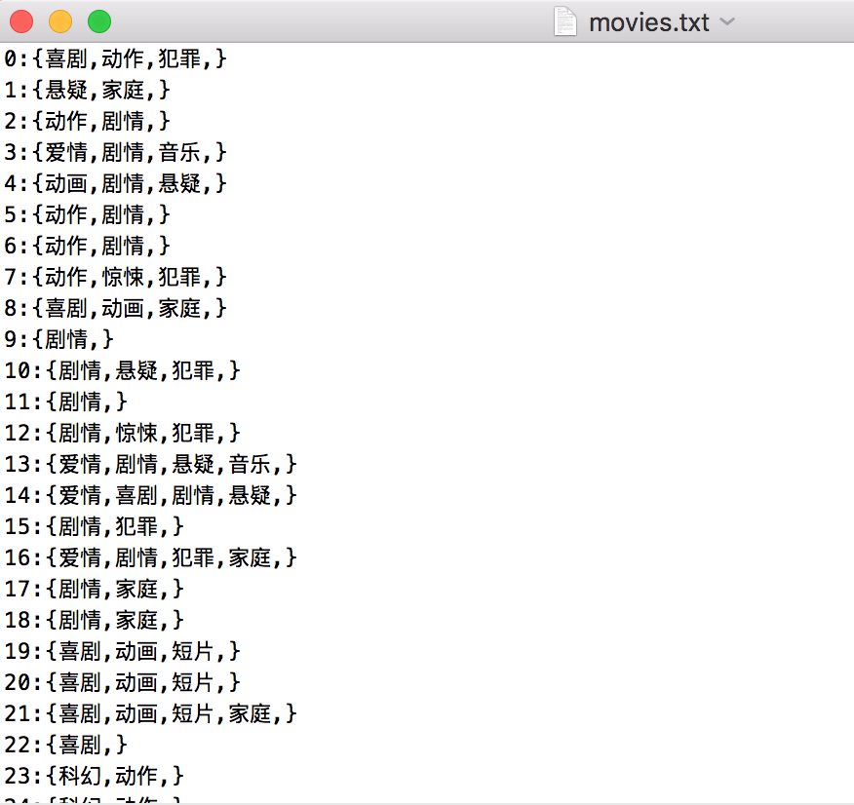
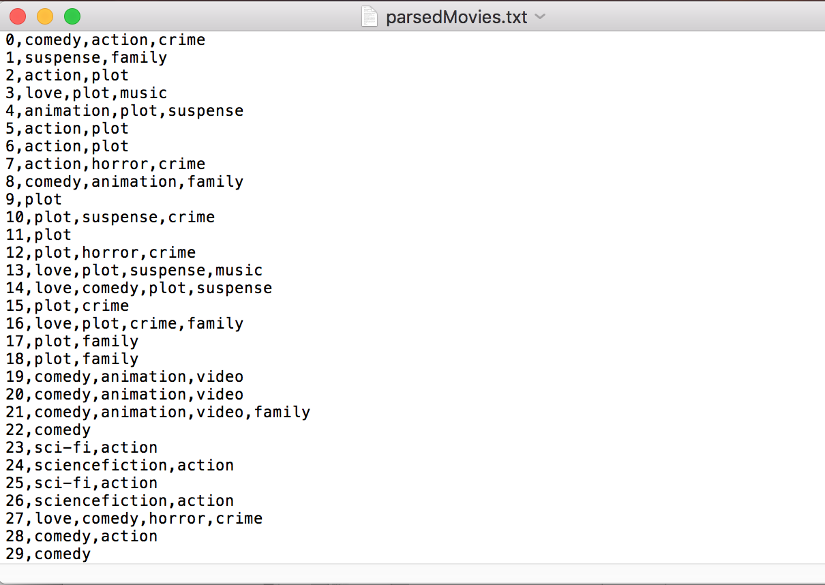
Challenges faced
Data set (movie info) was in chinese
Translated using google translate! and parsed the file to desired format
(took me a while to think of that !)

Slide 27
Challenges faced
Research about diversity of recommendation (appropriate research) was hard to find
How to draw the thick line between accuracy and diversity was confusing until I came to terms with it
No movie names given, so judging the output becomes difficult

Slide 28
Conclusion/ Future Work
Diverse recommendations is a good measure to consider while designing recommendation systems
Analyzing the impact of diversity on the application is a way to decide how much to use it
Future Work Add degree to diversity to limit the recommendations- makes it more accurate (adding accuracy to diversity) (more about this here)
Analyze the impact of this!
Best way to test the model is to deploy it and ask for feedback from users!
Tweak the model accordingly!

Slide 29
More on future work – adding degree to diversity- how and when?
Exactly how diverse should the recommendation be actually depends on your application.
E.g.: A movie recommendation system might require a good diversity but the same cannot be said about applications like Amazon where there are a variety of products vs. reviews where in introducing this approach will obfuscate the system and give unpredictable results.
Having said that, this is a good approach for applications like movies, food (yelp) or any other one track application where not a lot of products are sold/rated/evaluated/used/rented/viewed/reviewed/discussed
For systems like Amazon-> Can keep a high diversity factor (>3.5) so that the system will not get confused and rather diverse results (which are truly intriguing) will be recommended
Notes:
(This has been added in the revision)
Question: Applications where diversity degree tweaking will be useful/ applicable and examples

Slide 30
References
1) Q. Wu, S. Liu, C. Miao, Y. Liu and C. Leung, "A Social Curiosity Inspired Recommendation Model to Improve Precision, Coverage and Diversity," 2016 IEEE/WIC/ACM International Conference on Web Intelligence (WI), Omaha, NE, 2016, pp. 240-247.
2) http://www.mmds.org - Recommendation Systems and Hybrid Models
3) http://dl.acm.org/citation.cfm?id=2843948 - The Netflix recommendation system

