Slide 1
Customer Churn
Prevention
June 9th, 2023
Munich, Germany
Zurich, Switzerland

Slide 2



Data Consultants
Jose Araujo
Ena Dewan
Alaa Elshorbagy
Actuary &
Data Scientist
CLO Analyst &
Data Scientist
Mathematician &
Data Scientist

Slide 3
Agenda
Challenge
Objective
Churn situation in the Company
Approach
Questions to be solved
Predictive Models
Results / Model
Model with high explainability
Model with high predictive power
Outlook
Key takeaways
Recommendations

Slide 4
J
J
J
J
About us
What is our problem?
What was our approach?
Data Analysis
J
A
Plan Vanilla model
Naive Bayes
A
Naive Bayes II
E
E
J
Model Ena
Feature Importance - Model
Outlook

Slide 5
Customer Churn
Challenge
Approach
Results
Definition
Client stops using a product or service
Measure
Churn rate: number of people who stopped being customers during a set period of time
Importance
Decreases market-share
Increases costs
Impacts brand negatively
Hinders future growth

Slide 6
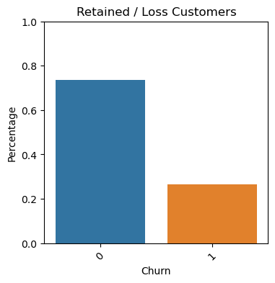
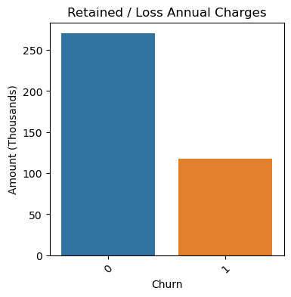
Current Situation
Challenge
Approach
Results
Decreases market-share
Increases Costs

Slide 7
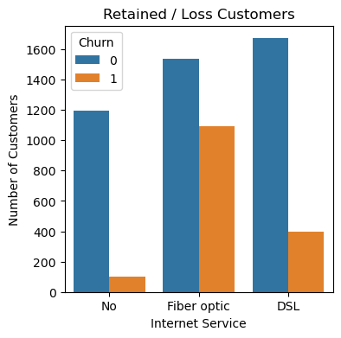
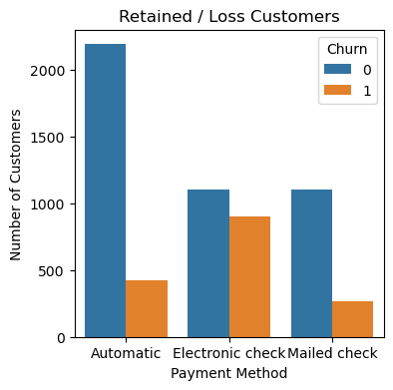
Current Situation
Challenge
Approach
Results
Impacts brand negatively

Slide 8
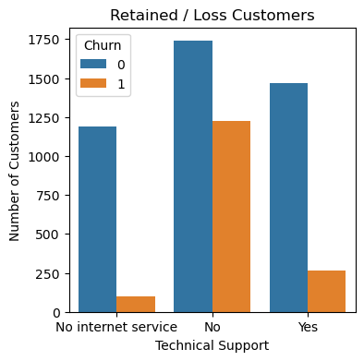
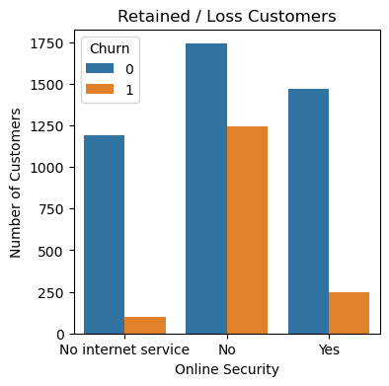
Current Situation
Challenge
Approach
Results
Impacts brand negatively

Slide 9
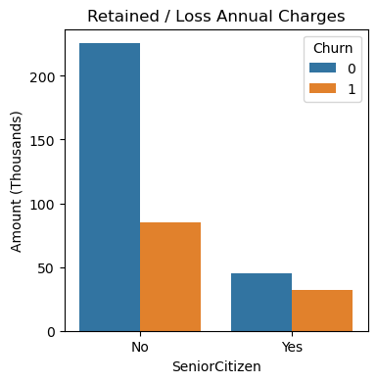
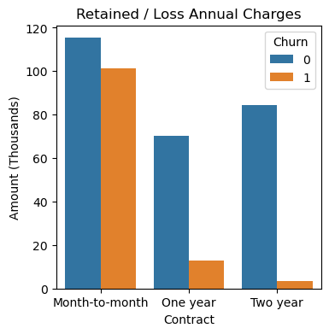
Current Situation
Challenge
Approach
Results
Hinders future growth

Slide 10
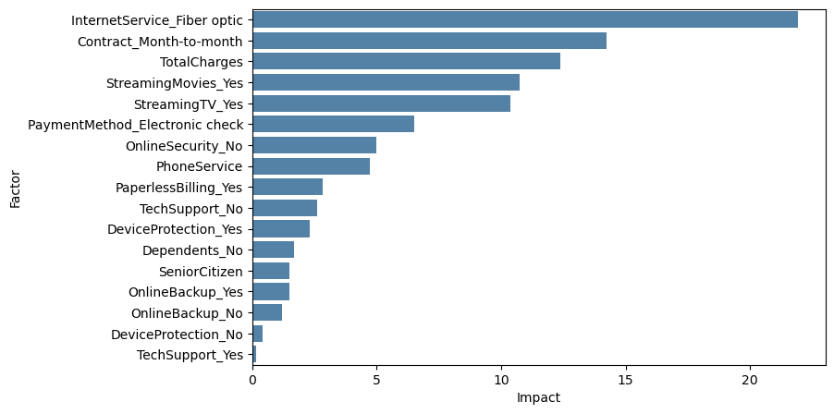
Current Situation
Challenge
Approach
Results
Relative impact to customer churning*
(*) : Impact to log-odds, scale to 100 %

Slide 11
Approach
Challenge
Approach
Results
Existing Client
Customer History
Predictive Model
Customers at risk of Churn
Happy Customer
Proactive
re-Engagement

Slide 12
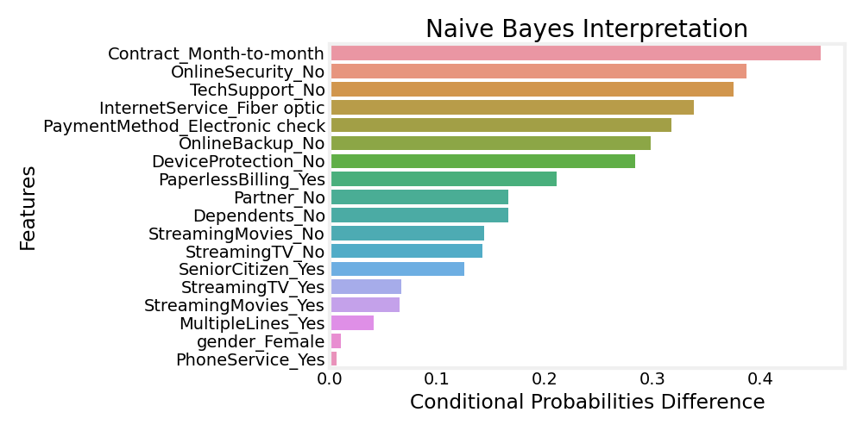
Intuitive or Naïve?
Approach
Results
Outlook

Slide 13
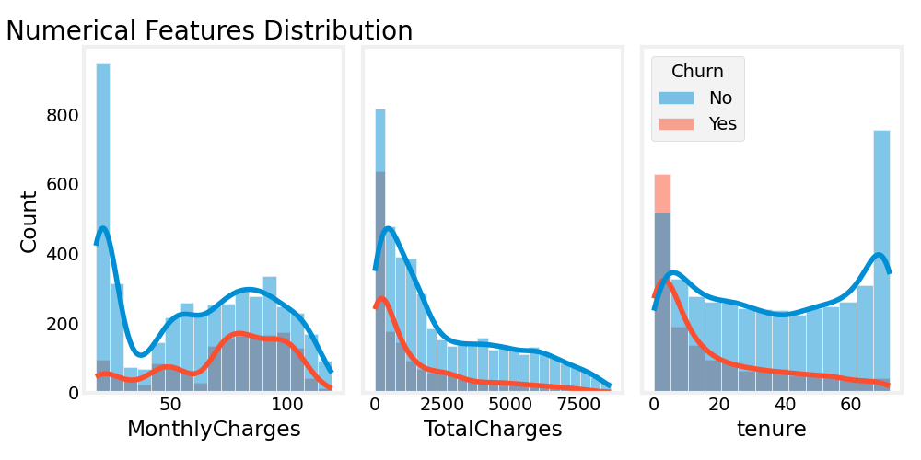
Intuitive or Naïve?
Approach
Results
Outlook

Slide 14
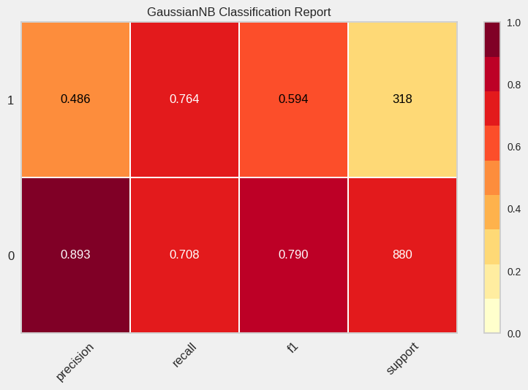
Intuitive or Naïve?
Approach
Results
Outlook

Slide 15
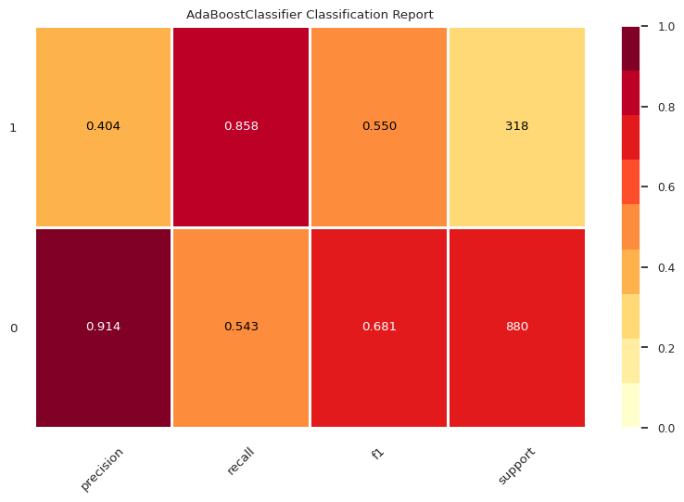
Predictive Model
Approach
Results
Outlook
Classification Report

Slide 16
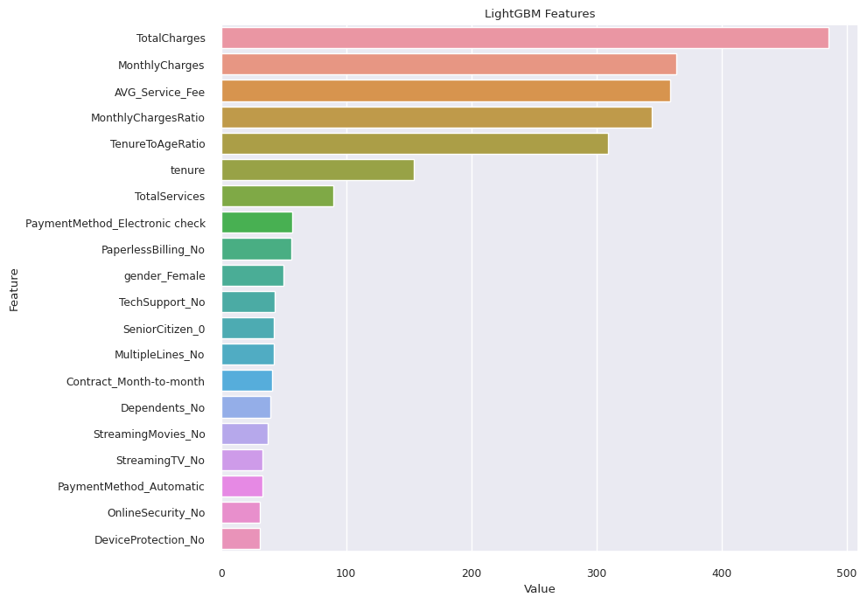
Predictive Model
Approach
Results
Outlook
Feature Selection: Feature Selection was based on LightGBM. This was used as Tree based algorithms are good with both categorical and numeric variables. 20 features were chosen out of 47 features with a threshold of 30.
KEEP Make bigger

Slide 17
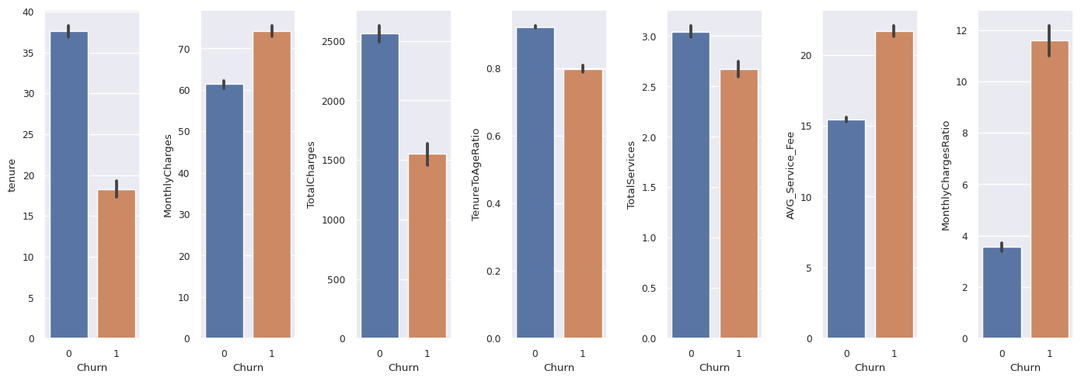
Predictive Model
Approach
Results
Outlook
New Features Creation: 4 new numeric features were added:
How many total services are being used?
What is the average fee per service per month?
What is ratio of monthly charges to the tenure?
What is ratio of Tenure to age? How long Senior citizen stays as their churning is more?

Slide 18
Outlook
Approach
Results
Outlook
Conclusion
Churning due to Fiber optic services has a 25% impact on economic losses
Young people represent 22% of the economic loss
Tenure and month-to-month contract have a high impact on churning
Providing additional services on internet packages reduces churning (e.g. Tech support, online security, etc)
Strategy
Improve fiber optic services, is the product reliable? Implement customer survey
Increase engagement activities among young people, and provide marketing tools to customer support
Introduce mid-term contracts with discounts
Include additional products to customers with internet services
Tech support: cost-benefit analysis to expand service (cost vs churning)
Survey on streaming services? Why clients leave?
Coming soon
Visit our github for updates: https://github.com/gordoaraujo/cl_churn_prediction

Slide 19
Questions?

Slide 20
Appendix

Slide 21
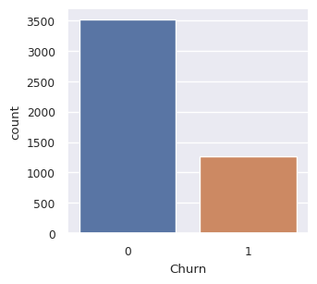
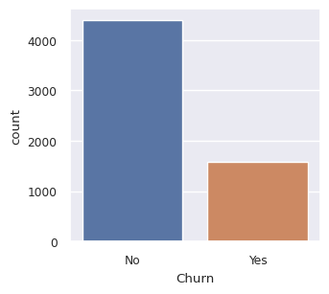
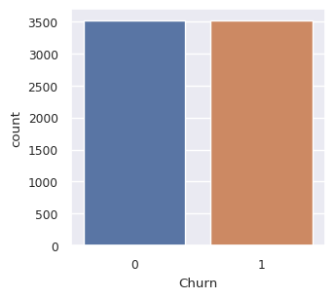
Model II
Approach
Results
Outlook
Feature Engineering:
Original model has 18 categorical variables and 3 numeric variables:
Categorical: customerID,gender, Partner, Dependents, PhoneService, MultipleLines, InternetService, OnlineSecurity, OnlineBackup, DeviceProtection, TechSupport, StreamingTV, StreamingMovies, Contract, PaperlessBilling, PaymentMethod, TotalCharges,SeniorCitizen
Numeric: tenure, MonthlyCharges,TotalCharges
Imputation: Total charges were set to NA for tenure=0. We analysed that these customers just joined and so total charges for those customers were put to zero.
Encoding: We used one hot encoding for our categorical variables. We removed CustomerID and PhoneService for our categorical variables. CustomerID had no relevance and PhoneService and MultipleLines are collinear. One hot encoding increased 16 categorical variables to 40.
Scaling: All the numeric variables were scaled using Standard Scaler in scikit learn which uses z-score .
Imbalance: This is a highly imbalanced dataset with Churn ratio of 1587/4399=0.36. We used SMOTE oversampling strategy to deal with this imbalance.
Original Dataset Trained Dataset Balanced Dataset with SMOTE

Slide 22
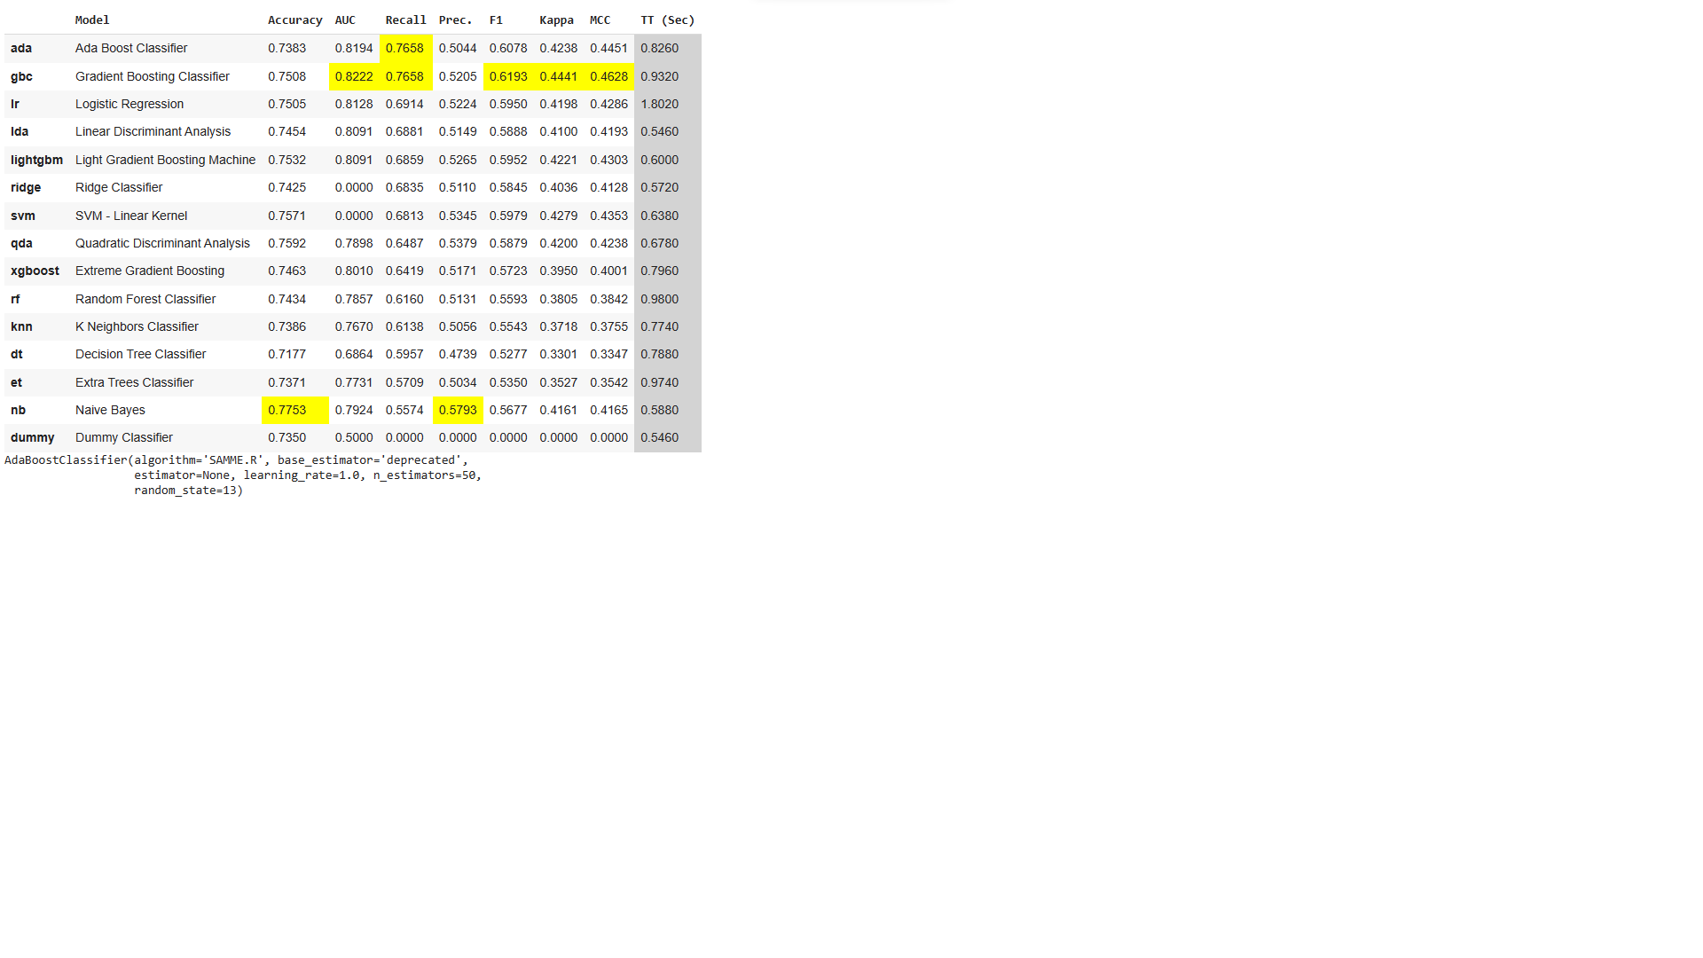
Model II
What was our challenge?
How did we
solve it?
Outlook
Benchmark Models: Benchmark models were chosen using Pycaret classification taking care of imbalance with SMOTE, feature selection using 20% features using LightGBM and normalizing the numeric features. As we would like to focus on Churning of customers, we will take recall(True positive rate of customers churned) as our deciding factor.
We implemented lot of models Adaboost,LightGBM,XGBoost, Catboost as per our analysis from pycaret.
Strategy to implement ML model: Extract important features using LightGBM.
Use a plain vanilla model with all features, train it and check recall and F1-Score—--> Use plain vanilla model with extracted features,train it and check recall and F1 score—> Hypertune parameters for model with selected features, train it and check recall and F1-Score —--> Choose the model with the best recall and F1.

Slide 23
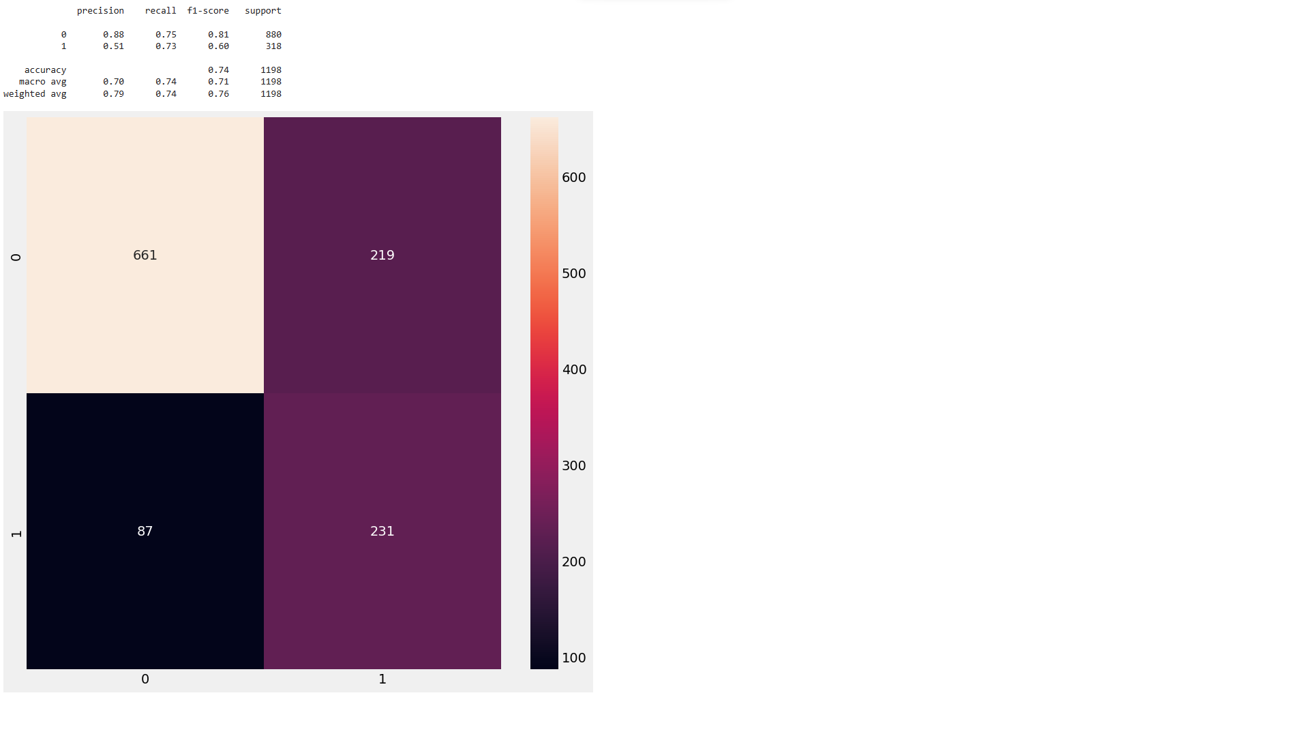
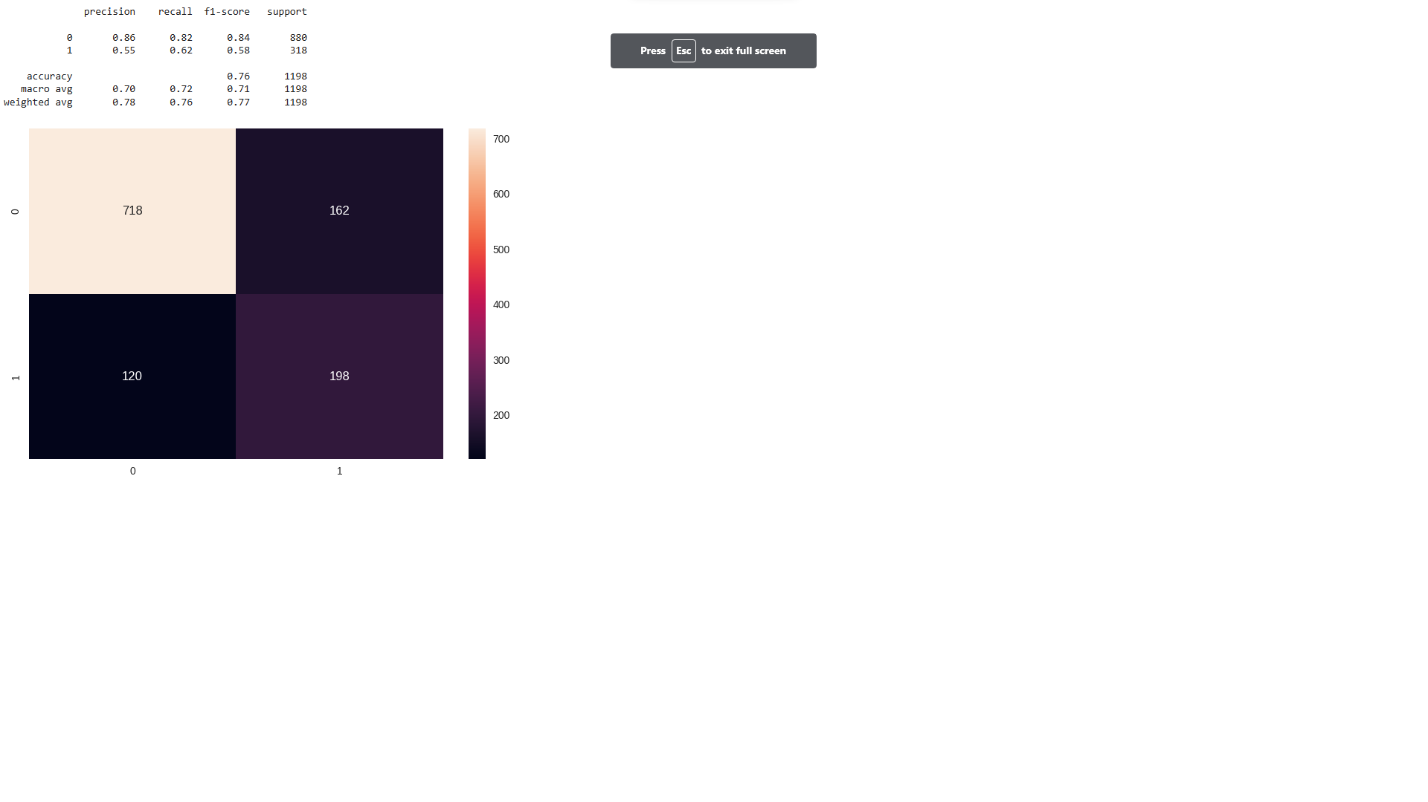
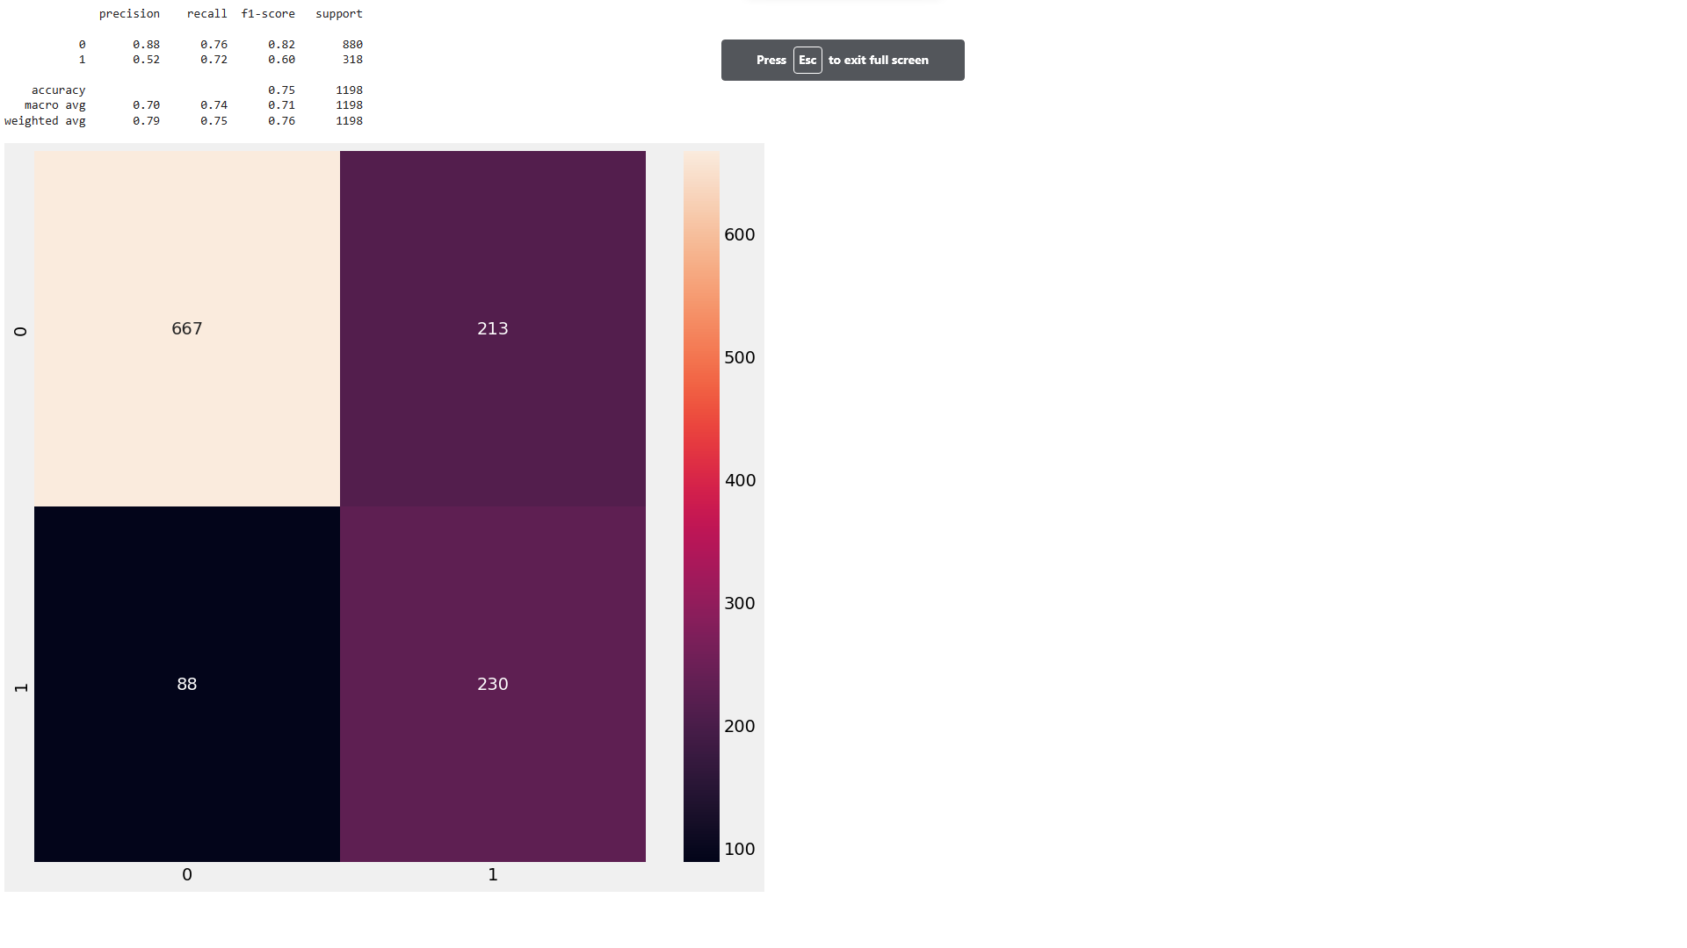
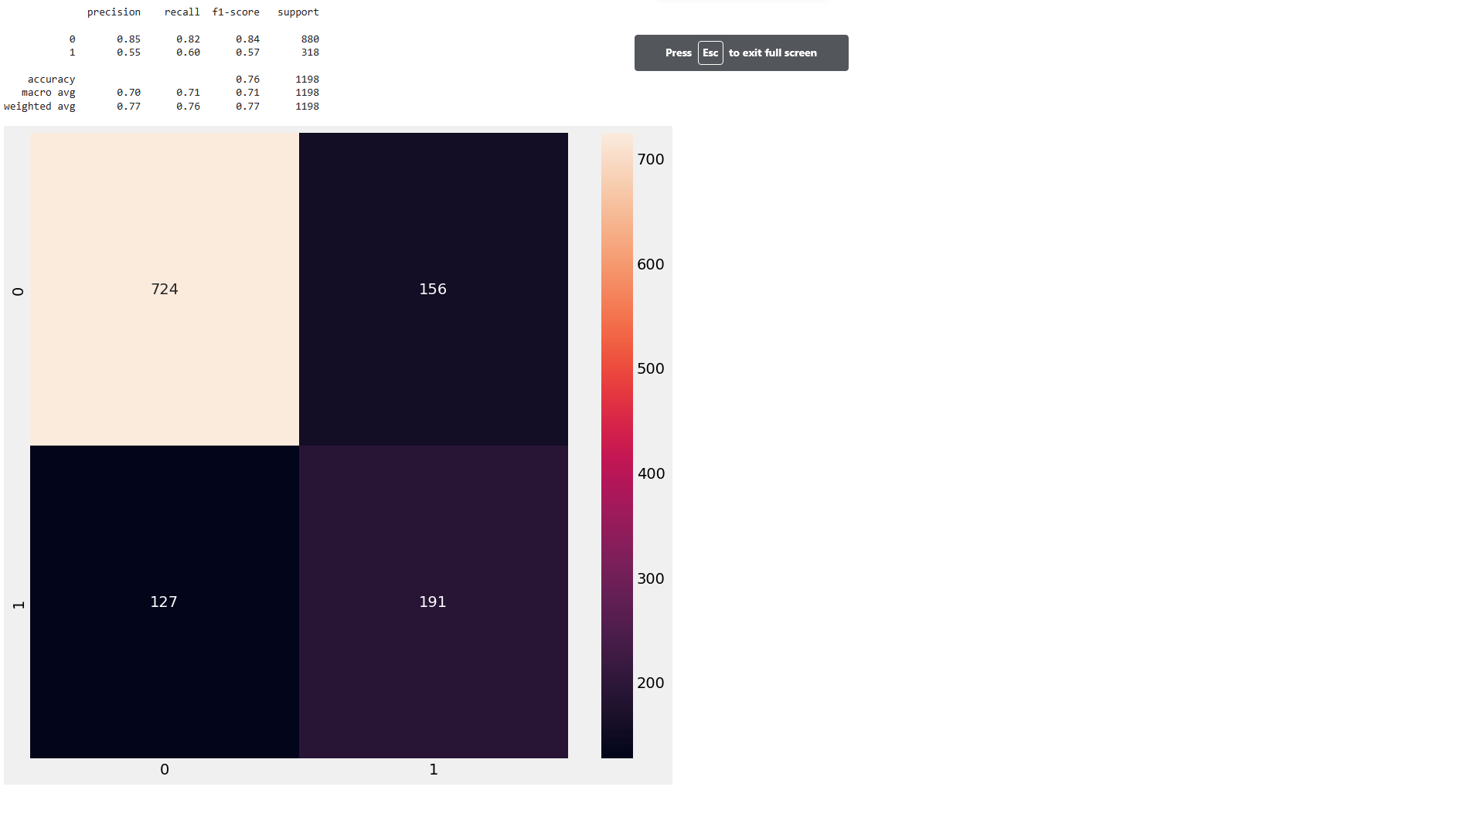
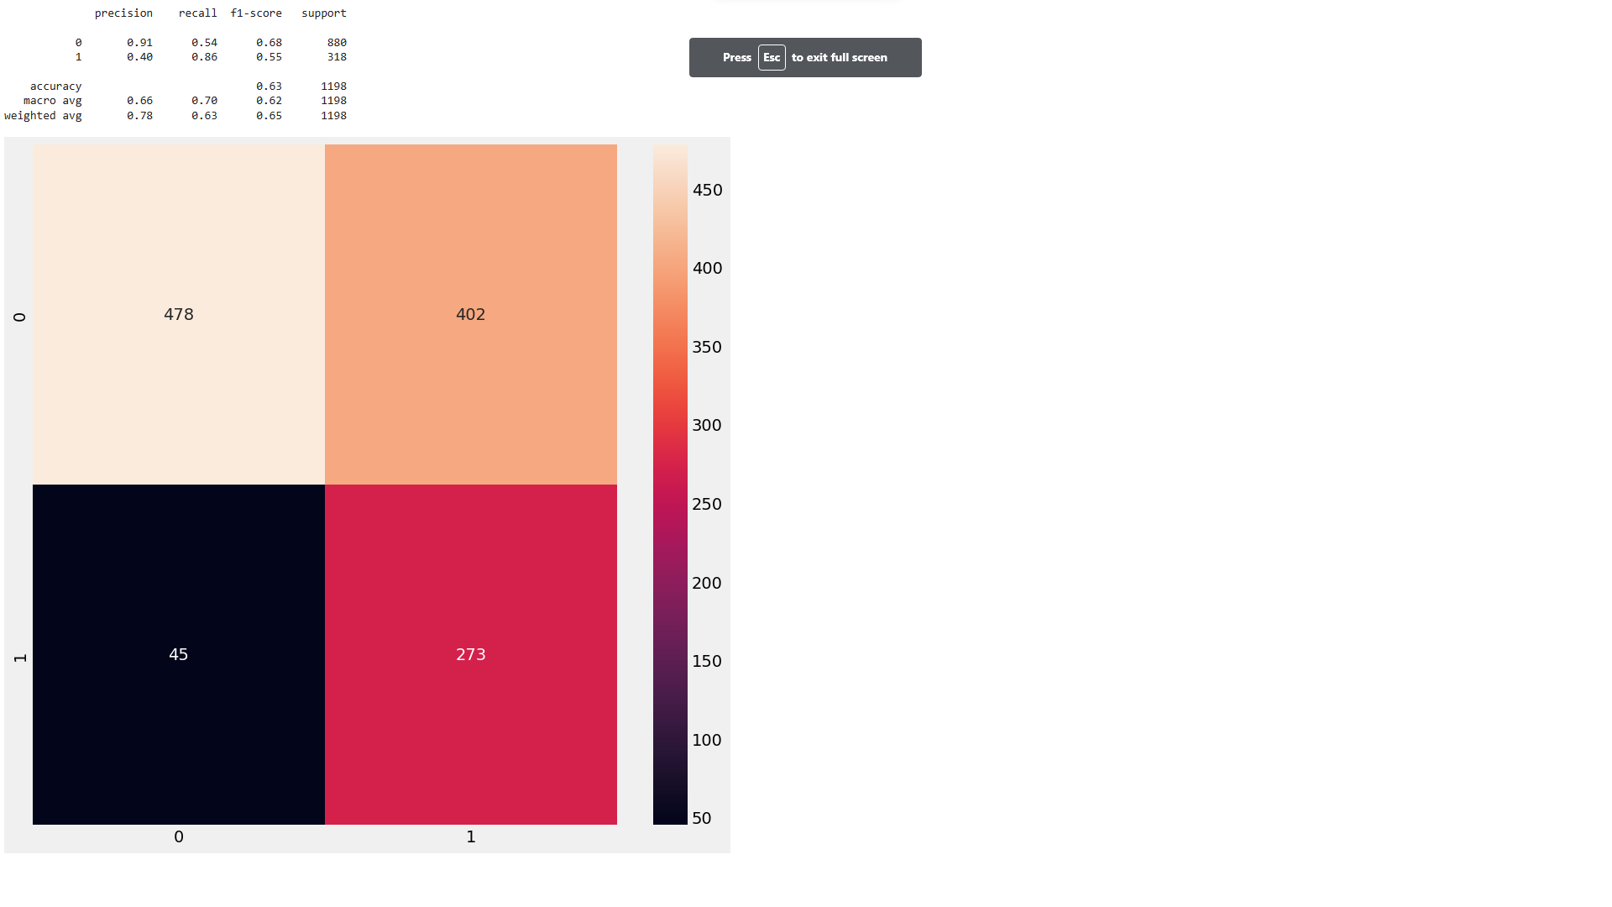


Model II
What was our challenge?
How did we
solve it?
Outlook
Best Models and classification matrix:
AdaBoost Classifier using recall as scoring function AdaBoost Classifier using recall as scoring function LightGBM Classifier using recall as scoring function
Plain Vanilla Plain Vanilla
Plain model with selected features from LightGBM Plain model with selected features from LightGBM
Model with selected features and hypertuning parameters Model with selected features and hypertuning parameters Model with selected features and hypertuning parameters

