Slide 1
11_2_ThreeJS_2
Computer Graphics

Slide 2
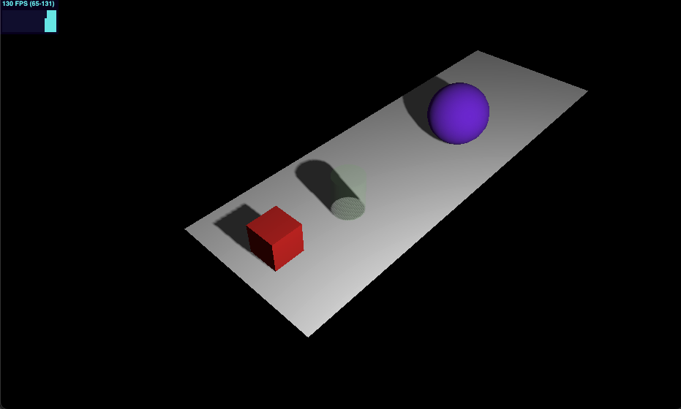
08-selecting-object

Slide 3
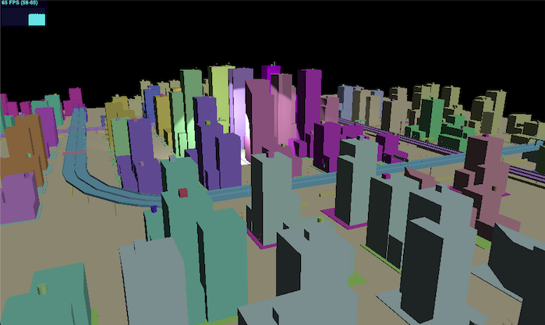
09-first-person-camera

Slide 4
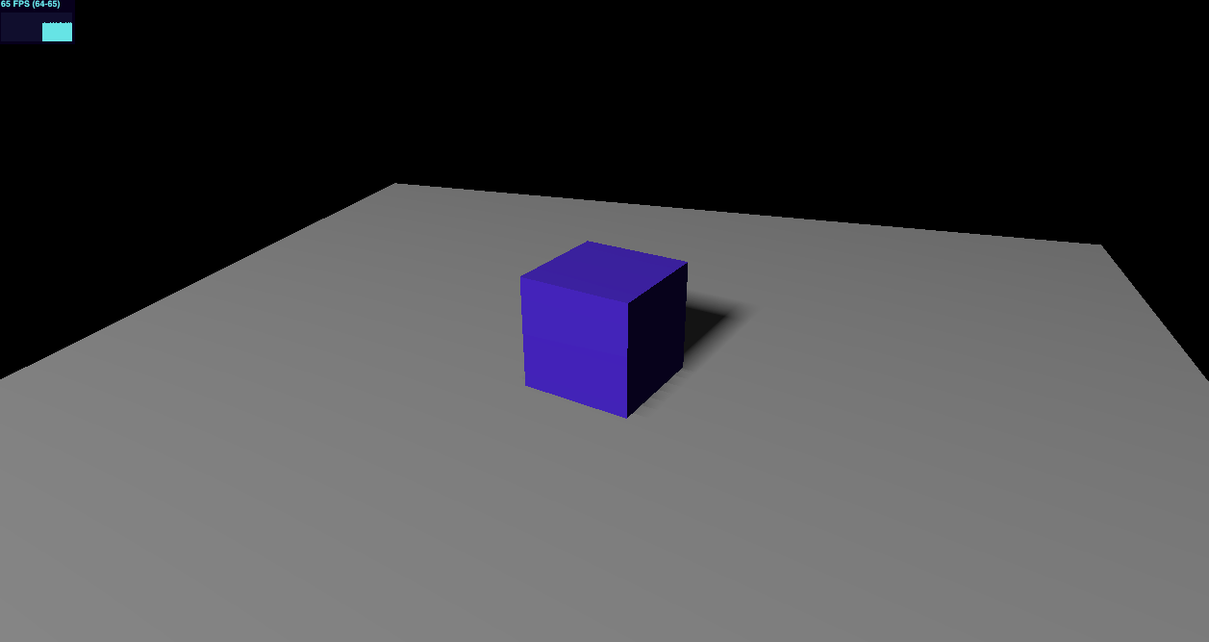
10-animation-clip-mixer

Slide 5
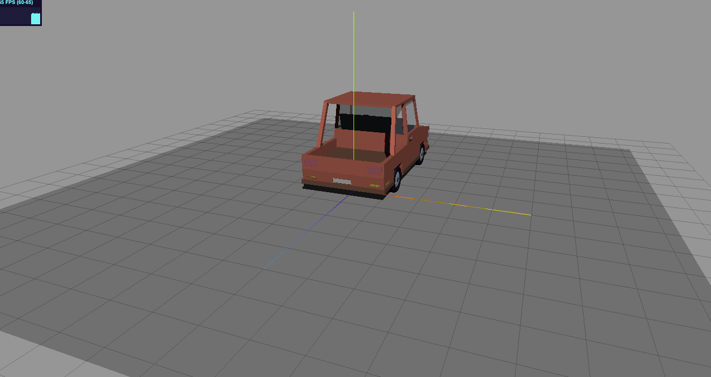
11-load-fbx-model

Slide 6
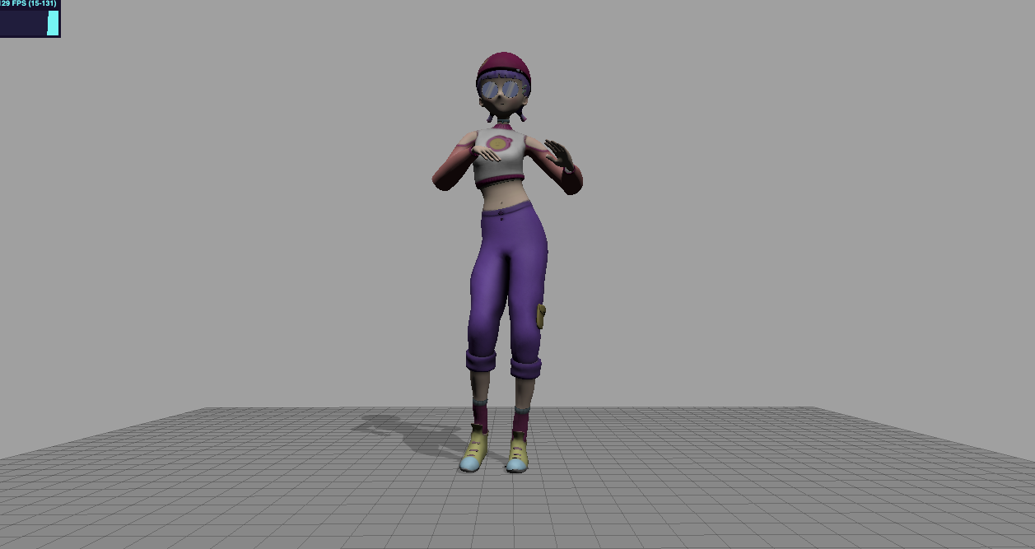
12-load-fbx-anim

